Slide 1
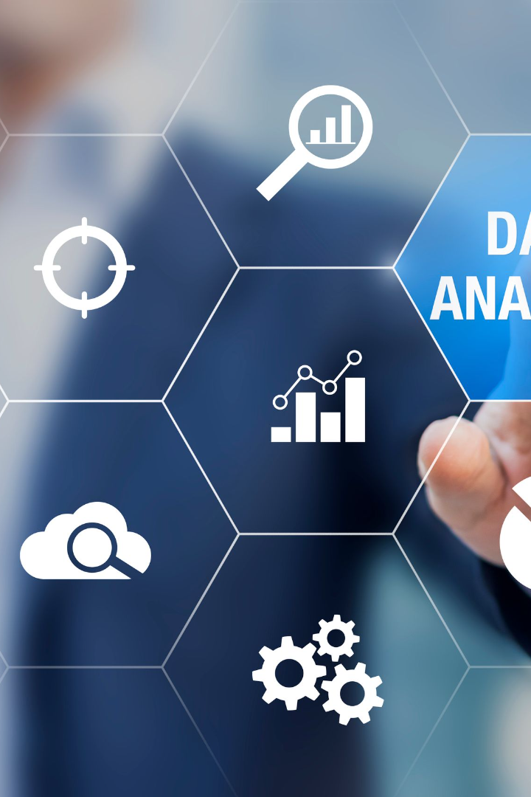
Big Data Analysis with IBM Cloud Databases
Big data analysis is the use of advanced analytic techniques against very large, diverse big data sets that include structured, semi-structured and unstructured data, from different sources.

Slide 2
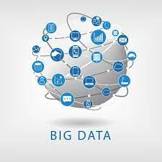
INTRODUCTION
Big data analysis refers to collecting, processing, cleaning, and analyzing large datasets to help organizations operationalize their big data.

Slide 3

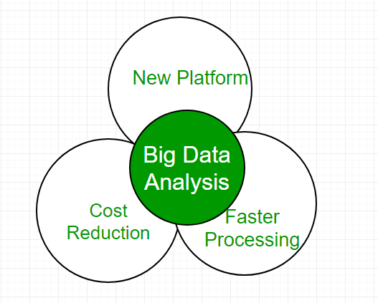
IBM Cloud Databases
1
Overview
2
Key Features
3
Use Cases
Big data analysis is the use of advanced analytic techniques against very large, diverse big data sets that include structured, semi-structured and unstructured data, from different sources.
Data exploration
Scalability
Support for various types of Analytics
Version control
Data management
The use cases of data analytics include better business decision-making, risk identification and mitigation, process and operation optimization, improved customer satisfaction..

Slide 4
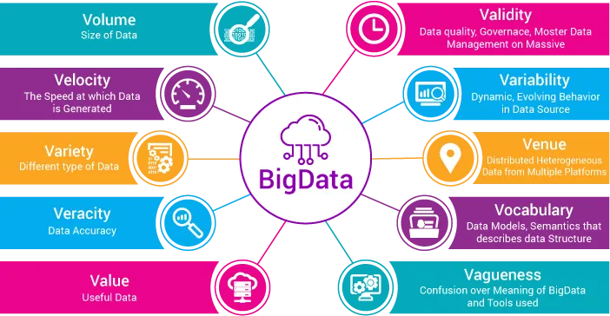
DIFFERENT TECHNIQUES

Slide 5
BENEFITS OF BIGDATA ANALYSIS
Faster and better
Decision making
Cost reduction
Potential Risks Identification
Flexible data processing and storage tools can help organizations save costs in storing and analyzing large anmounts of data.
Businesses function in high-risk environments, so they require effective risk management solutions to address issues. Big data plays a critical role in developing effective risk management processes and strategies.
Businesses can access a large volume of data and analyze a large variety sources of data to gain new insights and take action.

Slide 6
Data Analysis and Insights
1
Tools and Techniques
Explore the advanced tools and techniques available for analyzing big data and extracting actionable insights.
2
Meaningful Insights
Discover how IBM Cloud Databases enables businesses to uncover meaningful insights from their data, driving informed decision-making.
3
Data Visualization
Learn about the importance of visualizing data and how to effectively present your findings using IBM Cloud Databases.

Slide 7
CONCLUSION
The availability of Big Data, low-cost commodity hardware, and new information management and analytic software have produced a unique moment in the history of data analysis.
The convergence of these trends means that we have the capabilities required to analyze astonishing data sets quickly and cost-effectively for the first time in history.
These capabilities are neither theoretical nor trivial. They represent a genuine leap forward and a clear opportunity to realize enormous gains in terms of efficiency, productivity, revenue, and profitability.

