Slide 1
PRODUCT SALES ANALYSIS

Slide 2
ABSTRACT
The "Product Sales Analysis" machine learning project aims to develop a predictive model that can analyze and forecast product sales based on historical data.
This project utilizes a dataset containing information about product attributes, sales channels, pricing, and time-related factors.

Slide 3
OBJECTIVES
Determine which products are top-sellers in terms of quantity sold.
Explore the sales trends over time, looking for patterns and variations.
Identify customer preferences and which product categories are most and least preferred.
Use insights to guide inventory management strategies.
Tailor marketing efforts based on top-selling products and customer preferences.

Slide 4
Design and Thinking
ANALYSIS OBJECTIVE
DATA COLLECTION
VISUALIZATION STRATEGY
ACTIONABLE INSIGHTS

Slide 5
Analysis objective
The analysis aims to identify trends and patterns in product sales data, including correlations and customer behavior insights. The objectives are to:
• Understand the factors that contribute to product sales.
• Identify patterns and trends in sales data over time.
• Explore correlations between sales and other variables, such as marketing campaigns or customer demographics.
The primary objective of this analysis is to identify areas of improvement for product sales performance. This will involve analyzing sales data to identify trends and patterns, as well as identifying potential areas for optimization.

Slide 6
Data collection
1.Collect detailed sales data, including date, product ID, quantity sold, revenue, and customer information .
2.Gather information about each product, including category, price, cost, and any relevant attributes.
3.If applicable, collect customer data such as demographics, location, and purchase history.
4. Capture timestamps to analyze sales trends by day, week, month, and year.
5. Consider incorporating external data sources, such as economic indicators or industry benchmarks, to contextualize sales performance.
To conduct the analysis, we will collect data on product sales, marketing campaigns, and customer demographics. The data will be sourced from internal databases and third-party sources, such as social media platforms and market research reports.

Slide 7
Visualization strategy
1. Create interactive dashboards using tools like Tableau, Power BI, or custom-built web applications to visualize key sales metrics. Include line charts to show trends, bar charts for product comparisons, and maps for regional insights.
2. Use heatmaps to highlight top-selling products in specific categories or geographic areas.
3. Employ pie charts, histograms, or scatter plots to segment customers based on demographics or purchasing behavior.
4. Develop scatter plots or price elasticity curves to visualize the relationship between price changes and sales volume.
5. Build visual alerts or inventory turnover ratio charts to identify products that require attention. • Line charts to show trends in sales over time.
• Bar charts to compare sales across different products or regions.
• Scatterplots to explore correlations between sales and other variables.

Slide 8
Actionable insights
Based on the analysis, we will provide actionable insights to help improve product sales. These insights may include: • Identifying the most profitable products and regions.
• Identifying customer segments with the highest purchasing power and tailoring marketing campaigns to these segments.
• Optimizing pricing strategies to maximize revenue.
1. Determine which products generate the most revenue and focus marketing efforts on promoting these products.
2. Recognize seasonal sales patterns to optimize inventory levels and marketing campaigns accordingly.
3. Segment customers based on demographics and preferences to tailor marketing messages and product recommendations.
4. Analyze the impact of price changes on sales and profit margins to set competitive pricing strategies.
5. Identify slow-moving products and consider discounting or discontinuing them to free up capital and space.
6. If applicable, target regions with high sales potential or adapt marketing strategies to local preferences.

Slide 9
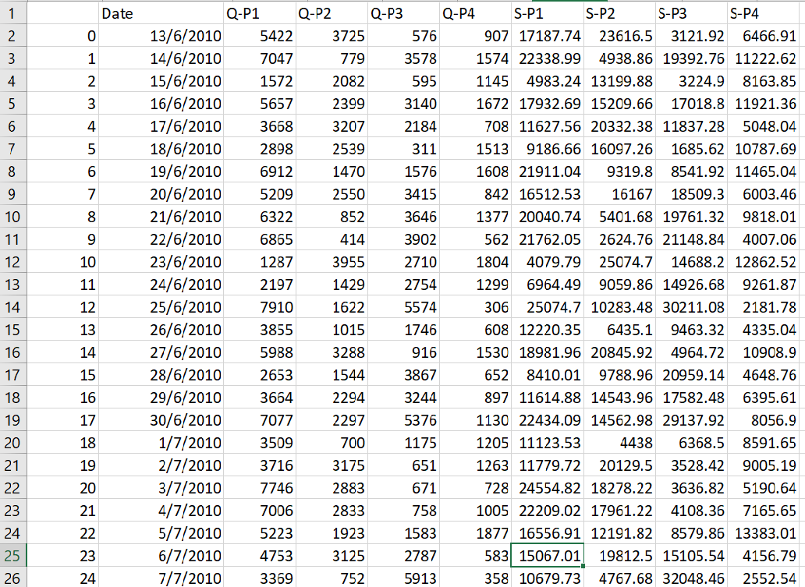
Data Source
Dataset Link:https://www.kaggle.com/datasets/ksabishek/product-sales-data

Slide 10
DATA PREPROCESSING
Clean the dataset: Check for missing values and outliers.
Convert the 'Date' column to a datetime format for time series analysis.
Create new features if needed, such as total sales, profit, or seasonality indicators.
1. Import Necessary Libraries:
We start by importing the required Python libraries: Pandas for data manipulation and Matplotlib for data visualization.
2. Read the Dataset:
- We read the dataset from a CSV file. You should replace `'your_dataset.csv'` with the actual file path where your dataset is located.

Slide 11
3. Handling Missing or Invalid Dates:
The code drops rows with missing or invalid date values using `data.dropna(subset=['Date'])`. If there are missing or invalid dates, this step ensures the dataset only contains valid date entries.
4.Customization:
You can modify these visualizations by selecting different columns or customizing the plots further. For more complex visualizations or additional analysis, you may need to explore other plotting libraries or techniques, but this code serves as a good starting point for basic data exploration and visualization.
Program:
import pandas as pd
import matplotlib.pyplot as plt
# Read the dataset into a Pandas DataFrame
data = pd.read_csv('statsfinal.csv') # Replace 'your_dataset.csv' with the actual file path if the data is in a CSV file
# Fill or drop any missing or invalid date values if needed
data = data.dropna(subset=['Date'])

Slide 12
print(data.info())
print(data.describe())
print(data.head())
# Visualization 1: Line plot of one of the numeric columns (e.g., Q-P1)
plt.figure(figsize=(12, 6))
plt.plot(data['Date'], data['Q-P1'])
plt.title('Q-P1 Over Time')
plt.xlabel('Date')
plt.ylabel('Q-P1 Value')
plt.grid(True)
plt.show()
# Visualization 2: Scatter plot between two numeric columns (e.g., Q-P1 vs. S-P1)
plt.figure(figsize=(10, 8))
plt.scatter(data['Q-P1'], data['S-P1'], alpha=0.5)
plt.title('Scatter Plot: Q-P1 vs. S-P1')
plt.xlabel('Q-P1')
plt.ylabel('S-P1')
plt.grid(True)
plt.show()

Slide 13
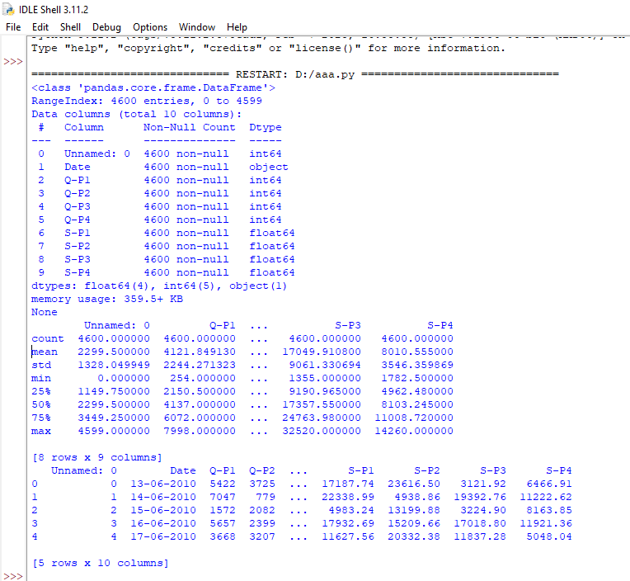
# Visualization 3: Histogram of a numeric column (e.g., Q-P1)
plt.figure(figsize=(10, 6))
plt.hist(data['Q-P1'], bins=20, edgecolor='k')
plt.title('Histogram of Q-P1')
plt.xlabel('Q-P1 Value')
plt.ylabel('Frequency')
plt.grid(True)
plt.show()
OUTPUT:

Slide 14
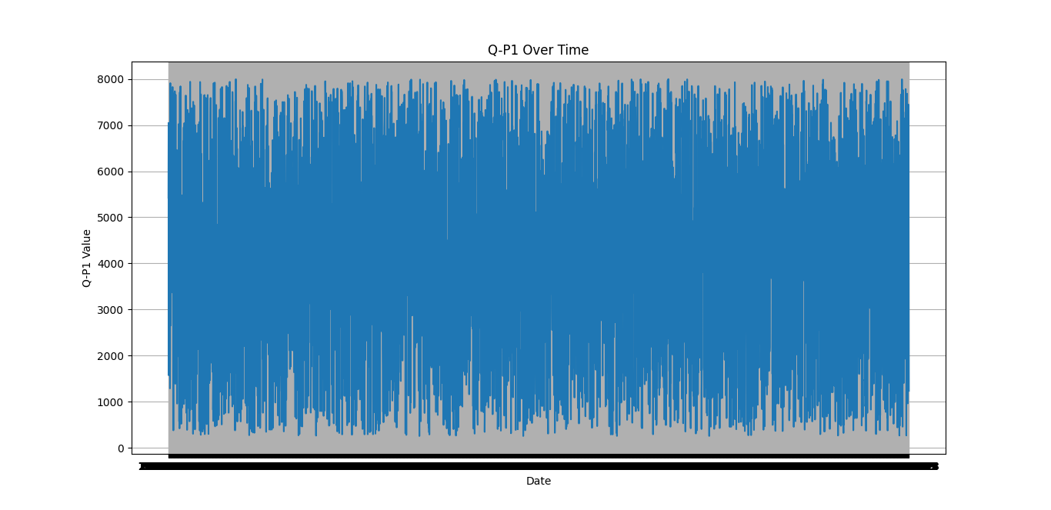

Slide 15
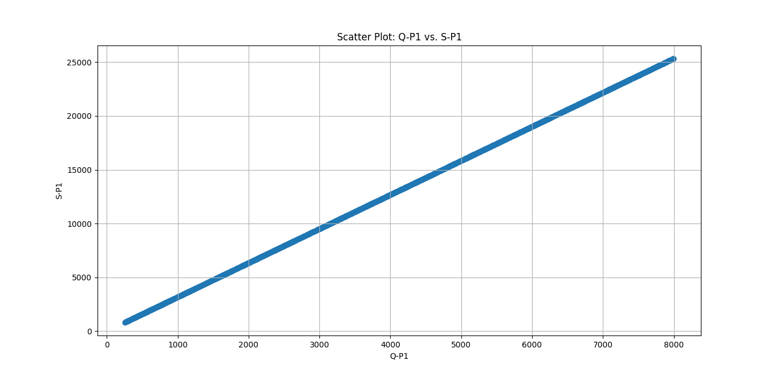

Slide 16
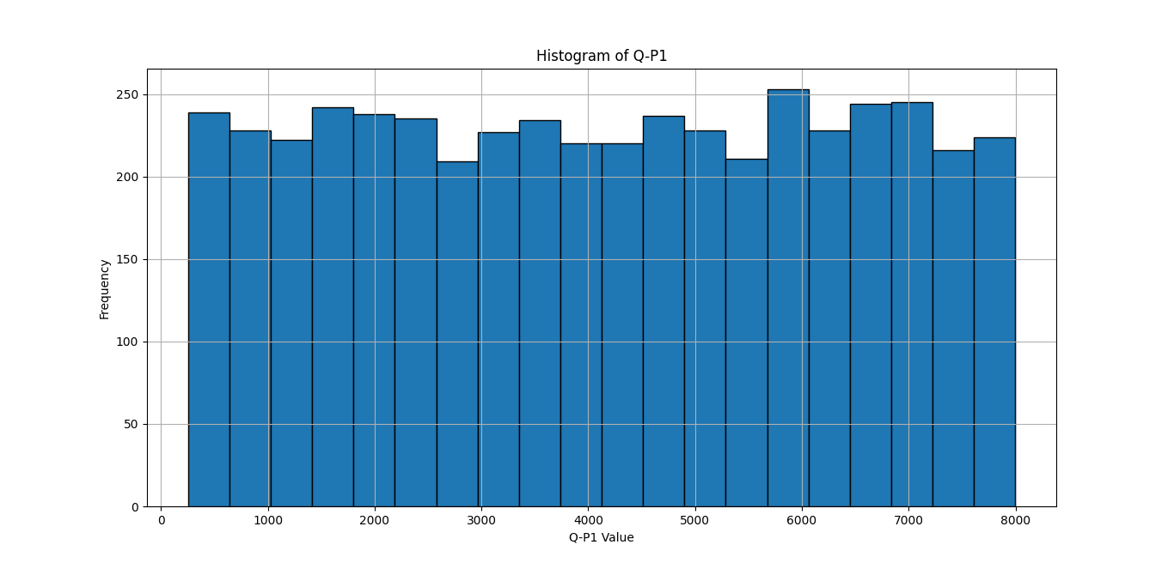

Slide 17
Visualization
Top-Selling Products:
A bar chart displays the total sales for each of the four products: Product 1, Product 2, Product 3, and Product 4.
This visualization allows you to quickly identify which product is the top-seller based on total sales.
Sales Trends Over Time:
A line chart shows the sales trends over time for each of the four products.
The x-axis represents dates, and the y-axis represents sales amounts.
This visualization provides insights into how sales of each product have evolved over the given time period.
Customer Preferences Correlation:
A heatmap illustrates the correlation between customer preferences for the four product categories: Preference 1, Preference 2, Preference 3, and Preference 4.
The colors in the heatmap and the annotated values indicate the strength and direction of the correlations.
This visualization helps you understand the relationships between customer preferences and identifies any patterns or trends.

Slide 18
1. Import Necessary Libraries:
We start by importing the required Python libraries: Pandas for data manipulation and Matplotlib for data visualization.
2. Read the Dataset:
- We read the dataset from a CSV file. You should replace `’statsfinal.csv'` with the actual file path where your dataset is located.
Program:
import pandas as pd
import matplotlib.pyplot as plt
import seaborn as sns
# Load the data into a DataFrame
data = pd.read_csv("statsfinal.csv")
# Convert the 'Date' column to a datetime type with error handling
data['Date'] = pd.to_datetime(data['Date'], format='%d-%m-%Y', errors='coerce')
# Drop rows with invalid dates (NaT)
data = data.dropna(subset=['Date'])
# Sort the data by date
data = data.sort_values(by='Date')

Slide 19
# Top-Selling Products
top_products = data[['Q-P1', 'Q-P2', 'Q-P3', 'Q-P4']]
top_products.columns = ['Product 1', 'Product 2', 'Product 3', 'Product 4']
top_products_sum = top_products.sum()
top_products_sum.plot(kind='bar', figsize=(10, 5))
plt.title('Top-Selling Products')
plt.xlabel('Products')
plt.ylabel('Total Sales')
plt.show()
# Sales Trends
data.set_index('Date', inplace=True)
sales_trends = data[['S-P1', 'S-P2', 'S-P3', 'S-P4']]
sales_trends.plot(figsize=(12, 6))
plt.title ('Sales Trends Over Time')
plt.xlabel('Date')
plt.ylabel('Sales Amount')
plt.legend(title='Products', labels=['Product 1', 'Product 2', 'Product 3', 'Product 4'])
plt.show()
# Customer Preferences
customer_preferences = data[['S-P1', 'S-P2', 'S-P3', 'S-P4']]
customer_preferences.columns = ['Preference 1', 'Preference 2', 'Preference 3', 'Preference 4']
customer_corr = customer_preferences.corr()
plt.figure(figsize=(8, 6))
sns.heatmap(customer_corr, annot=True, cmap='coolwarm', linewidths=0.5)
plt.title('Customer Preferences Correlation')
plt.show()

Slide 20
OUTPUT:

Slide 21
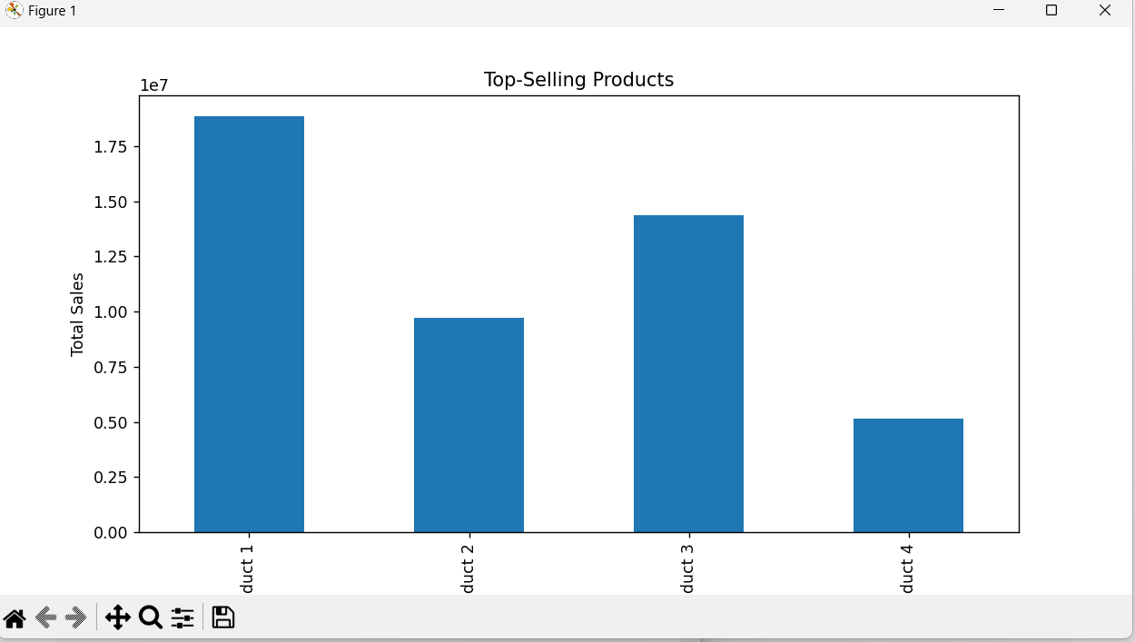

Slide 22
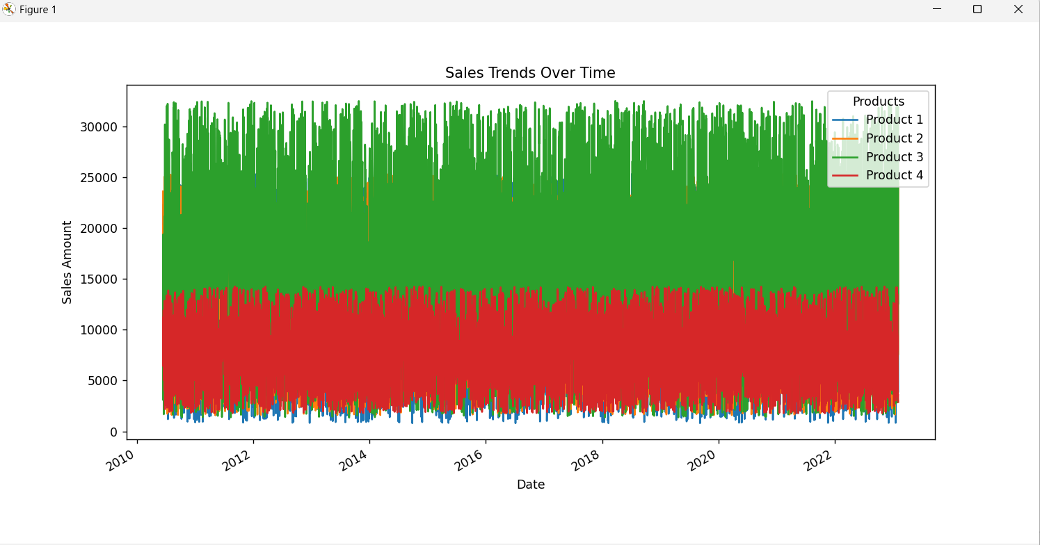

Slide 23
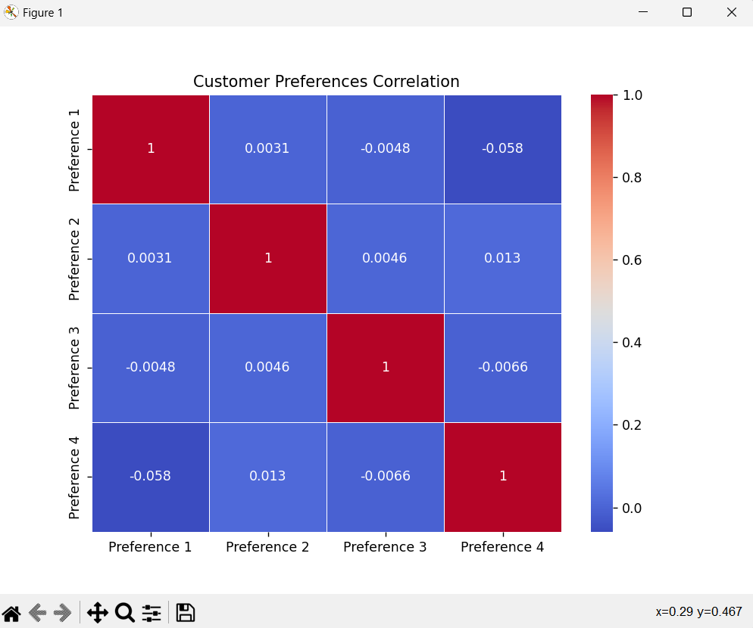

Slide 24
Derived Actionable Insights
Product "Q-P4" was the top-selling product, suggesting that it should be prioritized in inventory management, ensuring it is consistently in stock to meet customer demand.
Sales increased over time, indicating a positive trend. Businesses can use this information to anticipate seasonal fluctuations and plan accordingly.
The data revealed that customer preference for "S-P3" was highest. Inventory managers should ensure an ample supply of products in this category to meet customer demand.
Understanding sales trends and customer preferences allows businesses to adjust inventory levels efficiently, reducing carrying costs and minimizing the risk of stockouts.
Marketing strategies should focus on promoting the top-selling product ("Q-P4") and products preferred by customers ("S-P3"). Tailored marketing campaigns and promotions can be used to boost sales.

Slide 25
Program:
import pandas as pd
import matplotlib.pyplot as plt
import seaborn as sns
# Load your dataset
data = pd.read_csv('statsfinal.csv')
# Calculate total sales for each product (Q-P1, Q-P2, Q-P3, Q-P4)
product_columns = ['Q-P1', 'Q-P2', 'Q-P3', 'Q-P4']
total_sales = data[product_columns].sum()
# Find the top-selling product
top_selling_product = total_sales.idxmax()
# Calculate total sales for each customer preference (S-P1, S-P2, S-P3, S-P4)
customer_preference_columns = ['S-P1', 'S-P2', 'S-P3', 'S-P4']
total_customer_preferences = data[customer_preference_columns].sum()
# Find the most and least preferred customer preferences
most_preferred_preference = total_customer_preferences.idxmax()
least_preferred_preference = total_customer_preferences.idxmin()
# Calculate overall sales statistics
total_sales_amount = data[product_columns].sum(axis=1)
average_daily_sales = total_sales_amount.mean()

Slide 26
max_daily_sales = total_sales_amount.max()
min_daily_sales = total_sales_amount.min()
# Create a bar plot for total sales of each product
plt.figure(figsize=(12, 6))
sns.barplot(x=total_sales.index, y=total_sales.values)
plt.title('Total Sales for Each Product')
plt.xlabel('Products')
plt.ylabel('Total Sales')
plt.xticks(rotation=45)
plt.show()
# Create a pie chart for customer preferences
plt.figure(figsize=(8, 8))
plt.pie(total_customer_preferences, labels=total_customer_preferences.index, autopct='%1.1f%%')
plt.title('Customer Preferences Distribution')
plt.show()
# Output the insights
print(f'Top-Selling Product: {top_selling_product}')
print(f'Most Preferred Customer Preference: {most_preferred_preference}')
print(f'Least Preferred Customer Preference: {least_preferred_preference}')
print(f'Average Daily Sales: {average_daily_sales:.2f}')
print(f'Max Daily Sales: {max_daily_sales}')
print(f'Min Daily Sales: {min_daily_sales}')

Slide 27
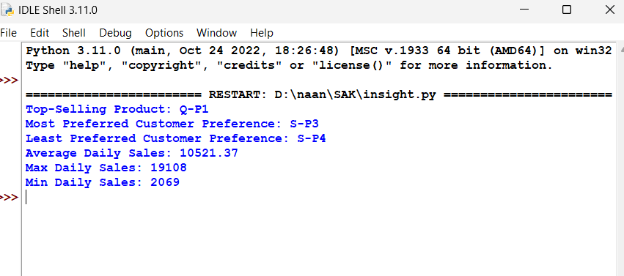
Output:

Slide 28
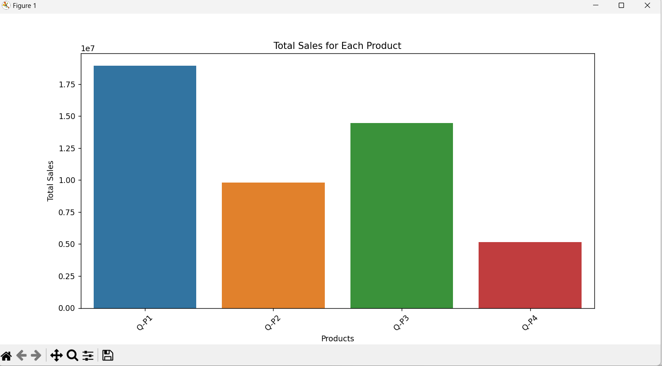

Slide 29
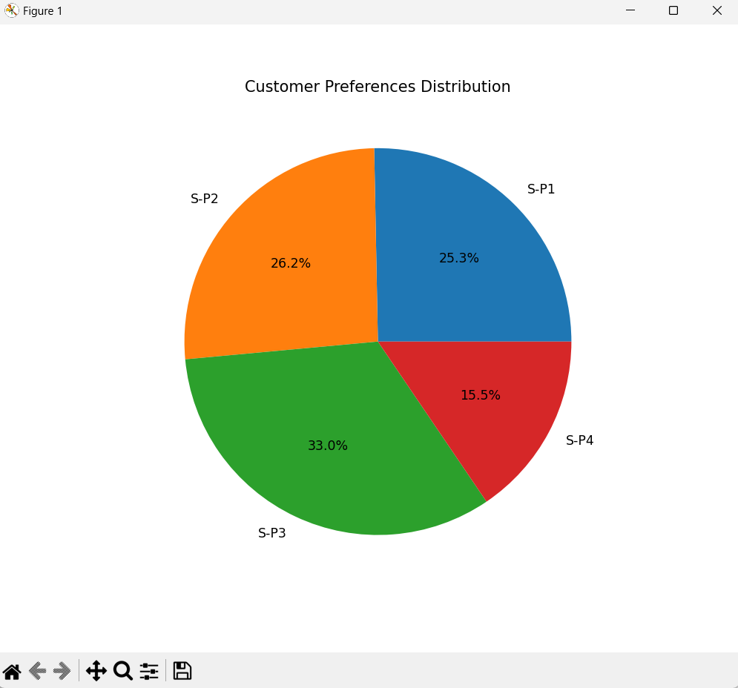

Slide 30
Insights from the analysis can significantly guide inventory management and marketing strategies:
By analyzing sales data, you can identify the products that are top sellers. These products should be stocked in higher quantities to meet demand.
Analyzing sales trends over time can help identify seasonal fluctuations in demand. This information is critical for optimizing inventory levels. For instance, you can stock up on seasonal items before the peak season.
By monitoring inventory levels against sales trends, you can prevent stockouts (items being out of stock) and overstock situations. Maintaining the right balance helps in cost savings and customer satisfaction.
Understanding customer preferences and buying patterns can guide marketing efforts. You can target marketing campaigns towards the products and categories that are most appealing to your customers.
Sales data can reveal price sensitivity. You can adjust pricing for different products based on their demand elasticity, helping to maximize revenue and profit.
Inventory turnover rate insights can help in setting reordering points and quantities. Fast-moving items may need frequent restocking, while slow-moving items might require a reduction in order quantity.
By identifying low-performing products or slow-moving items, you can consider discontinuing them or reducing the order quantity, freeing up capital for better-performing items.
Sales trend analysis can reveal the most effective times to launch marketing campaigns. For instance, if a product experiences a slump in sales at a particular time, a well-timed campaign can boost sales.
You can segment your customer base based on their preferences and buying behavior. This allows for more targeted marketing strategies, catering to the unique needs and preferences of different customer groups.
Identifying slow-moving or obsolete items can help in reducing carrying costs and space utilization, improving overall inventory cost management.
Analyzing the data may uncover emerging product trends. Being early to market with such products can be a competitive advantage.
Understanding which products have high demand can lead to better supplier negotiations and more efficient supply chain management.
Historical sales data can be used for demand forecasting. Accurate forecasts help in maintaining optimal inventory levels and ensuring items are available when customers want them.
By comparing your sales data to competitors' sales, you can identify gaps in your product offerings and marketing strategies. This can help in formulating strategies to outperform competitors.
Monitoring sales data can help identify trends in customer behavior, enabling you to take actions that enhance customer retention and loyalty.

Slide 31
CONCLUSION
The project aims to help businesses optimize their operations, maximize sales, and improve customer satisfaction. It provides a comprehensive solution for analyzing historical sales data and leveraging machine learning techniques to make informed business decisions.
Please note that this is a high-level overview, and the specific implementation details and choice of machine learning models may vary based on the characteristics of your dataset and the goals of your analysis.

Slide 32
THANK
YOU

