Slide 1



FoodTrends: Understanding Customer Preferences in-FB
~Malla Saranya

Slide 2

1
Project Overview & Objectives
2
Data Sources & Methodology
3
Executive Dashboard Overview
Agenda
4
Product & Preference Insights
Customer Segmentation & Sentiment Intelligence
5
6
Key Insights & Recommendations
7
Conclusion

Slide 3


Project Overview & Objectives
Project Overview
  Integration of Survey & Facebook Data
  Sentiment Analysis & Preference Study
  Interactive Power BI Dashboard
Objectives
  Analyze customer preferences
  Evaluate brand-wise sentiment
  Identify demographic trends
  Deliver business insights

Slide 4

Data Sources & Tools
Data Sources
  Structured Survey Data (3,559 responses)
  Facebook Posts & Engagement Data (73K+ records)
  Sentiment Score & Label Extraction
Tools Used
  Microsoft Excel (Data Cleaning)
  Power BI (Dashboard & Modeling)
  DAX (Calculations & KPIs)

Slide 5
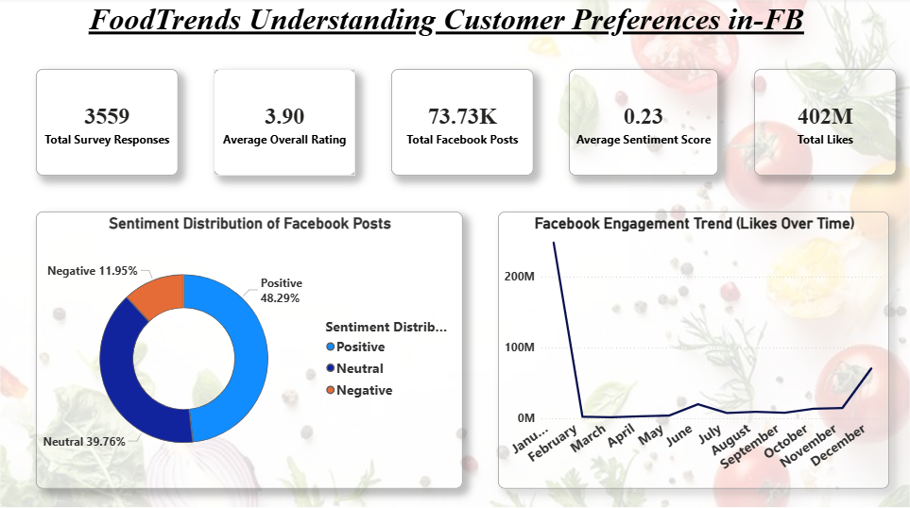
Executive Overview Dashboard
  3,559 Survey
Responses
  73K+ Facebook Posts
Analyzed
  402M Total Engagement
  48% Positive Sentiment
  Seasonal Engagement
Peaks Identified

Slide 6
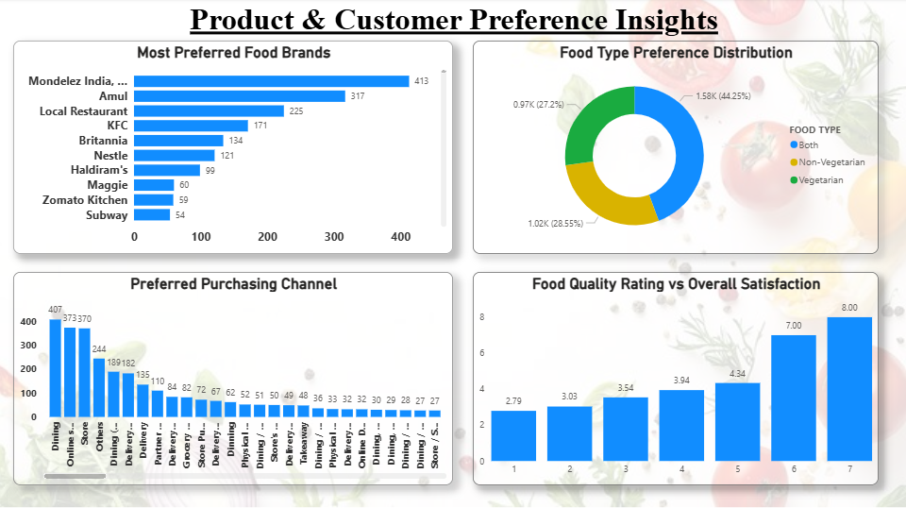
Product & Preference Insights
  Mondelez & Amul –
Most Preferred
Brands
  Mixed Food Type
Dominates
  Dine-In & Online –
Primary Channels
  Strong Correlation:
Quality → Satisfaction

Slide 7
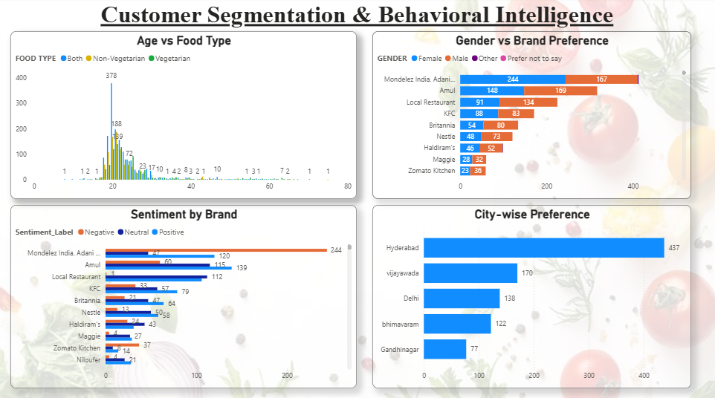
Customer Segmentation & Sentiment Intelligence
  Majority Customers:
Age 20–25
  Brand Preference
Varies by Gender
  Positive Sentiment
Dominates Leading
Brands
  Hyderabad –
Highest Participation

Slide 8
Key Findings & Business Recommendations
Key Findings
  Young Adults (20–25) Form Core Customer Segment
  Positive Sentiment Drives Brand Engagement
  Quality Perception Influences Satisfaction
  Urban Cities Show Higher Participation
Recommendations
  Target Youth-Focused Marketing Campaigns
  Strengthen Sentiment Monitoring for Brands
  Improve Quality Communication Strategies
  Focus Campaigns on High-Engagement Cities

Slide 9
Conclusion
  Integrated Structured & Unstructured Analytics
  Interactive Insight-Driven Dashboard
  Data-Backed Business Recommendations
  Supports Strategic Decision Making

Slide 10



Thank you!

