Slide 1

HealthKit

Slide 2
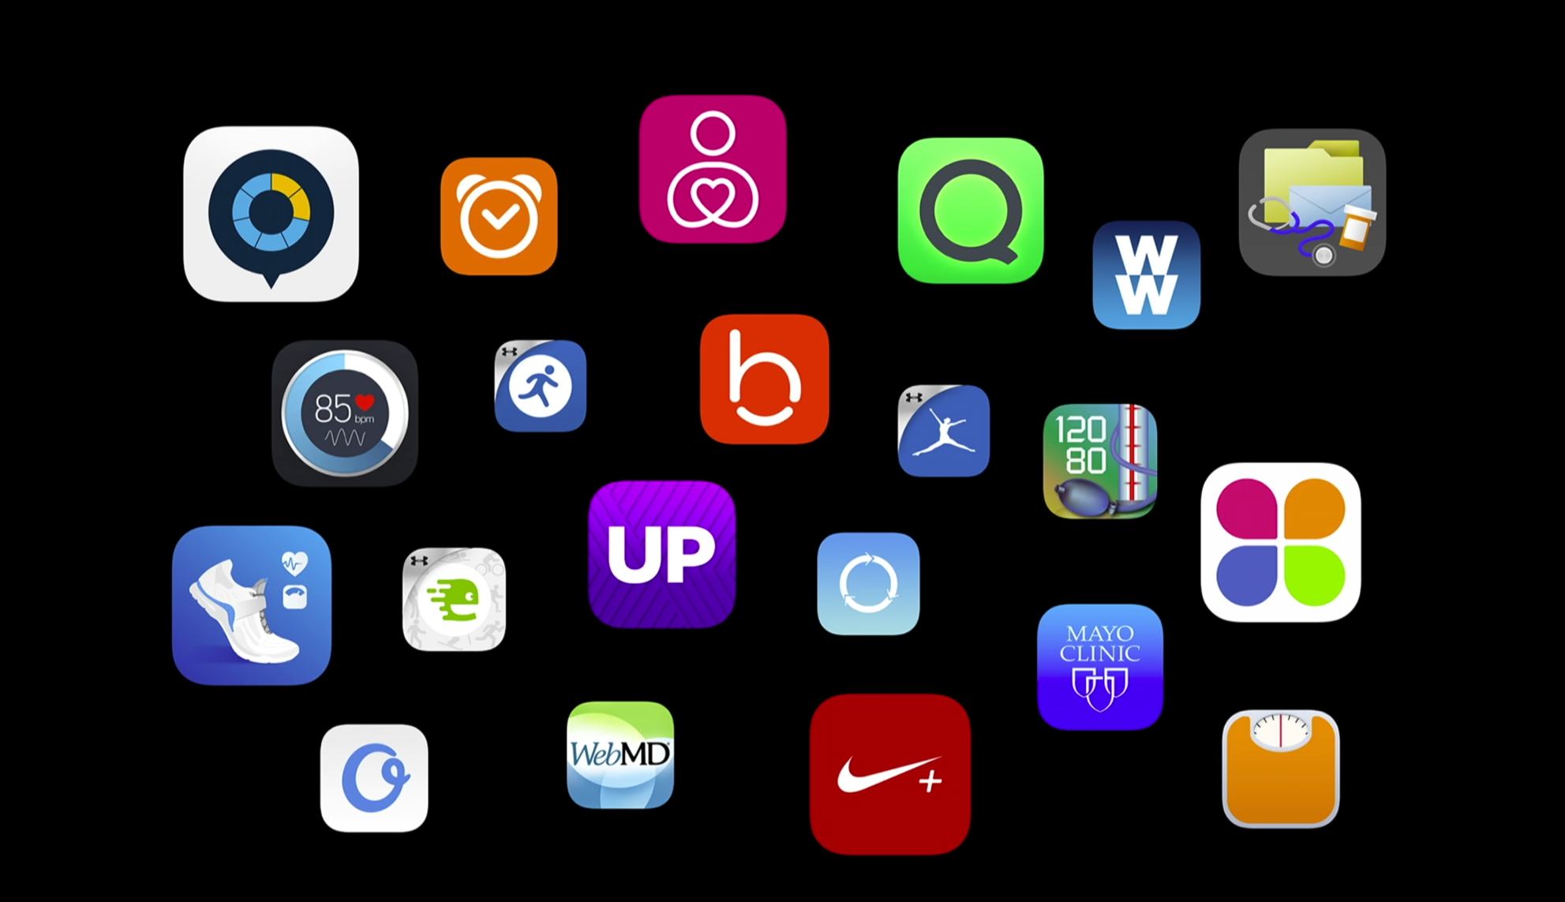

Slide 3
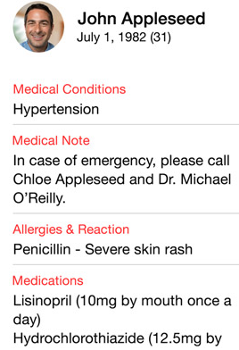
Key Features
Quick access dashboard
Emergency card
Accessible from lock screen
Share data between apps easily
Nutrition app <–> fitness app
Blood pressure <–> Doctor

Slide 4
- (void)setUpHealthStoreIfPossible {
if ([HKHealthStore isHealthDataAvailable]) {
NSSet *writeDataTypes = [self dataTypesToWrite];
NSSet *readDataTypes = [self dataTypesToRead];
[self.healthStore requestAuthorizationToShareTypes:writeDataTypes readTypes:readDataTypes completion:^(BOOL success, NSError *error){
if(!success) {
//Handle failure
return
}
dispatch_async(dispatch_get_main_queue(), ^{
[self updateUI];
});
}];
}
}
Note: iPad does not support HealthKit

Slide 5
HKUnit
Supports simple and complex unit types.
HKUnit *g = [HKUnit gramUnit];
HKUnit *dl = [HKUnit litreUnitWithMetricPrefix:HKmetricPrefixDeci];
HKUnit *gPerdL = [g unitDividedByUnit:dL];

Slide 6
HKQuantity
double value of a particular unit
HKUnit *gramUnit = [HKUnit gramUnit];
HKQuantity *grams = [HKQuantity quantityWithUnit:gramUnit doubleValue:20];
Double valueInKg = [grams doubleValueForUnit:[HKUnit unitFromString:@”kg”]];
Kg - .02

Slide 7
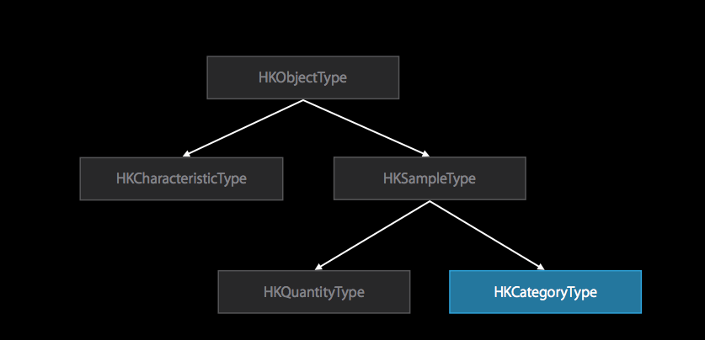
HKQuantityType

Slide 8
HKQuantityType
Every quantity type has a type identifier
You cannot create your own types
Example:
HKQuantityTypeIdentifierHeartRate
HKObjectType subcalss Type name
Creation:
3 constructors, one for each quantity type
Ex. +(HKQuantityType *)quantityTypeForIdentifier: (NSString *)identifier

Slide 9
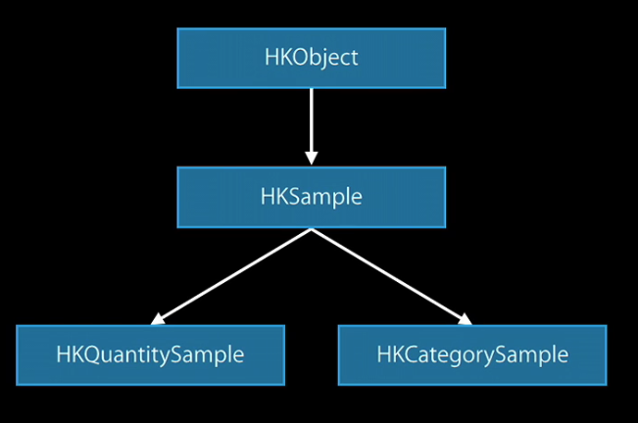
HKObject

Slide 10
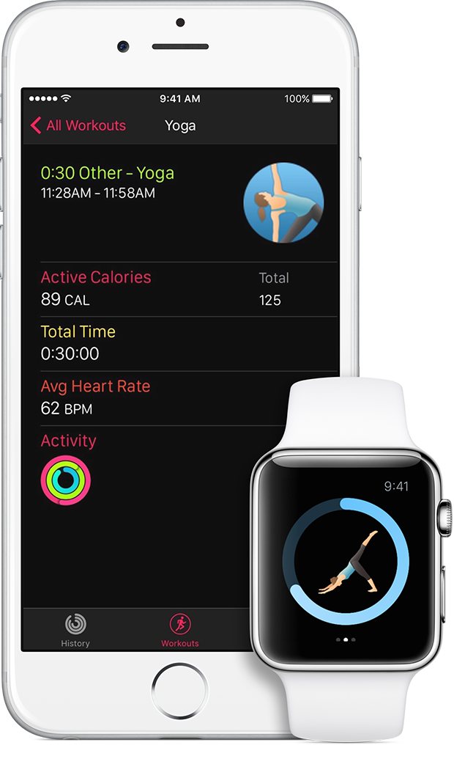
HealthKit + Apple watch
Recorded workout sessions on the apple watch are saved to healthkit.
Access to data such as,
Workout summary
Heart rate
Active energy burn
Activity ring on apple watch

