Slide 1

HealthKit

Slide 2
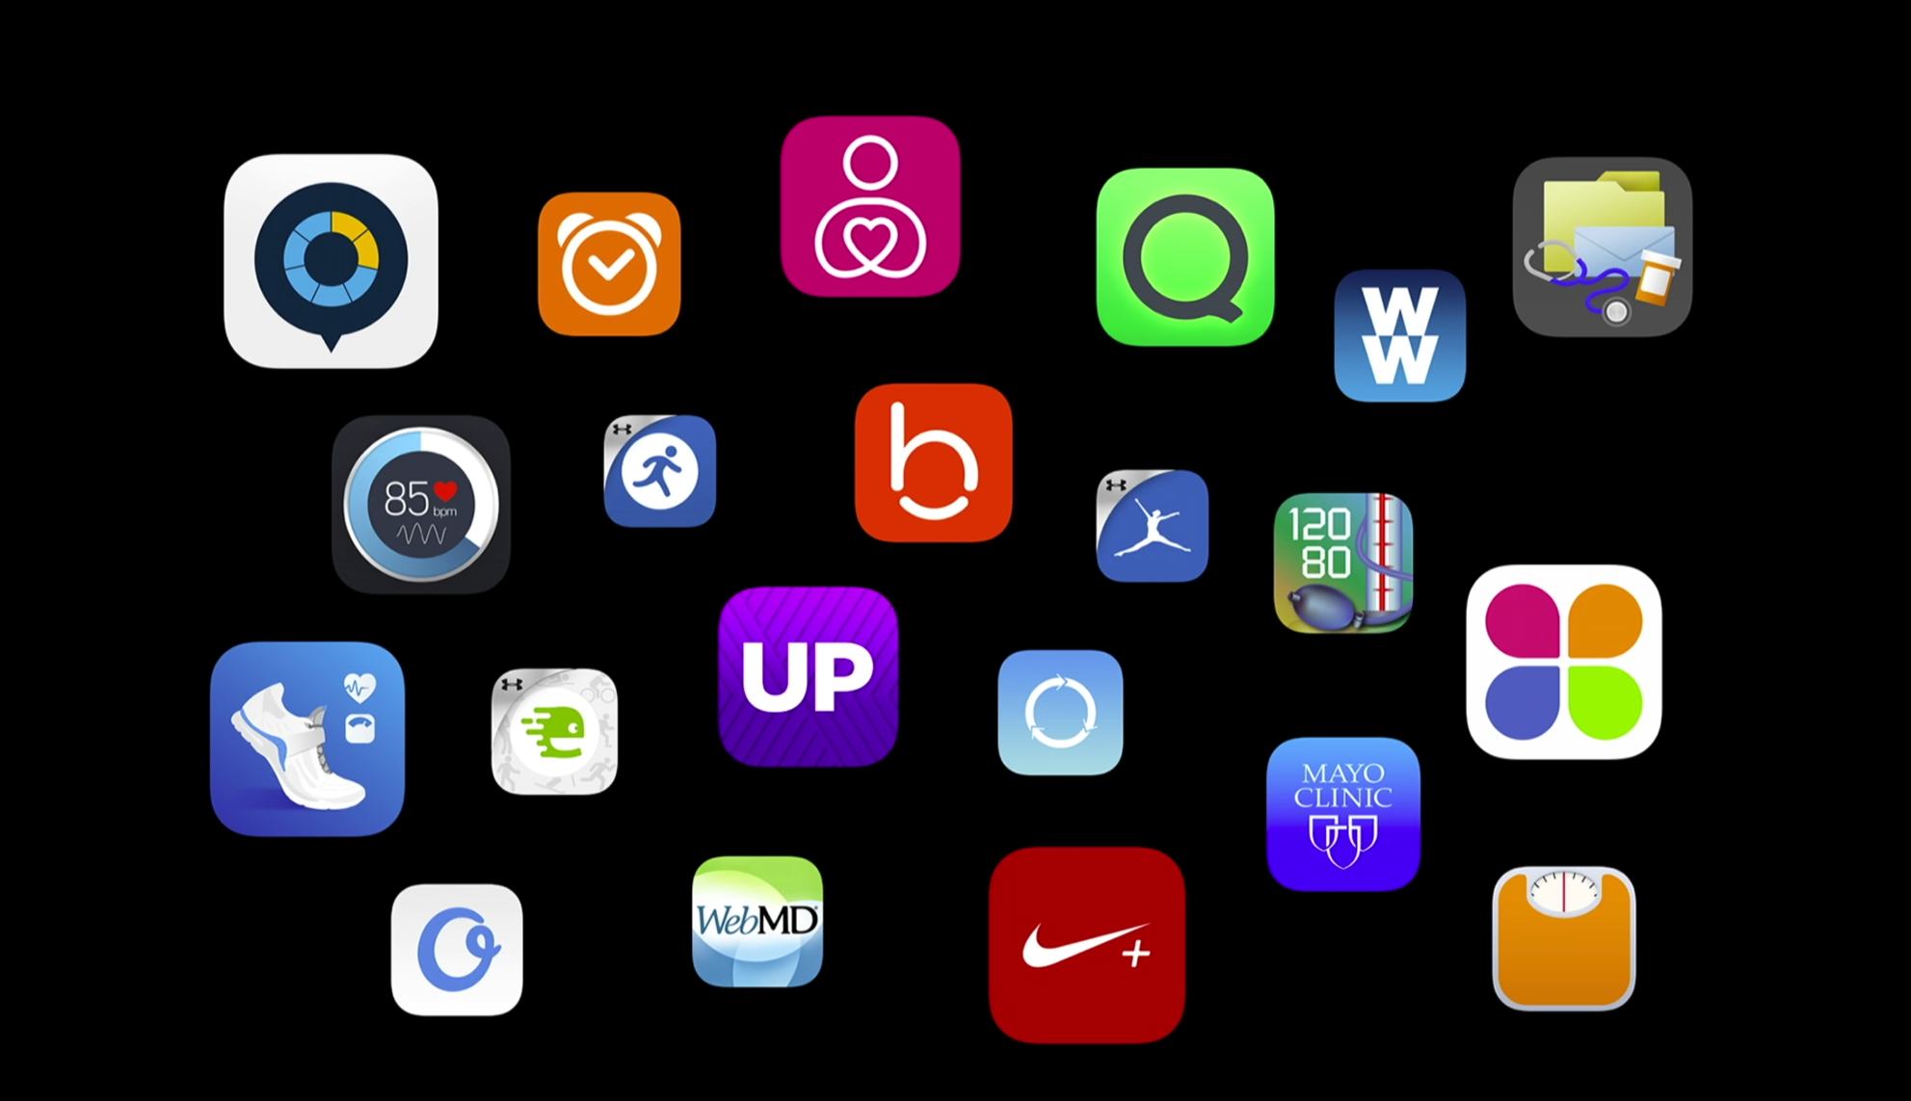

Slide 3
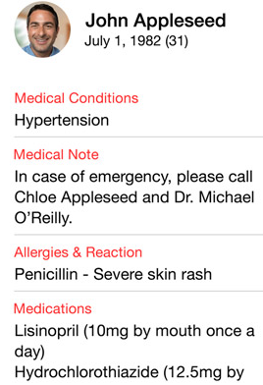
Key Features
Quick access dashboard
Emergency card
Accessible from lock screen
Share data between apps easily
Nutrition app <–> fitness app
Blood pressure <–> Doctor

Slide 4
- (void)setUpHealthStoreIfPossible {
if ([HKHealthStore isHealthDataAvailable]) {
NSSet *writeDataTypes = [self dataTypesToWrite];
NSSet *readDataTypes = [self dataTypesToRead];
[self.healthStore requestAuthorizationToShareTypes:writeDataTypes readTypes:readDataTypes completion:^(BOOL success, NSError *error){
if(!success) {
//Handle failure
return
}
dispatch_async(dispatch_get_main_queue(), ^{
[self updateUI];
});
}];
}
}
Note: iPad does not support HealthKit

Slide 5
HKUnit
Supports simple and complex unit types.
HKUnit *g = [HKUnit gramUnit];
HKUnit *dl = [HKUnit litreUnitWithMetricPrefix:HKmetricPrefixDeci];
HKUnit *gPerdL = [g unitDividedByUnit:dL];

Slide 6
HKQuantity
double value of a particular unit
HKUnit *gramUnit = [HKUnit gramUnit];
HKQuantity *grams = [HKQuantity quantityWithUnit:gramUnit doubleValue:20];
Double valueInKg = [grams doubleValueForUnit:[HKUnit unitFromString:@”kg”]];
Kg - .02

Slide 7
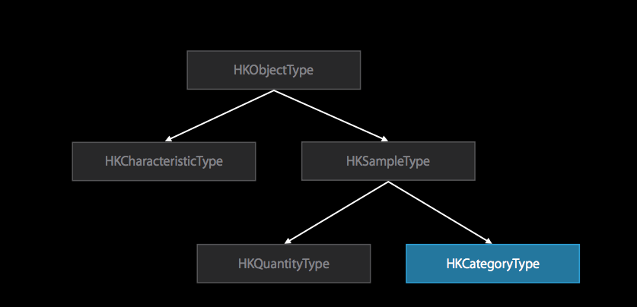
HKQuantityType

Slide 8
HKQuantityType
Every quantity type has a type identifier
You cannot create your own types
Example:
HKQuantityTypeIdentifierHeartRate
HKObjectType subcalss Type name
Creation:
3 constructors, one for each quantity type
Ex. +(HKQuantityType *)quantityTypeForIdentifier: (NSString *)identifier

Slide 9
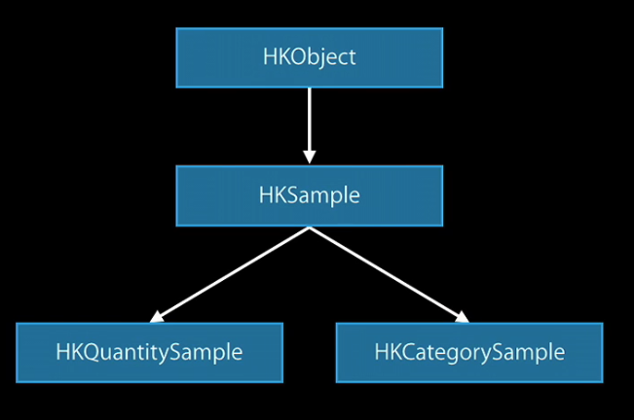
HKObject

Slide 10
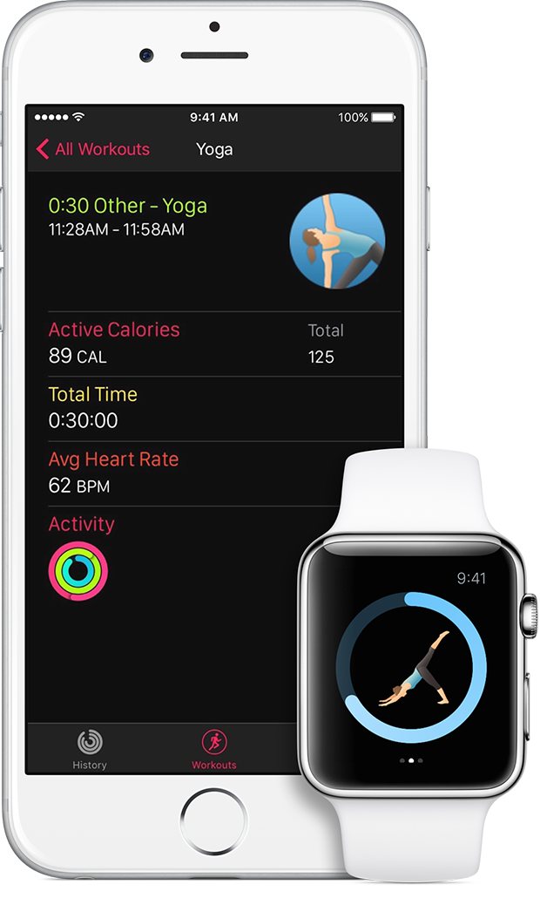
HealthKit + Apple watch
Recorded workout sessions on the apple watch are saved to healthkit.
Watchkit makes available,
Workout summary
Active energy burn
Heart rate
Activity ring on apple watch to view workout summary

