Slide 1


FLOW STEP-1 Json file to glue jobs creation
Job 1
Job 2
Glue jobs will created based on python files
Job 3
Input s3 URI
Schema & Python files will created based on array
Run this job
Job 4
Etc.,

Slide 2
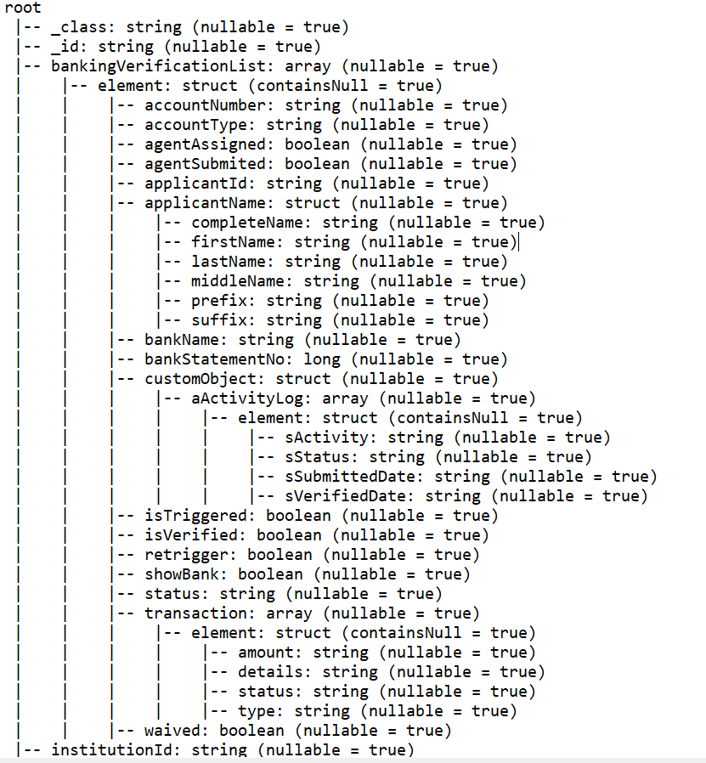
4 python files will be generated
main_1.py
bankingVerificationList _2.py
bankingVerificationList_customObject_aActivityLog _3.py
bankingVerificationList_transaction _4.py

Slide 3
Example S3 path : bankVerificationDetailsCustom_20241011000000.json
s3://datawarehouse-bilight/LentraData/LOS3.0/bankVerificationDetailsCustom/Daily/2024/10/11/bankVerificationDetailsCustom_20241011000000.json

Slide 4
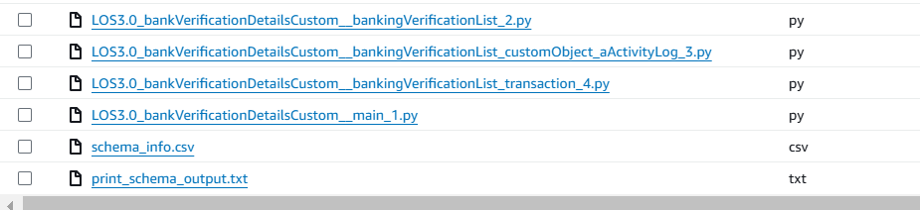
S3 output python files
Schema info
Print schema
Python files generated based on arrays present in schema

Slide 5
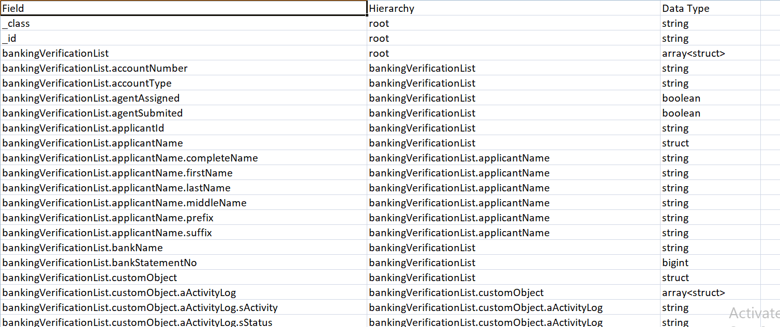
Schema info.csv

Slide 6
Print Schema

Slide 7
4 python files will be generated
main_1.py
bankingVerificationList _2.py
bankingVerificationList_customObject_aActivityLog _3.py
bankingVerificationList_transaction _4.py

Slide 8
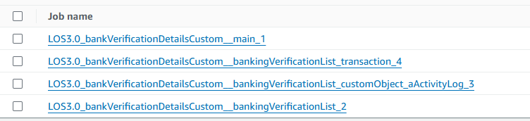
Glue Jobs created
Job 1
Job 4
Job 3
Job 2

Slide 9


FLOW STEP – 2 Glue jobs to csv generation
Job1
Activator1
Job2
CSV files will store in output s3 path
Job3
Job4
Activator2
Job5
Start
Job6
WF1
Job7
Activator3
Job8
Job9
Job10
Activator4
Job11
Job12
Job13
Activator5
Job14
Job15
Job16
Activator6
Job17
Job18
WF2
Job19
Activator7
Job20
Job21
End

Slide 10
Pipeline creation
This job will automate the process of running jobs through workflows. The workflow count is based on the number of jobs. Each workflow will have up to 5 activators, and each activator will handle 3 jobs. The code automatically divides the total job count by 5 to create workflows, and then divides it by 3 to assign jobs to activators within each workflow.
When the first workflow starts, the first activator will run its 3 jobs. Once completed, the output CSV will be stored in the specified S3 path, and the next activator will begin. Only after all activators in a workflow have successfully run will the next workflow start. This process continues until all jobs are completed successfully.

Slide 11
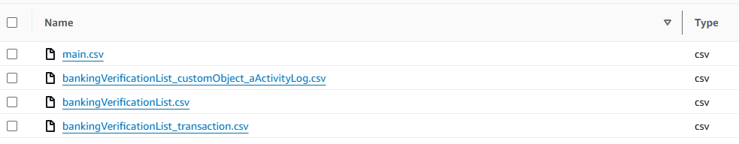
Store csv in output S3 path

Slide 12

FLOW STEP-3 S3 to RedShift

Slide 13
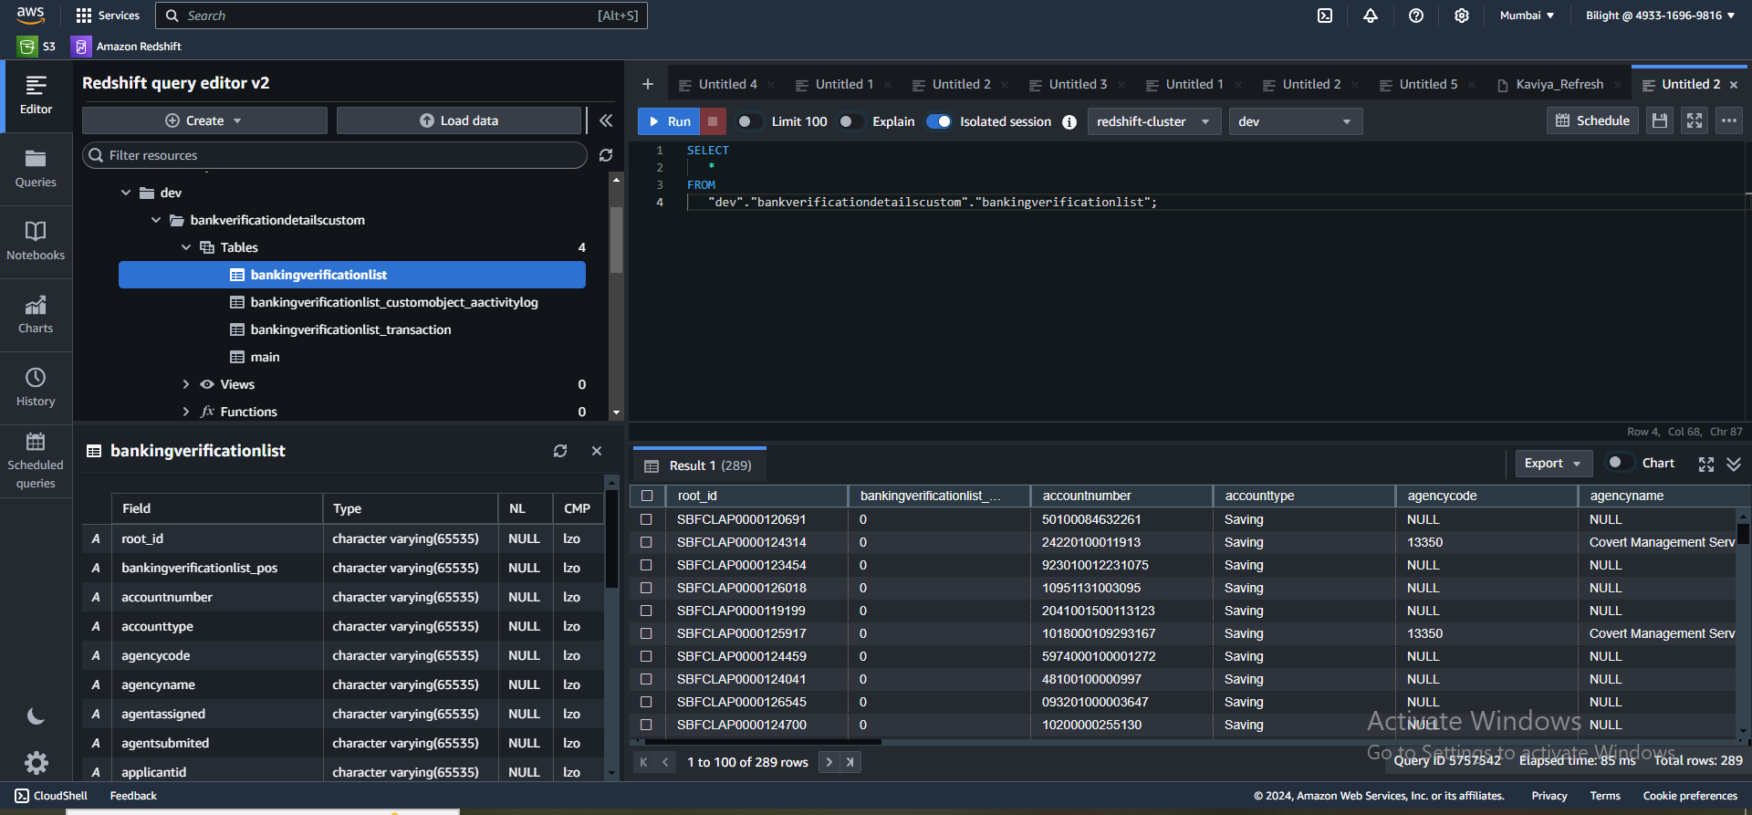
Get s3 output paths and create table names
This job will automate the process of moving CSV file data from the S3 output path to Redshift tables. It will take the S3 paths, derive the schema name and table name from each file paths, and load the data into the corresponding Redshift database schema table.

