Slide 1
Smart public restroom
Using IoT

Slide 2
Submitted by:
M.Nandhithadoss
M.Sindhu
V.Saranya
E.kalki

Slide 3
Introduction
The project aims to enhance public restroom management by installing IoT sensors to monitor occupancy and maintenance needs. The goal is to provide real-time data on restroom availability and cleanliness to the public through a platform or mobile app. This project includes defining objectives, designing the IoT sensor system.
This project includes defining objectives, designing the IoT sensor system, developing the restroom information platform, and integrating them using IoT technology and Python.

Slide 4
Objective
Project Objectives: Define objectives such as real-time restroom availability information, cleanliness monitoring improve user experience, and efficient restroom.

Slide 5
Number of complaints reduces. Restroom users can easily feedback on any problems they spot. Equipment is well-maintained due to real time data usage. A supervisor is always aware of daily, weekly, and monthly statistics concerning equipment exploitation, thus, is able to make the best decisions regarding rooms layout

Slide 6
Developing Smart toilet using IoT
Smart restroom is always aware of daily, weekly, and monthly statistics concerning equipment exploitation, thus, is able to make the best decisions regarding rooms layout. In addition to the abovesaid, there already exist smart sinks, mirrors, and toilets that by means of artificial intelligence adjust by moving up and down depending on who is using them; regulate surface, water, and pipes temperature; gather data about equipment and surrounding environment. Moreover, using machine learning and LoRaWAN, it is possible to teach smart devices to predict user’s behavior, develop situational awareness, automate many processes, and thus simplify routine. For example, you might want to have a face recognition system that automatically adjusts water temperature and pressure to your personalised settings when you are washing hands or having a shower. Such innovations will definitely bring more convenient.

Slide 7
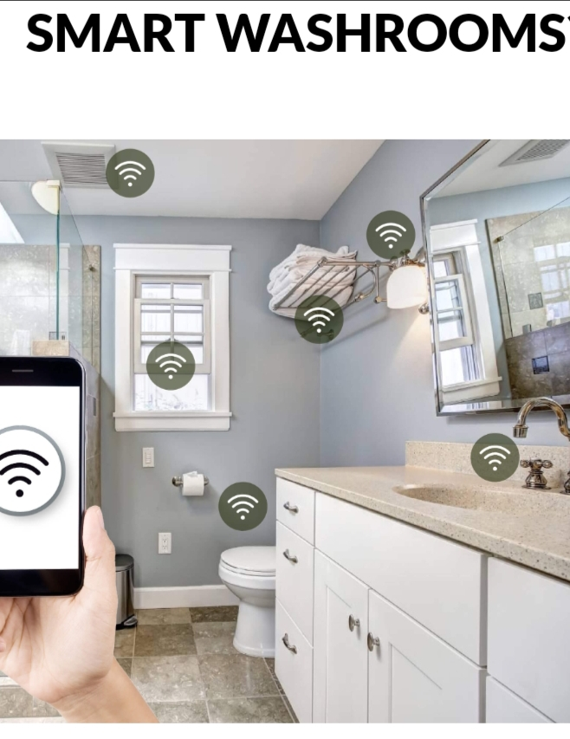
Smart restroom 🚺

Slide 8
Uses of smart restroom
Organizing sewages from the railway system. They
are trying to taking all the medical tests through the
usage of toilets. They are concentrated on reducing

Slide 9
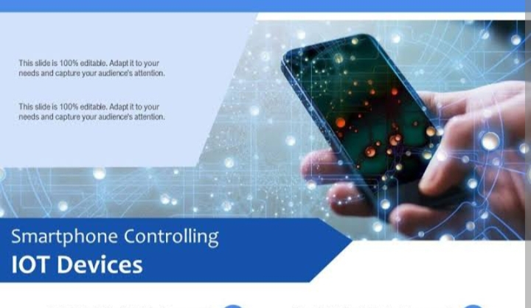
IoT devices

Slide 10
Smart products for restroom
Transport hubs (airports, train stations, bus and tram stops, etc.) Conference/exhibition centres Music/sporting venues Shopping centres/malls Healthcare institutions

Slide 11
Thank you

