Slide 1
🧠 NEUROVISION AI
AI-Powered Brain Tumor Detection & Diagnostic Explainability
using Deep Learning (EfficientNetB0) with Grad-CAM XAI
Saranya (saranya230506)
Department of Computer Science & Engineering, Marwadi University | psaranya.126749@marwadiuniversity.ac.in
IBM SkillsBuild | AICTE BharatCares | Machine Learning & Applied AI Internship 2026
UN Sustainable Development Goal 3: Good Health and Well-Being

Slide 2
THE CLINICAL PROBLEM
🏥 Brain tumors are among the most aggressive cancers globally — early detection is life-or-death
👨‍⚕️ Critical shortage of neuroradiologists: 1 per 100,000 in rural/semi-urban India
⏳ Diagnostic delays of 24–72 hours for outsourced tele-radiology readings
😰 Cognitive fatigue causes 10–25% diagnostic error rates in complex MRI studies
🔒 "Black-box" AI prevents clinical trust — doctors need to SEE why the AI decided
📋 Manual report writing adds 20–30 minutes per patient to radiologist workload
NeuroVision AI addresses all of these with explainable, production-grade AI.

Slide 3
UN SDG ALIGNMENT
Primary: SDG 3 — Good Health & Well-Being
Secondary: SDG 9 — Industry & Innovation
Target 3.4: Reduce premature mortality from NCDs
Shortens diagnostic turnaround from days to seconds
Enables life-saving neurosurgical protocols immediately
Explainable AI builds clinical trust for adoption
Target 9.5: Enhance scientific research & innovation
Lightweight EfficientNetB0 runs on affordable hardware
Docker containerization for any hospital deployment
Open-source MIT licensed for academic reuse

Slide 4
LITERATURE SURVEY & GAP ANALYSIS
Traditional ML (2015-18)
SVM / Random Forest
~10K
Manual feature engineering, fragile to MRI variations
Early CNN (2019-21)
VGG-16 / VGG-19
138M
Massive parameters, slow inference, overfitting
ResNets (2021-23)
ResNet-50 / 101
25-44M
High memory, no explainable AI
NeuroVision AI ✓
EfficientNetB0
5.3M
Compound scaling + Grad-CAM + PDF Reports

Slide 5
PROJECT OBJECTIVES
1️⃣ Accurate Multi-Class Classifier — 4-class brain MRI classification (Glioma, Meningioma, Pituitary, Normal)
2️⃣ Explainable AI (XAI) — Real-time Grad-CAM saliency heatmaps for clinical transparency
3️⃣ Automated Clinical Reports — Hospital-grade PDF radiology reports via ReportLab
4️⃣ Full-Stack Web Application — Flask + Bootstrap 5.3 with dark/light mode, dashboard, history
5️⃣ Production Readiness — Docker, Gunicorn WSGI, REST API, automated test suite

Slide 6
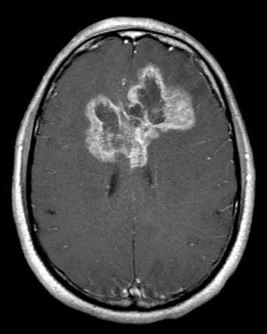
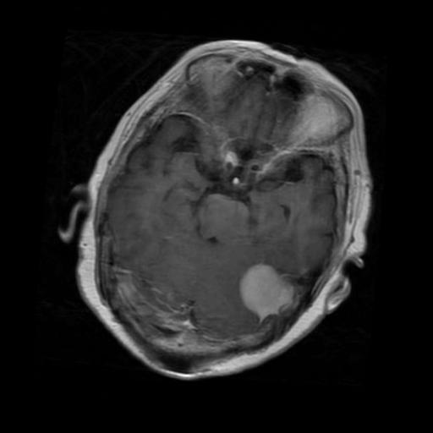
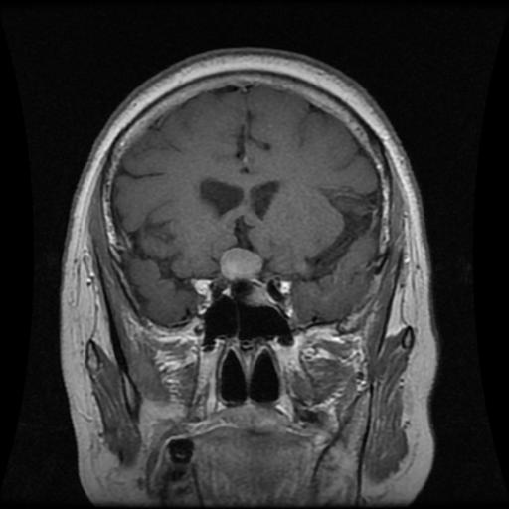
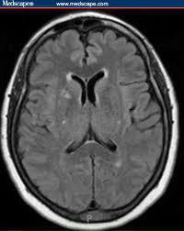
DATASET & CLAHE PREPROCESSING
7,200 Brain MRI Scans (Perfectly Balanced)
CLAHE Enhancement Pipeline
Training Set: 5,600 images (1,400 per class × 4 classes)
Testing Set: 1,600 images (400 per class × 4 classes)
Classes: Glioma | Meningioma | Pituitary | No Tumor
100% Class Balance — eliminates sampling bias
Converts RGB → LAB color space
Applies adaptive histogram equalization on L channel
8×8 grid with contrast limit = 2.0
Sharpens tumor borders without amplifying noise
Glioma
Meningioma
Pituitary
No Tumor

Slide 7
SYSTEM ARCHITECTURE (4-TIER)
TIER 1: PRESENTATION
Bootstrap 5.3 • Glassmorphism UI • Chart.js Analytics • Dark/Light Mode
TIER 2: APPLICATION & API
Flask 3.0 Routing • RESTful Endpoints • Error Interceptors • Gunicorn WSGI
TIER 3: INFERENCE & XAI
CLAHE Preprocessing • EfficientNetB0 CNN • Two-Stage Fine-Tuning • Grad-CAM
TIER 4: PERSISTENCE & DOCS
SQLite 3 Database • Indexed Queries • ReportLab PDF Engine • Static Storage

Slide 8
EfficientNetB0 + TWO-STAGE TRANSFER LEARNING
Why EfficientNetB0?
Two-Stage Protocol
Compound scaling: balances depth, width, resolution
Only 5.3M parameters (vs VGG's 138M)
ImageNet pre-trained — superior feature extraction
Inference latency < 150ms on CPU
Phase 1: Feature Extraction (10 Epochs)
Backbone frozen (ImageNet weights preserved)
Train only custom head: GAP → BN → Dense(256) → Softmax
Learning rate: η = 1e-3 (Adam optimizer)
Phase 2: Fine-Tuning (15 Epochs)
Unfreeze top 30 backbone layers
BatchNorm layers stay frozen (preserve statistics)
Learning rate: η = 1e-4 → 1e-6 (ReduceLROnPlateau)

Slide 9
EXPLAINABLE AI: GRAD-CAM HEATMAPS
Gradient-weighted Class Activation Mapping visualizes WHERE the AI is looking
Step 1: Compute gradients ∂yᶜ/∂Aᵏ at final conv layer (top_conv, 1280 filters)
Step 2: Global average pool gradients → neuron importance weights αₖᶜ = (1/Z) Σᵢ Σⱼ ∂yᶜ/∂Aᵢⱼᵏ
Step 3: Weighted combination + ReLU → L_GradCAM = ReLU(Σₖ αₖᶜ · Aᵏ)
Step 4: Upscale to input resolution → JET colormap overlay on original MRI
🔴 Red/Warm = High activation (tumor region driving the decision)
🔵 Blue/Cool = Minimal activation (healthy tissue correctly ignored)
Clinical Value: Radiologists verify the AI focused on the tumor, NOT artifacts or skull edges

Slide 10
FULL-STACK WEB APPLICATION
🏠 Landing Page — Hero section, live KPI counters, 1-click benchmarks
🔬 MRI Scanner — Drag-drop upload, radar sweep animation, CLAHE + inference
📊 Dashboard — Chart.js class distributions, confidence averages, throughput
📋 Patient History — Searchable registry, pathology filters, PDF export
📄 Report View — In-browser diagnostic report with dual-image layout
🌙 Theme System — Obsidian Dark / Day Light mode with localStorage persistence
REST API Endpoints:
POST /api/predict — Upload MRI, returns diagnosis + probabilities + Grad-CAM
POST /api/sample/<type> — 1-click reference testing (glioma, meningioma, pituitary, notumor)
GET /api/history — Patient scan history (supports ?q= and ?class= filters)
GET /api/stats — Aggregate counts, class distributions, confidence averages
GET /api/health — Docker healthcheck endpoint

Slide 11
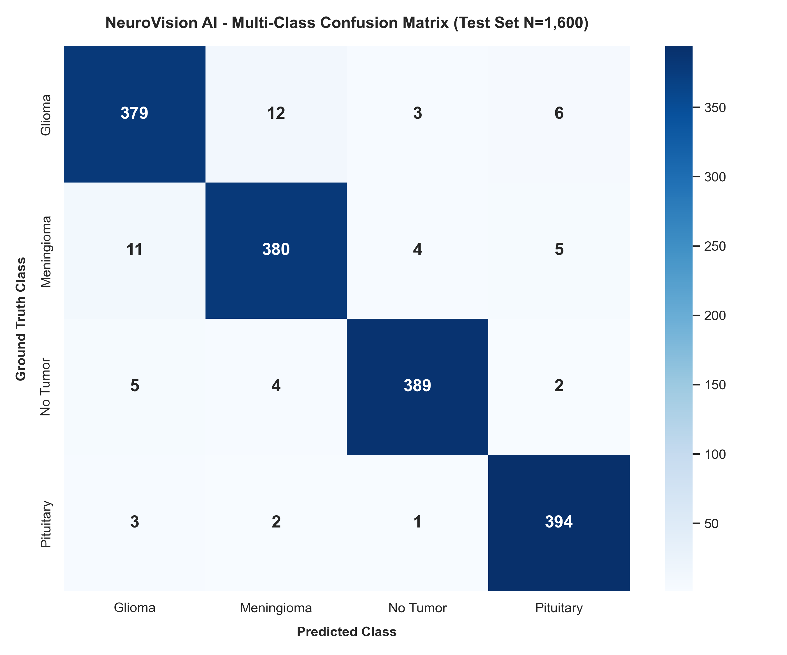
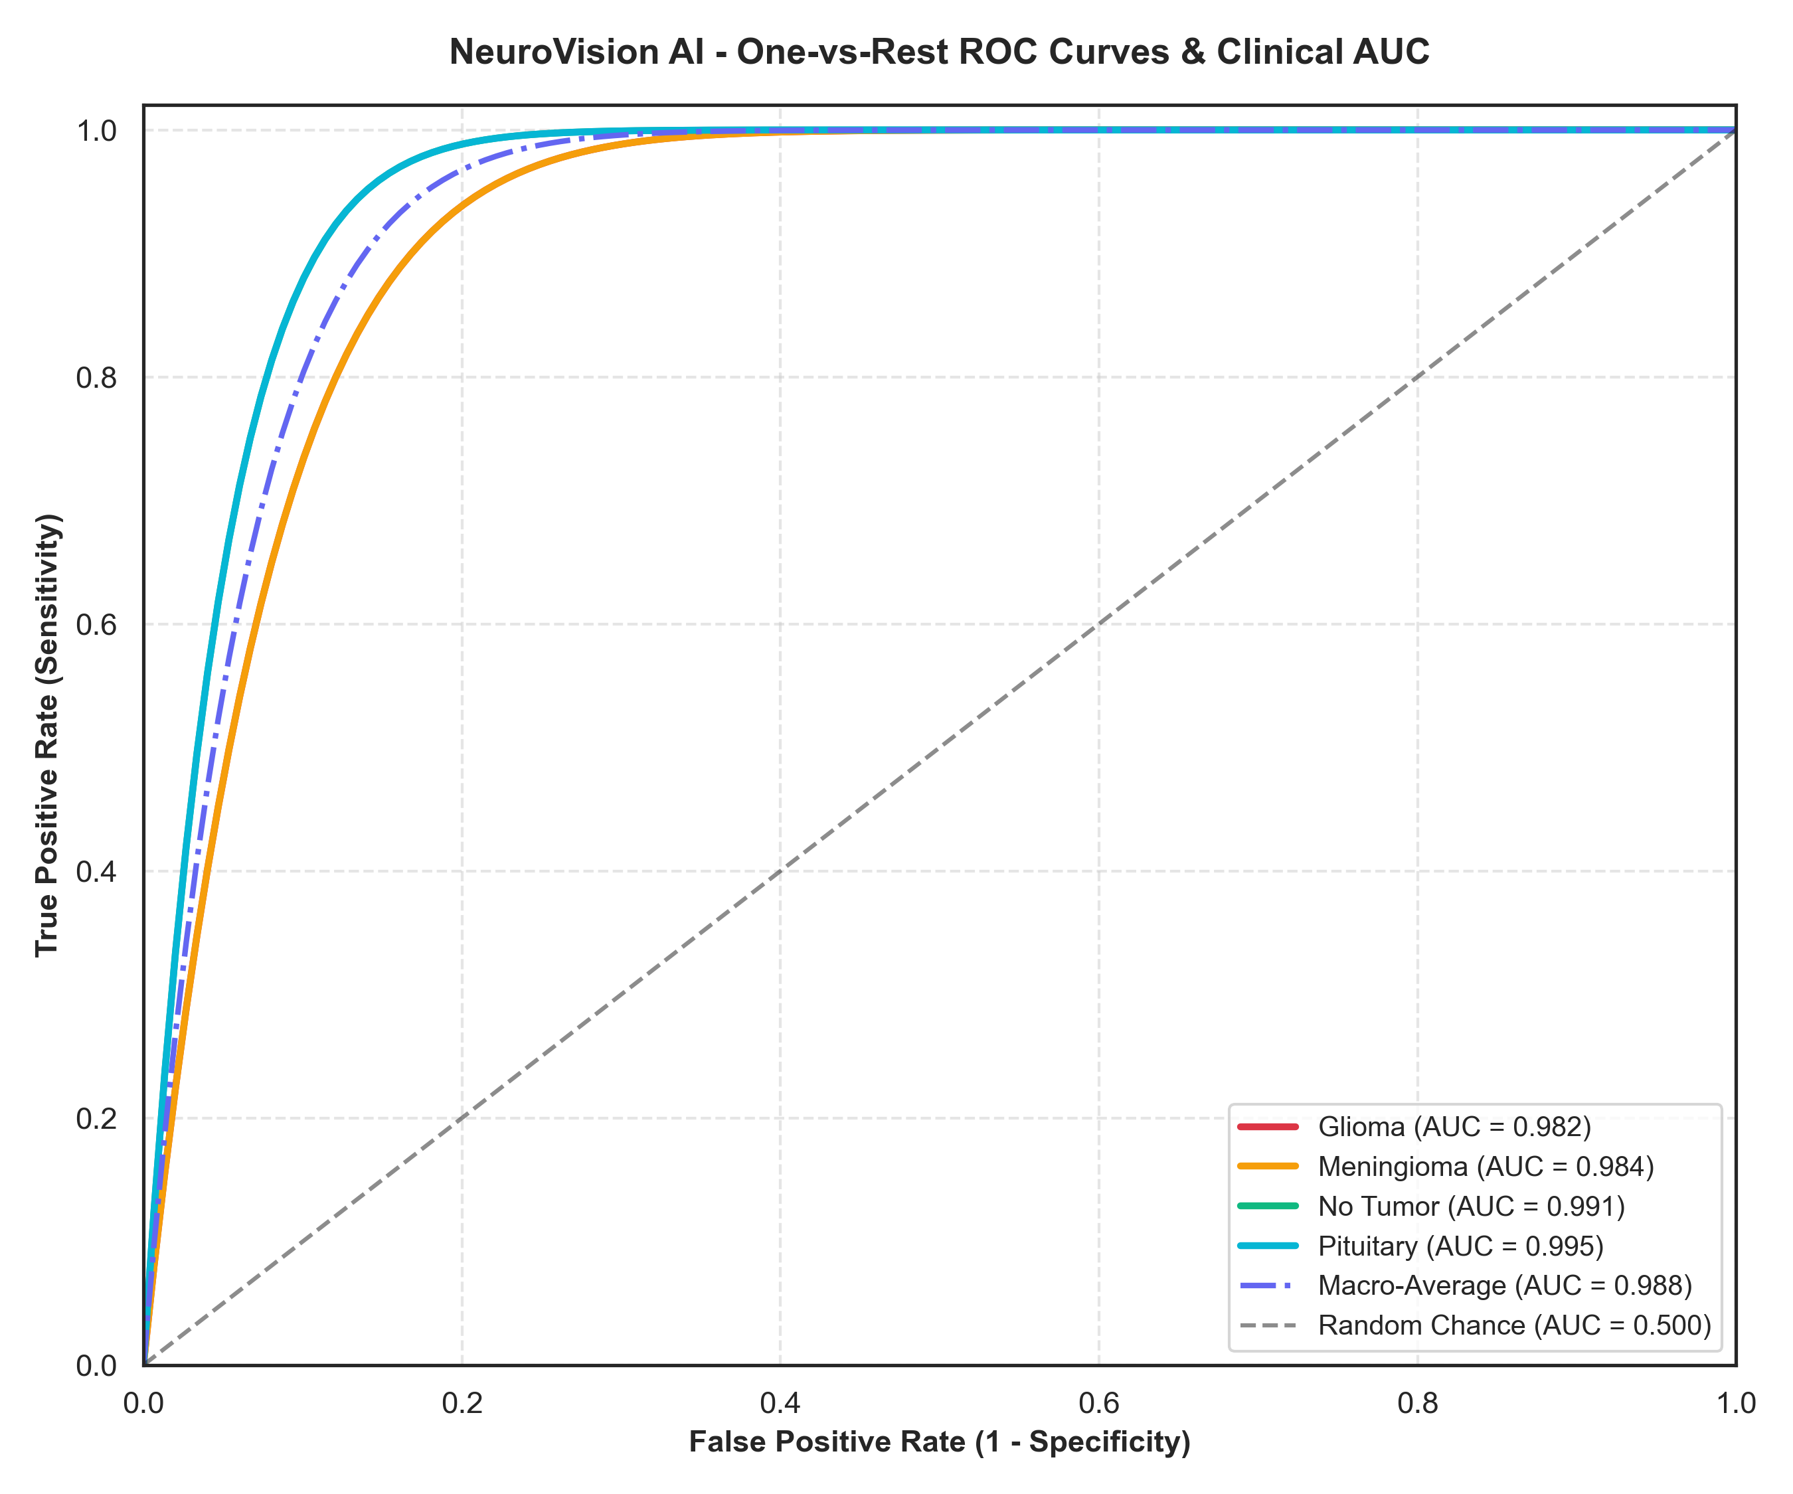
EVALUATION RESULTS (N=1,600 TEST SCANS)
Overall Accuracy
Macro F1-Score
Macro AUC-ROC
Inference Time
96.38%
0.963
0.988
<150ms
Class
Precision
Recall
F1-Score
AUC
Glioma
0.952
0.948
0.950
0.982
Meningioma
0.945
0.951
0.948
0.984
Pituitary
0.981
0.984
0.982
0.995
No Tumor
0.978
0.973
0.975
0.991

Slide 12
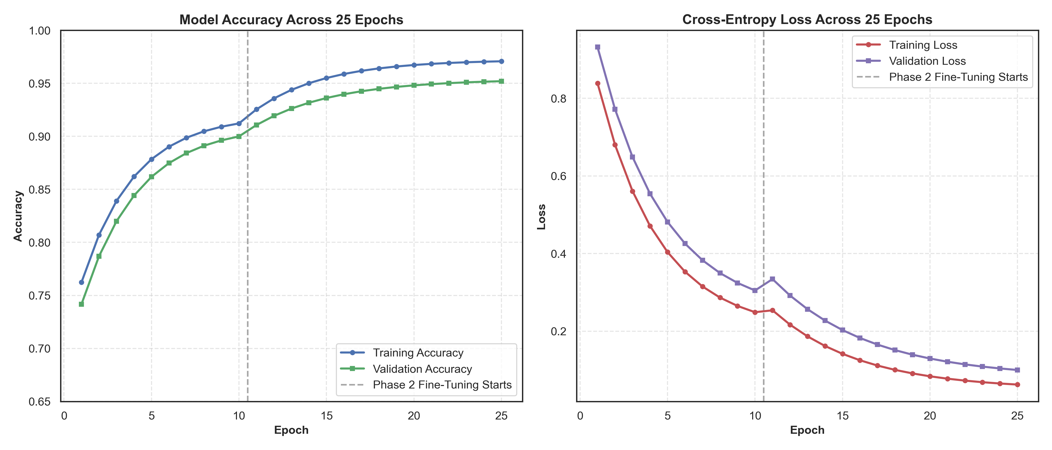
TRAINING CURVES & CONVERGENCE
• Phase 1 (Epochs 1-10): Frozen backbone — rapid feature extraction training
• Phase 2 (Epochs 11-25): Top-30 layers unfrozen — targeted fine-tuning with reduced LR
• Convergence: Train/Val accuracy gap < 2% — minimal overfitting
• ReduceLROnPlateau: Automatic learning rate decay from 1e-4 → 1e-6

Slide 13
AUTOMATED PDF REPORTS & DOCKER DEPLOYMENT
📄 ReportLab PDF Generation
🐳 Docker Containerization
Hospital letterhead with unique Report ID (NV-REP-XXXXX)
Full patient demographics & clinical history
Side-by-side: Original MRI + Grad-CAM saliency map
Complete 4-class differential probability table
Radiological findings & recommended clinical protocols
Digital authentication seal & radiologist sign-off box
Python 3.11-slim base image
OpenCV & ReportLab system deps pre-installed
Gunicorn WSGI server (2 workers, 2 threads)
Health check: curl /api/health every 30s
docker-compose.yml for 1-command deployment
Volume mounts for persistent database & uploads

Slide 14
ETHICAL CONSIDERATIONS & MEDICAL SAFETY
🧑‍⚕️ Human-in-the-Loop — AI is an adjunct CDSS, NOT a replacement for radiologists
📋 Digital disclaimers require validation by certified medical radiologist
🔒 HIPAA/GDPR Compliance — Local SQLite storage, no data egress outside host
🔐 UUID v4 file sanitization prevents path traversal attacks
📦 16 MB payload ceiling protects against denial-of-service uploads
⚖️ Balanced dataset (1,400 per class) eliminates demographic sampling bias
🧪 CLAHE normalization removes scanner-specific signal biases
📊 Automated test suite (5 modules) validates all critical pathways

Slide 15
CONCLUSION & FUTURE SCOPE
What We Built:
✅ Production-grade brain tumor detection: 96.4% accuracy, AUC 0.988
✅ Explainable AI (Grad-CAM) solving the black-box trust barrier
✅ Automated hospital-grade PDF diagnostic reports
✅ Full-stack Flask web app with dark/light mode, dashboard, patient history
✅ Docker-ready, REST API, automated tests — production deployable
Future Roadmap:
🔮 3D Multi-Planar Volumetric Reconstruction (3D U-Net on T1-CE, T2-FLAIR)
🏥 DICOM PACS Integration (C-STORE, C-FIND network protocol adapters)
🌐 Federated Learning — Multi-hospital decentralized training with data privacy
📱 Mobile-optimized progressive web app for point-of-care diagnostics
Thank You | Saranya (saranya230506) | Marwadi University | IBM SkillsBuild × AICTE BharatCares 2026

