Slide 1
Leveraging compiler optimization for the code clone detection
By
Saranya. D(192224136)
Hayagrish. V(192211815)
Anusha(192221062)

Slide 2
Introduction to Code Clone Detection
Code clone detection is the process of identifying similar or identical code segments within a codebase.
This is an important task in software maintenance and evolution, as it can help identify and manage technical debt, improve code quality, and facilitate refactoring efforts.

Slide 3
Importance of Code Clone Detection
Improving Code Quality:
Identifying and removing redundant or similar code can help reduce complexity and increase maintainability.
Managing Technical Debt:
Clones can often indicate areas of technical debt, which can be addressed through refactoring
Facilitating Refactoring:
Clone detection can help developers identify opportunities for restructuring and consolidating code.
Enhancing Software Evolution:
Understanding the clone structure of a codebase can inform future development and evolution decisions.

Slide 4
Challenges in Traditional Code Clone Detection
Scalability:
Traditional clone detection techniques can struggle to handle large, complex codebases due to their computational complexity.
False Positives:
Syntactically similar code may not always be semantically equivalent, leading to false positive clone detections.
Language Dependence:
Many clone detection approaches are tailored to specific programming languages, limiting their applicability across diverse codebases

Slide 5
Compiler Optimization Techniques
Dead Code Elimination:
Removing code that is never executed can help identify and consolidate similar code fragments.
Constant Propagation:
Replacing variables with their constant values can expose additional opportunities for code clone detection.
Code Inlining:
Inlining function calls can reveal more opportunities for identifying and merging similar code segments.
Strength Reduction:
Replacing complex operations with simpler equivalents can simplify the code and facilitate clone detection.

Slide 6

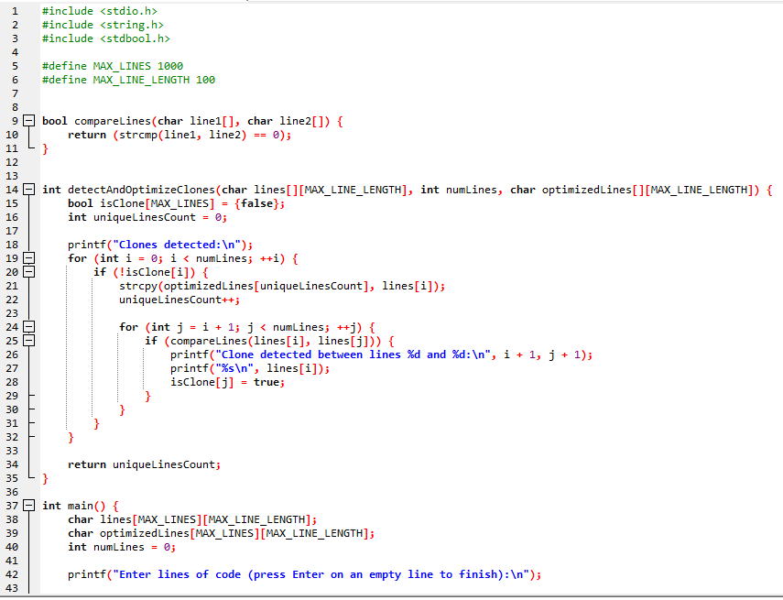
Program:

Slide 7
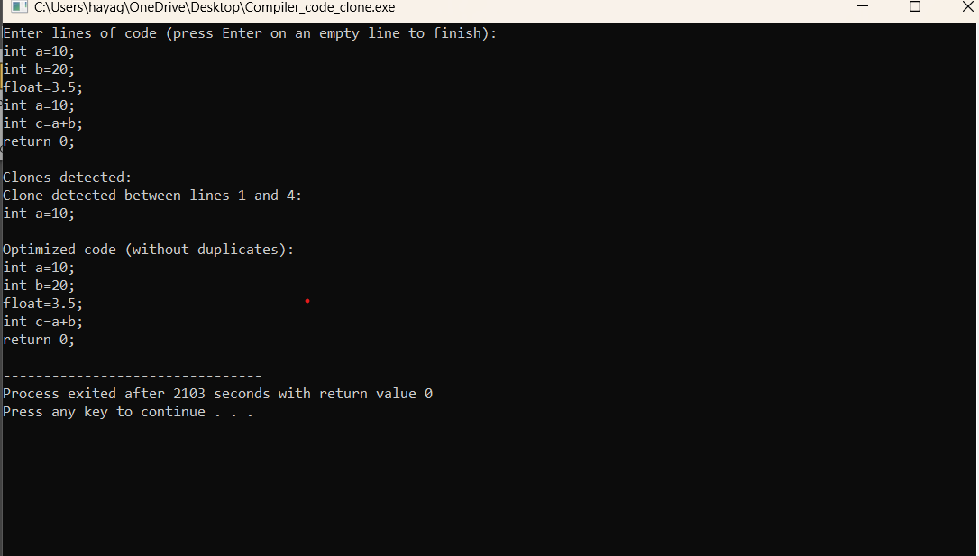
Output:

Slide 8
Steps of the Code clone detection:
Intermediate Representation:
Analyze the compiler's intermediate representation to identify semantically equivalent code fragments.
Optimization Passes:
Apply various compiler optimization techniques to simplify the code and expose more clones.
Clone Identification:
Use the optimized code to detect and group identical or similar code segments.

Slide 9
Conclusion and Future Scope:
Conclusion:
Leveraging compiler optimizations can offer a powerful and scalable approach to code clone detection, addressing the challenges of traditional techniques.
Future Scope:
Continued research and development in this area could further improve the accuracy, efficiency, and applicability of compiler-based code clone detection across diverse codebases.

Slide 10
Thank you

