Slide 1
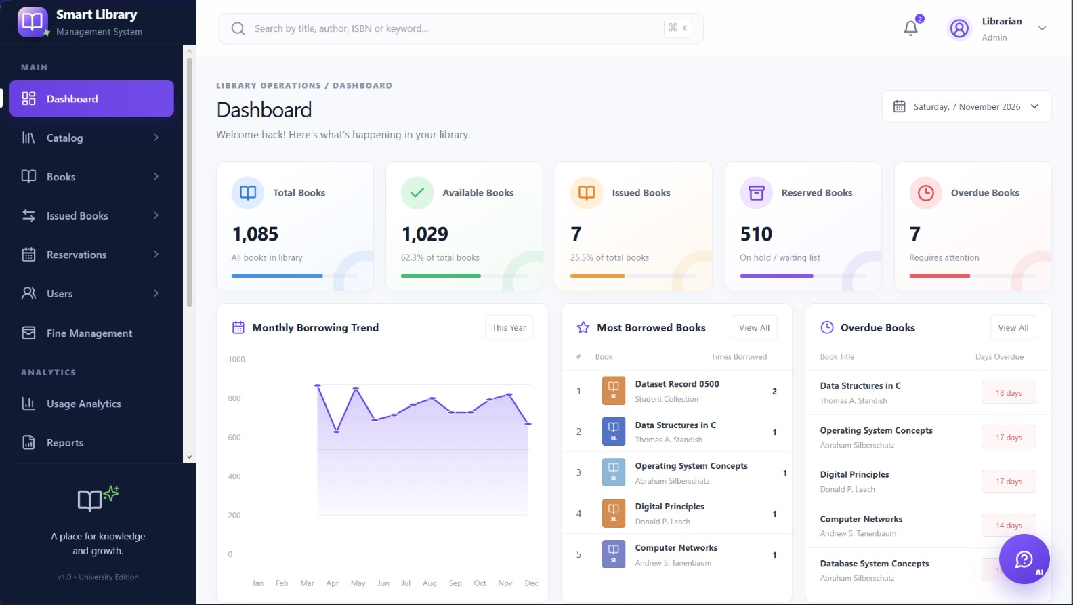
Library Management Book Availability System
Dashboard screenshot
Project report and presentation
B. Saranya, CH. Varshini, T. Bindhu
smartlib-7mbssm8g.manus.space
Notes:
Introduce the project: a Library Management Book Availability System, presented through the Smart Library Management System dashboard. State the team members. [Presenter cue: add course name, faculty and date if your instructor expects them - these were not in the material provided.]

Slide 2
Team members
BS
CV
TB
B. Saranya
CH. Varshini
T. Bindhu
H.T. No.
H.T. No.
H.T. No.
2503552637
2503A52632
2503A52638
Team details provided
Notes:
Team member names and hall-ticket numbers were supplied by the project team.

Slide 3




Problem statement
Why availability is hard to track
The problem
Copies change state constantly
Available, issued, reserved, overdue.
Readers and staff need a reliable way to check whether a copy is available now. Availability changes as copies are issued, reserved or overdue, so the catalogue should show each copy’s current status.
Titles have several copies
Availability is a count, not yes or no.
Reservations hide demand
A shelf copy may already be on hold.
Overdue books stay unavailable
They are on loan until returned.
Problem summary from project proposal
Notes:
Problem statement is based on the proposal: readers need to know copy-level availability as copies move through issue, reservation and overdue states.

Slide 4
Objectives and solution
Objectives
The solution
Bring the library dataset together in one cleaned, analysed form
Show available, issued, reserved and overdue books
Highlight titles with high demand and few copies
Make overdue books easy to see and follow up
Offer an interactive dashboard for everyday use
Dashboard screenshot
Objectives from project proposal
Smart Library Management System: a web dashboard built from the library dataset.
Notes:
Objectives are summarized from the proposal and dashboard scope.

Slide 5
How the dashboard helps
Question staff ask | Where the dashboard answers it
Is this book available? | Available Books card, High Demand table, search bar
What is on loan? | Issued Books card and Overdue Books list
Is anyone waiting for it? | Reserved Books card and Active Reservations
Which books are in demand? | Most Borrowed list and Monthly Borrowing Trend
What does the collection hold? | Books by Category chart and Total Books card
Every answer comes from a panel visible in the dashboard screenshots.
Notes:
Walk down the table: each question a librarian asks maps to a specific part of the dashboard. This slide links the problem to the solution.

Slide 6
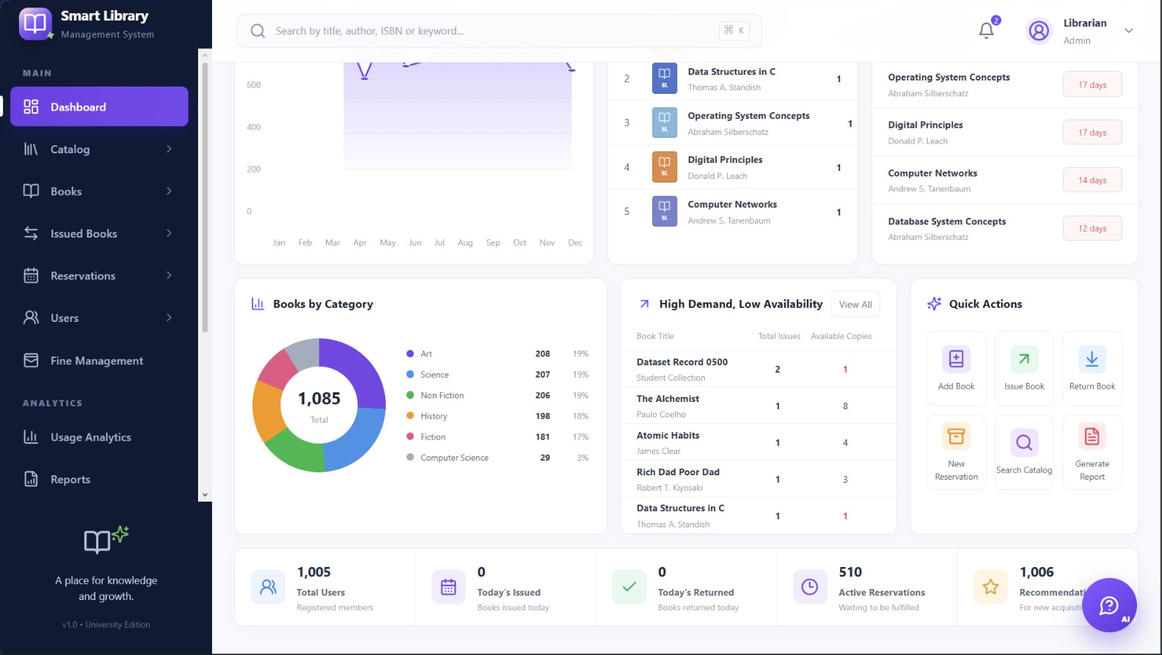
Dashboard overview
Dashboard screenshot, top of page
Dashboard screenshot, scrolled down
Dashboard overview screenshots. These screens show the project’s availability, circulation and demand views; the figures are a screenshot snapshot, not verified live data.
Notes:
These are the two screenshots of the live dashboard (smartlib-7mbssm8g.manus.space), taken on 7 November 2026. The left shows the top of the page, the right shows the lower half. The browser tabs were cropped out so the focus stays on the dashboard.

Slide 7
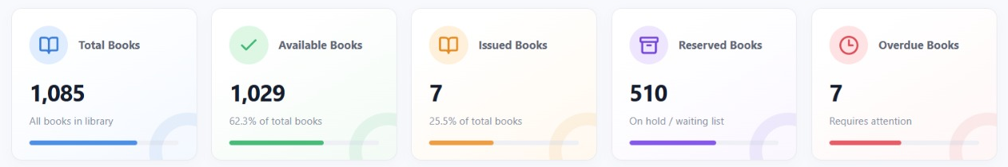
Key metrics at a glance
Dashboard summary cards (screenshot)
Counts and percentage labels conflict; see arithmetic below.
Available: 1,029 of 1,085 = 94.8% (screenshot label: 62.3%).
Issued: 7 of 1,085 = 0.6% (screenshot label: 25.5%). Verify dashboard calculations before presenting these percentages as correct.
Notes:
The dashboard screenshots are retained as the project overview. Treat values as a dated screenshot snapshot unless a live data refresh is confirmed.

Slide 8
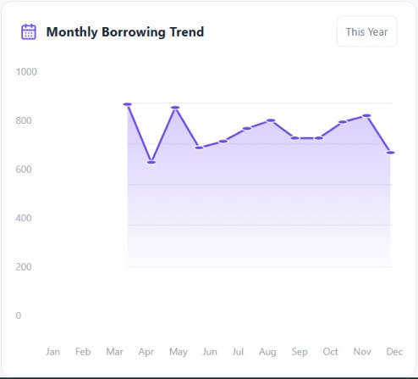
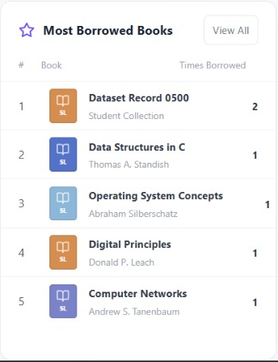
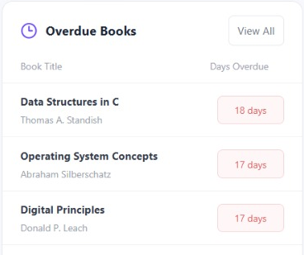
Borrowing trend and circulation
Dashboard screenshot: Monthly Borrowing Trend
Dashboard screenshot: Most Borrowed Books
Dashboard screenshot: Overdue Books (top three rows)
The trend spans January to December; the two lists name five titles each.
Notes:
Left: Monthly Borrowing Trend for the year, with a This Year filter. Middle: the five most borrowed books. Right: the five overdue books with days overdue; the list is cropped to its top three rows because the chat button covers the lower rows; all five rows are visible in the second screenshot. [Presenter cue: the trend line sits around 600 to 900 per month while only 7 books are shown as issued - confirm what the trend measures before explaining it.]

Slide 9
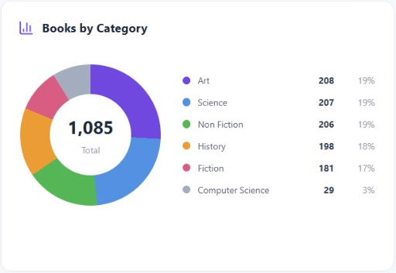
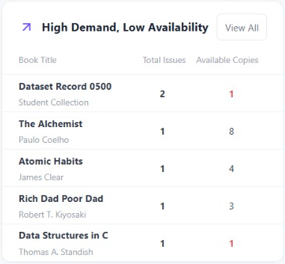
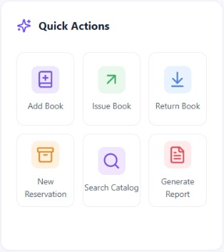
Collection, demand and quick actions
Dashboard screenshot: Books by Category
Dashboard screenshot: High Demand, Low Availability
Dashboard screenshot: Quick Actions
Staff see the collection mix, the titles with few copies left, and shortcuts for common tasks.
Notes:
Left: Books by Category (1,085 shown in the centre). Middle: titles with high demand and low availability, showing total issues and available copies. Right: Quick Actions - Add Book, Issue Book, Return Book, New Reservation, Search Catalog, Generate Report. [Presenter cue: confirm whether the Quick Actions buttons are working features before describing them as such.]

Slide 10
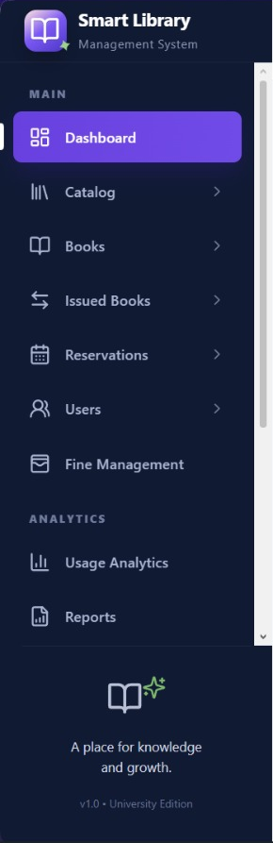
What it includes and how to use it
What it includes
How users can use it
Search bar, alerts and Librarian profile
Menu: Catalog, Books, Issued Books, Reservations, Users, Fine Management
Analytics: Usage Analytics, Reports
Five summary cards and six panels
Quick Actions shortcuts
Read the summary cards for current status
Search by title, author, ISBN or keyword
Check Overdue Books and follow up
Spot low-availability titles in High Demand
Use Quick Actions or the menu for detail
Screenshot: menu
Menu labels transcribed from screenshot
Notes:
Everything listed here is visible in the screenshots: the search bar (title, author, ISBN or keyword), the notification bell, the Librarian Admin profile, the menu modules and the Analytics group. The usage steps describe the controls as they appear. [Presenter cue: the menu pages were not captured, so confirm what each one opens, and mention only what you have tested. There is also an AI chat button at the bottom right - confirm what it does before mentioning it.]

Slide 11



Benefits for users
Library staff
Students
Administrators and management
See the status of every book in one view
Follow up overdue books quickly
Spot titles that need more copies
Staff can answer availability questions faster
Popular titles can be restocked sooner
Overdue follow-up frees titles for others
Usage Analytics and Reports
Category mix shows thin areas
Member and reservation counts
Notes:
Library staff benefit directly. Students benefit indirectly through faster, better-informed service. Administrators and management can use the analytics and reports. [Presenter cue: the screenshots show a Librarian Admin view only. If there is a student-facing view, say so; otherwise keep the student benefits framed as indirect.]

Slide 12
Books by category
What it shows
Cleaned CSV category counts; five groups total 1,000 loan records.
Takeaway
Art is largest (208 records); Fiction is smallest (181). The CSV has no Computer Science category.
Source: cleaned CSV; separate from dashboard inventory totals.
Source: data/processed/library_datasets_cleaned.csv
Notes:
This chart uses the cleaned CSV only. It contains five categories and 1,000 records; dashboard inventory totals come from a different view.

Slide 13
Overdue books by days overdue
What it shows
Days overdue for the five titles in the Overdue Books panel.
Takeaway
All five are 12 to 18 days overdue. Data Structures in C is the longest at 18 days.
Values read from the dashboard screenshot (Overdue Books).
Notes:
These are the five titles listed on the dashboard, longest overdue first. The summary card says 7 books are overdue, so two more are not listed in the screenshot. [Presenter cue: confirm whether the panel shows only the top five.]

Slide 14
Demand against availability
What it shows
Total issues and available copies for the titles in the High Demand, Low Availability panel.
Takeaway
Dataset Record 0500 and Data Structures in C each have only one available copy.
Values read from the dashboard screenshot (High Demand, Low Availability).
Notes:
Compare the two bars for each title. The Alchemist has eight available copies, while Dataset Record 0500 and Data Structures in C have one each. [Presenter cue: 'Dataset Record 0500' looks like a placeholder title in the dataset - confirm it is a real record before presenting.]

Slide 15
Data source and method
1
2
3
4
5
6
Proposal
Collection
Cleaning
Analysis
Visuals
Dashboard
Data source
Cleaning
Analysis
Source: Kaggle library_datasets.csv. The cleaned file contains 1,000 records and 9 columns.
Standardizes column names, text, dates and reservation flags; removes exact duplicate rows; converts overdue status to numeric. Invalid values are flagged.
Analysis summarizes categories, reservations, overdue flags, loan duration and monthly borrowing. Every book ID in the CSV occurs once, so the file cannot identify repeat-borrowed titles.
Raw file preserved
Python cleaning script
Notes:
Dataset: Kaggle library_datasets.csv. Cleaning steps are documented in data_cleaning.py and reports. Exact duplicate rows removed; text and columns normalized; dates parsed where possible; known reservation flags standardized; overdue status numeric-converted.

Slide 16
Key findings
1,000
507
627
10.22
loan records in cleaned CSV (9 columns)
reservation_status=true (50.7%)
overdue_status=1 (62.7%)
mean loan duration in days (median 10)
These findings describe the cleaned Kaggle CSV. Dashboard inventory counts are a separate screenshot snapshot.
Notes:
Statistics on this slide use only data/processed/library_datasets_cleaned.csv: 1,000 rows, 507 true reservation flags, 627 overdue flags, average duration 10.22 days, median 10 days. Dashboard screenshots are a separate source.

Slide 17
Limitations
The cleaned CSV has 1,000 loan records; dashboard screenshots show inventory of 1,085 books.
Dashboard card percentages conflict with counts: 1,029/1,085 = 94.8%; 7/1,085 = 0.6%.
Dashboard figures come from screenshots; project files do not confirm a live refresh.
Every book ID occurs once in the cleaned CSV, so it cannot identify repeat-borrowed titles.
Use inventory and active-loan data to calculate current availability; the CSV is historical borrowing data.
Notes:
Important interpretation limits: CSV loan records are not a live inventory; dashboard screenshot totals/percentages conflict; no repeat book IDs in CSV; current availability requires inventory plus active-loan status.

Slide 18
Possible future improvements
Live data
Overdue alerts
Student view
Connect to the library's circulation records
Send reminders to members automatically
Let students check availability themselves
Demand forecast
Export reports
Access roles
Plan new purchases from borrowing patterns
Download dashboard figures for meetings
Different views for staff, faculty and students
All items are proposed ideas, not features of the current dashboard.
Notes:
These are suggestions for future work, not things the dashboard does today. [Presenter cue: drop any that do not fit your plans, or add your own.]

Slide 19
Conclusion
The project combines a repeatable borrowing-data workflow with a dashboard view of availability, circulation and demand. The cleaned CSV and dashboard screenshots represent separate sources. Verify dashboard figures before using them as live inventory.
Thank you. Questions?
smartlib-7mbssm8g.manus.space
Notes:
Conclusion distinguishes the cleaned loan dataset from the dashboard screenshot snapshot. Confirm current inventory and formulas before operational use.

