Slide 1

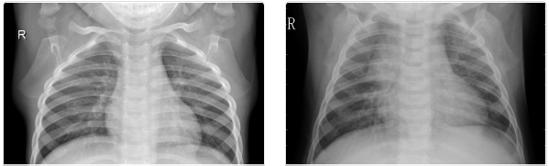
Transfer Learning-based Pneumonia Detection using Chest X-Ray Images
4TH YEAR 6TH SEMESTER
UNIVERSITY OF ENGINEERING AND MANAGEMENT, KOLKATA

Slide 2
Saranya Bhattacharjee University Roll No. 12019009001311
Aditya Jaiswal University Roll No. 12019009023073
Nisha Kumari University Roll No.12019009023082
Aman Chopra University Roll No. 12019009022013
Aniket Singh University Roll No. 12019009022126
Shubham Mukherjee University Roll No. 12019009001221
Under the guidance of Prof. Sankhadeep Chatterjee & Prof. Amartya Chakraborty
Department of Computer Science and Engineering

Slide 3
INTRODUCTION
According to the World Health Organization (WHO), pneumonia kills about 2 million children under 5 years old every year and is consistently estimated as the single leading cause of childhood mortality (Rudan et al., 2008), killing more children than HIV/AIDS, Malaria, and Measles combined.
Chest X-rays - Currently the best available method for diagnosing pneumonia as stated by WHO (2001). However, detecting pneumonia is a challenging task that relies on the availability of expert radiologists.
Our study aims to ultimately aid in expediting the diagnosis and referral of these treatable conditions, thereby facilitating earlier diagnosis, and resulting in improved clinical outcomes.

Slide 4
PROBLEM STATEMENT
Build an AI model which can automatically detect Pneumonia from Chest X-ray images
Sub-problems:
1) Pneumonia vs. Normal Cases Classification with Chest X-ray
2) Bacterial vs. Viral Cases Classification with Chest X-ray

Slide 5
IMPORTANT METRICS
Immediate treatment for someone with pneumonia is utmost important, so everyone with pneumonia has to be found out correctly with the model, i.e., in evaluation terms of Machine Learning:
Recall has to be high for Pneumonia vs Normal cases
Once some one is diagnosed with Pneumonia, we have to identify whether it is a viral pneumonia case or bacterial pneumonia, as the patient has to be treated accordingly because mistreatment as a viral case could be fatal. Moreover, the treatments for both are different.
In this case, Precision is very important

Slide 6
ABOUT THE DATASET
There are a total of 5,856 X-Ray Grey-Scale images (JPEG) and 2 categories, namely Pneumonial vs. Normal images.
These pediatric chest X-rays of pneumonial patients is further distinguished into viral and bacterial pneumonia to facilitate rapid referrals for children needing urgent intervention.
SET | Total Images | Normal | Pneumonia | Bacterial | Viral
Training | 5216 | 1341 | 3875 | 2530 | 1345
Testing | 624 | 234 | 390 | 242 | 148

Slide 7
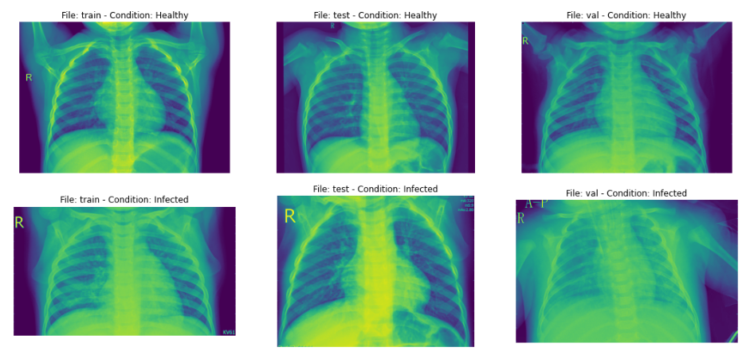
PNEUMONIA VS NORMAL X-RAY IMAGES

Slide 8
DATA AUGMENTATION
Technique to artificially create new training data from existing training data
Implementation: ImageDataGenerator class from Keras
Transformations used include:
Zoom
Horizontal shift, Vertical shift
Horizontal flip, Rotation and shear

Slide 9
MODELS USED
Convolution Neural Network (CNN)
Transfer learning models
InceptionV3
DenseNet
ResNet50
VGG16

Slide 10
CNN ARCHITECTURE
INPUT FEATURE EXTRACTION CLASSIFICATION OUTPUT
Feature extraction - The feature extraction component of a convolutional neural network is what distinguishes CNNs from other multilayered neural networks. It typically comprises of repeating sets of these sequential steps
CONVOLUTION LAYER POOLING LAYER NON-LINEAR ACTIVATION UNIT

Slide 11
CNN ARCHITECTURE: DEBRIEF
Block-1
Block-2
Block-3
Conv2D
Conv2D
Max-Pooling
SeparableConv2D
SeparableConv2D
BatchNormalization
Max-Pooling
SeparableConv2D
SeparableConv2D
BatchNormalization
Max-Pooling
Block-6
Block-5
Block-4
Flatten Dense Layer DropOut Dense Layer DropOut Output Layer
SeparableConv2D
SeparableConv2D
BatchNormalization
Max-Pooling
DropOut
SeparableConv2D
SeparableConv2D
BatchNormalization
Max-Pooling
DropOut

Slide 12

TRANSFER LEARNING
Intuition: What has been learned in one setting is exploited to improve generalization in another setting
Why Transfer Learning?
CNNs are data-hungry: require significant amounts of data and Resources to train
ImageNet ILSVRC Model was trained on 1.2 million images over the period of 2–3 weeks across multiple GPUs
We can make use of the features learned in those pre trained model
Advantages of transfer learning
Reduces the training time and data needed to achieve a custom task
Very popular in Computer Vision; often produces robust models with improvement in Metrics
How to use it?
It takes a CNN that has been pre-trained (typically ImageNet), removes the last fully-connected layer and replaces it with our custom fully-connected layer, treating the original CNN as a feature extractor for the new dataset. Once replaced, the last fully-connected layer we train the classifier for the new dataset

Slide 13
MODEL RESULTS

Slide 14
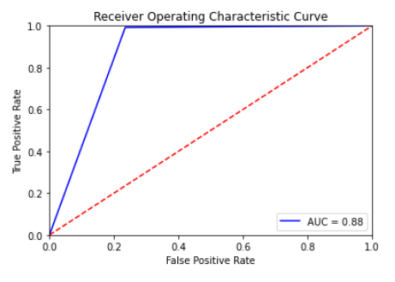
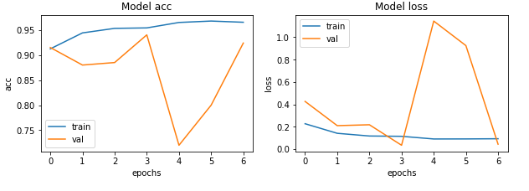
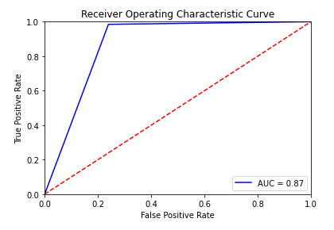
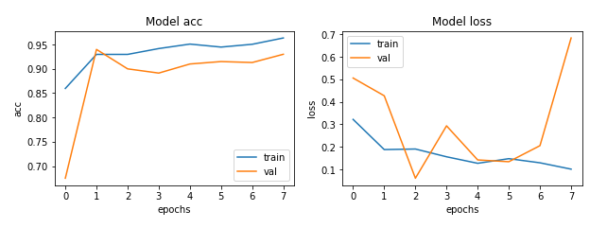
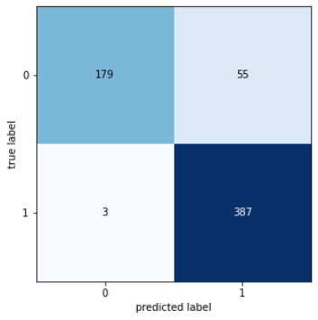
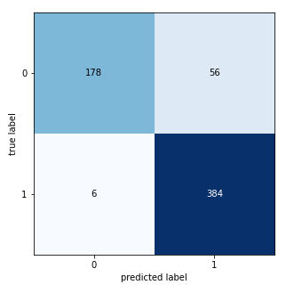
VGG16 MODEL
NORMAL VS PNEUMONIA RESULTS
INCEPTION-V3 MODEL
TEST METRICS
Accuracy: 90.71%
Precision: 87.55%
Recall: 99.23%
F1-score: 93.02%
TEST METRICS
Accuracy: 90.06%
Precision: 87.27%
Recall: 98.46%
F1-score: 92.53%
BENCHMARK RECALL VALUE : 93.2%
BENCHMARK RECALL VALUE : 93.2%
ACHIEVED BETTER THAN BENCHMARK
ACHIEVED BETTER THAN BENCHMARK

Slide 15
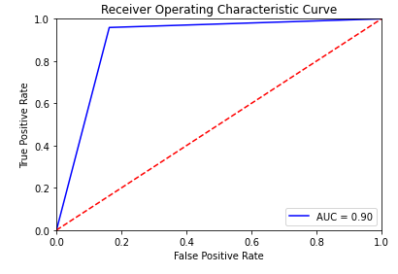
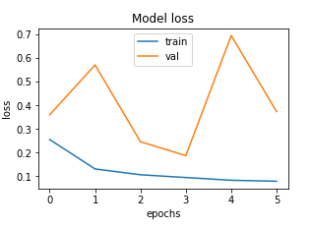
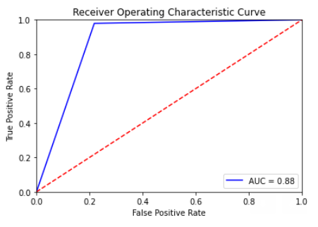
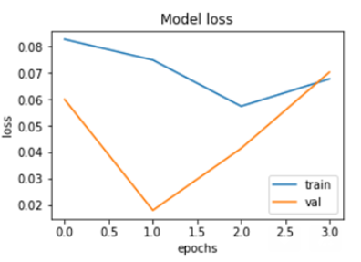
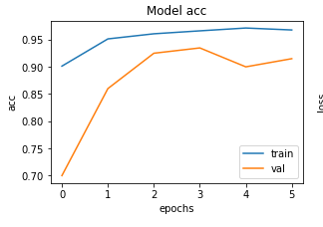
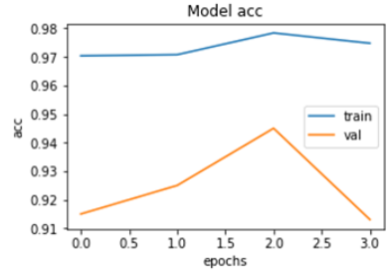
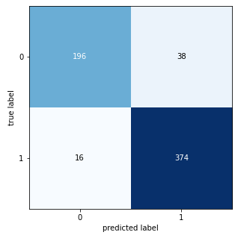
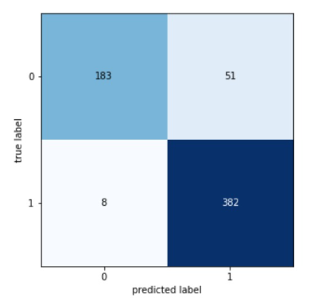
DENSENET MODEL
NORMAL VS PNEUMONIA RESULTS
RESNET50 MODEL
Test metrics
Accuracy: 91.34%
Precision: 90.77%
Recall: 95.89%
F1-score: 93.26%
Test metrics:
Accuracy: 92.95% Precision: 92.95% Recall: 95.64%
F1-score: 94.43%
BENCHMARK RECALL VALUE : 93.2%
BENCHMARK RECALL VALUE : 93.2%
ACHIEVED BETTER THAN BENCHMARK
ACHIEVED BETTER THAN BENCHMARK

Slide 16
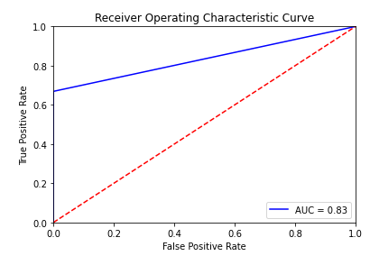
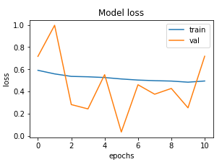
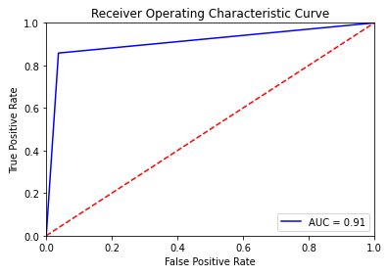
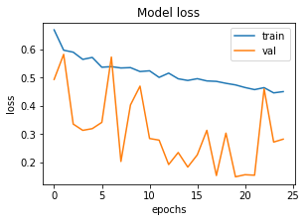
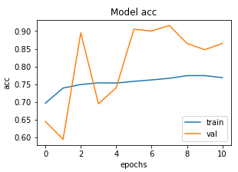
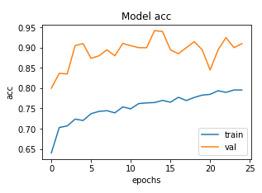
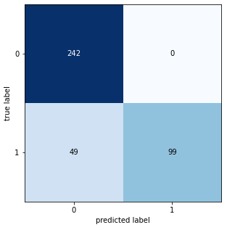
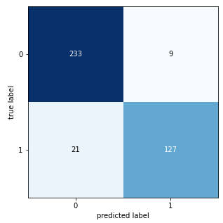
VGG16 MODEL
BACTERIAL VS. VIRAL CLASSIFICATION RESULTS
INCEPTION-V3 MODEL
Test metrics
Accuracy: 87.43%
Precision: 100.0%
Recall: 66.89%
F1-score: 80.16%
TEST METRICS
Accuracy: 90.06%
Precision: 87.27%
Recall: 98.46%
F1-score: 92.53%
BENCHMARK PRECISION,F1: 48.11%, 62.36%
BENCHMARK PRECISION,F1: 48.11%, 62.36%
ACHIEVED BETTER THAN BENCHMARK
ACHIEVED BETTER THAN BENCHMARK

Slide 17
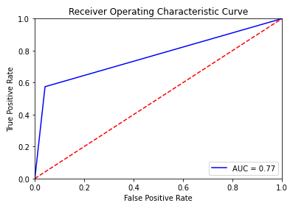
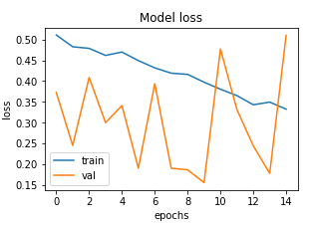
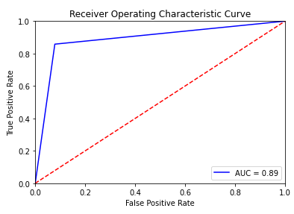
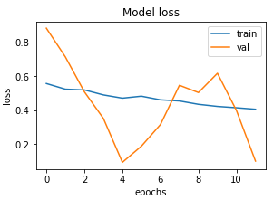
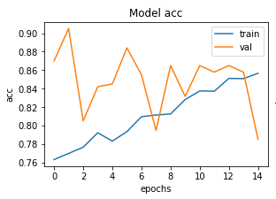
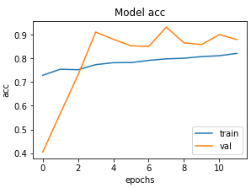
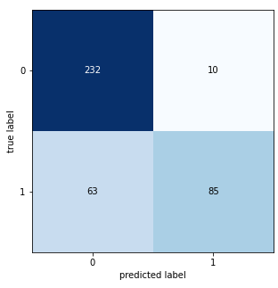
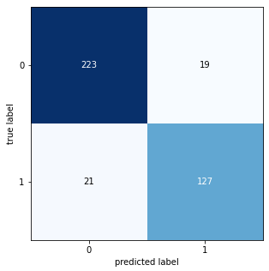
DENSENET MODEL
BACTERIAL VS. VIRAL CLASSIFICATION RESULTS
RESNET50 MODEL
Test metrics:
Accuracy: 81.28%
Precision: 89.47%
Recall: 57.43%
F1-score: 69.96%
Test metrics:
Accuracy: 89.74%
Precision: 86.98%
Recall: 85.81%
F1-score: 86.39%
BENCHMARK PRECISION,F1: 48.11%, 62.36%
BENCHMARK PRECISION,F1: 48.11%, 62.36%
ACHIEVED BETTER THAN BENCHMARK
ACHIEVED BETTER THAN BENCHMARK

Slide 18
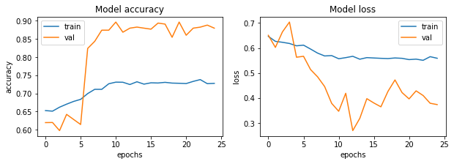
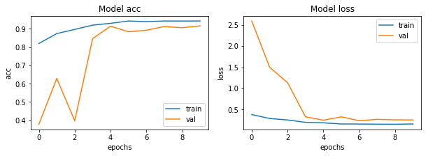
CNN RESULTS
BACTERIAL VS. VIRAL CLASSIFICATION RESULTS
Test metrics:
Accuracy: 88.21%
Precision: 94.74%
Recall: 72.97%
F1-score: 82.4%
NORMAL VS PNEUMONIA RESULTS
Test metrics:
Accuracy: 91.03%
Precision: 89.76%
Recall: 96.66%
F1-score: 93.08%

Slide 19
CONSOLIDATED RESULTS
NORMAL VS PNEUMONIA RESULTS
Models | Precision | Recall | Accuracy | F1 Score | AUC
VGG16 | 87.55 | 99.23 | 90.71 | 93.02 | 88
InceptionV3 | 87.27 | 98.46 | 90.06 | 92.53 | 87
DenseNet | 90.77 | 95.89 | 91.34 | 93.26 | 90
ResNet50 | 92.95 | 95.64 | 92.95 | 94.43 | 92
CNN | 89.76 | 96.66 | 91.03 | 93.08 | 91
BACTERIAL VS. VIRAL CLASSIFICATION RESULTS
Models | Precision | Recall | Accuracy | F1 Score | AUC
VGG16 | 100 | 66.89 | 87.43 | 80.16 | 83
InceptionV3 | 87.27 | 98.46 | 90.06 | 92.53 | 87
DenseNet | 89.47 | 57.43 | 81.282 | 69.958 | 77
ResNet50 | 86.98 | 85.81 | 89.74 | 86.39 | 89
CNN | 94.736 | 72.97 | 88.205 | 82.44 | 85

Slide 20
CONCLUSION
We can clearly see from the results that our transfer learning models are performing better than our conventional CNN model
For Normal vs Pneumonia case - Our transfer learning model has performed remarkably well and has produced Recall better than the benchmark score (93.2%); VGG16 (Recall: 99.23) being the champion model
For Bacterial vs. Viral case - Our models have produced better F1 scores and Precision than the benchmarks of F1 (62.36%) and Precision(48.11%); INCEPTIONV3 (F1-Score 92.53%) being the champion model
Showcased the power of the transfer learning system to make highly effective classifications (better than benchmarks), even with a very limited training data

Slide 21
FUTURE SCOPE
Long way in improving the health of at-risk children in energy-poor environments
Our study was limited by depth of Data. With increased access to data and training of the model with radiological data from patients and nonpatients in different geography, significant improvements can be made
Future studies could entail use of images from varied manufacturers, so that the system will be universally useful
Ophthalmology, CT Scans —in principle, the techniques we have described here could potentially be extended in a wide range of medical images across multiple disciplines
Perform Occlusion testing to identify areas of greatest importance used by model while assigning a diagnosis

Slide 22

REFERENCES
Kermany et. al, Michael Goldbaum, Michael Goldbaum, Wenjia Cai, Carolina C.S. Valentim, Huiying Liang, Sally L. Baxter, Alex McKeown. Identifying medical diagnoses and treatable diseases by image-based deep learning. In Cell 172, 1122–1131, 2018
Imran, A. Training a CNN to detect Pneumonia. 2019. Available online: https://medium.com/datadriveninvestor/training-a-cnn-to-detect-pneumonia-c42a44101deb (accessed on 23 October 2022).
Chouhan, V.; Singh, S.K.; Khamparia, A.; Gupta, N.; Tiwari, P.; Moreira, C.; Damasevicius, R.; De Albuquerque, V.H.C. A Novel Transfer Learning Based Approach for Pneumonia Detection in Chest X-ray Images. Appl. Sci. 2020, 10, 559.
Aydogdu, M.; Ozyilmaz, E.; Aksoy, H.; Gursel, G.; Ekim, N. Mortality prediction in community-acquired pneumonia requiring mechanical ventilation; values of pneumonia and intensive care unit severity scores. Tuberk Toraks 2010, 58, 25–34.
WHO. Standardization of Interpretation of Chest Radiographs for the Diagnosis of Pneumonia in Children; World Health Organization: Geneva, Switzerland, 2001.
Jung, H.; Kim, B.; Lee, I.; Lee, J.; Kang, J. Classification of lung nodules in CT scans using three-dimensional deep convolutional neural networks with a checkpoint ensemble method. BMC Med. Imag. 2018, 18, 48.
Kaggle Dataset Link
(Rest of the References have been presented in the Project Report)

