Slide 1
Digital
portfolio
STUDENT NAME: SARANYA.D
REGISTER NO: 2426J0711
NMID : asbru4d2426j0711
DEPARTMENT: INFORMATION TECHNOLOGY
COLLEGE : PIONEER COLLEGE OF
ARTS AND SCIENCE
UNIVERSITY: BHARATHIAR UNIVERSITY

Slide 2
PROJECT TITLE
STUDENT DIGITAL PORTFOLIO
USING
FRONT END DEVELOPMENT

Slide 3
(01) Problem Statement
(02) Project Overview
(03) End Users
(04) Tools and Technologies
AGENDA
(05) Portfolio design and Layout
(06) Features and Functionality
(07) Results and Screenshots
(08) Conclusion
(09) Github Link

Slide 4
PROBLEM STATEMENT
Traditional methods of tracking student performance, such as paper-based files or static resumes, fail to reflect a student’s overall skills, creativity, and progress over time. These approaches often become disorganized, difficult to update, and inaccessible for teachers, peers, and potential employers. As a result, students are unable to showcase their true potential and holistic development. To address this challenge, there is a need for a digital portfolio platform that allows students to systematically document, update, and display their academic achievements, projects, and personal skills in a dynamic and engaging way.

Slide 5
PROJECT
OVERVIEW
This project involves the design and development of a fully responsive Digital Portfolio Website using front-end technologies—HTML, CSS, and JavaScript. The portfolio serves as a personal website to showcase my skills, projects, resume, and contact information in an organized and visually appealing manner.
The goal of this project is to demonstrate my proficiency in:
Structuring content using semantic HTML.
Styling and layout with modern CSS techniques (Flexbox, Grid, Media Queries).
Interactivity and user experience through JavaScript features (form validation, animations, dynamic content).
This portfolio is optimized for various screen sizes, providing a seamless user experience across desktop and mobile devices.

Slide 6
WHO ARE THE END USERS?
Recruiters & Hiring Managers
Use the portfolio to evaluate the student’s skills, projects, and overall presentation for internships or job opportunities.
College Professors & Mentors
Review the student’s work as part of academic assessments, capstone projects, or personal development tracking.
Clients or Freelance Leads
Potential clients looking to hire a student for freelance web development or design work.
Peers & Collaborators
Fellow students or project teammates who may view the portfolio to understand a student’s strengths and past work.
The Student (Portfolio Owner)
Uses the portfolio as a self-promotion tool to track growth, reflect progress, and apply for opportunities.

Slide 7
TOOLS AND TECHNIQUES
Creating a student digital portfolio using front-end technologies involves several tools that assist in designing, coding, testing, and deploying the portfolio website. Here's a breakdown:
1. HTML/CSS/JavaScript
HTML: Structure of the portfolio (e.g., sections for About, Projects, Skills, Contact).
CSS: Styling for layout, colors, typography, and responsiveness.
JavaScript: Adds interactivity (e.g., image sliders, form validation, animations).
2. Front-End Frameworks
React.js: Component-based structure makes it easier to reuse UI elements like project cards or navigation bars.
Vue.js or Angular (optional): Other popular frameworks for building dynamic user interfaces.
Tools:

Slide 8
3. CSS Frameworks & Preprocessors
Bootstrap or Tailwind CSS: Rapid design with pre-built components or utility-first classes.
SASS/SCSS: CSS preprocessor to write cleaner, more maintainable styles.
4. Code Editors
Visual Studio Code (VS Code): Most popular editor with extensions for HTML, CSS, JS, and Git integration.
5. Version Control
Git: Tracks changes in code.
GitHub/GitLab/Bitbucket: Hosts code online and showcases contribution history.
6. Design & Prototyping Tools
Figma or Adobe XD: Design wireframes and UI mockups before coding.
Canva: Create graphics or banners for the portfolio.
7. Deployment Platforms
GitHub Pages: Free hosting for static websites.
Netlify or Vercel: Simple drag-and-drop or Git-based deployment with CI/CD support.
8. Browser Developer Tools
Chrome/Firefox DevTools: Inspect and debug HTML/CSS/JS directly in the browser.

Slide 9
TECHNIQUES:
The techniques used in building a digital portfolio involve coding practices, design strategies, and usability enhancements:
1. Responsive Web Design
Use media queries to ensure the site looks good on all screen sizes (desktop, tablet, mobile).
Implement mobile-first design for better performance on small devices.
2. Component-Based Development
Break down UI into reusable components (e.g., Navbar, Footer, ProjectCard) using React or Vue.
3. Single Page Application (SPA)
Load content dynamically without refreshing the whole page.
Improves user experience and speed.
4. User-Centered Design (UCD)
Design with the user (viewer, employer, teacher) in mind.
Focus on readability, accessibility (e.g., contrast, alt text), and navigation ease.
5. Animation & Transitions
Use CSS transitions or libraries like Framer Motion (for React) to create smooth animations and hover effects.

Slide 10
PORTFOLIO DESIGN AND LAYOUT
1. Homepage Structure
Simple and engaging landing page with student’s name, photo, and tagline.
Quick links to sections like About, Projects, Skills, Resume, Contact.
2. Responsive Layout
Use Flexbox or CSS Grid to build layouts that adapt to all screen sizes.
Mobile-first approach for better accessibility.
3. Section Breakdown
About Me: Brief intro, goals, interests.
Projects: Cards or grid showing title, description, tech used, and live/demo link.
Skills: Visual list or progress bars for HTML, CSS, JavaScript, frameworks.
Resume: Downloadable PDF or embedded preview.
Contact: Form using HTML + EmailJS or Formspree.

Slide 11
4. Navigation Bar
Fixed or scrollable top navbar for smooth user experience.
Use JavaScript or libraries (like React Router) for Single Page Navigation.
5. Design Elements
Consistent color palette and typography (Google Fonts recommended).
Hover effects, transitions, and icons (e.g., Font Awesome) for modern feel.
6. Branding & Personalization
Student logo, initials, or signature.
Custom favicon and personalized URL (e.g., via GitHub Pages).
7. User Experience (UX)
Clear CTA (Call to Action) buttons like “View Project”, “Download Resume”.
Fast loading, accessible, and easy-to-navigate design.

Slide 12
FEATURES AND FUNCTIONALITY
1. Interactive Homepage
Engaging hero section with name, tagline, and photo
Smooth scroll to internal sections (using JavaScript or React)
2. Project Showcase
Dynamic project cards or grid layout
Each project includes:
Image/preview
Title & description
Tech stack (HTML, CSS, JS, etc.)
Live demo & GitHub link
3. Responsive Design
Fully optimized for desktop, tablet, and mobile
Built with Flexbox, Grid, or frameworks like Bootstrap or Tailwind
4. Skills Section
Visual representation using:
Progress bars
Icons (e.g., HTML5, CSS3, React)
Category filters (Frontend, Tools, etc.)

Slide 13
5. Contact Form
Functional form using:
EmailJS, Formspree, or Netlify Forms
Validation using JavaScript
Success/error message display
6. Resume Integration
Embedded resume viewer (PDF) or direct download link
Option to open in a new tab
7. Dark/Light Mode (Optional)
Toggle button using JavaScript or React state
Improves accessibility and user experience
8. Social Media & External Links
Icons with links to:
GitHub
LinkedIn
Email
Portfolio blog or personal site
9. Animations & Transitions
Smooth effects using:
CSS animations
AOS (Animate on Scroll)
Framer Motion (React)

Slide 14
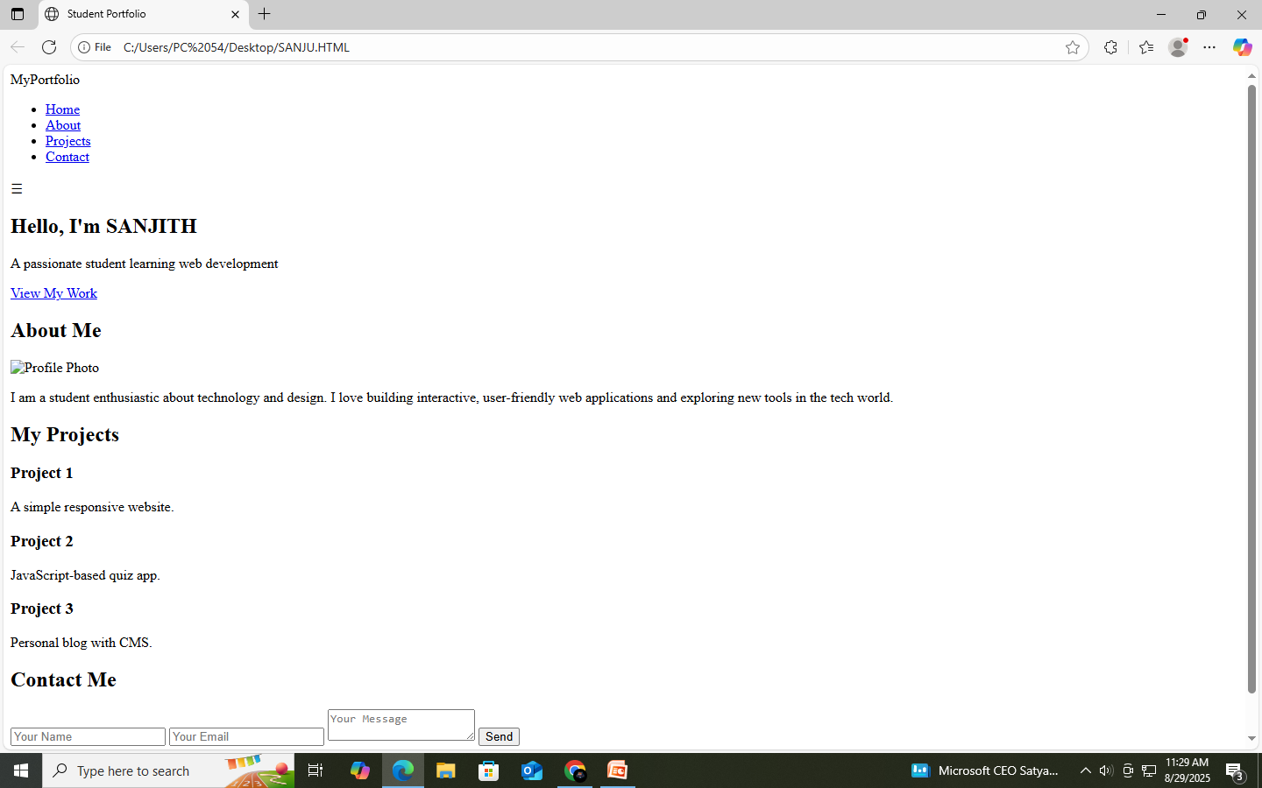
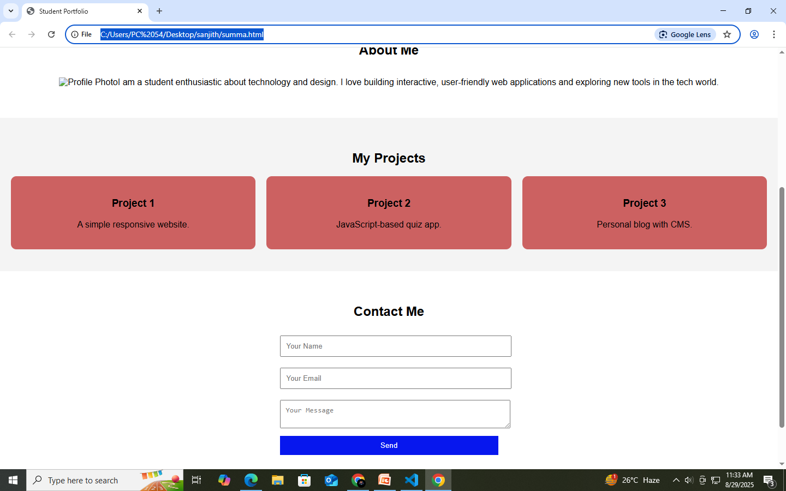
RESULTS AND SCREENSHOTS
Only HTML code
HTML+CSS+JS

Slide 15
CONCLUSION
HIGHLIGHTS
FINAL SUMMARY
BENEFIT TO SOCIETY
The portfolio presents a clean, responsive design built with HTML, CSS, and JavaScript.
Projects are showcased with interactive cards, live demos, and GitHub links.
Modern UI components and layout techniques (Flexbox/Grid) enhance user experience.
Navigation is intuitive, with smooth scrolling and mobile-friendly responsiveness.
Overall, it reflects the student’s front-end skills, creativity, and personal brand.
The student digital portfolio effectively demonstrates core front-end development skills through a visually appealing and functional website.
It integrates HTML, CSS, JavaScript, and optionally frameworks like React to create an interactive user experience.Key sections like About, Projects, Skills, and Contact are well-organized and easy to navigate.
Responsive design ensures accessibility across all devices.Overall, it serves as a powerful tool to showcase the student's technical abilities, creativity, and readiness for professional opportunities.
Student digital portfolios promote transparency in learning and skill development. They encourage self-expression and creativity through technology. By showcasing real-world projects, they inspire peers and younger learners. They support career readiness, contributing to a more skilled, tech-savvy workforce. Overall, they foster digital literacy and innovation in education and the broader community.

Slide 16
GITHUB LINK

Slide 17
Thanks for this opportunity

