Slide 1
END-TO-END DATA ANALYTICS PORTFOLIO PROJECT
Retail Sales & Profitability Optimization
Objective: Analyze 10k+ transaction records to identify profit leaks, optimize discount strategies, and deliver interactive Power BI business insights.
Prepared for GitHub Portfolio | Tools: Python • SQL • Power BI

Slide 2
SUPERSTORE ANALYTICS PROJECT
Business Context & Dataset Overview
Business Problem & Challenge
• High Revenue, Low Profit Margin: Superstore achieves $2.32M in sales but generates only $292K profit (~12.5% margin).
• Heavy Discount Erosion: Aggressive promotional discounting across specific sub-categories severely eats into margins.
• Unprofitable Product Categories: Tables (-$17.8K) and Bookcases (-$3.6K) consistently run at substantial net losses.
• Goal: Uncover root causes, regional variations, and operational inefficiencies to drive actionable profitability growth.
Dataset Characteristics
• Dataset Size: 10,194 Transaction Records across US Retail Operations.
• Time Horizon: Multi-year transactional history covering orders, shipping, and fulfillment.
• Key Dimensions: Customer Segments (Consumer, Corporate, Home Office), Regions, Categories & Sub-Categories.
• Core Metrics: Sales ($), Quantity Sold, Applied Discount Rate (%), and Net Profit ($).

Slide 3
SUPERSTORE ANALYTICS PROJECT
Tools Tech Stack & Data Cleaning Pipeline
Technology Stack
Python (Pandas/NumPy)
Data ingestion, structural cleaning, schema validation, and statistical analysis.
SQL (PostgreSQL/SQLite)
Relational querying, aggregations, window functions, and cohort segmentation.
Power BI Desktop
Interactive visual dashboard creation, DAX modeling, and regional drill-downs.
Key Data Cleaning & Preprocessing Pipeline
1. Missing Value & Standard Handling
Identified and imputed missing postal codes using state/city lookups; standardizing address records.
2. Data Type Formatting
Converted Order Date and Ship Date into uniform standard datetime objects (`YYYY-MM-DD`) for time-series modeling.
3. Deduplication & Schema Integrity
Removed duplicate transaction entries (`row_id`) and verified clean primary key constraints.
4. Feature Engineering
Created calculated metrics: Profit Margin %, Order Processing Time (Days to Ship), and Discount Bins for targeted analysis.

Slide 4
SUPERSTORE ANALYTICS PROJECT
Analytical Workflows: SQL Queries & Python Scripting
SQL Analysis: Discount Impact
SELECT
category,
sub_category,
ROUND(AVG(discount), 2) AS avg_discount,
ROUND(SUM(sales), 2) AS total_sales,
ROUND(SUM(profit), 2) AS total_profit
FROM superstore_cleaned
GROUP BY category, sub_category
HAVING SUM(profit) < 0
ORDER BY total_profit ASC;
Key Finding: High average discount rates (>20%) directly correlate with negative total profit across sub-categories like Tables and Bookcases.
Python Analysis: Correlation & Profiling
import pandas as pd
# Calculate Correlation Matrix
corr = df[['sales', 'quantity', 'discount', 'profit']].corr()
# Filter Sub-Categories with Negative Profit
loss_makers = df.groupby('sub_category')\
.agg({'sales':'sum', 'profit':'sum', 'discount':'mean'})\
.query('profit < 0')\
.sort_values(by='profit')
Key Finding: Discount shows a statistically significant negative correlation (-0.22) with profit, proving discounts impair overall business health.

Slide 5
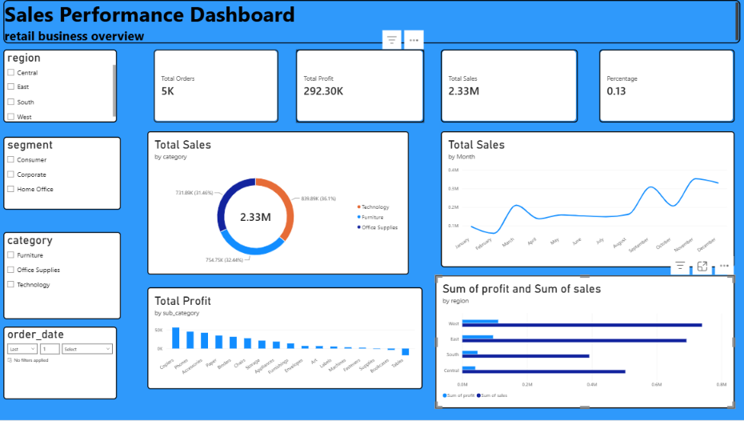
SUPERSTORE ANALYTICS PROJECT
Power BI Executive Dashboard & Analytical Findings
Key Analytical Findings
• Discount Threshold Effect
Discounts exceeding 20% consistently turn positive gross margins into net operational losses.
• Furniture Category Vulnerability
Tables represent a net loss of -$17,753 despite generating over $208K in gross sales.
• Regional Disparity
Central Region suffers from the lowest profit margins (~7.9%) due to aggressive regional promotional discounting.
• Customer Segments
Consumer segment drives 50%+ of overall volume but exhibits high price sensitivity and discount dependence.

Slide 6
SUPERSTORE ANALYTICS PROJECT
Strategic Recommendations & Project Conclusion
1. Cap Promotional Discounts
Action: Set strict discount limits (max 15%) on high-loss sub-categories (Tables, Bookcases).
Impact: Reclaims an estimated $20,000+ annually in profit leakage.
2. Re-evaluate Furniture Catalog
Action: Re-negotiate supplier costs for Tables/Bookcases or bundle with high-margin Tech accessories.
Impact: Elevates Furniture margin from 2.6% to benchmark 12%+.
3. Regional Pricing Controls
Action: Implement localized pricing & dynamic discount governance in the Central Region.
Impact: Standardizes profitability margins across all geographic territories.
Project Summary & Conclusion
By combining Python data cleaning, SQL query modeling, and Power BI visual analytics, this project demonstrates how data-driven governance over discounting and product mix directly unlocks significant margin growth.

