Slide 1

DASHBOARD DESIGN
Sales & Financial
Performance Dashboard
An interactive dashboard for business stakeholders, built on the Financial Sample dataset (700 transactions, FY2013–FY2014)
$118.7M
$16.9M
14.2%
+250%
TOTAL SALES
TOTAL PROFIT
PROFIT MARGIN
YOY SALES GROWTH

Slide 2





Objective & Approach
Objective
Design Principles Applied
Design an interactive dashboard that helps business stakeholders quickly understand sales performance, profitability, and growth trends — without needing to dig through raw spreadsheets.
Right KPIs
Interactivity
Sales, Profit, Margin %, Growth — the metrics stakeholders actually act on
Year, Segment, Country & Product filters update every chart instantly
Time-series
Cards & Totals
Dataset
Monthly trend line reveals seasonality and growth patterns
Four headline KPI cards summarize the whole dataset at a glance
Financial Sample dataset (Kaggle-style sales/financial data)
700 transaction records, FY2013–FY2014
5 customer segments, 5 countries, 6 product lines
Consistent Theme
Navigation
One navy/ice-blue palette used across every chart and page
Two-page structure: Overview and Product & Market Detail
Tools Used
Built as a custom interactive web dashboard (HTML / JavaScript / Chart.js) as a free alternative to Power BI / Tableau Desktop — same outcome, zero installation required.
Task 3: Dashboard Design | Data Analyst Internship
2

Slide 3
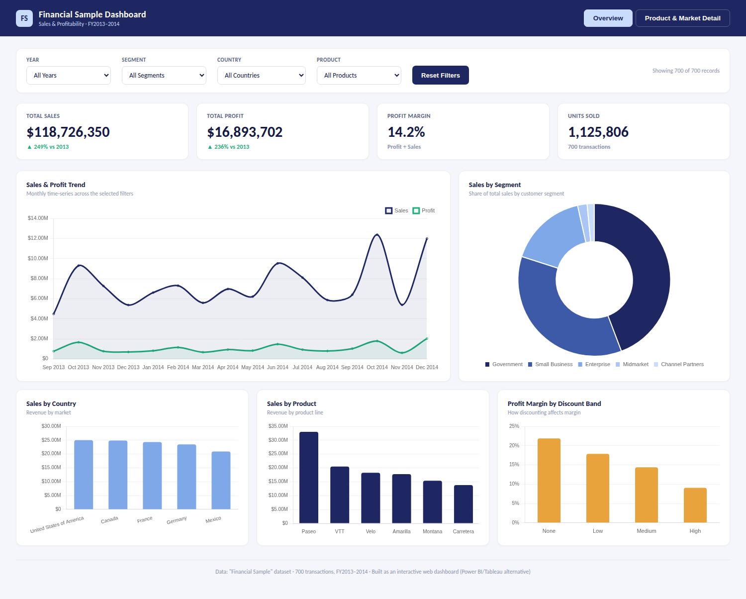
Dashboard — Overview Page
KPI cards, sales & profit trend, and breakdowns by segment, country, and product
Task 3: Dashboard Design | Data Analyst Internship
3

Slide 4
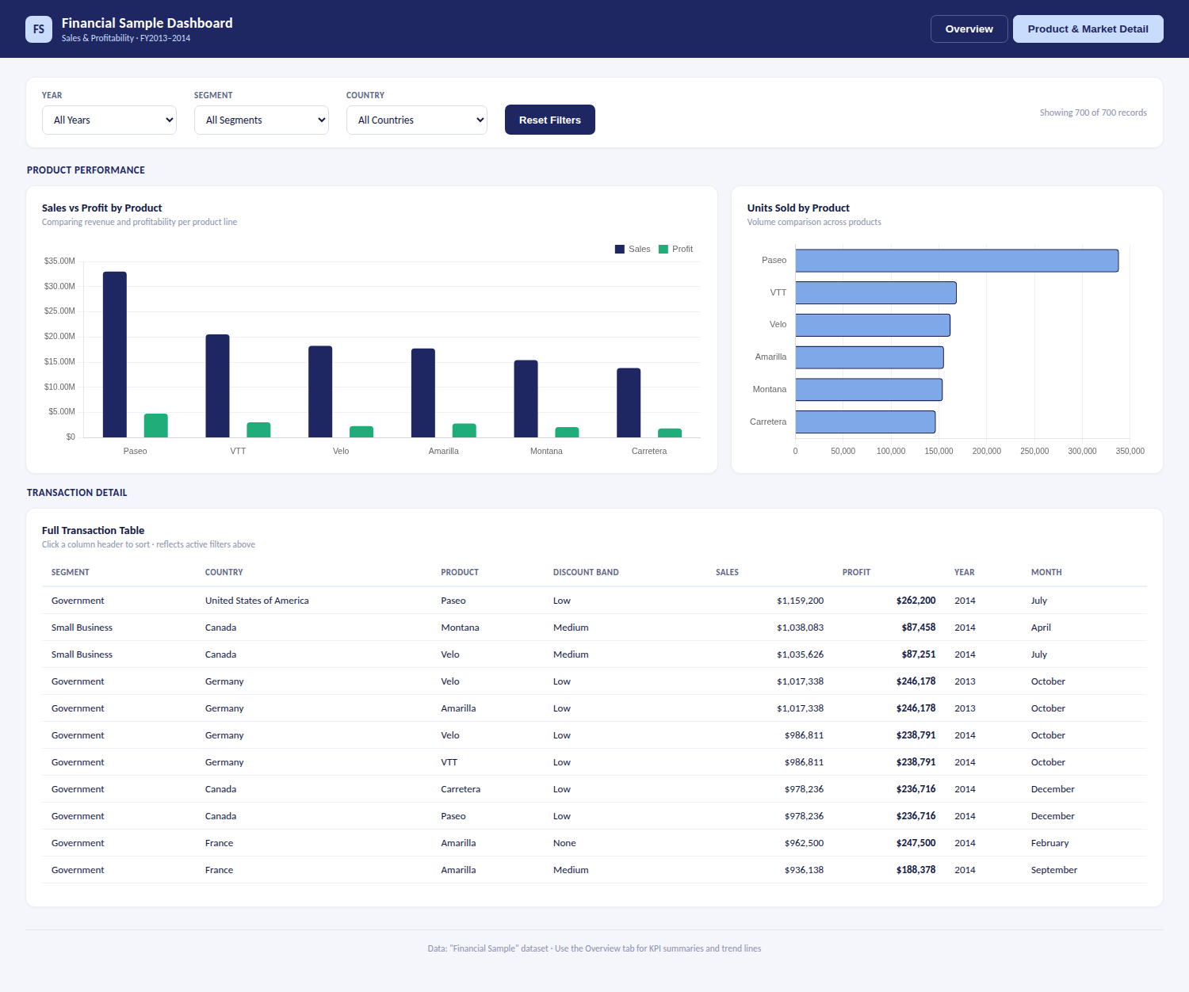
Dashboard — Product & Market Detail
Sales vs. profit by product, unit volumes, and the full sortable transaction table
Task 3: Dashboard Design | Data Analyst Internship
4

Slide 5

Key Insights
What the data tells business stakeholders
Strong Year-over-Year Growth
Government Leads, but Concentration Risk Exists
Sales grew from $26.4M in 2013 to $92.3M in 2014 — roughly 250% growth, with profit growing 236% over the same period.
The Government segment drives $52.5M in sales (44% of total) — more than double the next-largest segment, Small Business.
Discounting Is Eroding Margin
Paseo Is the Revenue Leader
Profit margin drops from ~22% with no discount to under 10% on “High” discount-band deals — discounting is not paying for itself in volume.
Paseo generates $33.0M in sales, more than any other product line, and outsells the next-closest product (VTT) by over 60%.
Task 3: Dashboard Design | Data Analyst Internship
5

Slide 6


What I Learned
1
How to choose KPIs that map directly to business questions (growth, profitability, volume) rather than just displaying raw numbers
2
Why interactivity (filters/slicers) matters — it lets one dashboard serve many different stakeholder questions
3
How discount strategy and profit margin interact — a dashboard can surface a finding a flat spreadsheet would hide
4
How to structure a multi-page dashboard with clear navigation so it doesn't overwhelm a single screen
Full code, dataset, screenshots & README available in the GitHub repository for this task

