Slide 2
df1['Question_text_length']=df1['question'].apply(len)
df1['Answer_text_length']=df1['answer'].apply(len)
df1.head(10)
df1.iloc[:,7:9].describe()
Question_text_length Answer_text_length
count 314231.000000 314231.000000
mean 73.061662 170.099981
std 43.300531 234.429674
min 1.000000 1.000000
25% 38.000000 47.000000
50% 61.000000 107.000000
75% 103.000000 212.000000
max 293.000000 13576.000000

Slide 3
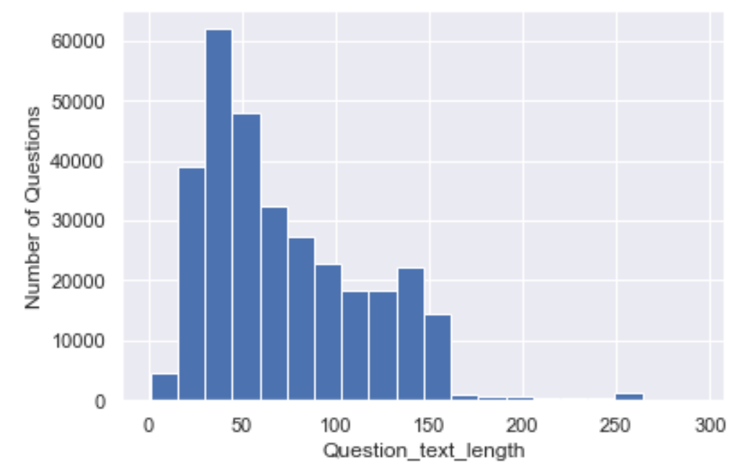
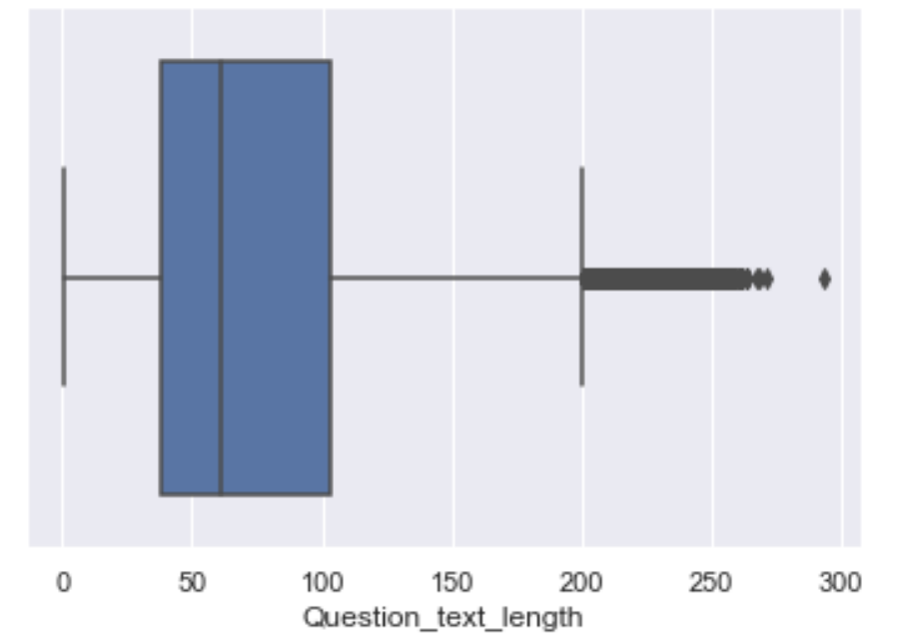
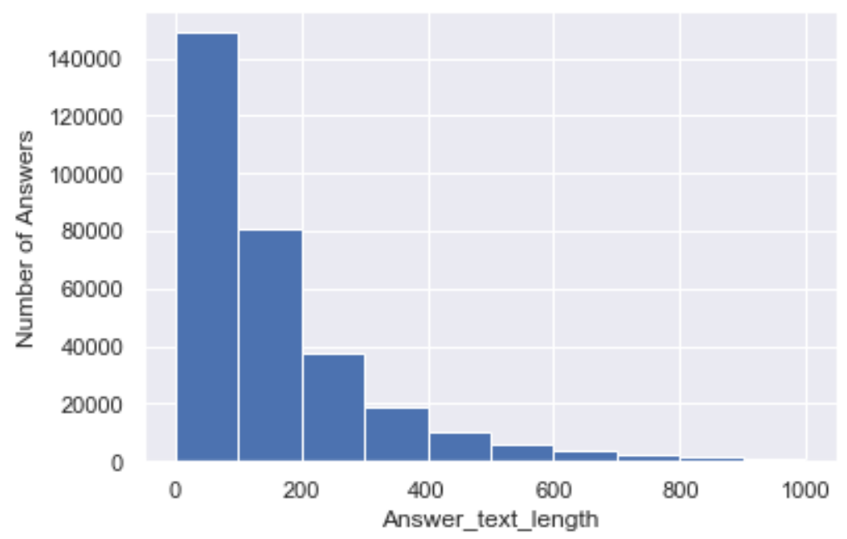
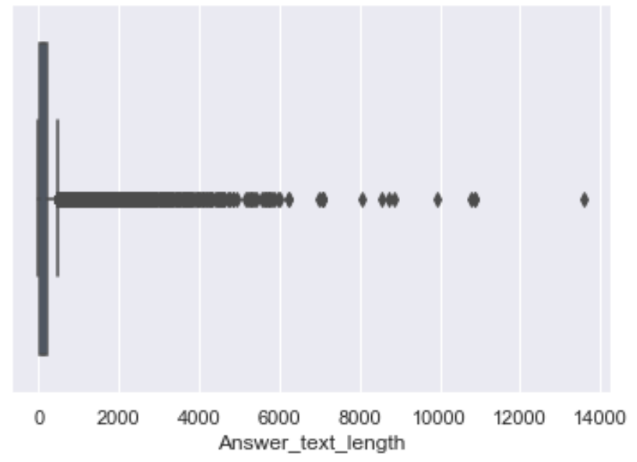
Average word length of phrases in Question is 14.
Average word length of phrases in Answer is 32.

Slide 4
text analysis of every row based on question column…ex row1
Is this cover the one that fits the old nook color? Which I believe is 8x5
Question_text_length 75
Answer_text_length 65
char_count 75
num_words 16
capitals 3
caps_vs_length 0.04
num_exclamation_marks 0
num_question_marks 1
num_punctuation 2
num_stopwords 9
num_symbols 0
mean_word_len 3.75
num_unique_words 15
words_vs_unique 0.9375
num_smilies 0
continue

Slide 5
ant_slash_n 0
has_timestamp 0
has_http 0
nouns 5
adjectives 1
verbs 4
nouns_vs_length 0.0666667
adjectives_vs_length 0.0133333
verbs_vs_length 0.0533333
nouns_vs_words 0.3125
adjectives_vs_words 0.0625
verbs_vs_words 0.25
count_words_title 3
punct_percent 12.5

Slide 6
text analysis of every row based on answer column…ex row1
Yes this fits both the nook color and the same-shaped nook tablet
char_count 65
num_words 12
capitals 1
caps_vs_length 0.0153846
num_exclamation_marks 0
num_question_marks 0
num_punctuation 1
num_stopwords 5
num_symbols 0
mean_word_len 4.5
num_unique_words 10
words_vs_unique 0.833333
num_smilies 0
ant_slash_n 0
has_timestamp 0
has_http 0
nouns 4
adjectives 1
verbs 1
nouns_vs_length 0.0615385
continue

Slide 7
adjectives_vs_length 0.0153846
verbs_vs_length 0.0153846
nouns_vs_words 0.333333
adjectives_vs_words 0.0833333
verbs_vs_words 0.0833333
count_words_title 1
punct_percent 8.33333

Slide 8
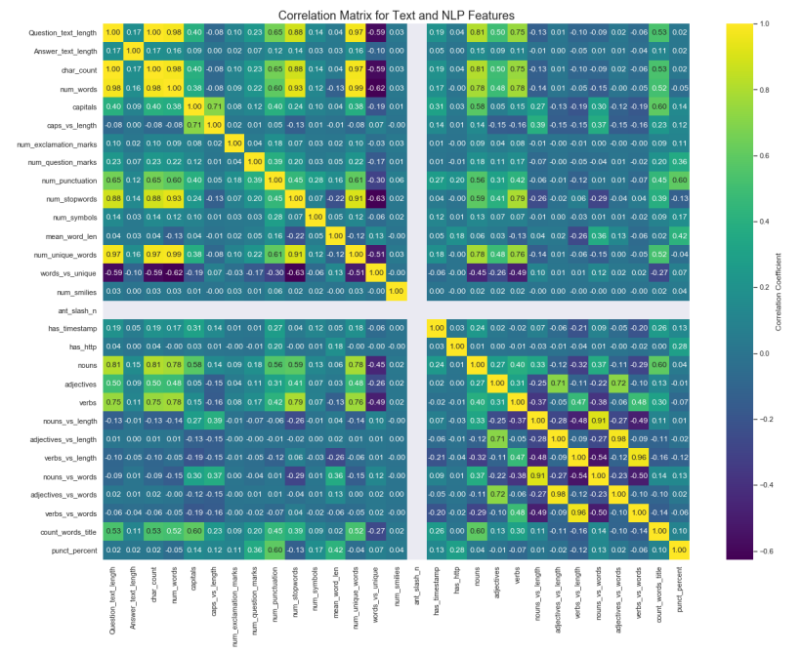
Co-relation matrix

Slide 9
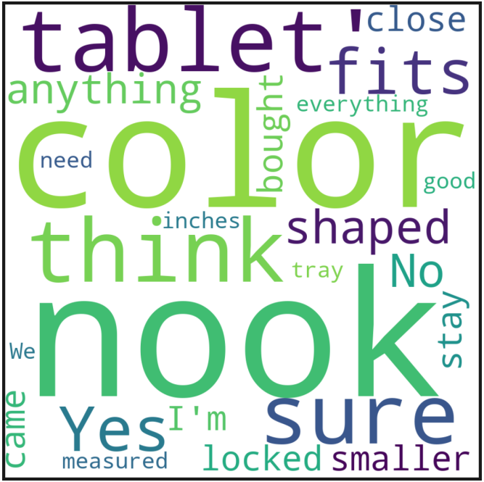
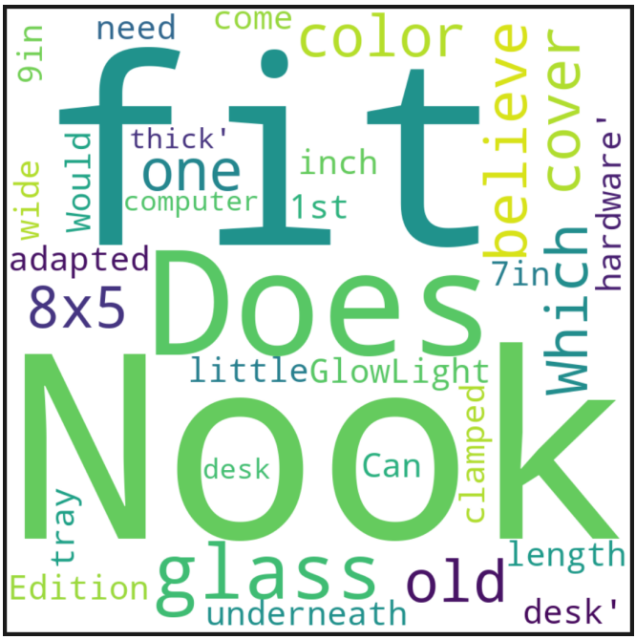
Word cloud : Answer
Word cloud : Question

Slide 10
Bigram: Question
Bigram: Answer
[(('work', 'with'), 24520),
(('Does', 'this'), 22882),
(('Will', 'this'), 20210),
(('is', 'the'), 18528),
(('this', 'work'), 18408)]
[(('.', 'I'), 79282),
(('.', 'The'), 37079),
(('.', 'It'), 35391),
(('I', 'have'), 34742),
((',', 'but'), 32972)]
Trigram: Question
Trigram: Answer
[(('this', 'work', 'with'), 9467),
(('Will', 'this', 'work'), 8107),
(('What', 'is', 'the'), 6550),
(('I', 'have', 'a'), 5780),
(('?', '?', '?'), 5660)]
[(('I', 'do', "n't"), 15919),
(('.', 'I', 'have'), 11675),
(('.', 'If', 'you'), 10436),
(('do', "n't", 'know'), 7322),
(('.', 'It', 'is'), 6324)]

Slide 11
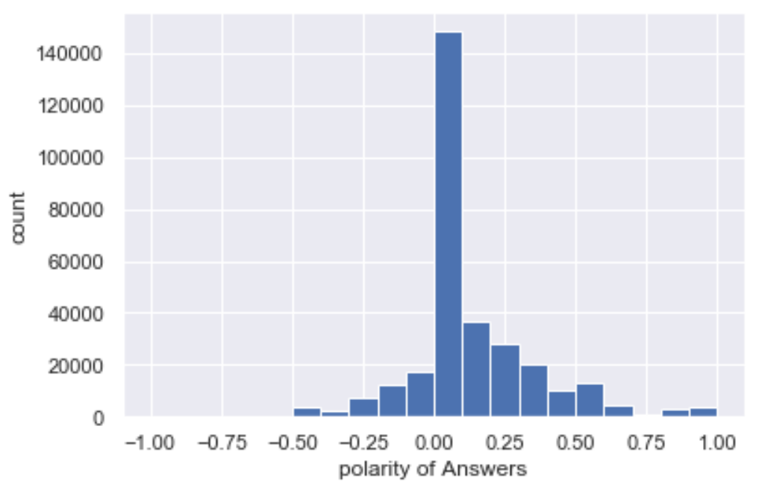
The distribution of Answers sentiment polarity score

Slide 12
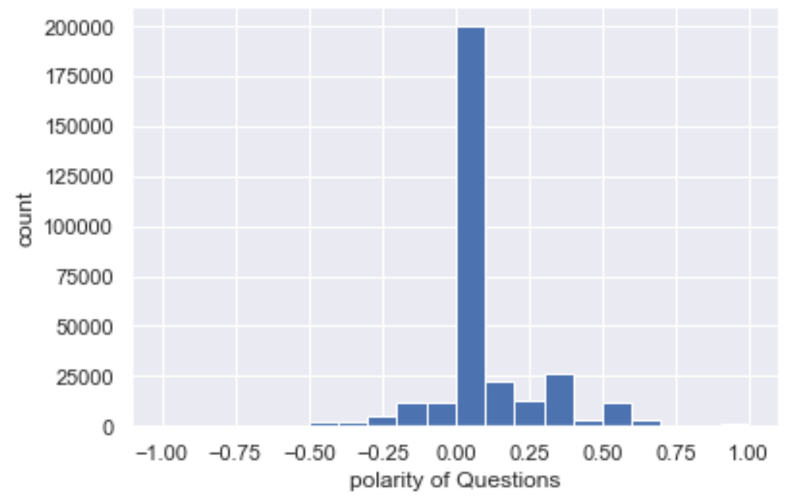
The distribution of Question sentiment polarity score

