Slide 1
DGITAL PORTFOLIO

Slide 2
Digital portfolio
STUDENT Name: Saranya M
REGISTER NO AND NMID: asbru10210082422k1472
NM Gmail I'd : saranyamnm2422k1472@gmail.com
NM id ( username) : 17A320033BD06E494C147BA5F52BB545
DEPARTMENT: BSc.Computer Science
COLLEGE: Government arts and science College Sathyamangalam

Slide 3
Digital portal
A digital portal is a website or platform that provides a single point of access to a variety of information, tools, services, or resources. It often acts as a gateway for users to interact with digital content or systems.
Personalized dashboards Notifications and updates Search functionality

Slide 4
AGENDA
1.problem statement 2.project overview 3.End usar 4.Teols and technolagies 5.portfolio deigs, and Cayout 6. Features and Functionality 7. Result and screenshot 8.conclusion 9.Github link

Slide 5
PROBLEM STATEMENT
Navigating through multiple platforms or systems to access different services. Delays in service delivery due to manual of disjointed, processes. Limited access to real-time updates, documents, or communication channels.

Slide 6
PROJECT OVERVIEW
Dashboard Personalized interface showing hiệu metrics or actions Content Management System (CMS) Manage documents, news, updates Communication Tools Chat, notifications, message boards

Slide 7
YOU ARE THEEND USERS
Employees (internal HR or operations portal) Customers (customer service or product Cortal) Students (learning management system) Citizens (government services portal Partners/vendors (526 portal)

Slide 8
TOOLS AND TECHNIQUES
Frontend (User Interface Lager) 2. Backend (Server-Side Logic) 3. Database Systems 4.Authentication & Security 5. Cloud & Hosting Platforms 6. Content Management (Optional)

Slide 9
PORTFOLIO DESIGN AND LAYOUT
Here’s a standard layout structure you can follow: 1. Home / Landing Page Clean, eye-catching intro Short tagline or statemgreg.. I design clean, user-friendly interfaces.”) Visual preview of your best work

Slide 10
FEATURES AND FUNCTIONALITY
Secure login/logout Registration/sign-up process Role-based secess control (admin, user, guest. Etc.) Password recovery/reset Two-factor authentication

Slide 11
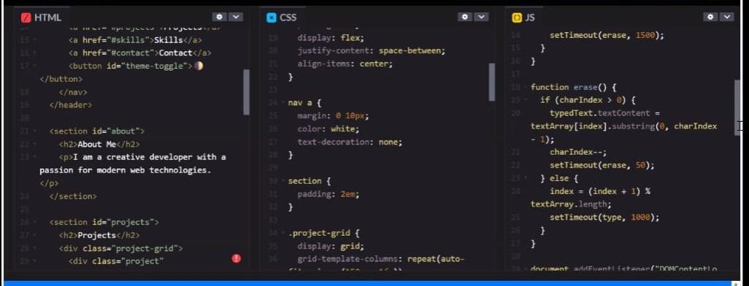
RESULTS AND SCREENSHOTS

Slide 12
CONCLUSION
Centralized Access: Brings users, data, and services into one unified platform User-Friendly Design: Enhances usability through intuitive navigation and personalized dashboards.. Improved Communication: Streamlines messaging. Notifications, and collaboration.

