Slide 1

WEATHER APP

Slide 2
SELF INTRODUCTION
SARANYA T
16UG08047

Slide 3
CONTENTS
INTRODUCTION TO PROJECT
OBJECTIVE
PROBLEM STATEMENT
LITERATURE REVIEW
GENERAL ASPECTS AND TECHNOLOGY
IMPLEMENTATION
RESULTS AND DISCUSSIONS
CONCLUSION

Slide 4
INTRODUCTION TO PROJECT
Weather is what is happening in the atmosphere at any time or short period of time. Weather conditions can change suddenly. Today may be warm and sunny, tomorrow may be cool and cloudy.
Weather is the application of science and technology to predict the conditions of the atmosphere for a given location and time.
Weather are made by collecting quantitative data about the current state of the atmosphere at a given place and project how the atmosphere will change.

Slide 5
OBJECTIVE
To setup the Weather app for detecting temperature and pressure with JavaScript and xml by adding new configuration.
Its innovative weather can be identified with open weather map.

Slide 6
PROBLEM STATEMENT
In some locations the API doesn’t provide the city any value.
It don’t need to setup a weather station in each city on each country to get weather information in your app.

Slide 7
LITERATURE REVIEW
1. series regression models for weather:
Author: Agrawal
Abstract: weather parameters was used to associate in having intervention model for average10 days stream flow weathercast.
2. Several authors have discussed the fuzziness associated with the weather systems.
Author: Montgomery and Lynwood
Abstract: The concept of correlation for long-range forecasting of the Asian summer monsoon and his findings are relevant even today.

Slide 8
GENERAL ASPECTS AND TECHNOLOGY
It's dependable and damn accurate. Minute-cast is scarily accurate, and it's hard to leave weather for another weather app without it.
weather features like the thunderstorms also develop because of the movement of heat in the atmosphere.

Slide 9
IMPLEMENTATION
android:id="@+id/selectCity"
android:layout_width="wrap_content“
android:layout_height="wrap_content" android:text="Change City" android:textStyle="italic".
android:id="@+id/weather_icon"
android:layout_width="wrap_content“
android:layout_height="wrap_content“
android:layout_centerVertical="true“
android:layout_centerHorizontal="true"

Slide 10
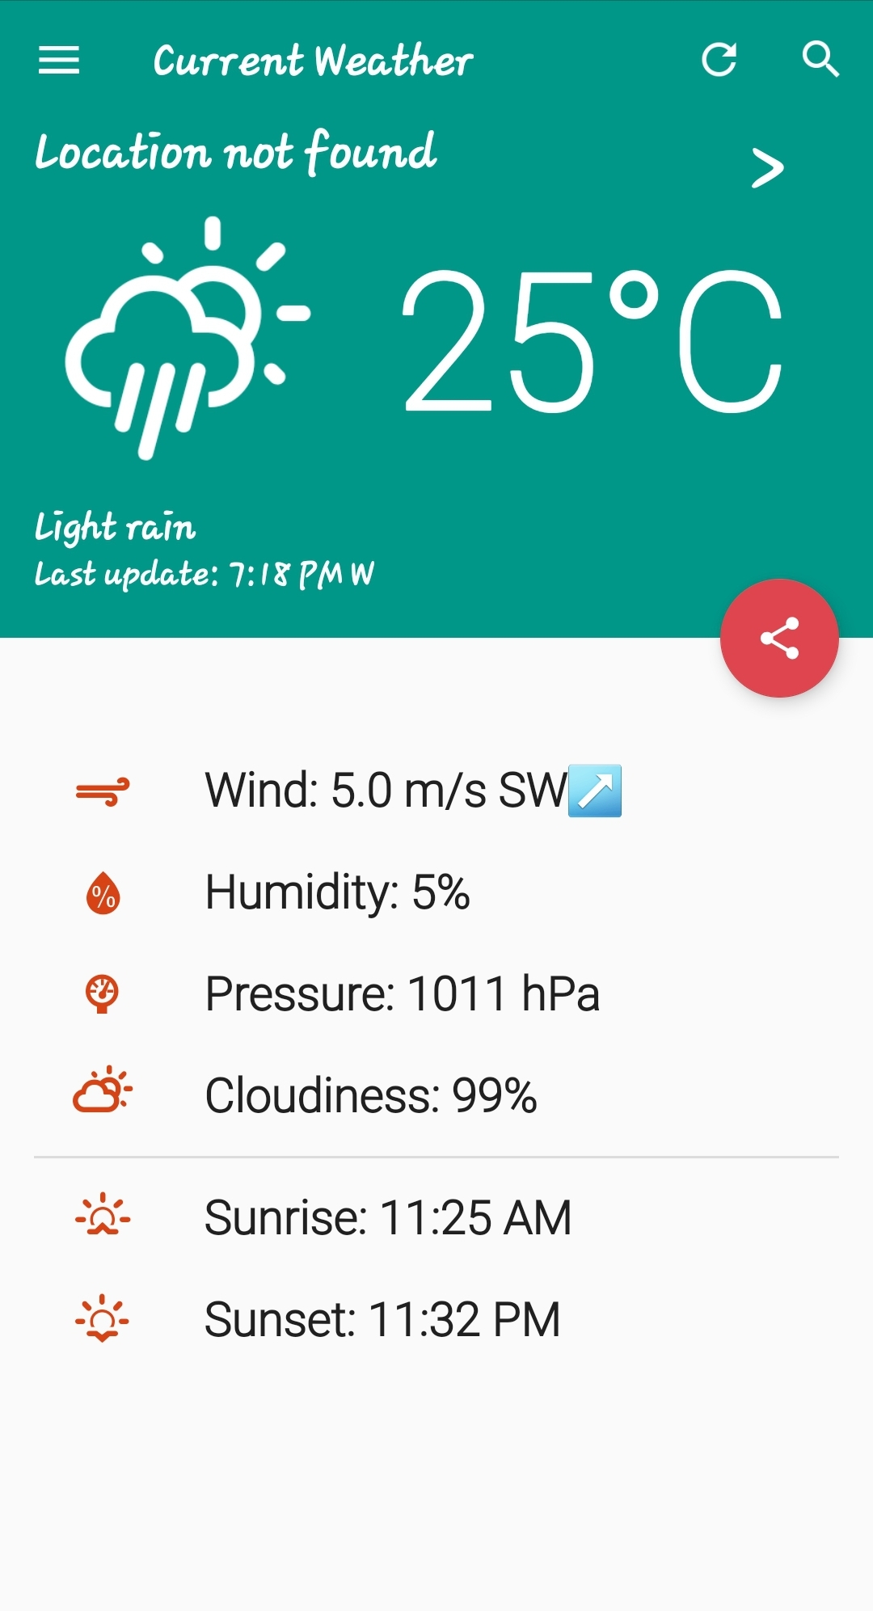
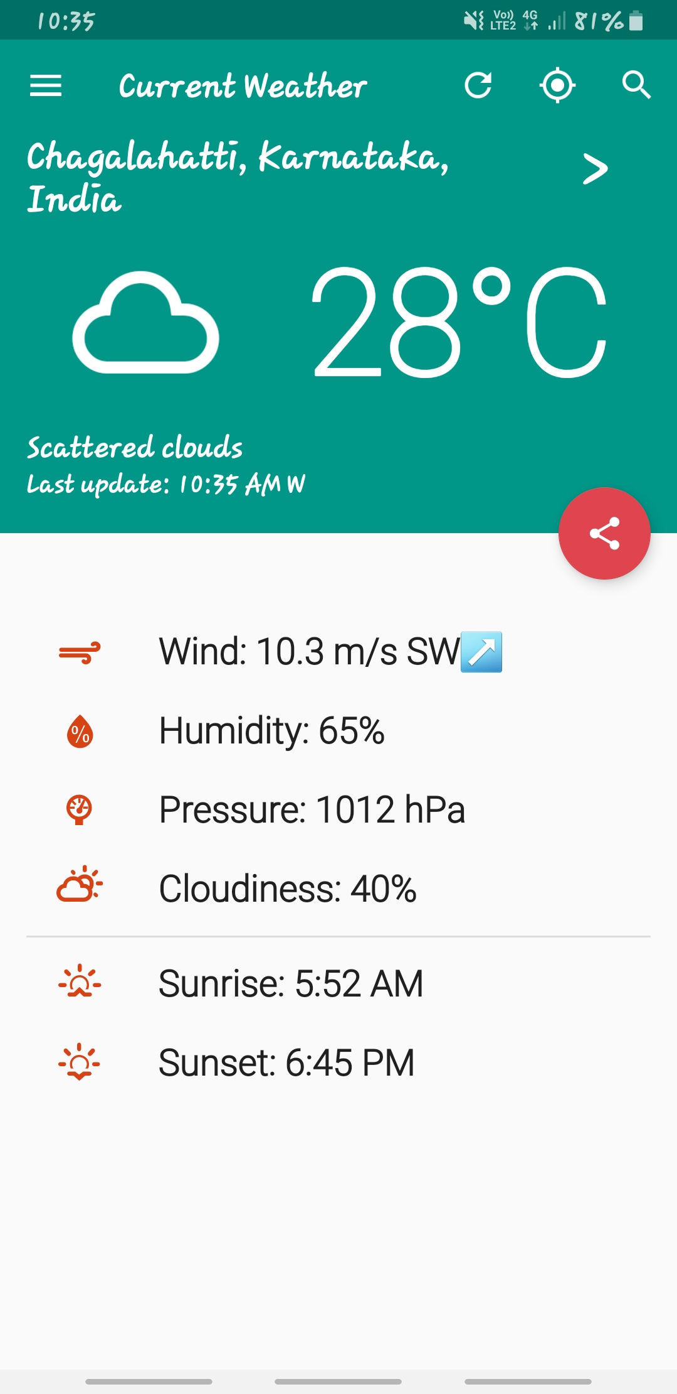
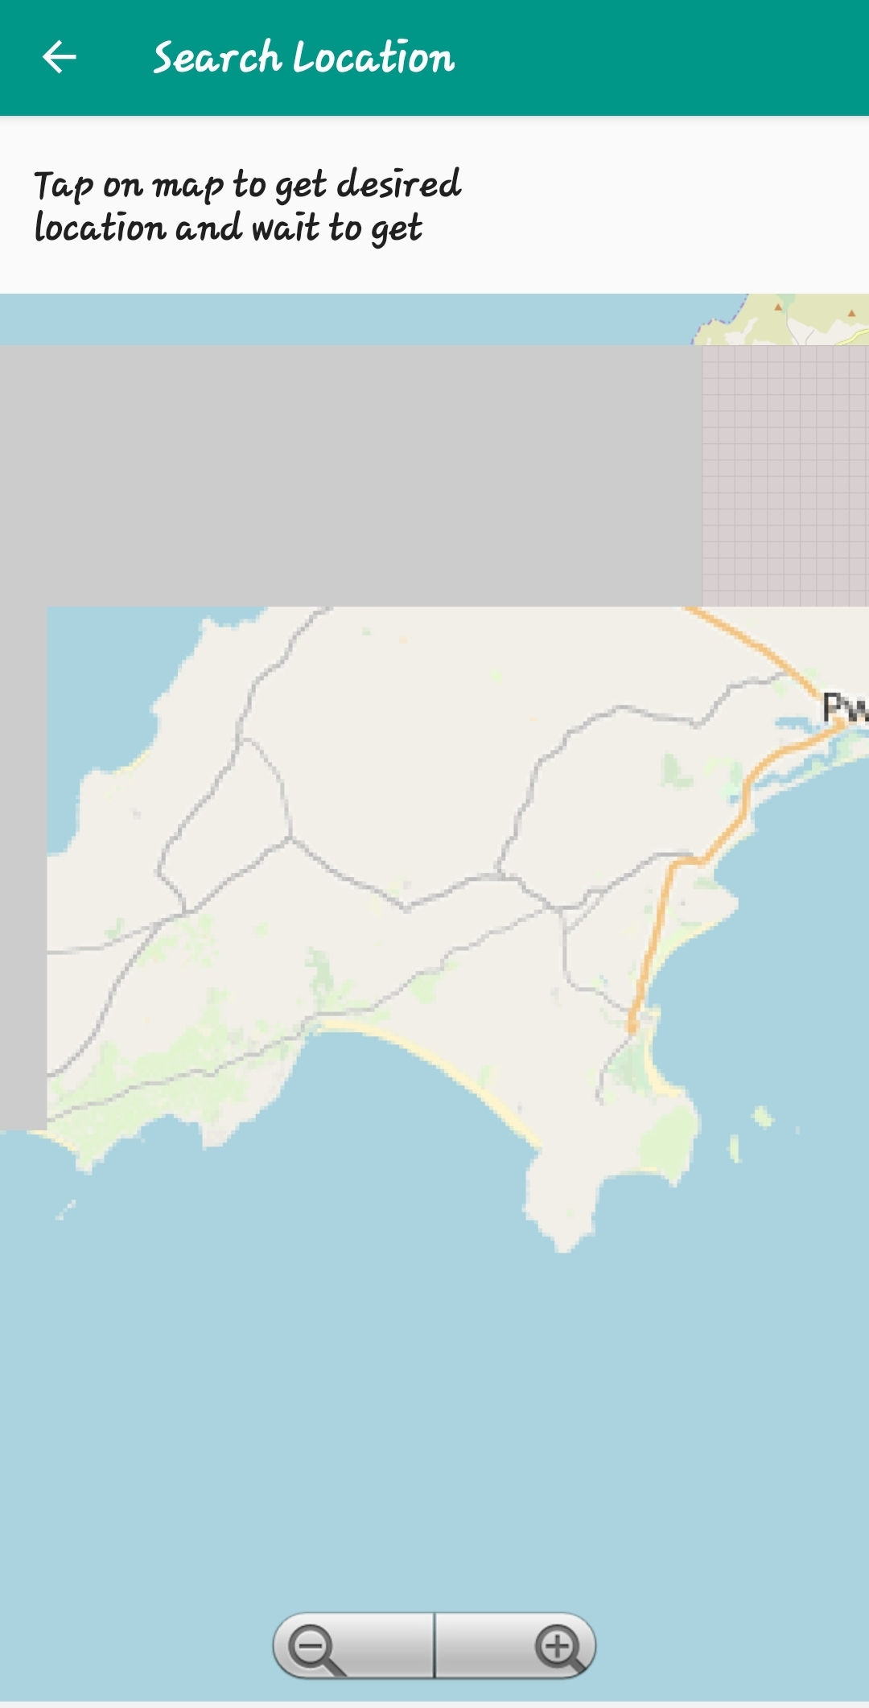
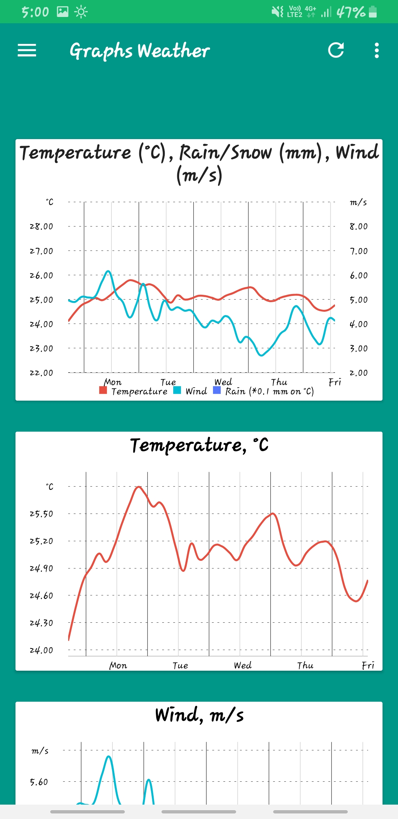
RESULTS AND DISCUSSIONS
Now we can find the weather conditions using this weather app to find temperature and pressure.
.

Slide 11
CONCLUSION
We may have a advantage of creating a own app for weather detecting for temperature and pressure. If we want to go to a new place, then we cannot check the weather through our existing application in that place .We have to check through search engines like google.

Slide 12
REFERENCES
1.https://inducesmile.com/android/create-a-beautiful-android-weather-app-usingopenweathermap-api-and-volley-library-part-2
2. https://code.tutsplus.com/tutorials/create-a-weather-app-on-android--cms-21587
3. https://mediummm/@sasude9/sbasic-android-weather-app-6a7c0855caf4 4.https://www.javacodegeeks.com › Android › Android Core

Slide 13
THANK YOU

