Slide 1
Digital Portfolio
STUDENT NAME:Saranya.M
REGISTER NO AND NMID: 24131130500122014/asanm11324131130500122014
DEPARTMENT: B.C.A
COLLEGE: 113-Vallalar Arts and Science College,Annamalai University

Slide 2
PROJECT TITLE DIGITAL PORTFOLIO

Slide 3


AGENDA
Problem Statement
Project Overview
End Users
Tools and Technologies
Portfolio design and Layout
Features and Functionality
Results and Screenshots
Conclusion
Github Link
3/21/2024 Annual Review

Slide 4

PROBLEM STATEMENTS: Traditional resumes cannot fully demonstrate a student’s creativity and practical work. A digital portfolio helps to visually and interactively display their abilities to recruiters or academic institutions.

Slide 5

PROJECT OVERVIEW: this smart portfolio is a digital platform that uses to showcase their skills,achievements, and projects interactively.it provides personalized insights,enhances presentation,and supports career growth by connecting learners.

Slide 6

END USERS: 1. Students / Job Seekers: They create and maintain their digital portfolios to showcase skills, creativity, and achievements. 2. Recruiters / Employers: They review the portfolios to evaluate candidates beyond traditional resumes. 3. Academic Institutions / Faculty: They assess student projects, learning outcomes, and overall progress.

Slide 7

Tools and Technologies: Front-End Development Tools: 1.HTML5, CSS3, JavaScript: For designing the structure, style, and interactivity of the portfolio. 2.React.js / Angular / Vue.js: For building dynamic and responsive user interfaces. 3.Bootstrap / Tailwind CSS: For responsive design and faster UI development. .

Slide 8
FEATURES AND FUNCTIONALITY:
they build modern ,accessible websites and
Delightful user experiences.
You can download cv by clicking button ”download cv” with smooth scroll
You can send message by clicking the last button.

Slide 9
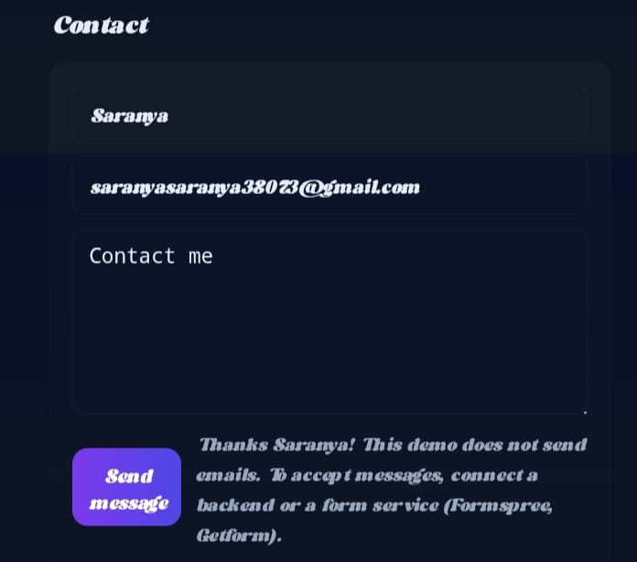

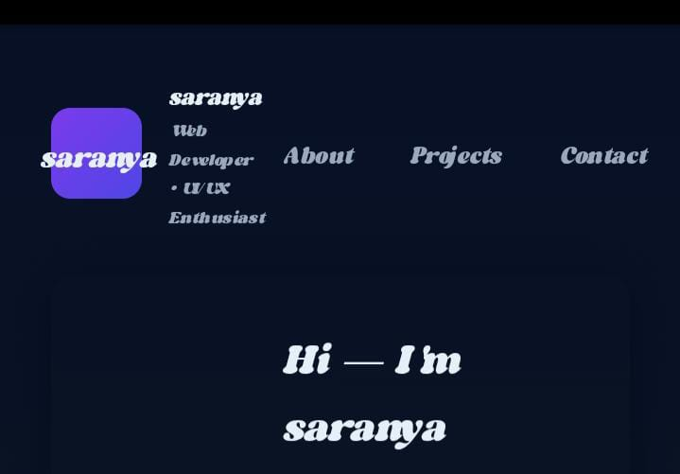
RESULTS AND SCREENSHOTS:
The proposed digital portfolio system was successfully developed and implemented. It provides an interactive platform to showcase their academic achievements, skills, and projects in a structured and visually appealing way.
3/21/2024 Annual Review
9

Slide 10
CONCLUSION
A digital portfolio's conclusion is a reflective piece that summarizes your overall learning journey, growth, and key insights gained throughout the creation process.
10

