Slide 1
CLUSTERING
Saranya S Chandran (GROUP – 3)
24/11/2022 – 22/12/2022

Slide 2
Business Problem
Divide all countries in different clusters based on economic and development factors.
Objective
The objective of this cluster analysis is to create clusters on global development measurement dataset. The dataset having information about economic and development metrics related to various countries.

Slide 3
Project Flow
Data Preprocessing
CREATE SIMILARITY METRICS
RUN CLUSTERING ALGORITHM
INTERPRET RESULTS AND ADJUST

Slide 4
Exploratory Data Analysis (EDA)

Slide 5
Dataset Details
No: of rows = 2704
No: of columns = 25
Datatype = After the removal of special characters, all columns are numerical except Country column.
Null Values = Lot of null values are there in every columns except Country and Population Urban. Null values are handled by imputing zeros.
Duplicated Values = There are no duplicated values present in the dataset.
Unique Values = Every columns have unique values.
Correlation = BirthRate is highly correlated with Infant Mortality Rate and Population 0-14. Co2 Emission, Energy Usage, GDP, Tourism Inbound and Tourism Outbound are highly correlated. Life Expectancy Male is highly correlated with Life Expectancy Female. I.e. 10 columns are highly correlated.

Slide 6
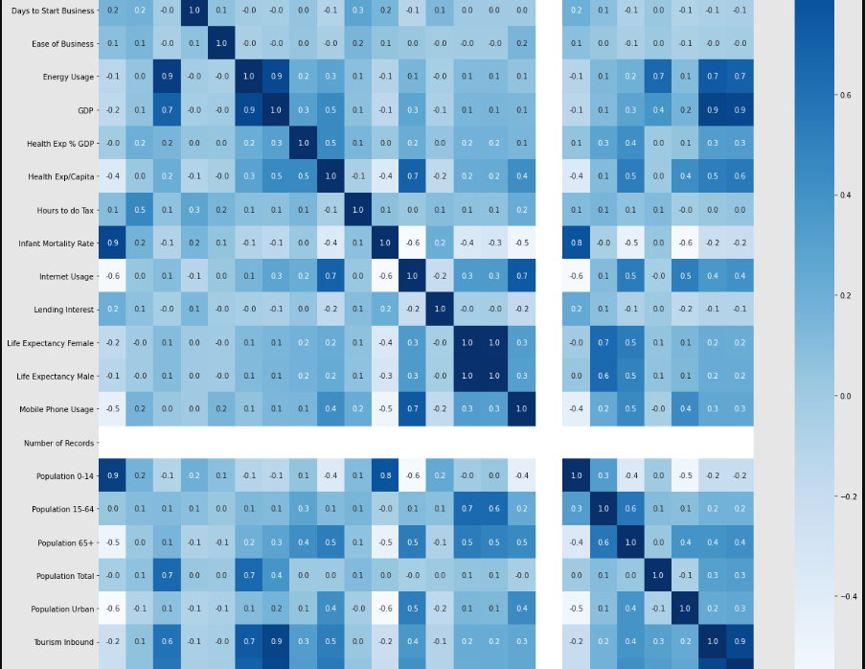

Slide 7
Skew = 6 columns are approximately normally distributed. 3 columns are negatively skewed data. Rest of the columns are positively skewed data. So the dataset contains more positively skewed data.
Normal Distribution :- Birth Rate, Health Exp % GDP, Mobile Phone Usage, Population 0-14,
Approximately Normal Distribution :- Population 65+, Population Urban
Positively Skewed Data :- Business Tax Rate, Co2 Emissions, Days To start business, Ease of Business, Energy Usage, GDP, Health Exp/Capita, Hours to do Tax, Infant Mortality Rate, Internet Usage, Lending Interest, Population Total, Tourism Inbound, Tourism Outbound
Negatively Skewed Data :- Life Expectancy Female, Life Expectancy Male, Population 15-64

Slide 8
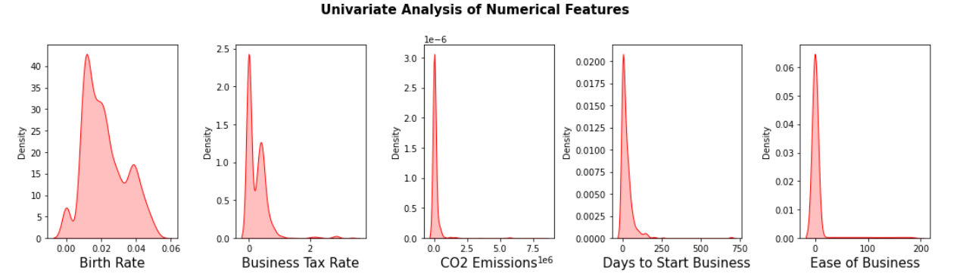
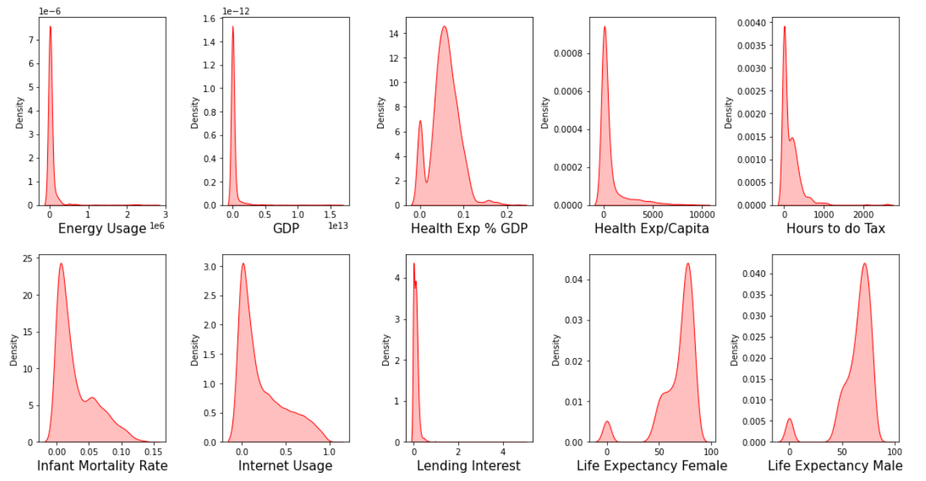
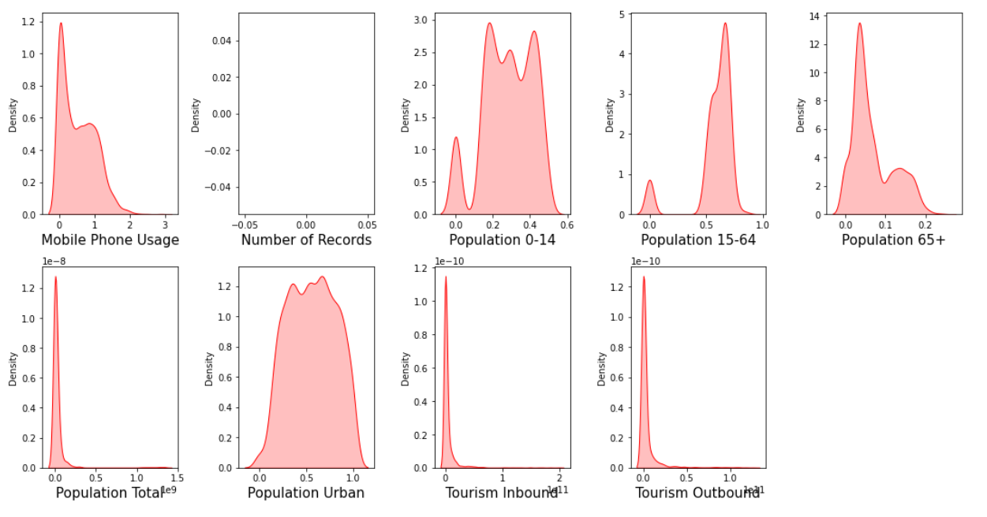

Slide 9
Kurtosis = 8 columns are Platykurtic. Rest of the columns are Leptokurtic. Leptokurtic means that columns produce more outliers.
Value Counts = 208 countries are there. Each countries have 13 set of data.
Standardization = Data is standardized using Standard_Scaler().
Outliers = Outliers are checked by using boxplot. Except 4 columns rest of the columns have outliers. The columns which having more outliers are Co2 Emissions, Days to start Business, Energy Usage, GDP, Population Total, Tourism Inbound, Lending Interest and all other leptokurtic columns. Outliers are handled by calculating Interquartile Range and plotted by using boxplot.

Slide 10
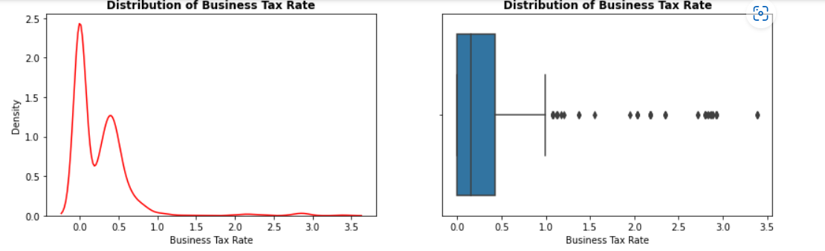
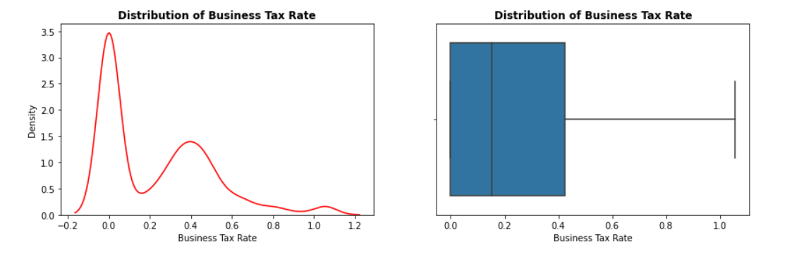
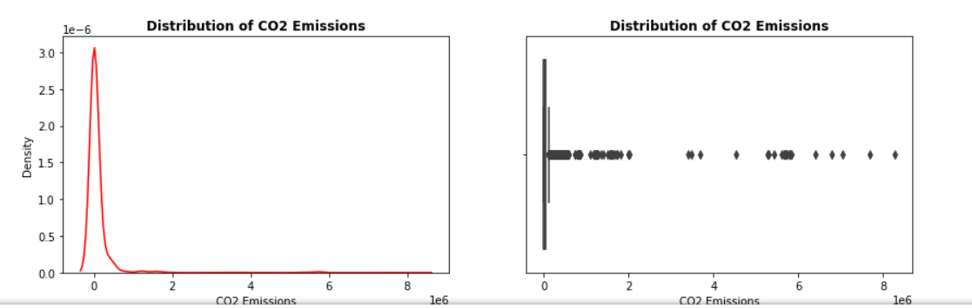
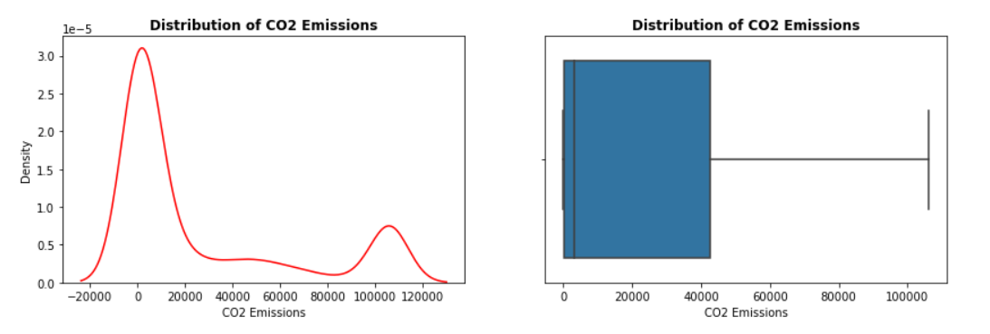
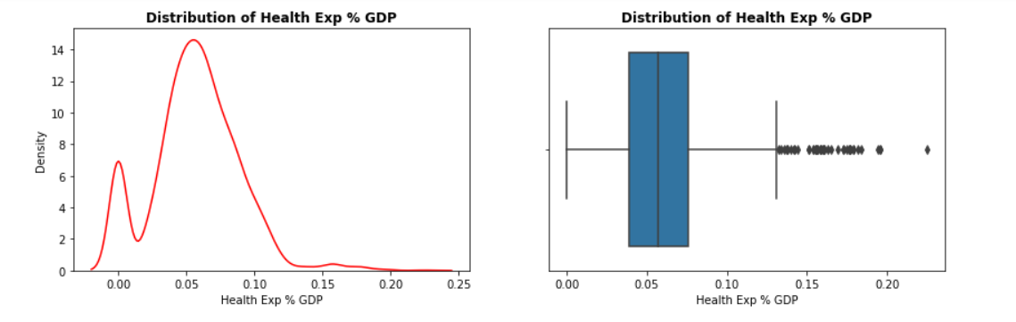
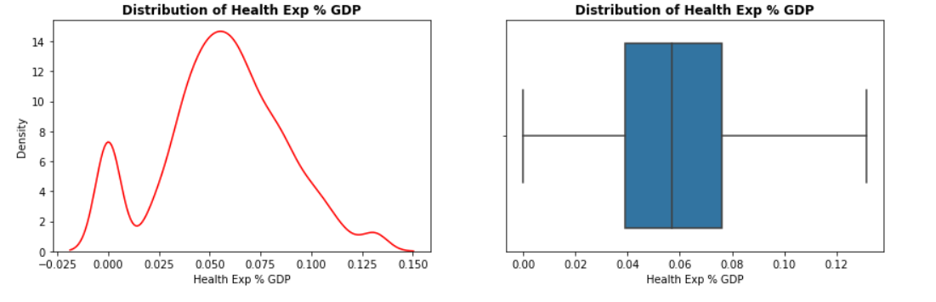
Columns with Outliers
Columns after Outlier removal

Slide 11
Summary Of EDA
Lot of missing values are there and handled with imputed with zero.
All are numerical values except for Country column.
Mean is slightly more than median for most of the features. So it is right skewed data.
10 columns are highly correlated
Most of the columns are Leptokurtic
All Leptokurtic columns and few Platykurtic columns have outliers. Outliers are handled and plotted using boxplot.
Standardized the data using Standard Scaler.

Slide 12
QUERIES
Do we need to remove highly correlated features?
No: of record column has only 1 value. Do we need to remove that column?
After the removal of outliers, the column “ease of business” has only one value. Do we need to remove that column?
In the dataset , there are lot of Skewed and Leptokurtic Data. Do we need to apply transformations to remove skewness and kurtosis?
If needed, there are lot methods to remove skewness, Can we apply any method as our wish?

Slide 13
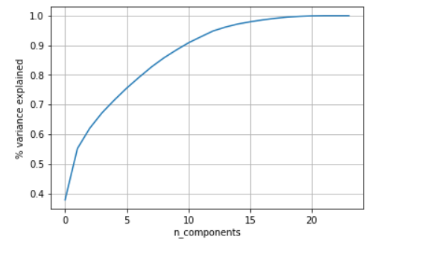
EDA
KNN Imputation - Lot of null values are there in every columns except Country and Population Urban. Null values are handled by KNN Imputation. After KNN Imputation all missing values for each column replaced with an estimated Value.
PCA – Done PCA for removing correlation.
This is the plot for % of cumulative variance explained Vs the no of dimensions.

Slide 14
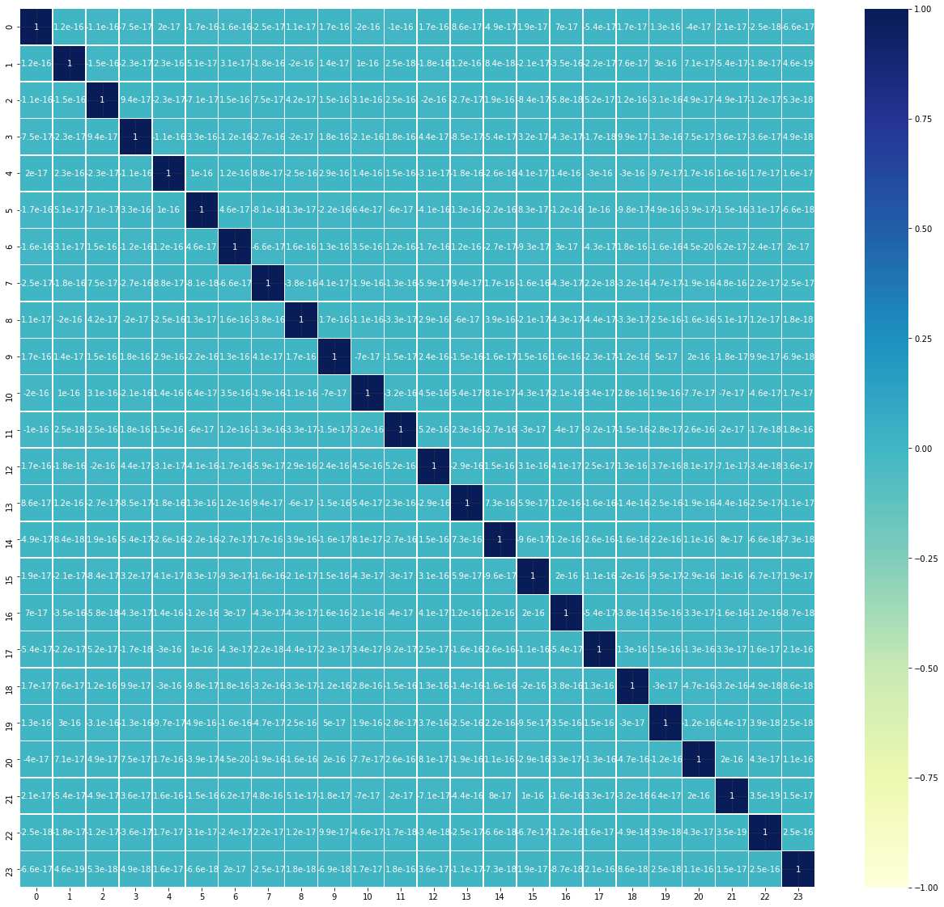
The total variance of data captured by 1st PCA is .37, for first two PCA is 0.55 and first 18 PCA is 0.99.
We took 24 components of PCA and compute a correlation heat map to observe multicollinearity.
From the above correlation heat map, it can be now observed that none of the independent variables are now correlated.

Slide 15
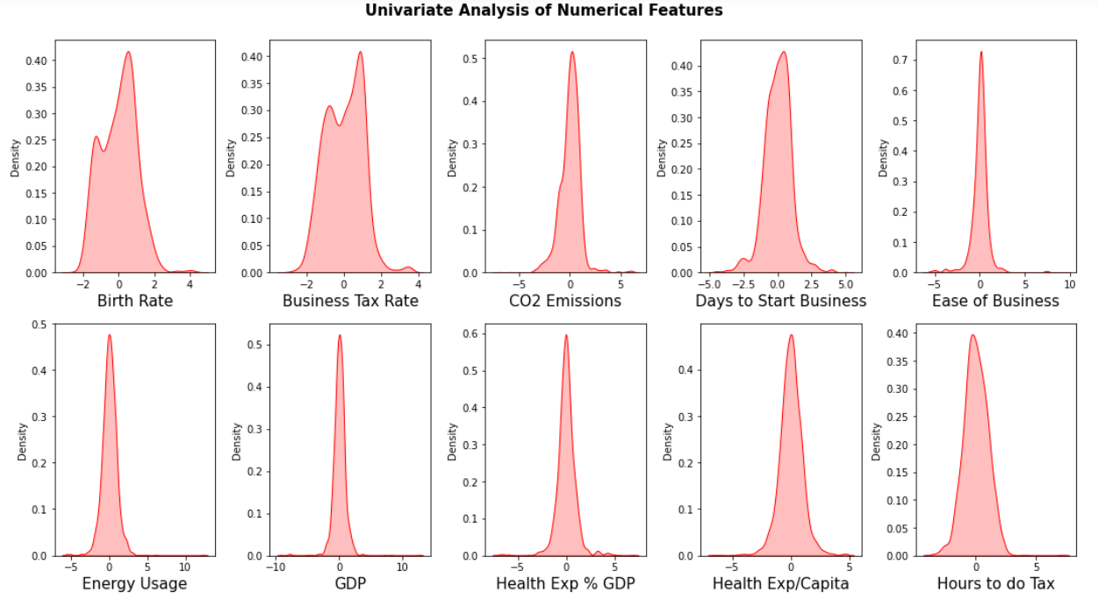
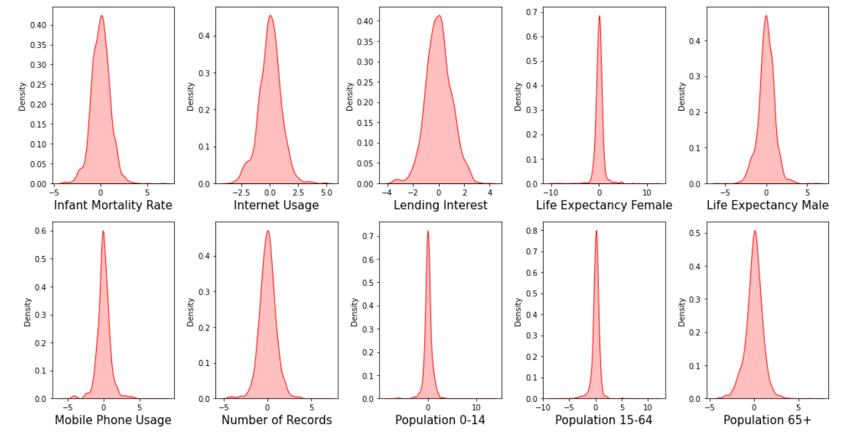
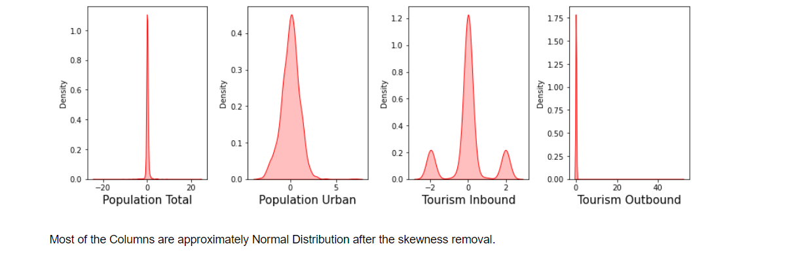
Power Transformation – Skewness is handled by using Power Transformation.
Before applying transformation, mean of skew is 3.76.
After the transformation, mean of skew is 2.3.

Slide 16
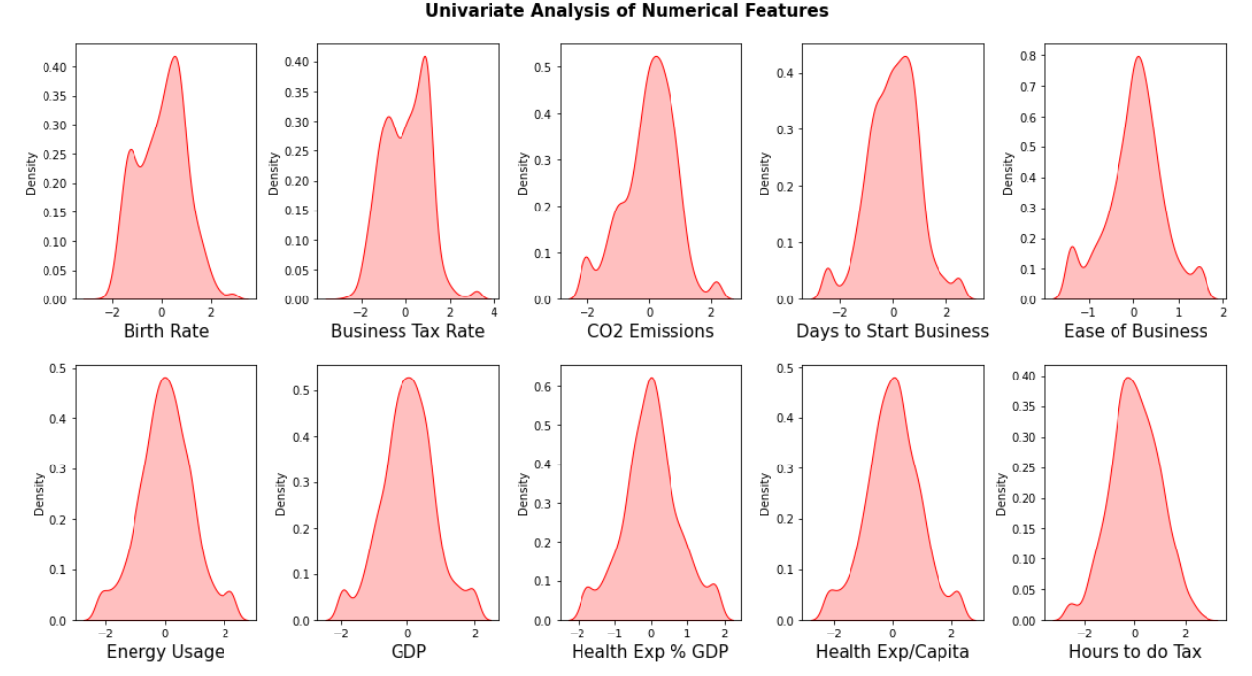
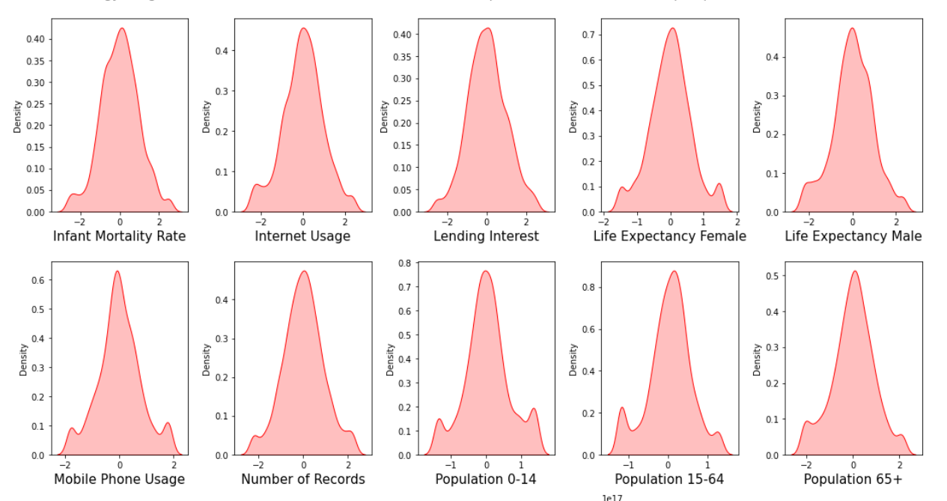
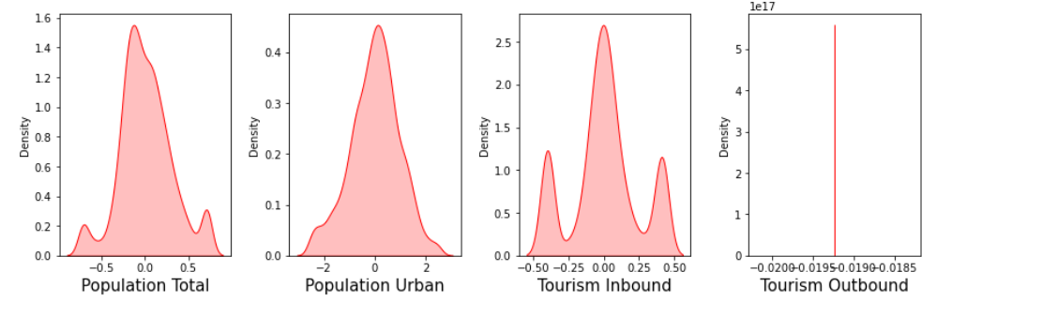
After skewness, outlier and correlation removal, the data looks like

Slide 17
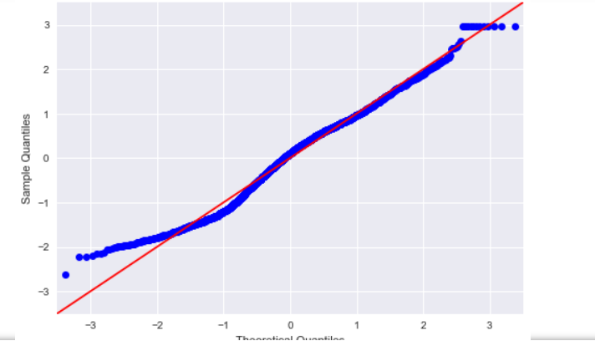
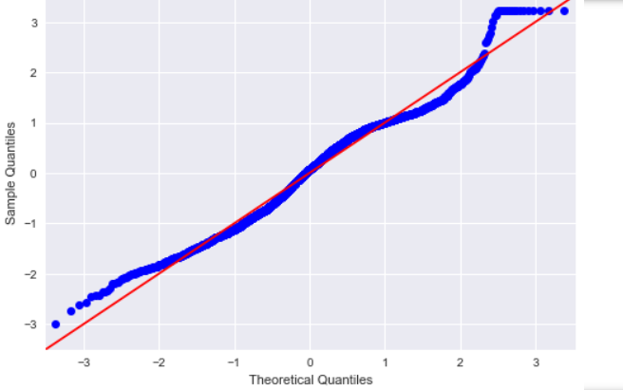
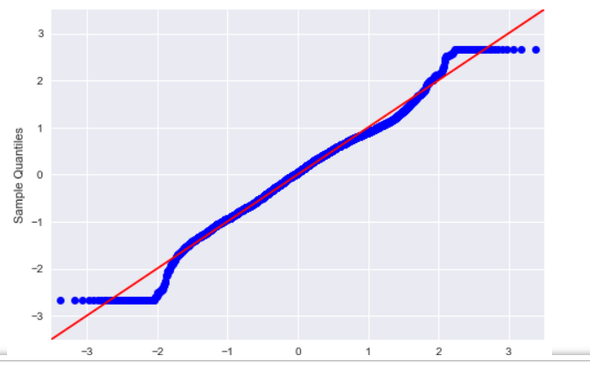
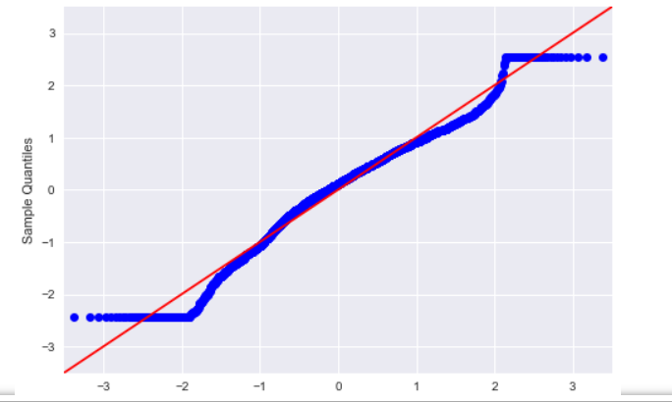
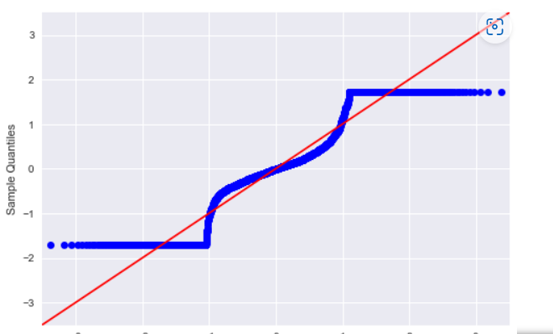
Q-Q Plot
Birth Rate
Business Tax Rate
Days To Start Business
CO2 Emissions
Tourism Inbound

Slide 18
Summary Of EDA
Lot of missing values are there and handled with KNN Imputation.
All are numerical values except for Country column.
Mean is slightly more than median for most of the features. So it is right skewed data.
Skewness is handled by Power Transformation
10 columns are highly correlated
Correlated columns are handled by using PCA
All Leptokurtic columns and few Platykurtic columns have outliers. Outliers are handled and plotted using boxplot.
Standardized the data using Standard Scaler.

Slide 19
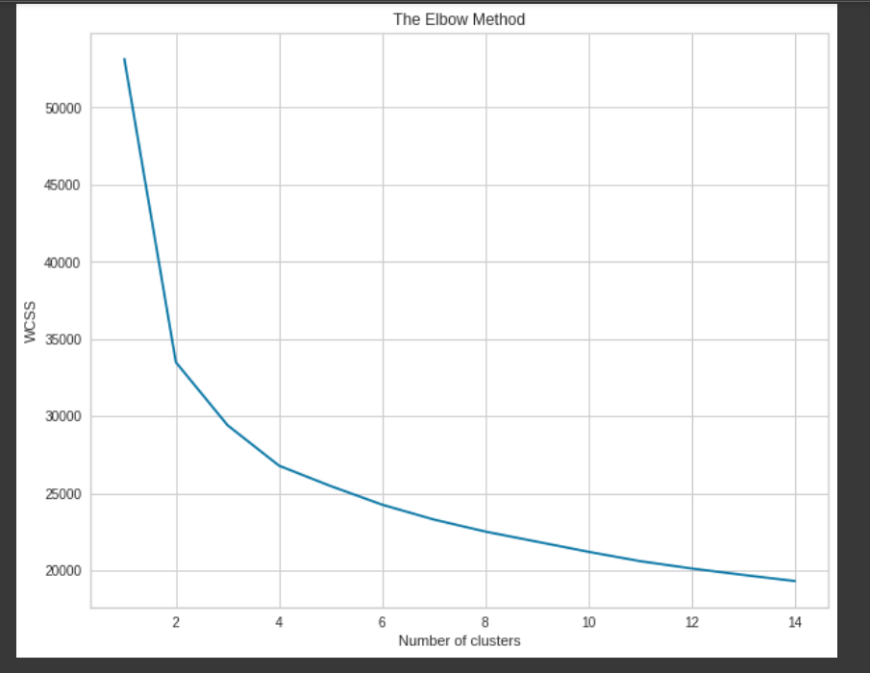
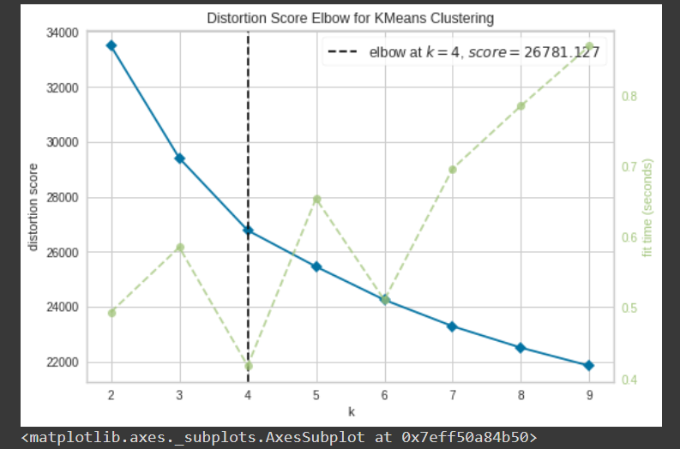
Optimal Number Of Clusters
Elbow Method - The elbow method is a graphical representation of finding the optimal ‘K’ in a K-means clustering.
It is not clear what should be the Elbow point. So we validated the value of k using Silhouette Plot.

Slide 20
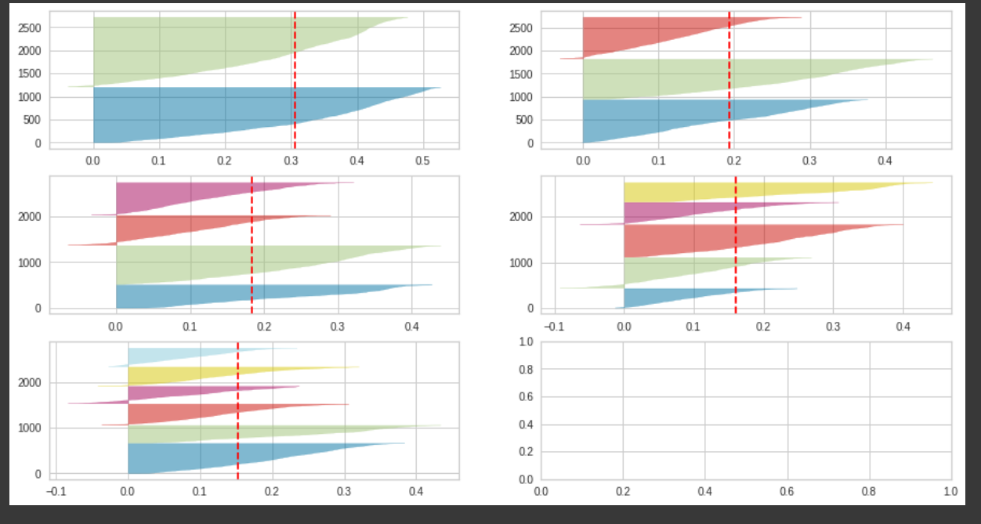
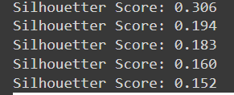
Silhouette Plot
Selecting optimal value for n_clusters is based on Silhouette score and fluctuation in the size of silhouette plots.
Here silhouette score is high for cluster 2 but the fluctuation is wider.
The cluster 5 which has good silhouette score and also the thickness of the silhouette plot is more uniform
Thus we can select optimal number of clusters as 5.

Slide 21
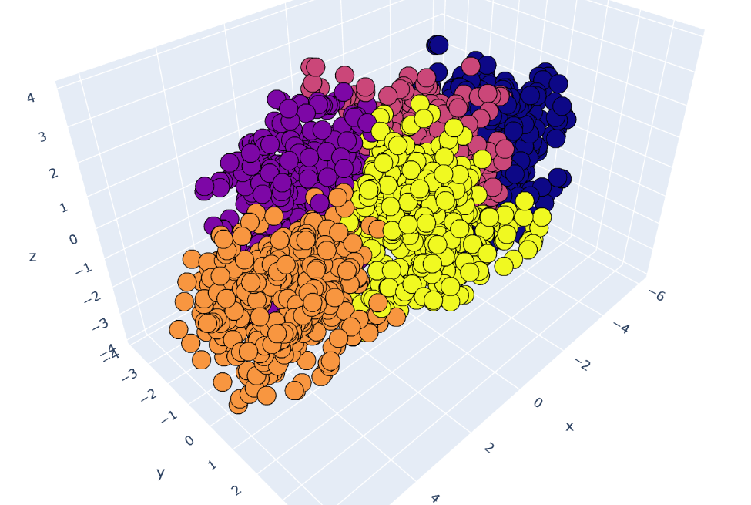
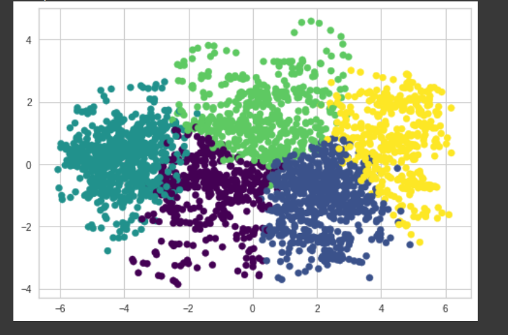
Clustering Algorithm
Applied different clustering algorithms such as KMeans, DBScan and in hierarchical Agglomerative Clustering.
In Kmeans, used 15 PCA component and 5 clusters.
By applying DBScan, obtained there is no noise in data

Slide 22
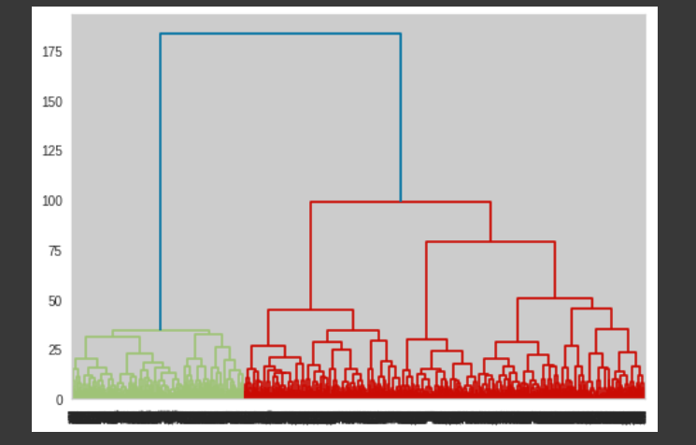
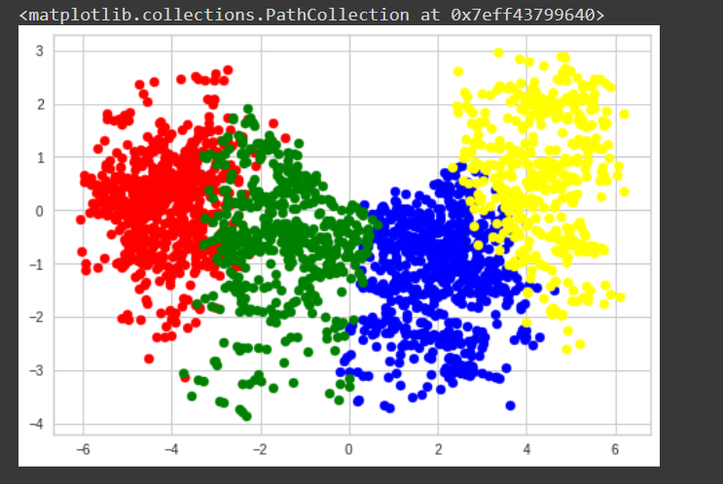
In agglomerative clustering, checked silhouette score of different cluster with different PCA components.
Clusters used 3-10 and PCA components used 5-10
0.16 silhouette score for 4 clusters and 8 PCA components is good fit.

Slide 23
SUMMARY
We got 0.16 silhouette score for 4 clusters and 8 PCA components is good fit in Heirachical agglomerative clustering
We got 0.16 silhouette score for 5 clusters and 15 PCA components is good fit in K Means clustering
DBScan obtained no Noise in clustering.

Slide 24
Deployment - StreamLit
Integration of ML model into an existing production environment where the user can enter the input to generate output, later it can used in making business decisions.
In Python, we can achieve the same by using different frameworks called Django, flask, streamlit.
Streamlit -
A faster way to build and share data apps.
Streamlit turns data scripts into shareable web apps in minutes.
All in pure python.
No front-end experience required.

Slide 25
Steps
1. Setup a virtual environment
Pip install virtualenv
Python –m venv cluster
Cluster\Scripts\activate.bat
2. Install streamlit and other required packages
Pip install streamlit
Other packages are:-
pandas==1.2.4
numpy==1.20.1
sklearn==0.24.1
scipy==1.6.2

Slide 26
3. Run the python file in streamlit
Convert the jupyter file to .py file
Then run the file using
Streamlit run streamlit_deploy.py
Got the webpage which is interactive.
Here model is used K-Means Clustering Model with 5 clusters and 15 PCA components.
Model is saved using pickle library
Input csv file -> cluster will displayed in the page.

Slide 27
SUMMARY
We used Streamlit to create a web app using pure python.
The webapp provided model predictions using a trained model.

