Slide 1
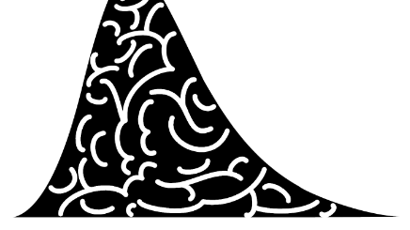
Evidence Accumulation Models & Bayesian Model Seleciton
Model-Based Neuroscience and Cognition Summer School
2025

Slide 2
The “Full" DDM
Three between-trial parameter variabilities.
Expensive to compute
Hard to estimate
Necessary to capture key benchmark patterns (except perhaps st0).
Voss, A., & Voss, J. (2007). Fast-dm: A free program for efficient diffusion model analysis. Behavior Research Methods, 39(4), 767–775.
Boehm, U., Annis, J., Frank, M.J., Hawkins, G.E., Heathcote, A., Kellen, D., …, Matzke, D., & Wagenmakers, E.-J. (2018). Estimating between-trial variability parameters of the diffusion decision model: Expert advice and recommendations. Journal of Mathematical Psychology, 87, 46-75.
Ratcliff, R., & Rouder, J. N. (1998). Modeling response times for two-choice decisions. Psychological Science, 9(5), 347–356.

Slide 3
The Linear Ballistic Accumulator (LBA)
Only between-trial noise
Rates ~ normal (mean_v, sd_v)
Start point ~ uniform (0-A)
One accumulator per response.
Threshold b (gap B = b-A)
Non-decision time ter (or t0)
A, B, sd_v, ter positive (log scale)
Must fix an accumulator parameter for scale (typically sd_v)
Brown, S. D., & Heathcote, A. (2008). The simplest complete model of choice response time: Linear ballistic accumulation. Cognitive Psychology, 57(3), 153–178.
Donkin, C., Brown, S. D., & Heathcote, A. (2009). The overconstraint of response time models: Rethinking the scaling problem. Psychonomic Bulletin & Review, 16(6), 1129–1135.

Slide 4
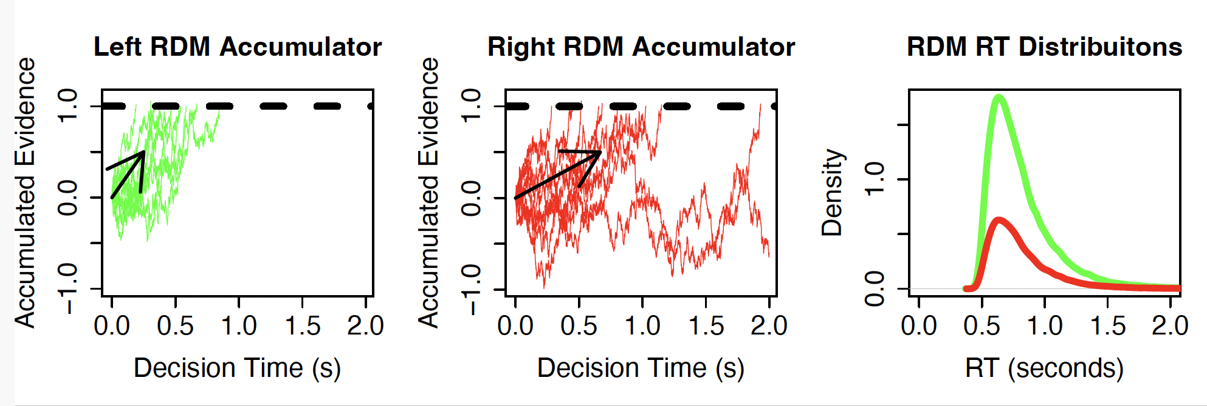
Racing Diffusion Model (RDM)
Same parameter names as the LBA except sv -> s
A=0 (typically, whereas always A> 0 in the LBA)
Tillman, G., Zandt, T. V., & Logan, G. D. (2020). Sequential sampling models without random between-trial variability: the racing diffusion model of speeded decision making. Psychonomic Bulletin & Review, 27(5), 911–936.

Slide 5
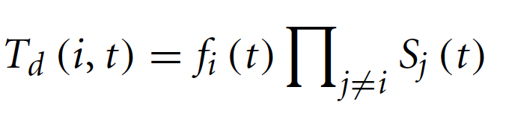
Lognormal Race (LNR)
Suppose a linear accumulator starts a distance d from a threshold and increases in activation linearly with rate v. Hence, the time to reach the threshold is t=d/v.
Suppose both the distance and rate have Lognormal distributions from trial to trial, Where N(μ, σ ²) is a normal random variable with mean μ and variance σ² :
We assume from here that d and v are independent, in which case:
That is, the time for the accumulator to achieve threshold also has an exact Lognormal (LN) distribution.
The LNR likelihood (also LBA and RDM) follows from the independent race equation:

Slide 6
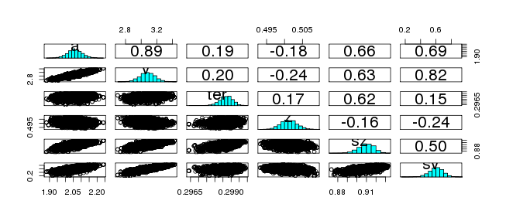
Correlated (sloppy) posteriors.
Model selection for cognitive models
Complexity is not just parameter counting: Need to take account of “functional form complexity”

Slide 7
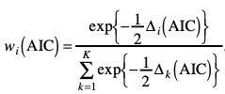
Bayesian Information Criteria
Bayesian ICs are based on posterior deviance
Deviance of mean of posterior parameters (Dmean): = best fit (sometimes min(D) better)
Mean of posterior deviances (meanD): slightly penalized fit
Effective number of parameters pD = meanD – dMean
Deviance Information Criterion: DIC = meanD + pD
Bayesian Predictive Information Criterion: BPIC = meanD + 2*pD
ICs for a set of models can be turned into model weights/probabilities:
DIC wDIC BPIC wBPIC EffectiveN meanD Dmean minD
WDM -1439 0.000 -1428 0.000 11 -1450 -1458 -1460
SZ -1506 0.000 -1491 0.000 15 -1521 -1530 -1536
st0 -1638 0.297 -1619 0.282 19 -1657 -1666 -1676
sv -1502 0.000 -1490 0.000 12 -1514 -1521 -1525
SZsv -1504 0.000 -1489 0.000 15 -1519 -1530 -1534
SZst0 -1638 0.348 -1619 0.344 19 -1657 -1667 -1676
st0sv -1638 0.311 -1619 0.360 19 -1657 -1666 -1675
DDM -1634 0.045 -1613 0.014 21 -1655 -1667 -1677

Slide 8
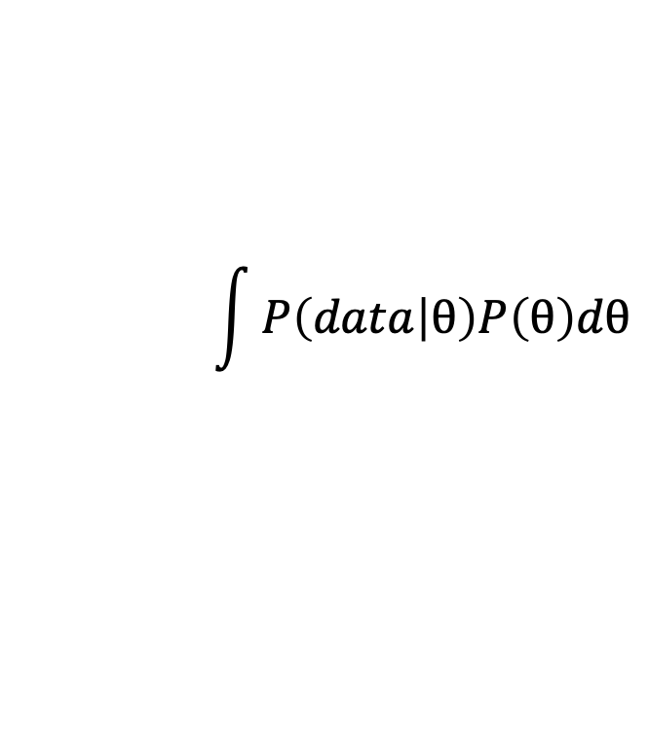
Bayes Factors
$$\int{P\left(data | θ\right)P\left(θ\right)dθ}$$
Bayesian Factors are based on the marginal likelihood
As the marginal likelihood is the probability of the data given the
model integrated over the prior , unlike the ICs it is intrinsically sensitive to the prior
EMC2 reports the marginal deviance (MD=-2 x marginal likelihood)
Bayes factors are the ratios of marginal deviances (or likelihoods)
Just as with the ICs they can be turned into weights/posterior model probabilities.
MD wMD DIC wDIC BPIC wBPIC EffectiveN meanD Dmean minD
WDM -1382 0.000 -1439 0.000 -1428 0.000 11 -1450 -1458 -1460
SZ -1447 0.000 -1506 0.000 -1491 0.000 15 -1521 -1530 -1536
st0 -1573 0.540 -1638 0.297 -1619 0.282 19 -1657 -1666 -1676
sv -1444 0.000 -1502 0.000 -1490 0.000 12 -1514 -1521 -1525
SZsv -1445 0.000 -1504 0.000 -1489 0.000 15 -1519 -1530 -1534
SZst0 -1570 0.117 -1638 0.348 -1619 0.344 19 -1657 -1667 -1676
st0sv -1572 0.284 -1638 0.311 -1619 0.360 19 -1657 -1666 -1675
DDM -1568 0.059 -1634 0.045 -1613 0.014 21 -1655 -1667 -1677
It has only recently become practical to calculate marginal likelihoods for cogntive models, with bridge sampling being the prefered technique.
Boehm, U., Evans, N. J, Gronau, Q. F., Matzke, M., Wagenmakers, E-J., & Heathcote, A. (2023). Inclusion Bayes factors for mixed
hierarchical diffusion decision models. Psychological Methods. https://doi.org/10.1037/met0000582

Slide 9
Readings
AIC and BIC: Myung, I. J., & Pitt, M. A. (1997). Applying Occam’s razor in modeling cognition: A Bayesian approach. Psychonomic Bulletin & Review, 4(1), 79–95
Functional Form Complexity: Pitt, M. A., & Myung, I. J. (2002). When a good fit can be bad. Trends in Cognitive Sciences, 6(10), 421–425.
Mean Deviance: Liu, C. C., & Aitkin, M. (2008). Bayes factors: Prior sensitivity and model generalizability. Journal of Mathematical Psychology, 52(6), 362–375.
DIC: Spiegelhalter, D. J., Best, N. G., Carlin, B. P., & Linde, A. (2014). The deviance information criterion: 12 years on. Journal of the Royal Statistical Society: Series B (Statistical Methodology), 76(3), 485–493.
BPIC: Ando, T. (2011). Predictive Bayesian Model Selection. American Journal of Mathematical and Management Sciences, 31(1–2), 13–38.

