Slide 1
Suicide Rate Insights
Sara Osowski

Slide 2
Introduction
  Dataset includes global suicide trends in regards to continent, sex, age, country, and more
  Suicide rates are highly researched → Can learn a lot from working with this topic
  Interested in learning about…
    Demographics decreasing in suicide rates more than others
    Comparing high school/college aged students in the U.S. to other demographics

Slide 3
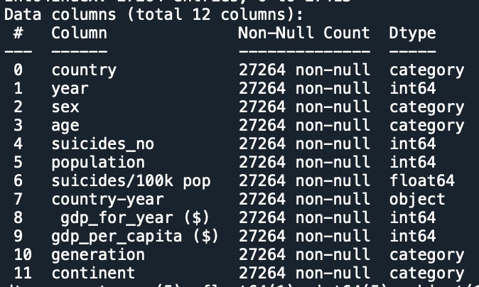
The Data
Data from https://www.kaggle.com/lmorgan95/r-suicide-rates-in-depth-stats-insights
  The process:
    Cleaned data & performed EDA
    Graphed trends
Description of the data after cleaning

Slide 4
Men v. Women
GLOBALLY,
IN THE UNITED STATES,
Men are
﻿3.327509547453905 times
more likely to commit suicide than women.
Men are
﻿3.836424271622146 times
more likely to commit suicide than women.

Slide 5
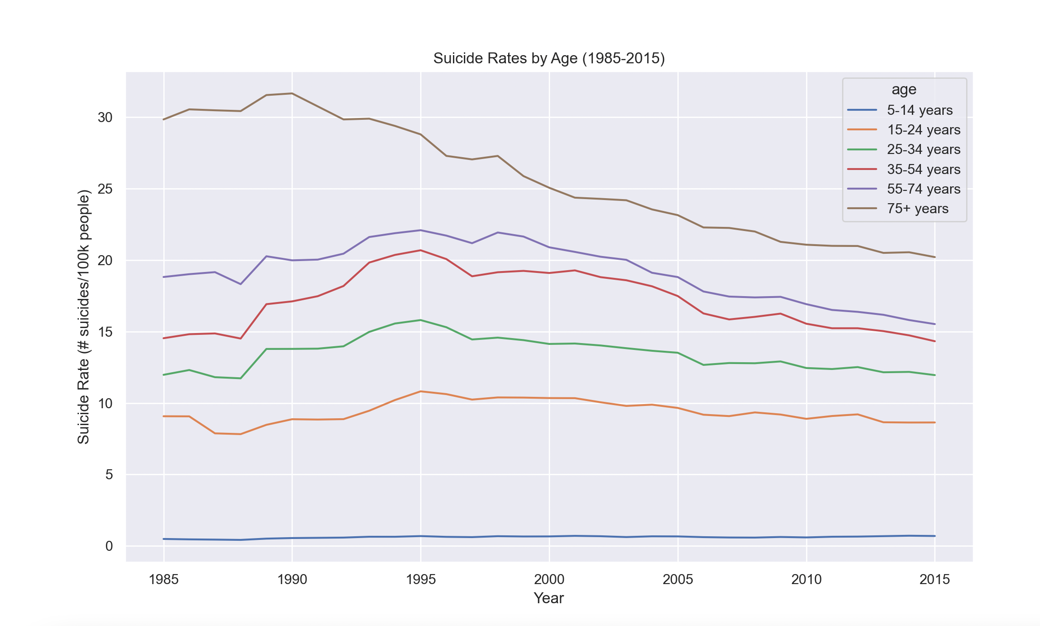
Which ages are decreasing in suicide rates more than others?
  Peak of total suicides in 1999
  Suicide rates are decreasing or stagnant for most age groups after peak
  Higher suicide rate is correlated to higher age

Slide 6
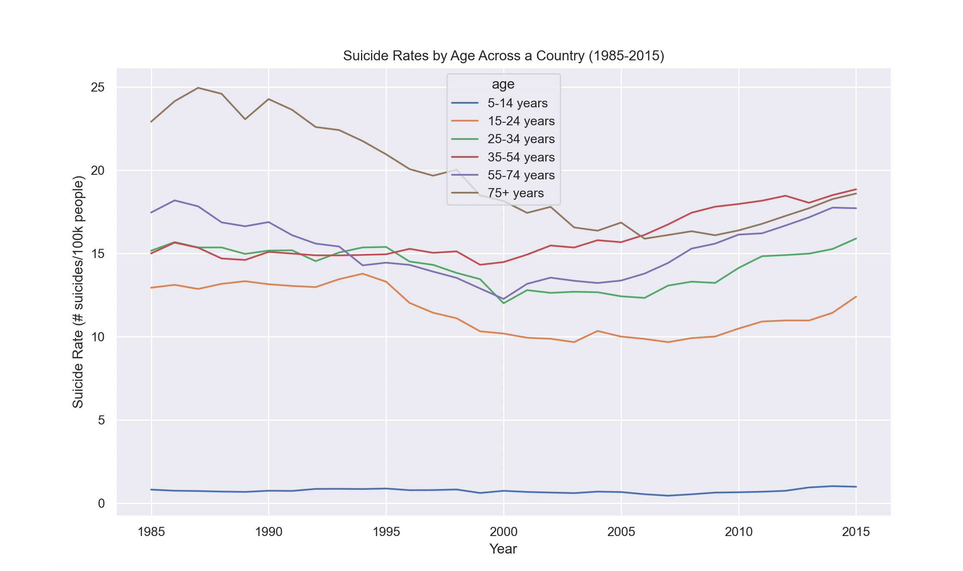
Which ages are decreasing in suicide rates more than others? (U.S.)
In the U.S. specifically, rates are not as consistent between ages or years
Ages 35-54 most recently have the highest rates

Slide 7
Comparing high school/college aged students in the U.S. to other demographics

Slide 8
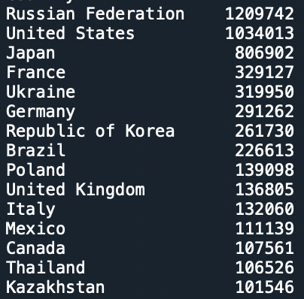
Comparing high school/college aged students in the U.S. to other demographics
First wanted to see where the U.S. stands in total suicides for ages 14-24 from 1985-2015 compared to other countries
U.S. and Russia have much more than any other country
In all countries, men have ~3x more total suicides than women
Top 15 countries in total suicides

Slide 9
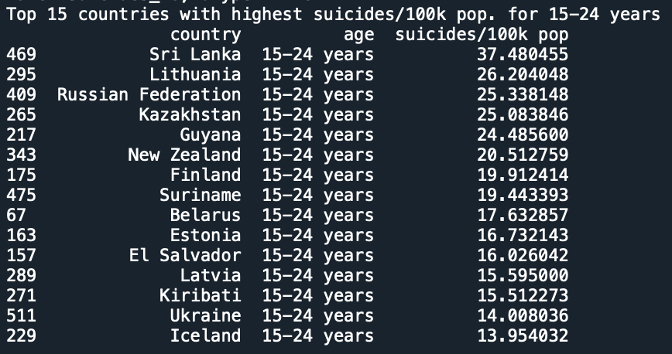
Top 15 Countries with the highest suicides per 100k Population for Age Range 15-24
United States is not one of the countries with the highest suicide rates despite being high in the previous list for total suicides.

Slide 10
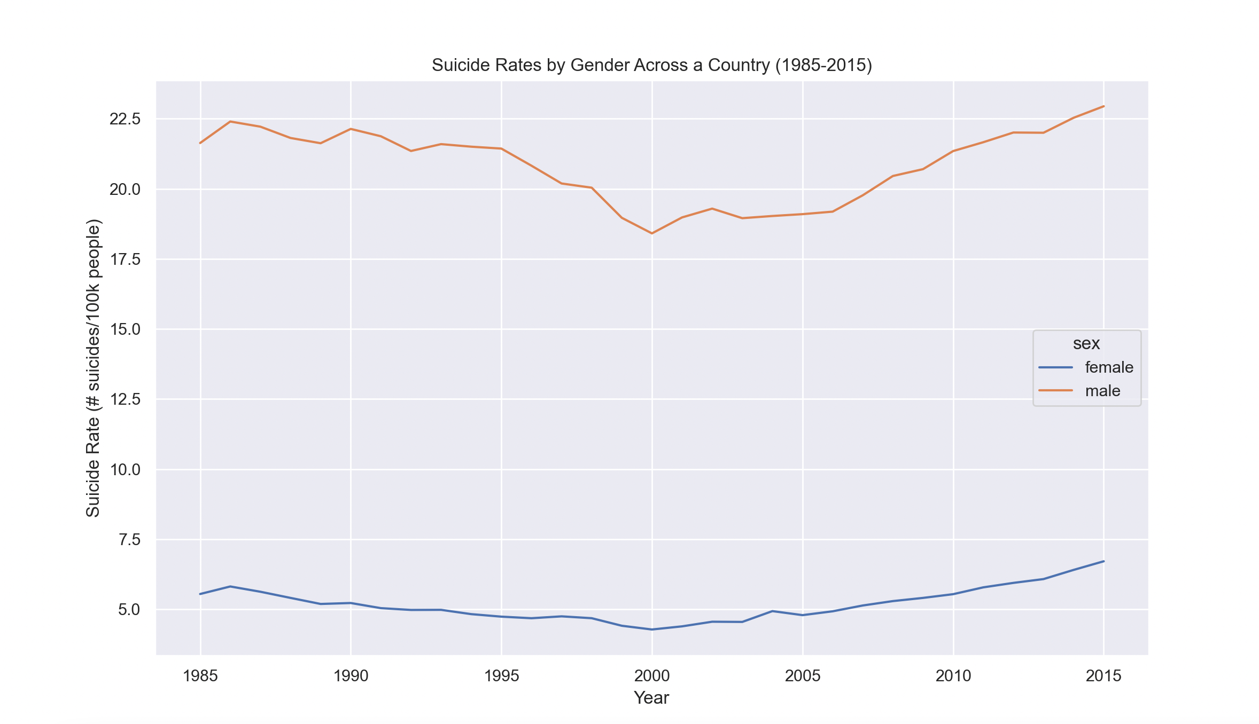
Suicide rate for U.S. Men v. Women
A closer view at the difference between rates for men and women
Male and female rates peaked in 2015
  Dip in the graph; upward trend towards the end
  Upward trend in most recent years

Slide 11
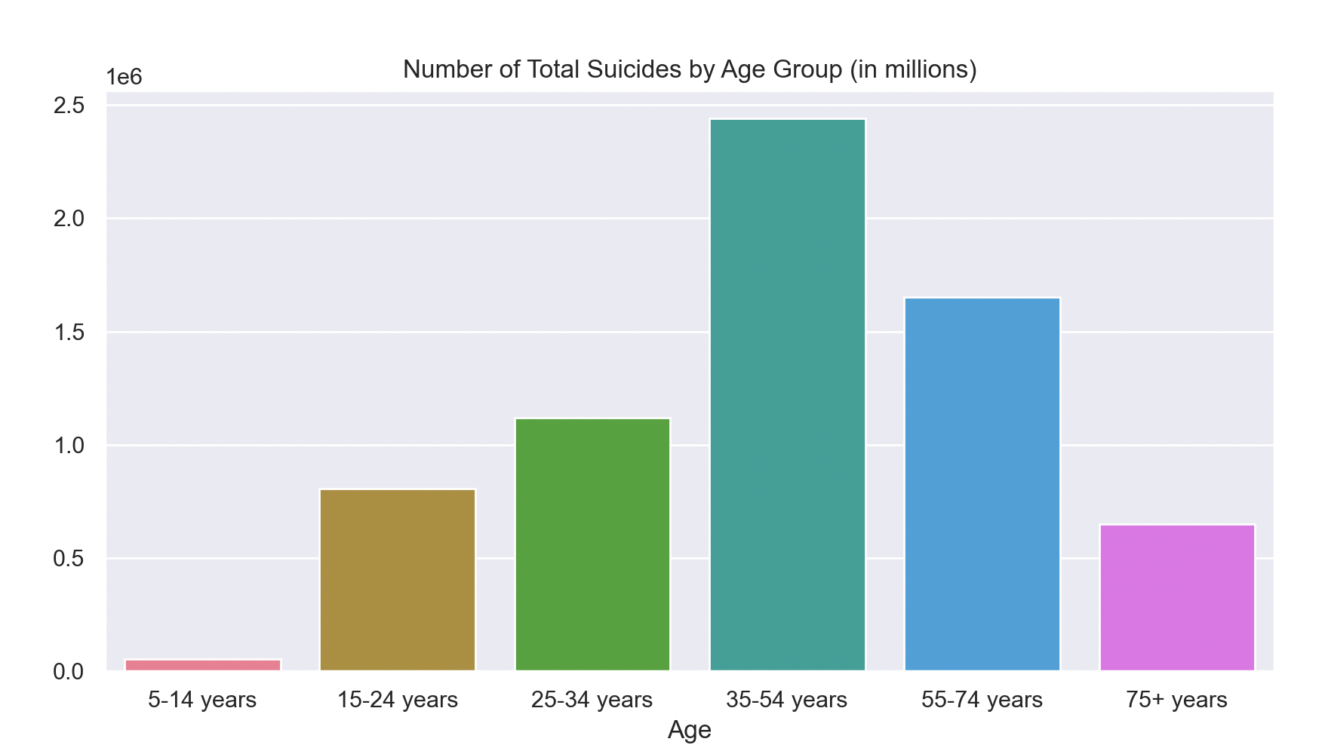
Suicide Rate Per Generation
Mid-life peak in suicide trends
High school/college age group has less than half of 35-54 age group

Slide 12

Thank You!

