Slide 1
An introduction to Reinforcement Learning
Sara Paknezhad Panahi

Slide 2
Contents
General structure of the reinforcement learning problem
Reinforcement function
Reward
Considering future rewards
Optimal performance models
Learning policy
Model-free & model-based RL algorithms
On-policy and Off-policy method
An overview of several RL algorithms
Q-learning algorithm
Policy iteration algorithm
SARSA algorithm
DQN algorithm
DDPG algorithm

Slide 3
General structure of the reinforcement learning problem
In a standard RL problem we have the following main components:
The decision maker is known as the agent
The environment in which the agent acts and receives feedback from it
The mechanism by which the agent transitions between states of the environment is known as the action
The reward is the feedback on how good or bad the action chosen by the agent is
A state in reinforcement learning is a representation of the current environment that the agent is in.

Slide 4
The act of learning consists of learning a policy, which is actually a mapping from a state to an action, in such a way that using this policy to choose actions leads to receiving the maximum reward from the environment.
policy
. . .
r
t +1
r
t +2
r
. . .
s
s
t +1
s
t +2
t +3
s
t +3
t
a
a
t +1
a
t +2
a
t
t +3

Slide 5
Reinforcement function
In RL, when the agent performs an action in a certain state, it receives a reward in return. In this operating system, the agent is responsible for maximizing the reward received in the long term.
One of the design points of an RL system is to define a reinforcement function suitable for the agent's goals. This is done in different ways.

Slide 6
Reward
If a sequence of rewards is available as follows:
The agent should try to maximize the reward it receives from the environment. In fact, maximizing Expected Value.
maximize
Learning operations are divided into two categories:
Continual: The system follow the work forever or as long as we can.
Episodic: The operation ends somewhere. In the final state, if the agent does any action it returns to the same state and receives zero reward.
. . .
r
t +1
r
t +2
r
s
s
t +1
s
t +2
t +3
s
E
t
a
a
t +1
a
t +2
a
t
k

Slide 7

Considering future rewards
Reward Rt: the total reward that the agent can collect starting from time t.
This reward can be calculated in different ways. One way is as follows, where closer rewards are given more value.
In fact, the agent is at the moment t and has a prediction of his future.
+3
+50
-1
-1
r₁
r₄
r₅
r₉

Slide 8
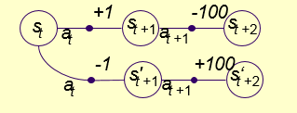
Optimal performance models
One of the important points in choosing an action is how to include future events in the agent's current decision. There are different models to consider the impact of future events in the choice of action:
First model: In this model, only the current reward is important and future rewards are not included in the decision. In this method, the first route is selected.

Slide 9
The second model: This method is very common and rewards that will be taken in the future are given less value than immediate rewards. For example, if the first route is selected.
The third model (average reward model): In this method, no difference between near and distant rewards is considered. For example, in the figure below, the first and second paths are not different.

Slide 10
Learning policy
The goal is to find an optimal policy that maximizes Rt.
How to calculate Rt if the model has a Markov characteristic:
The dynamic equations of the system are as follows:
If we solve the reinforcement learning problem according to the above equations, we have actually solved an MDP (Markov Decision Process) problem.

Slide 11
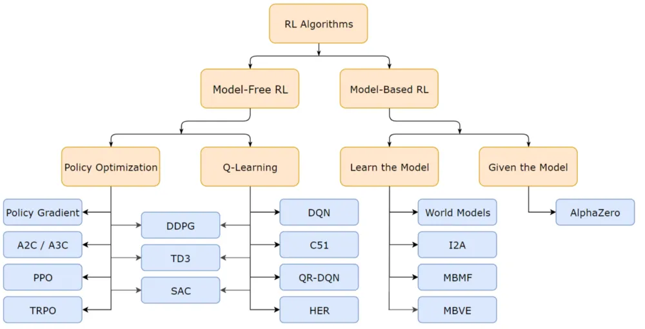

Slide 12
Model-free & model-based RL algorithms
Model-based RL: The model is a simulation of the dynamics of the environment. That is, the model learns the transition probability function T(s1|(s0, a)) (that is, the probability of transitioning state s1 if action a is selected in the previous state or s0). If the learning of the probability transfer function is successful, the decision agent can calculate the probability of the occurrence of a given state based on the current state and action.
Model-free RL: Model-free algorithms are actually based on the test and error method and based on the result, they update their knowledge. they will not need space to store possible combinations of states and actions

Slide 13
On-policy and Off-policy method
In the On-policy method, the decision-making agent learns the value based on the action a that results from the current policy. But in the Off-policy method, the learning process is such that the agent learns the value from action a* (the best available action), which is the result of another policy.

Slide 14
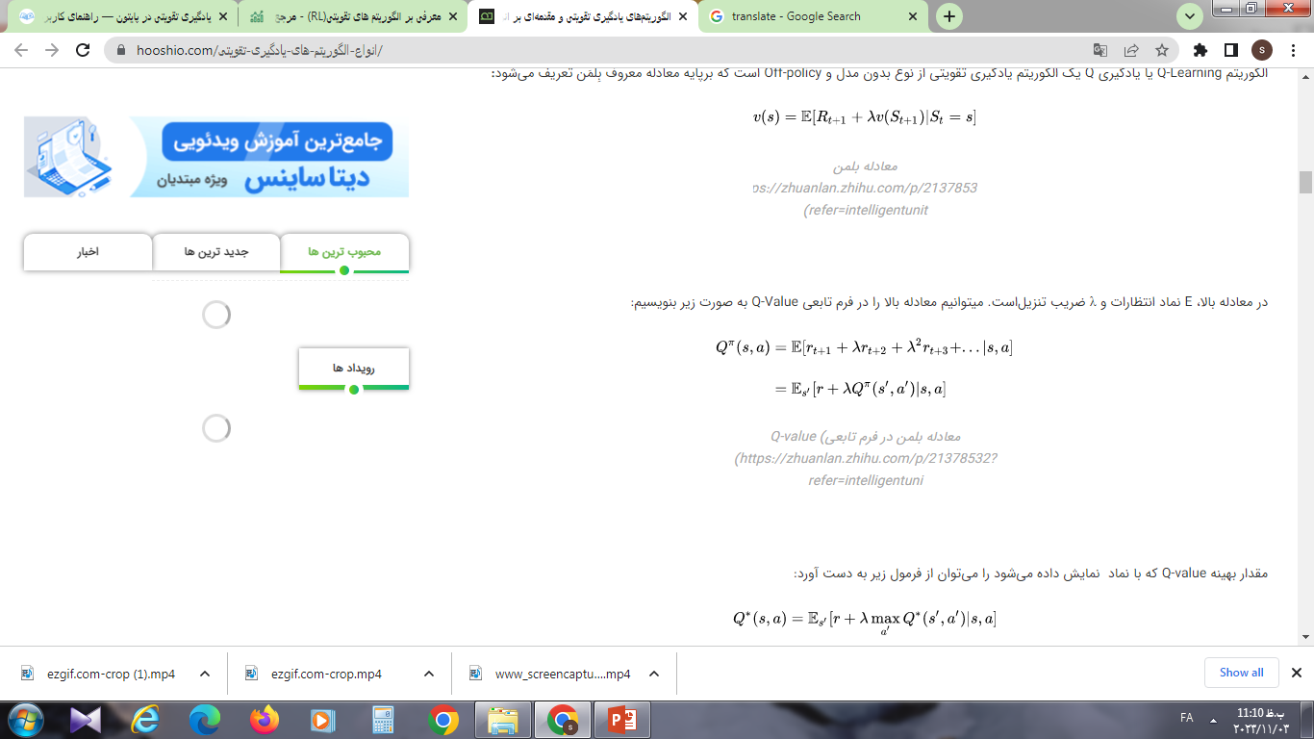
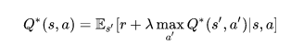
An overview of several RL algorithms
Q-learning algorithm:
The Q-Learning algorithm is a model-free and off-policy reinforcement learning algorithm, which is defined based on the famous Bellman equation:
The optimal Q-value:

Slide 15
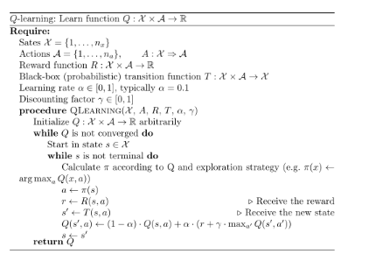
Q-learning algorithm:

Slide 16
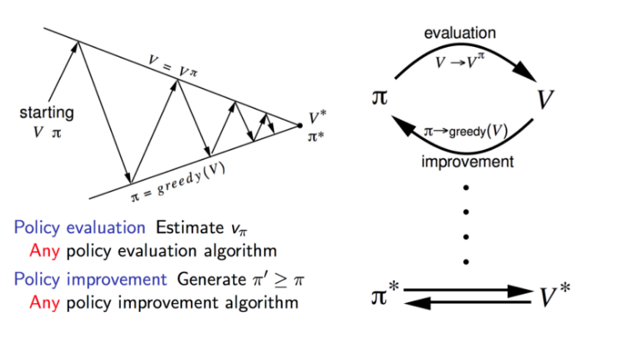
Policy iteration algorithm
In the policy iteration method, a loop is formed between policy evaluation and its improvement.

Slide 17
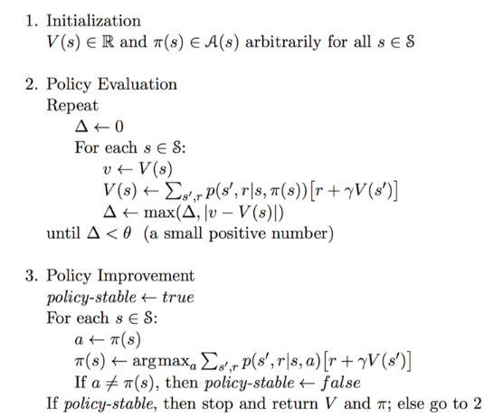
Policy iteration algorithm

Slide 18
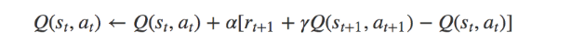
SARSA algorithm
The SARSA algorithm (which stands for State-Action-Reward-State-Action) is similar to the Q-learning algorithm. The key difference between these two algorithms is that SARSA, unlike the Q-learning algorithm, belongs to the category of On-Policy algorithms. Therefore, the SARSA algorithm calculates the Q-value according to the action that results from the current policy, not the action that results from the greedy policy.

Slide 19
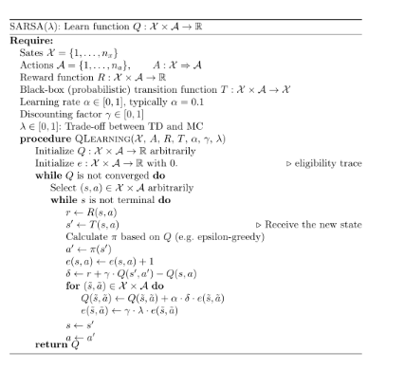
SARSA algorithm

Slide 20
Deep Q-Learning (DQN) algorithm
When the agent in the Q-learning algorithm is faced with a completely new situation, it will have no way to identify and choose the appropriate action. In other words, the decision-making agent of Q-learning algorithm does not have the ability to estimate the value of unknown states. To solve this problem, the DQN network removes the two-dimensional array and replaces it with a neural network.
DQN network estimates the Q-value function with the help of a neural network. The current state is given as an input to this network, then the Q-value corresponding to each action will be received as an output from the network.

Slide 21
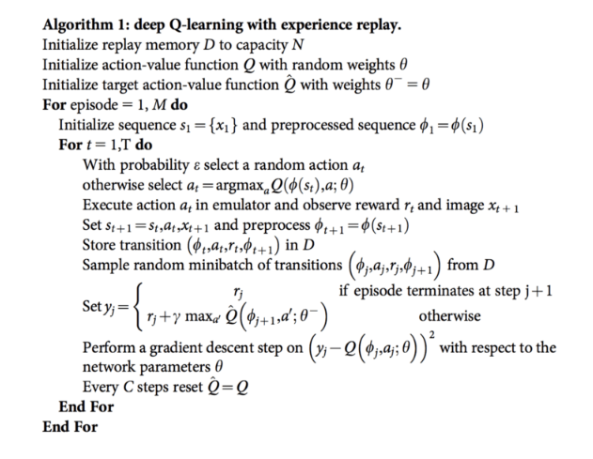
DQN algorithm

Slide 22
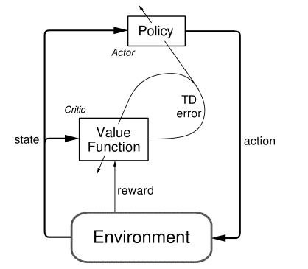
DDPG algorithm
The deep deterministic policy gradient (DDPG) algorithm is a model-free, online, off-policy reinforcement learning method. A DDPG agent is an actor-critic reinforcement learning agent that searches for an optimal policy that maximizes the expected cumulative long-term reward.

Slide 23
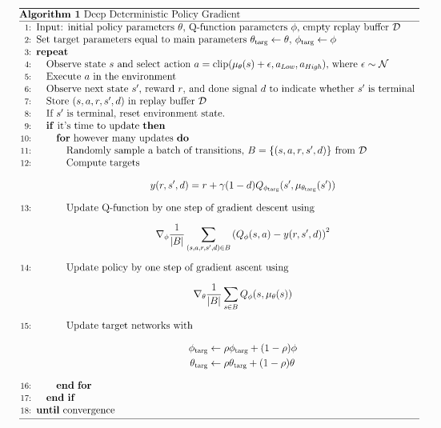
DDPG algorithm

Slide 24
Thanks
Any question?

