Slide 1
Sales Volume Forecasting
Zachary Corbett
Victor Dontsov
Sara Parveen
Set

Slide 2
* Client: Product distributor who purchases office products from manufacturers, holds them and then resells them to its business customers * Improve the inventory planning process for the product distributor * Create a model that makes predictions about the sales volume for different product categories
Background

Slide 3
Value of model
* Meet customer demand and ensure customer satisfaction
* Avoid having too much inventory which can lead to unnecessary storage costs, handling costs and cash-flow pressures
* Avoid stockouts which can result in loss of sales and/ or fines
* Maintain high profitability

Slide 4
Target Audience
* Product distributor whose data was analyzed
* All product sales planning, supply chain, and procurement professionals

Slide 5
Data Source
* The data used for this project comes in the form of CSV files obtained from the product distributor.
* The CSVs have 5-years worth of data (2018 to 2022) for Purchase, Sales and Product Details.

Slide 6
Data Hosting
* The raw CSV data files are hosted on an S3 Bucket through Amazon AWS.
* The database schema was stored in the Databricks File System (DBFS) through a Databricks Community Edition Account. This file system is ultimately hosted on AWS without charges for computing.

Slide 7
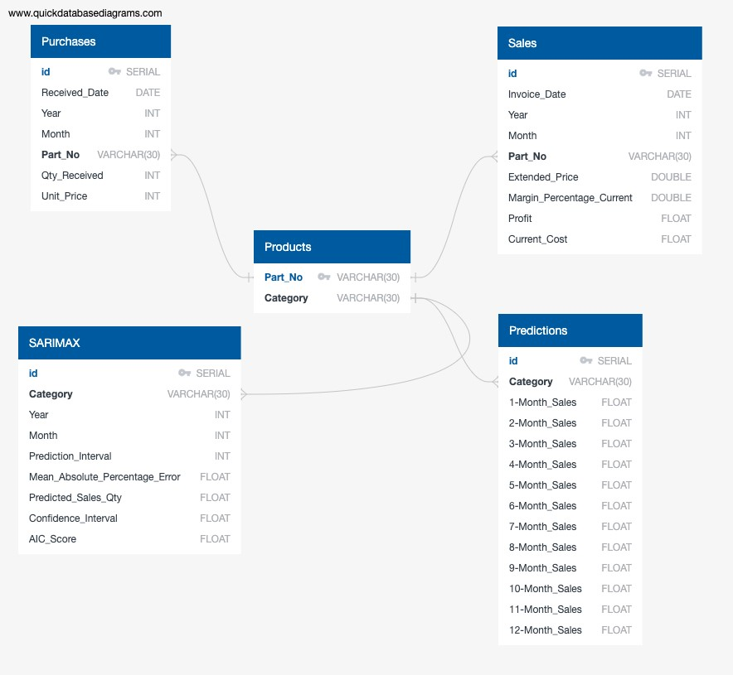
Database Creation

Slide 8
Data Cleaning
01
02
03
04
Load and merge DataFrames
Select and filter the columns to be used
Convert the columns to the appropriate data type
Group the data to get yearly and monthly aggregates

Slide 9
Data Model Description
SARIMAX Model
* Time Series Analysis for Sales Volume predictions * Trained On 4-years (2018-2021) * Parameters: p - order of the autoregressive part d - degree of first differencing involved q - order of the moving average part P, D, Q - all previous characteristics with seasonal factors s - seasonal length in the data

Slide 10
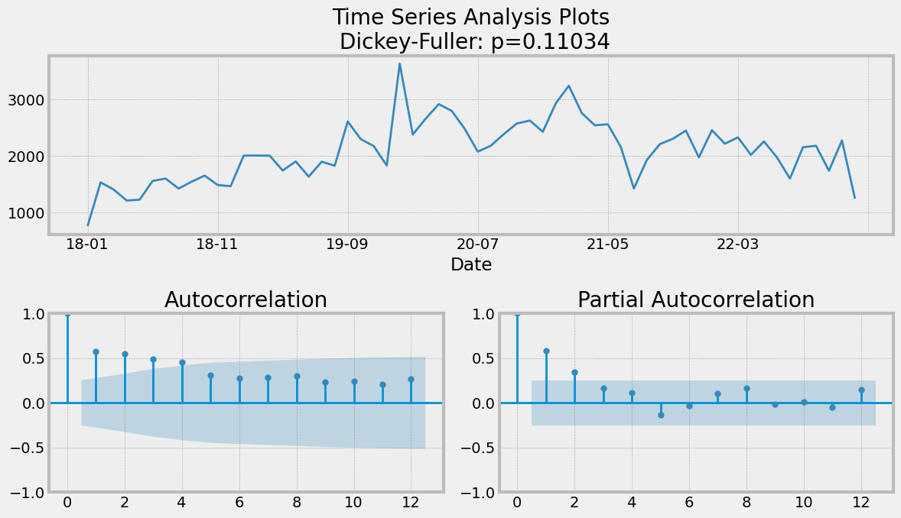
Step 1: Identified the stationarity of the time series
P-Value > 0.05 implies data is not stationary

Slide 11
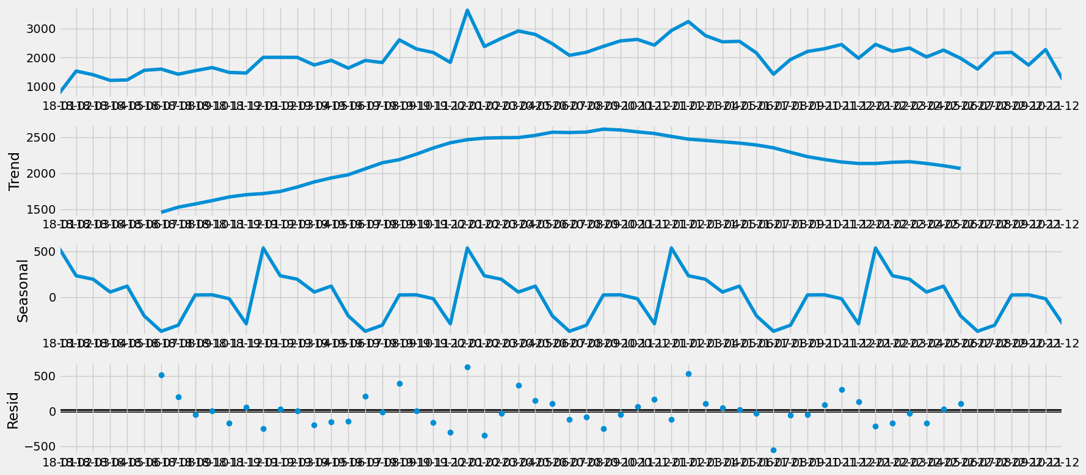
Step 2: Suggested the initial parameters
Applied differencing analysis if needed

Slide 12
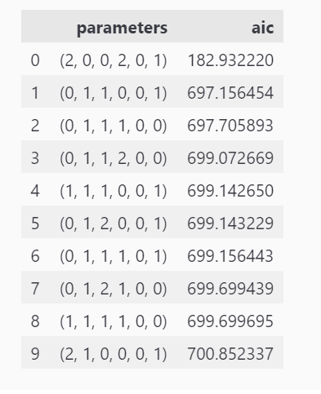
Step 3: Generated the final parameters for the model
Selected parameters based on AIC Scores

Slide 13
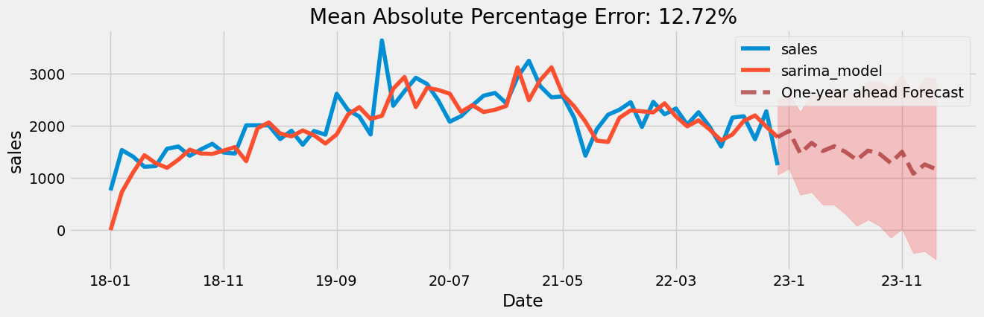
Step 4: Ran the SARIMAX model

Slide 14
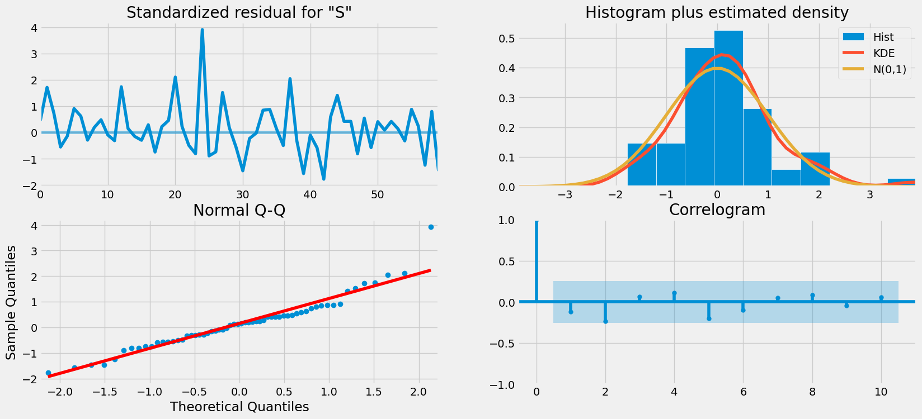
Error Analysis

Slide 15
Attempt to Optimize the Model
Product Category | Mean Absolute Percentage Error (Attempt 1) | Mean Absolute Percentage Error (Attempt 2)
All categories | 14.09% | 12.28%
Anti-Fatigue Mat | 39.86% | 34.19%
Desk Pad | 32.62% | 37.37%
Entrance Mat | 43.63% | 42.40%
Polycarbonate Chair Mat | 25.91% | 21.24%
Porcelain Whiteboard | 42.87% | 48.14%
PVC Chair Mat | 19.99% | 20.31%
Recycled Chair Mat | 41.50% | 41.50%
Steel Whiteboard | 31.49% | 34.42%
Tempered Glass Chair Mat | 41.95% | 46.20%
Tempered Glass Whiteboard | 44.48% | 47.31%

Slide 16
Visualizations and Dashboards
* Used Databricks Dashboards
* Created filters in the Databricks Notebooks

Slide 17
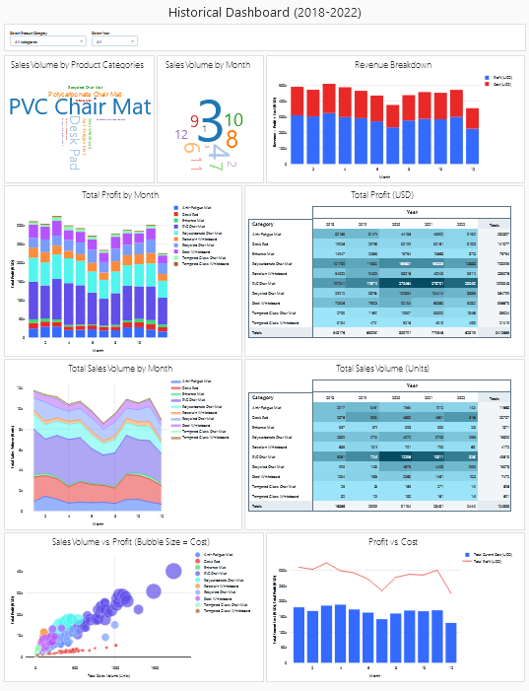
Historical Dashboard (2018-2022)

Slide 18
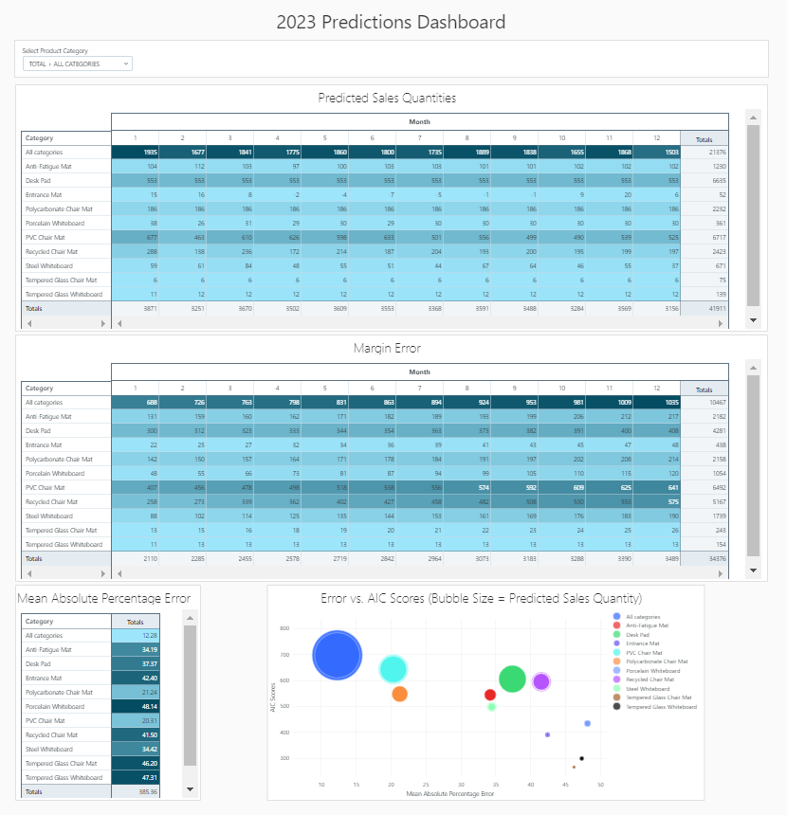
Predictions Dashboard (2023)

Slide 19
Limitations and Assumptions
01
02
03
04
134 different product SKUs within the original dataset
Unlimited resources and budget
Unlimited warehouse space to store the products
No minimum order quantities

Slide 20
Challenges
* The clusters on Databricks Community Edition reset after 2 hours of inactivity.
* ETL was processed in Databricks and it was truncating the data to 10,000 rows.
* The dashboards in Databricks do not have a default option for adding filters to visualizations.
* The filters on the Databricks dashboards do not carry over to the HTML file.

Slide 21
Conclusions
* Predictions show a slight decline in sales volume in the next year for overall sales but stable sales for some categories.
* Sales predictions are helpful but additional models incorporating special dimensions of warehouse, and budget constraints could help make more applicable predictions.
* Margin Error increases for longer time periods. This makes it more appropriate for Just-In-Time distributors.

Slide 22
Thank you for listening!

Slide 23
Any Questions?

