Slide 1
Confidence Estimation for Radiology Report Generation
Summary of Current Results – April 6, 2026
Sara Pohland
University of California, Berkeley
Notes:
Total: 51-52min
Intro: 4.5min
PaRCE: 7min
Saliency: 9.5-10min
Counterfactual: 10min
Nav: 7.5-8min
Design: 10min
Conclusions: 2.5min

Slide 2
1. Setup
Run inference with MedGemma on 1,000 provided X-ray scans.
Saves study identifier, full generated text response, list of generated token strings, per-token log probability of predicted token, per-token predictive entropy approximated from top-20 logprobs.
Score MedGemma responses using CRIMSON.
Saves study identifier, CRIMSON raw score ∈ (−1, 1], CRIMSON error breakdown – counts of false findings, missing findings, and attribute errors by type (location, severity, descriptor, measurement, certainty, unspecific, overinterpretation, temporal).

Slide 3
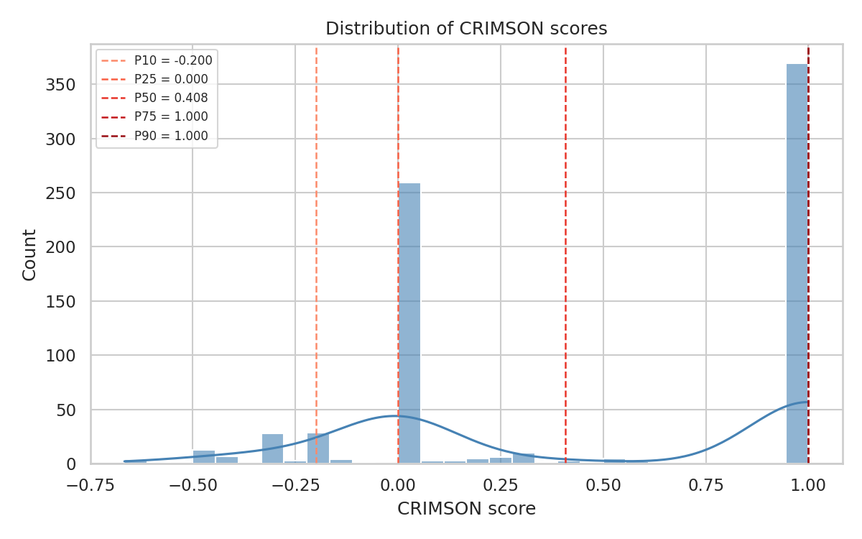
1. Setup: Score MedGemma responses
756 judged reports:
369 fully correct (49%)
297 partially correct (39%)
90 incorrect (12%)
fully correct
incorrect
partially correct

Slide 4
2. Sources of Confidence Information
2.1 Logit-Based Confidence
2.2 Consistency under Input Perturbation
2.3 Consistency during Sampling
2.4 Vision-Text Grounding
2.5 Hidden-State Probing
2.6 Explicit Human Feedback
2.7 Implicit Human Feedback

Slide 5
2. Sources of Confidence Information
2.1 Logit-Based Confidence
2.2 Consistency under Input Perturbation
2.3 Consistency during Sampling
2.4 Vision-Text Grounding – requires access to internal states
2.5 Hidden-State Probing – internal states + more data
2.6 Explicit Human Feedback – user interaction data
2.7 Implicit Human Feedback – user behavioral data

Slide 6
2.1 Logit-Based Confidence
During generation, the model outputs a probability distribution over its vocabulary at each step, which reflects how certain it is about each token.
Low log-probabilities and high entropy indicate that the model was uncertain in its predictions, which tends to correlate with lower-quality or incorrect responses.
These token-level signals are cheap to collect during inference and require no additional forward passes.

Slide 7
2.1 Logit-Based Confidence: Metrics
Log-probability metrics:
Minimum token log probability
Average token log probability
Variance of token log probabilities
5th-percentile token log probability
10th-percentile token log probability
Mean of the k lowest token log probabilities
Average token log probability weighted by word order
earlier tokens weighted higher, assuming they set diagnostic context
Average token log probability weighted by semantic significance
content words weighted over filler (i.e., articles, prepositions, conjunctions)
Average token log probability weighted by ontology importance
currently uses RadLex lexicon to upweight clinically relevant words

Slide 8
2.1 Logit-Based Confidence: Metrics
Entropy metrics:
Maximum token entropy
Average token entropy
Variance of token entropy
90th-percentile token entropy
95th-percentile token entropy
Mean of the k highest token entropies
Average token entropy weighted by word order
earlier tokens weighted higher, assuming they set diagnostic context
Average token entropy weighted by semantic significance
content words weighted over filler (i.e., articles, prepositions, conjunctions)
Average token entropy weighted by ontology importance
currently uses RadLex lexicon to upweight clinically relevant words

Slide 9
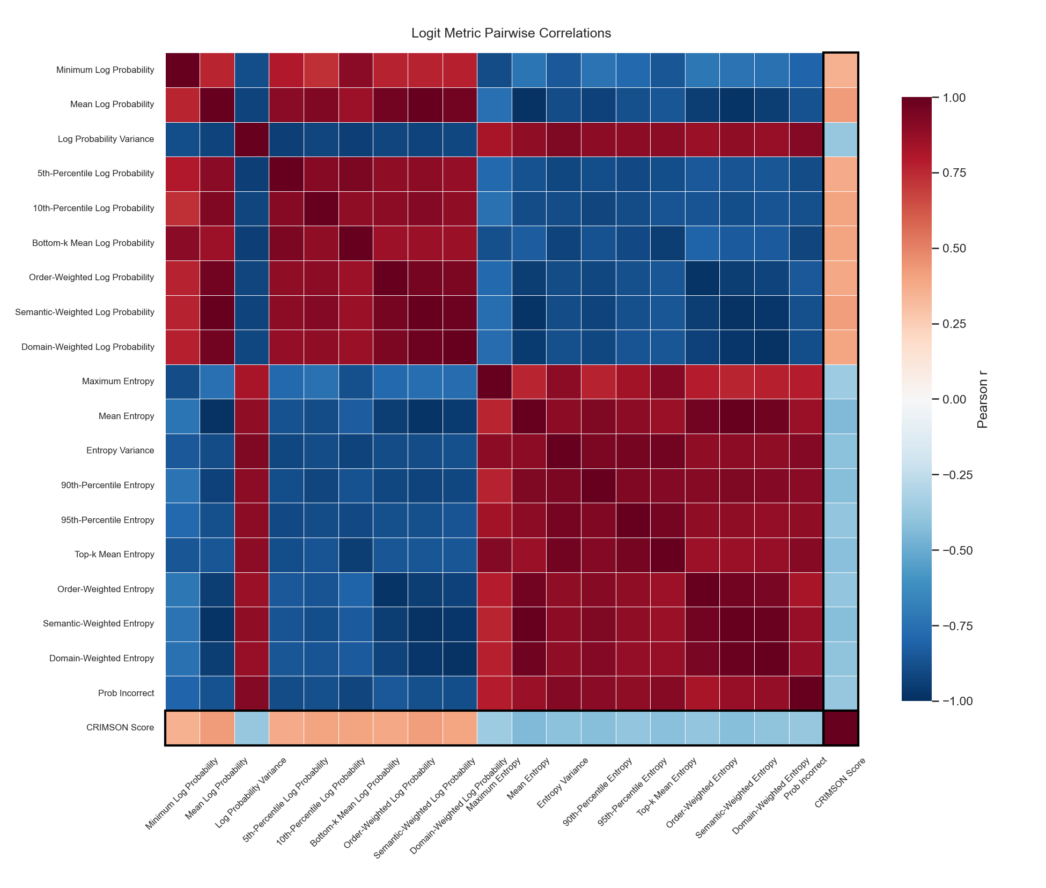
2.1 Logit-Based Confidence: Correlation
Log-prob metrics
Entropy metrics

Slide 10
2.1 Logit-Based Confidence: Performance
Metric | AUROC | AUPRC
Min Log Probability | 0.789 | 0.304
Mean Log Probability | 0.847 | 0.364
Log Probability Variance | 0.831 | 0.334
5th-Percentile Log Probability | 0.824 | 0.335
10th-Percentile Log Probability | 0.841 | 0.353
Bottom-k Mean Log Probability | 0.840 | 0.378
Order-Weighted Log Probability | 0.794 | 0.316
Semantic-Weighted Log Probability | 0.848 | 0.362
Domain-Weighted Log Probability | 0.841 | 0.340

Slide 11
2.1 Logit-Based Confidence: Performance
Metric | AUROC | AUPRC
Maximum Entropy | 0.797 | 0.313
Mean Entropy | 0.843 | 0.357
Entropy Variance | 0.833 | 0.341
90th-Percentile Entropy | 0.837 | 0.360
95th-Percentile Entropy | 0.829 | 0.346
Top-k Mean Entropy | 0.842 | 0.374
Order-Weighted Entropy | 0.783 | 0.305
Semantic-Weighted Entropy | 0.845 | 0.360
Domain-Weighted Entropy | 0.841 | 0.345

Slide 12
2.2 Consistency under Input Perturbation
A confident model should produce similar responses when the input is slightly perturbed, while an uncertain model is more sensitive to small changes.
By generating multiple responses under controlled input perturbations and measuring how much the output changes, we can estimate model uncertainty without requiring additional model components or external supervision.

Slide 13
2.2 Perturbation Consistency: Metrics
Per-perturbation-type metrics:
Mean ROUGE-1 F1 between each noise-perturbed response and original
Mean ROUGE-L F1 for noise perturbations
Mean ROUGE-1 F1 between each blur-perturbed response and original
Mean ROUGE-L F1 for blur perturbations
Aggregate metrics:
Mean ROUGE-1 F1 averaged across all perturbation types and samples
Mean ROUGE-L F1 averaged across all perturbation types and samples
ROUGE Reference: https://medium.com/nlplanet/two-minutes-nlp-learn-the-rouge-metric-by-examples-f179cc285499

Slide 14
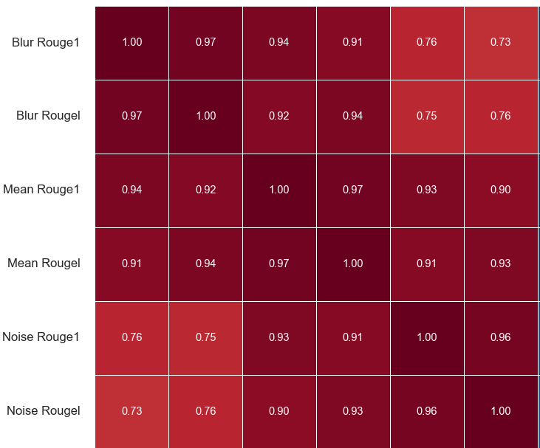
2.2 Perturbation Consistency: Correlation
Blur metrics
Mean metrics
Noise metrics

Slide 15
2.2 Perturbation Consistency: Performance
Metric | AUROC | AUPRC
Blur ROUGE-1 | 0.725 | 0.240
Blur ROUGE-L | 0.710 | 0.214
Mean ROUGE-1 | 0.724 | 0.242
Mean ROUGE-L | 0.716 | 0.217
Noise ROUGE-1 | 0.694 | 0.234
Noise ROUGE-L | 0.686 | 0.205

Slide 16
2.3 Consistency during Sampling
Under temperature sampling, a model draws responses stochastically rather than greedily, producing different outputs on each forward pass.
A confident model will produce responses with low variance across samples, while an uncertain model will produce inconsistent or contradictory outputs.

Slide 17
2.3 Consistency during Sampling: Metrics
Pairwise stability metrics:
Mean ROUGE-1 F1 across all unique pairs of sampled responses
measures intrinsic output variance under stochastic decoding
Mean ROUGE-L F1 across all unique pairs of sampled responses
Greedy-anchored stability metrics:
Mean ROUGE-1 F1 of each sampled response against the original greedy response
measures how far stochastic decoding drifts from deterministic response
Mean ROUGE-L F1 of each sampled response against the original

Slide 18
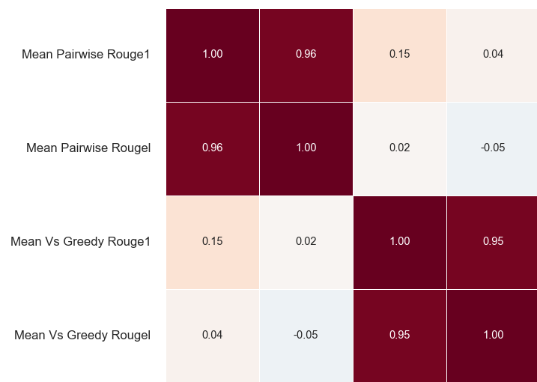
2.3 Consistency during Sampling: Correlation
Pairwise metrics
v. Greedy metrics

Slide 19
2.3 Consistency during Sampling: Performance
Metric | AUROC | AUPRC
Mean Pairwise ROUGE-1 | 0.649 | 0.187
Mean Pairwise ROUGE-L | 0.650 | 0.191
Mean vs. Greedy ROUGE-1 | 0.732 | 0.244
Mean vs. Greedy ROUGE-L | 0.712 | 0.222

Slide 20
3. Confidence Calibration and Evaluation
3.1 Confidence Calibration
3.2 Combining Multiple Signals
3.3 Confidence Evaluation

Slide 21
3. Confidence Calibration and Evaluation
3.1 Confidence Calibration
3.2 Combining Multiple Signals
3.3 Confidence Evaluation

Slide 22
3.2 Combining Multiple Signals
Each method in Sections 2.1–2.3 can be calibrated independently (3.1), but signals from different methods can also be combined into a single joint calibration.
Currently, we choose features via greedy forward selection, fit a logistic regression over the selected features, and produce a combined score, capturing the probability a report is incorrect.

Slide 23
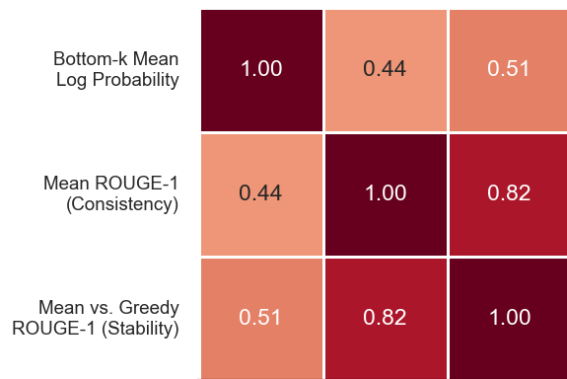
3.2 Combining Signals: Correlation

Slide 24
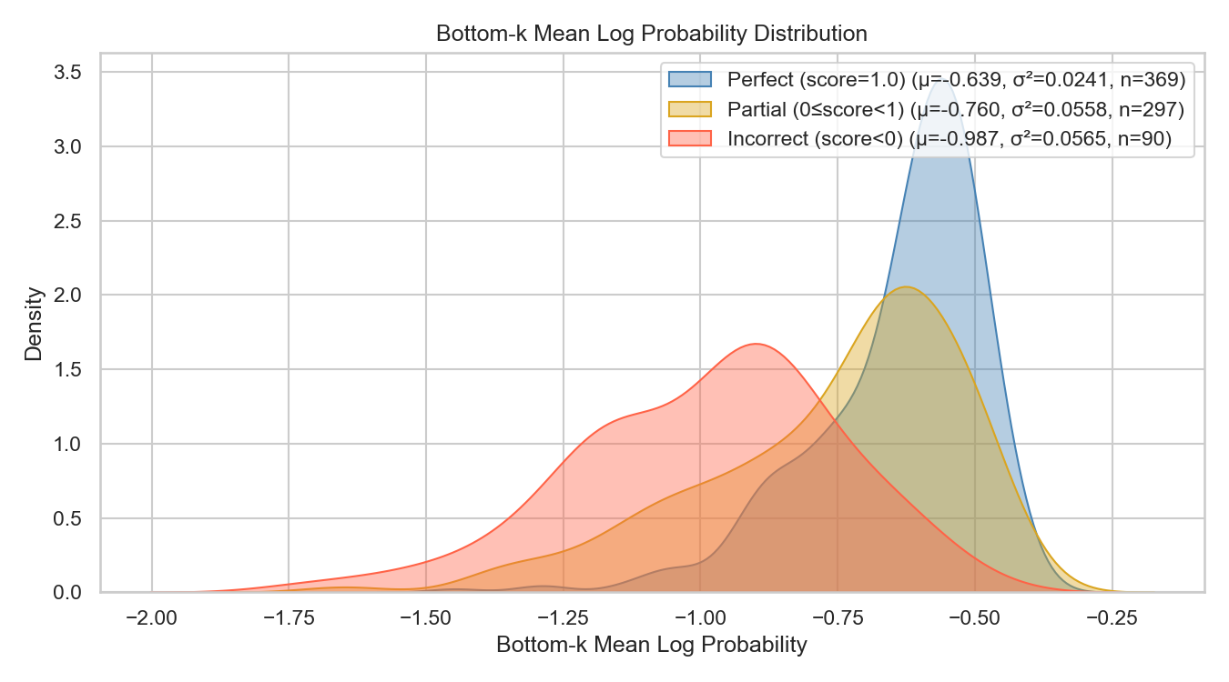
3.2 Combining Signals: Feature Selection
Best feature (highest AUPRC):
Mean of the k lowest token log probabilities (from 2.1)

Slide 25
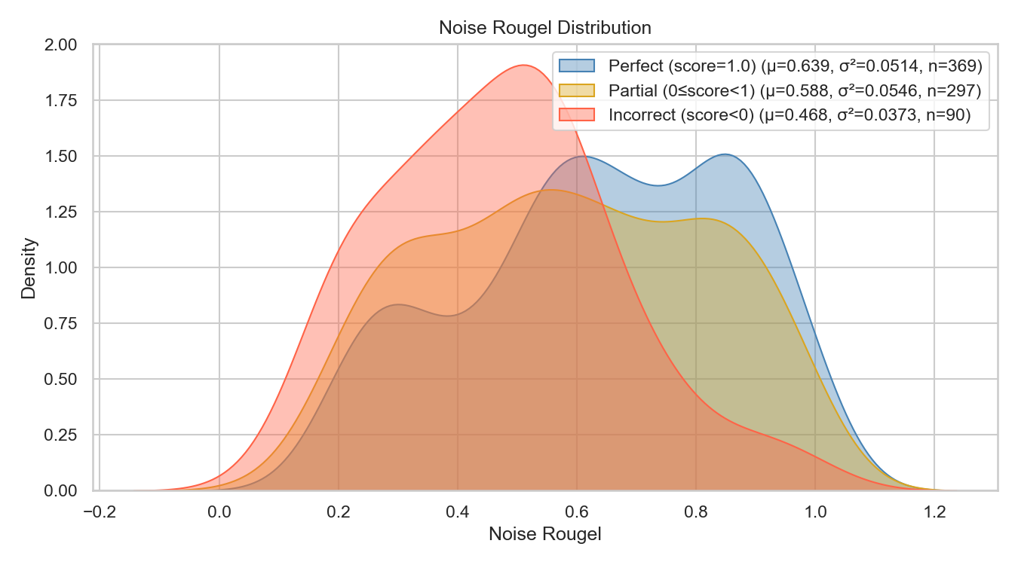
3.2 Combining Signals: Feature Selection
Best complementary feature (improving AUPRC):
Mean ROUGE-L F1 for noise perturbations (from 2.2)

Slide 26
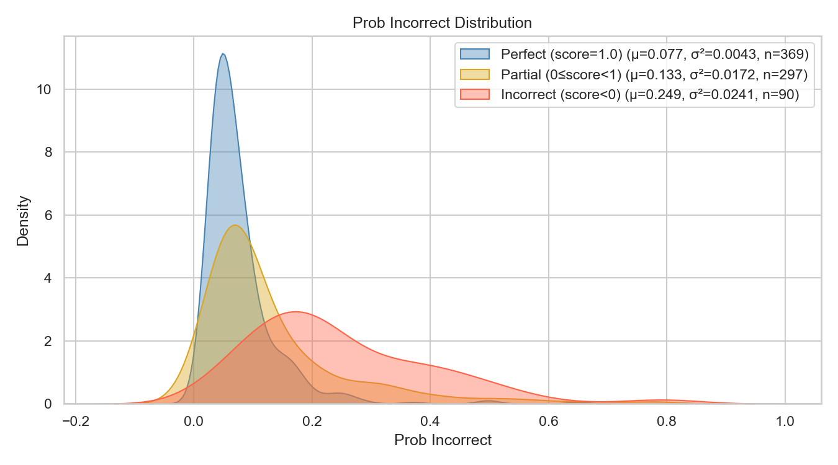
3.3 Confidence Evaluation
Logistic regression classifier using two best features calibrated using 5-fold cross-validation

Slide 27
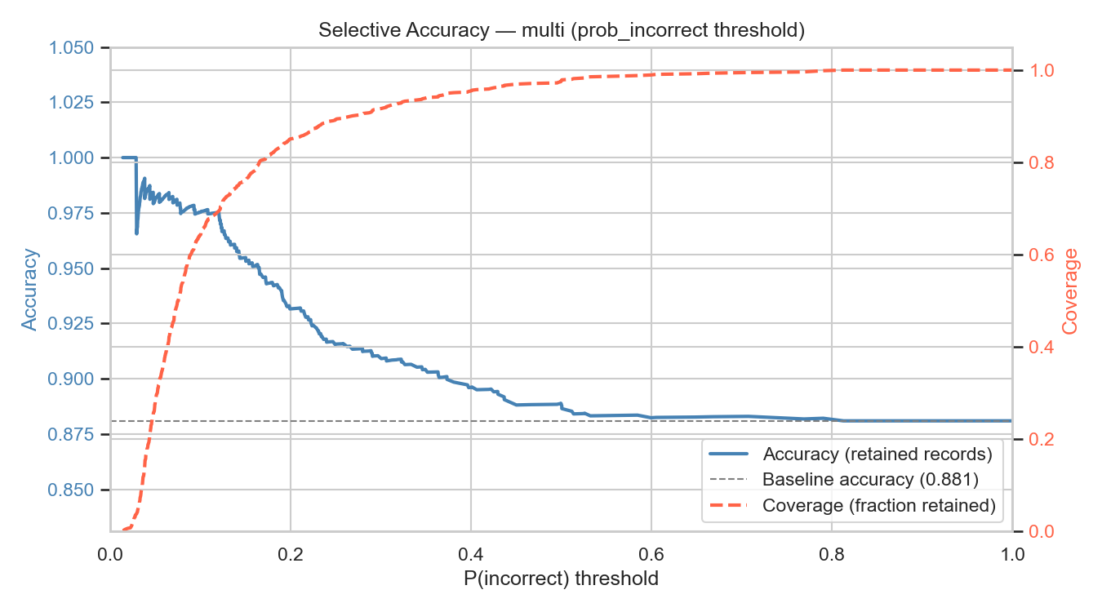
3.3 Confidence Evaluation: Acc. v Cov.
Logistic regression classifier using two best features calibrated using 5-fold cross-validation
Cov: 70%
Acc: 97.5%
Cov: 100%
Acc: 88.1%

Slide 28
3.3 Confidence Evaluation: Acc. v Cov.
Logistic regression classifier using two best features calibrated using 5-fold cross-validation
Target Accuracy | Threshold | Actual Accuracy | Accuracy Increase | Reports Retained | Report Coverage
90% | 0.373 | 90.1% | 2.00% | 717 | 94.84%
95% | 0.165 | 95.03% | 6.94% | 604 | 79.89%
97.5% | 0.120 | 97.52% | 9.43% | 525 | 69.44%
99% | 0.038 | 99.07% | 10.97% | 107 | 14.15%

Slide 29
Future Work
Improve logit-based metrics
Improve consistency under input perturbation metrics
Improve consistency under temperature sampling metrics
Implement other methods to obtain confidence information
Perform more involved multi-signal calibration
Perform more rigorous evaluation of confidence scores
Explore and evaluate methods for integrating confidence information into the radiologist-support platform

Slide 30
A. Improve logit-based metrics
Test different values of k for mean top/bottom k sample metrics.
Test domain weighting for mean top/bottom k sample metrics.
Consider the use of other lexicons for domain weighting.
Learn the weighting function using a small probe.
Investigate whether per-sentence or per-finding aggregation outperforms per-token aggregation.
(Not immediate) Calibrate log probabilities more during training.

Slide 31
B. Improve consistency under input perturbation metrics
Consider other ways to measure extent of response change.
Apply more natural variations to inputs that reflect realistic scanner variability.
Selectively mask or occlude anatomical regions and measure whether/how the report changes for that finding specifically.
Increase the number of samples and test if performance is affected.
Also evaluate how much this affects computation time.

Slide 32
C. Improve consistency under temperature sampling metrics
Consider other ways to measure extent of response change.
Evaluate whether sampling variance correlates with correctness across different temperature values.
We may also combine the scores produced at multiple temperature values.
Increase the number of samples and test if performance is affected.
Also evaluate how much this affects computation time.

Slide 33
D. Implement other methods to obtain confidence information
With access to intermediate model representations, we could measure the similarity between the vision encoding of the input and the text encoding of the generated response to understand how well the response is anchored to the visual input.
With access to hidden states and a labelled training split, we could train a lightweight classifier on the model's internal states to predict whether a given response will be judged correct.
Eventually, we could also use explicit and implicit human feedback.

Slide 34
E. Perform more involved multi-signal calibration
Incorporate additional methods into the calibration step.
Explore other feature selection strategies, beyond forward greedy.
Calibrate with more data and evaluate on a dedicated test split.
Evaluate non-linear models as alternatives to logistic regression for combining signals.
Consider ensemble/mixture-of-experts approaches that combine categories of methods, potentially using a multi-step scheme.

Slide 35
F. Perform more rigorous evaluation of confidence scores
After performing more involved calibration with additional data, evaluate how well the score is actually calibrated.
Brier score, Expected Calibration Error (ECE), reliability diagrams, etc.
Evaluate all methods in terms of performance and computational cost.
Understand how model performance varies across distributions of data and whether confidence estimates continue to provide a useful signal.
Design out-of-distribution (OOD) detection methods.
Utilize error breakdown provided by CRIMSON (or another LLM judge) to detect false findings or predict particular types of errors.
Evaluate how confidence estimation methods generalize across data modalities and different generative models.

Slide 36
G. Explore/evaluate methods for integrating confidence information into the platform
Don’t show low-confidence suggestions below some threshold and evaluate accuracy of retained reports as a function of threshold.
Have the agent present the user with multiple options when it is not confident in a particular response.
Measure “human uplift” on real-world decision tasks.
Model per-user correction patterns, and to personalize suggestions to individual radiologists over time.
A low-confidence prediction could trigger re-generation with a different prompt or sampling strategy.
We may also better characterize situations where the model does poorly and use this to guide re-training.

Slide 37
Appendix

Slide 38
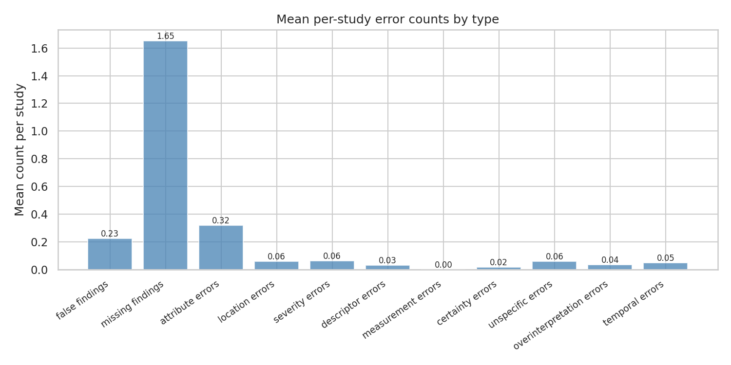
1. Setup: Score MedGemma responses

Slide 39
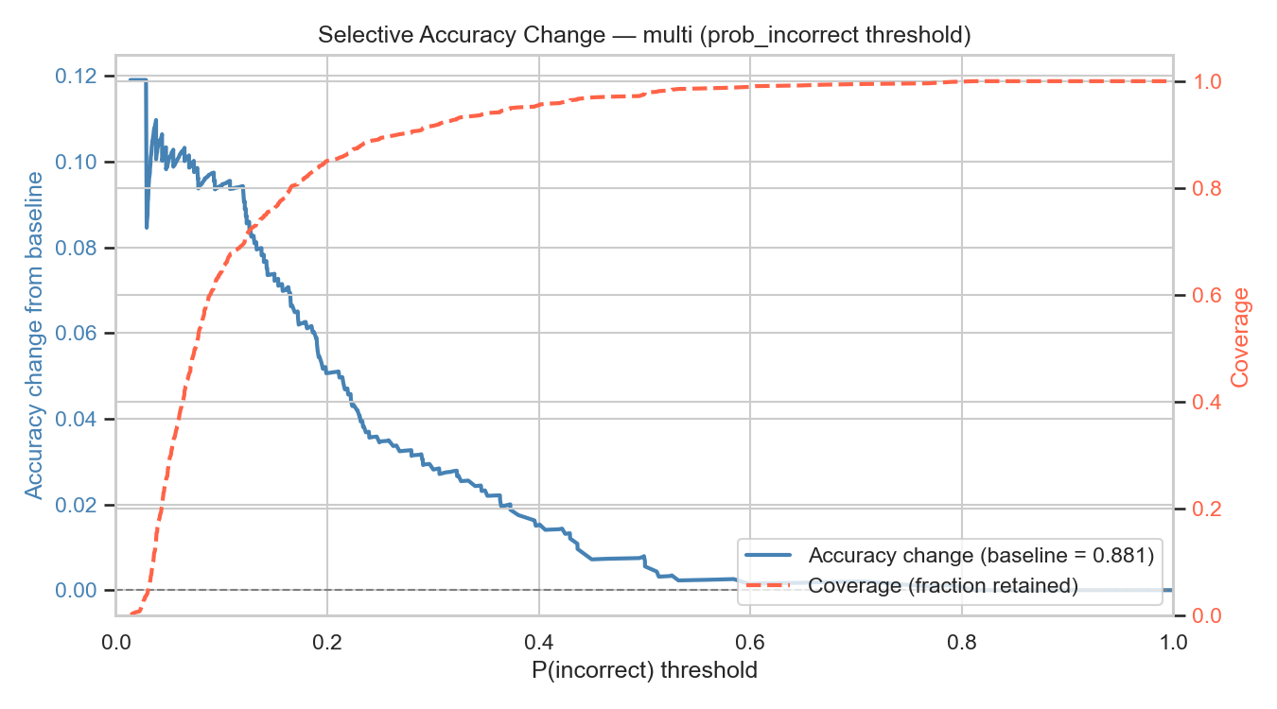
3.3 Confidence Evaluation
Logistic regression classifier using two best features calibrated using 5-fold cross-validation

