Slide 1
Prediction of 30-Day Hospital Readmission in Patients with Diabetes
Sara Raees

Slide 2
Background
Dataset: Diabetes 130-US Hospitals for Years 1999–2008 (UCI Machine Learning Repository).
Aim: Develop a prediction model for 30-day hospital readmission among hospitalized patients with diabetes.
Approach: A stratified sample was used to preserve the proportion of patients readmitted within 30 days.

Slide 3
Study Population
Total observations: 20001
Proportion readmitted within 30 days: 11.16%
Outcome: Binary variable readmit30 (“Yes” / “No”)

Slide 4
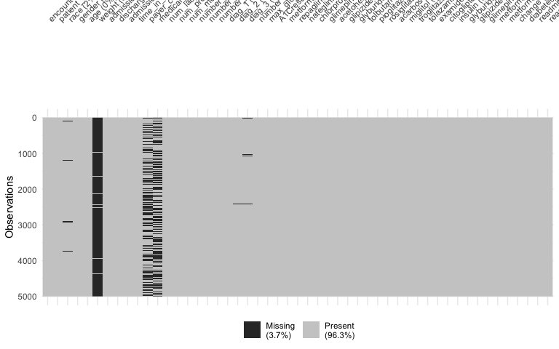
Missingness Analysis

Slide 5
Interpretation: Most variables have near-complete data. However, variables such as weight, medical_specialty, and payer_code show high missingness. Predictors with >50% missing data are excluded prior to modeling.

Slide 6
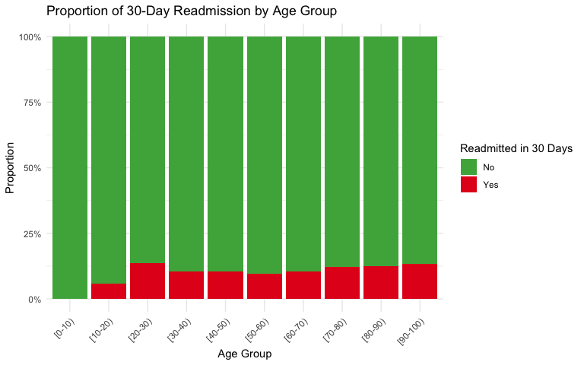
Analysis: Age Group

Slide 7
Interpretation: Readmission proportion slightly varies across age groups. While older patients make up a large portion of the cohort, the proportion of those readmitted within 30 days is comparable across advanced age categories.

Slide 8
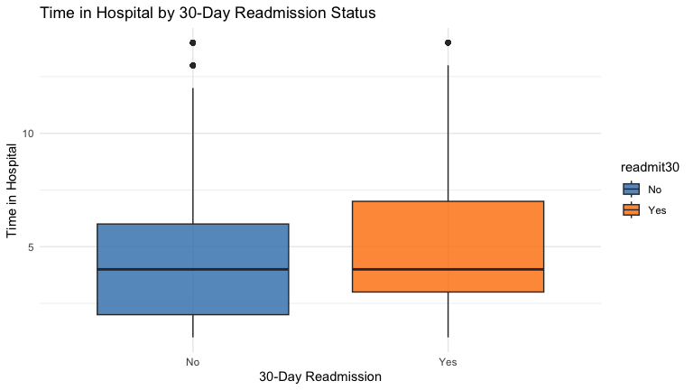
Analysis: Time in Hospital

Slide 9
Interpretation: Patients readmitted within 30 days (“Yes”) tend to have a slightly higher median time in the hospital during their initial stay compared to those not readmitted (“No”), suggesting longer initial stays may relate to higher readmission risk.

Slide 10
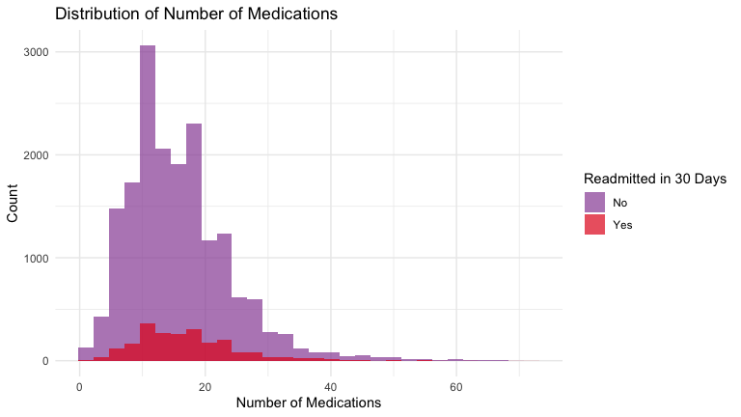
Analysis: Number of Medications

Slide 11
Interpretation: The distribution of number of medications is right-skewed. The group readmitted within 30 days has a notably wide spread in the number of prescribed medications, which may be a proxy for more complex or severe underlying health conditions.

Slide 12
Methods
Identifier Removal: Excluded encounter_id, patient_nbr.
Threshold: Removed predictors with >50% missingness.
Train/Test Split: 70% Training / 30% Testing.
Imputation:
Numeric: Median Imputation
Categorical: Added “Missing” category
Models Evaluated:
Logistic Regression
Random Forest (ntree = 300)

Slide 13
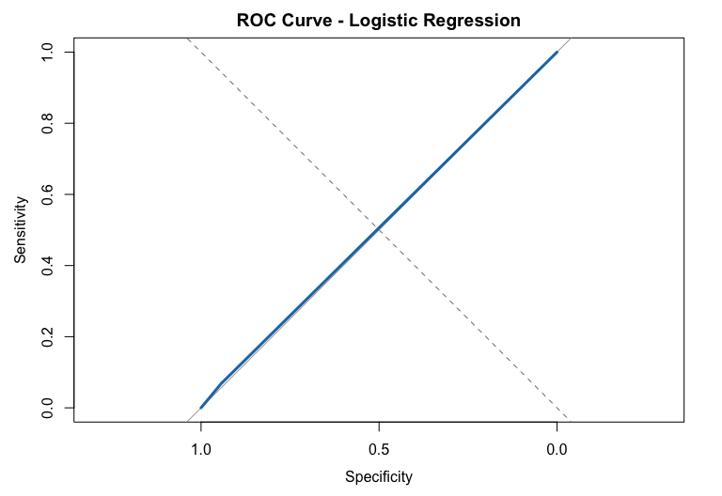
Logistic Regression: ROC Curve

Slide 14
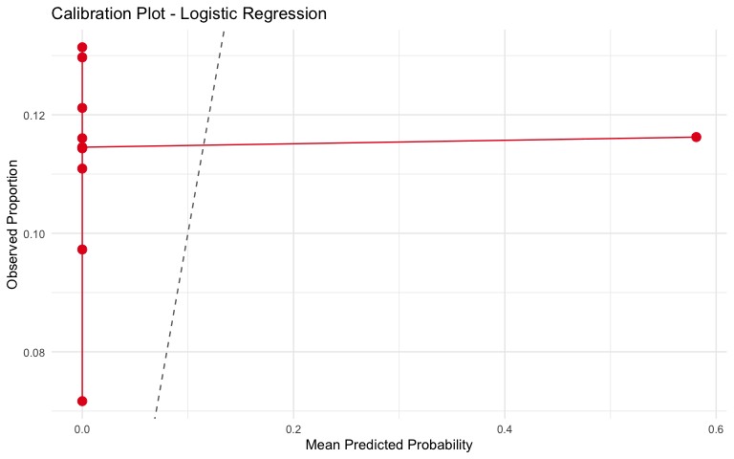
Logistic Regression: Calibration

Slide 15
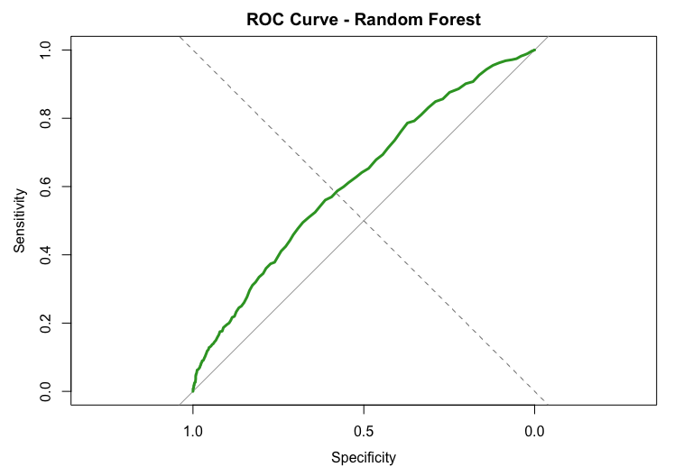
Random Forest: ROC Curve

Slide 16
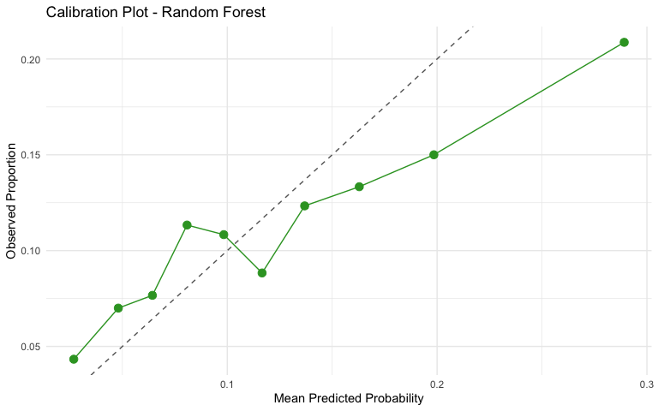
Random Forest: Calibration

Slide 17
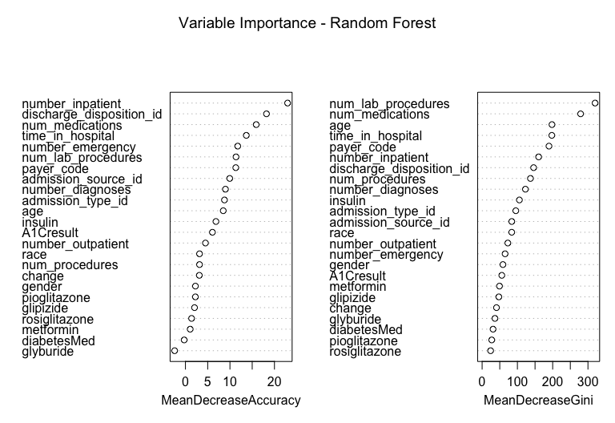
Random Forest: Variable Importance

Slide 18
Interpretation: Variables like num_lab_procedures, num_medications, time_in_hospital, and age consistently emerge as the most important predictors in the model. This emphasizes that healthcare utilization and demographic factors during the initial admission are key indicators of potential readmission risk.

Slide 19
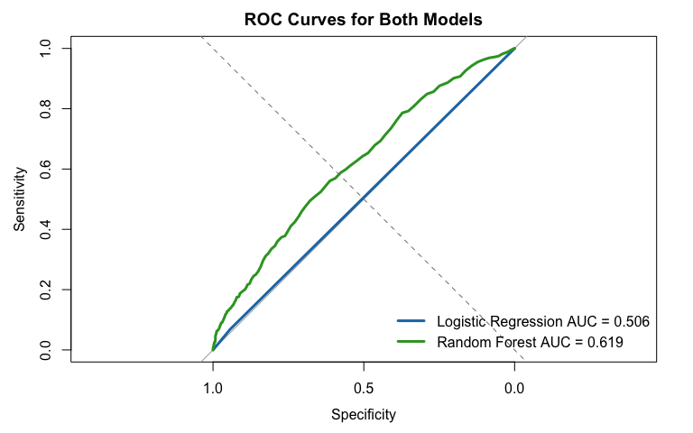
Model Comparison

Slide 20
Summary & Conclusion
Logistic Regression:
AUC: 0.506 | Brier Score: 0.155
Performance is slightly better than random baseline, limited discriminatory ability.
Random Forest:
AUC: 0.619 | Brier Score: 0.0979
Outperformed Logistic Regression with better overall discrimination and prediction accuracy.
Conclusion: Predicting 30-day hospital readmission is challenging; Random Forest identifies high-risk patients better.

Slide 21
Project Information
Full code and analysis available on GitHub:
https://github.com/sararaees786/Predictive-Modelling

