Slide 1
Online Based Emergency Medicine And Doctor Services
Student ID
18101062
18101059
18101067

Slide 2
Problem Statement :
People who are from remote areas are deprived from proper treatment facilities. For this reason they need to go to Dhaka city for getting better treatment, which are so much painful and also expensive one the other hand, during emergency situation its became very pathetic for them to collect necessary medicines.
For solving all of these problems, our system will be very helpful for common people.

Slide 3
Objective of the System :
Our main purpose is to provide proper medicine and medical services through online.

Slide 4
Features of the System
Emergency Medicine delivery service.
Live video conferencing with specialized doctors.
A website and Application for android and ios platform.
24/7 emergency doctors service (only phone call).

Slide 5
Resources we need to build the system
Money
Manpower

Slide 6
Revenue after a fixed time
Doctors visiting charge + 100 tk charge for every patients.
Assume that, if 300 patients treat daily, then the income of TK 30,000 will be earned and if the daily medicine is sold 12,000 TK then annual revenue will be 1,51,20,000 TK.

Slide 7
Requirement Analysis

Slide 8
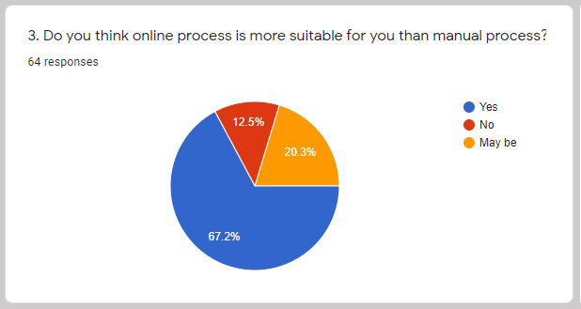
Do you think online process is more suitable for you than manual process?

Slide 9
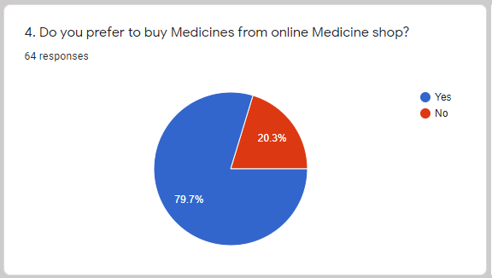
Do you prefer to buy Medicines from online Medicine shop ?

Slide 10
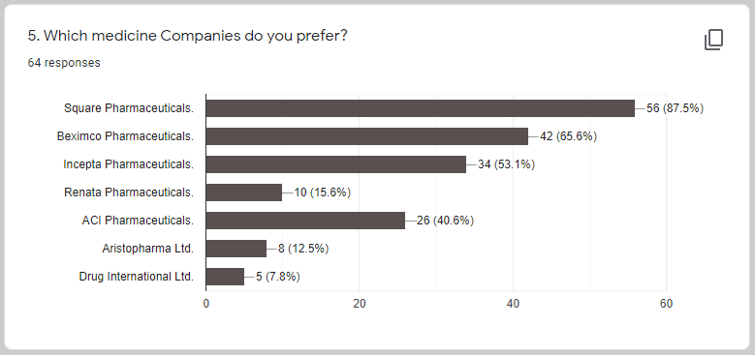
Which medicine Companies do you prefer ?

Slide 11
How long will you wait for your ordered medicines to receive?

Slide 12
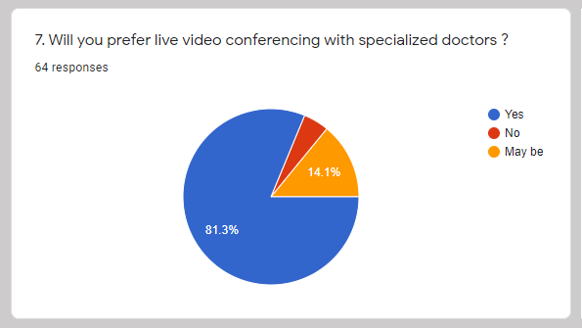
Will you prefer live video conferencing with specialized doctors ?

Slide 13
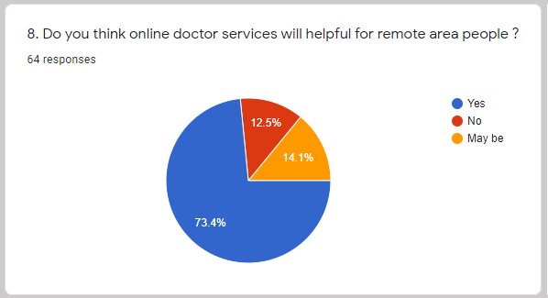
Do you think online doctor services will helpful for remote area people ?

Slide 14
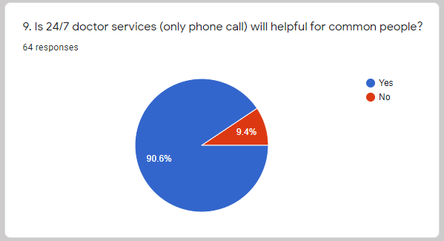
Is 24/7 doctor services (only phone call) will helpful for common people?

Slide 15
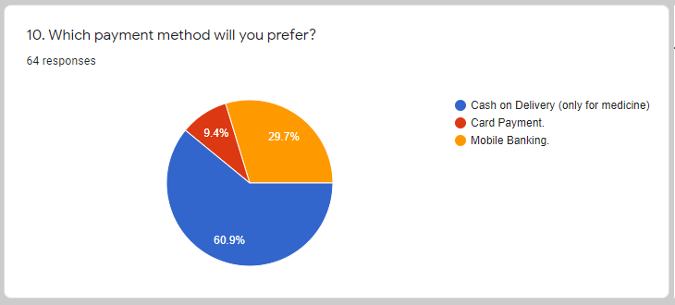
Which payment method will you prefer ?

Slide 16
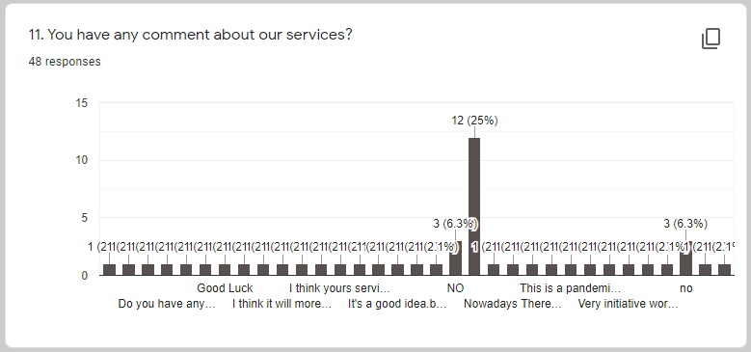
You have any comment about our services ?

Slide 17
Decision from Survey
After this survey we see that the responses from people is quit impressive and they also liked our features. So we don’t need any changes for our project. In the future if require any feature then we will update it.

Slide 18
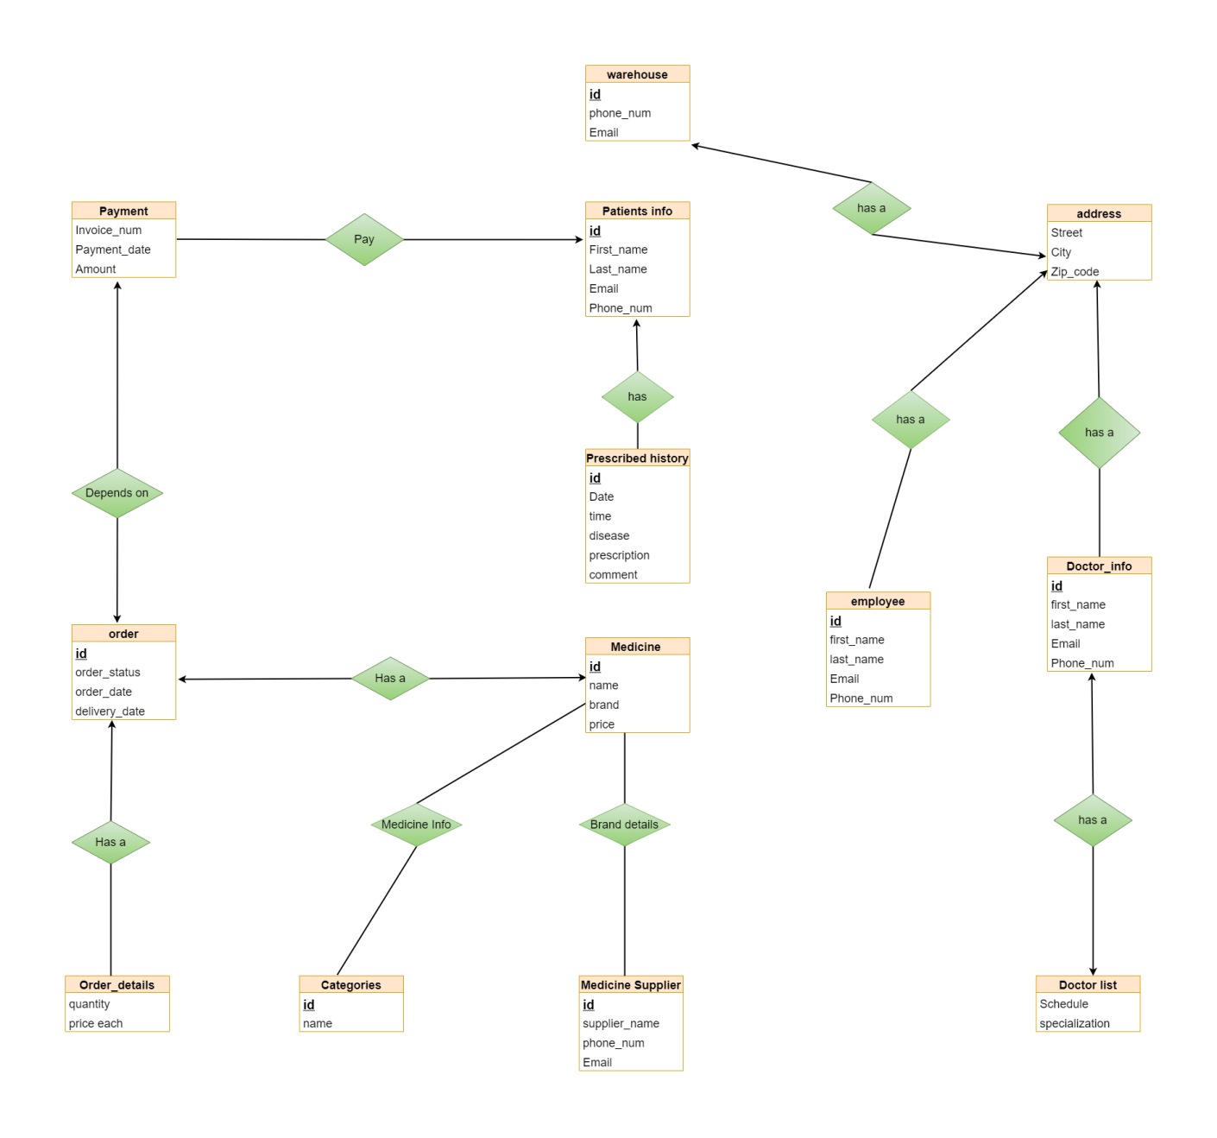
ER Diagram

Slide 19
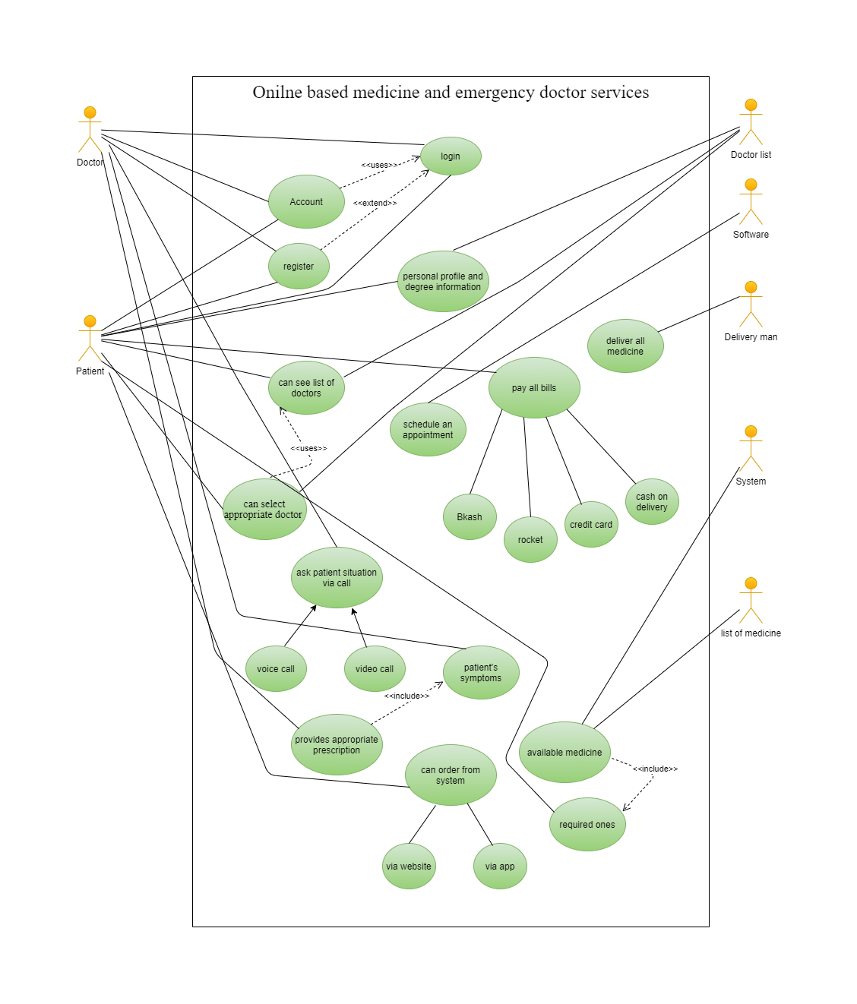
Use Case Diagram

Slide 20
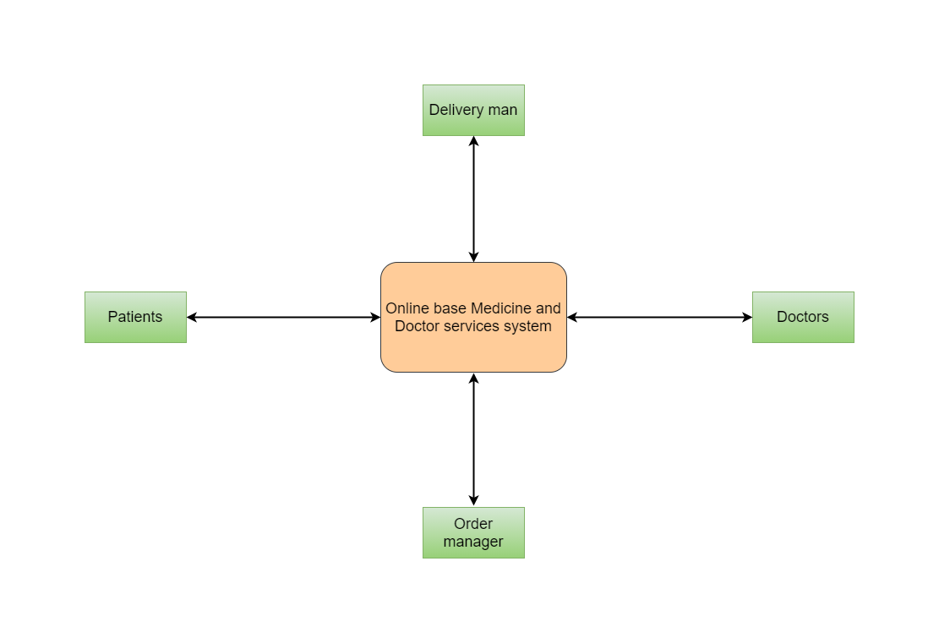
Data Flow Diagram Level 0

Slide 21
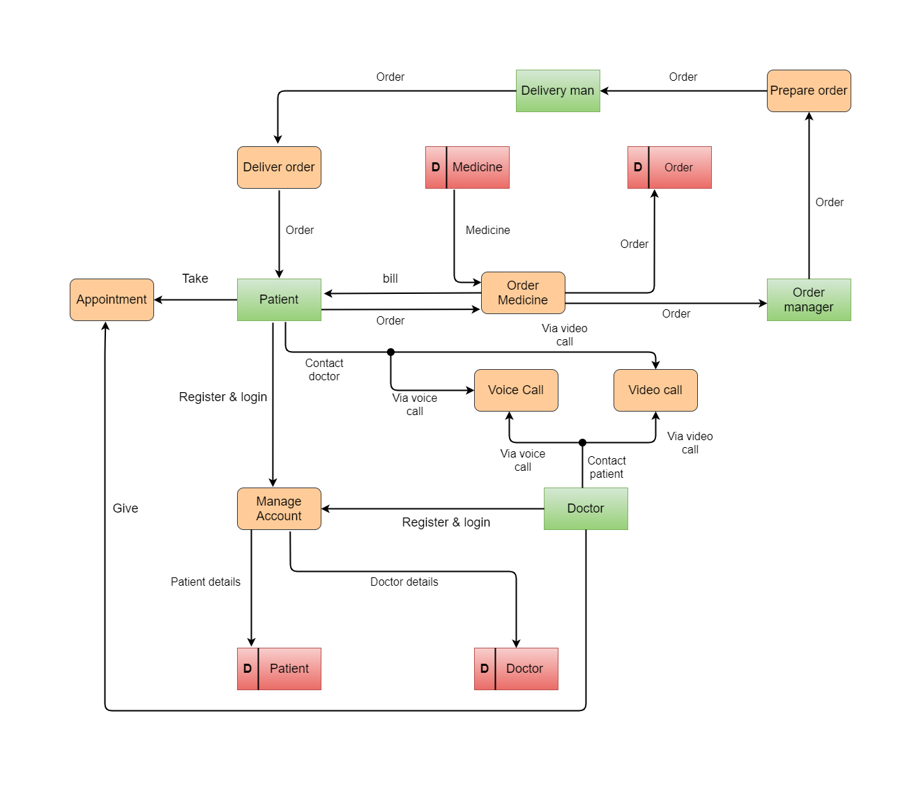
Data Flow Diagram Level 1

Slide 22
Thank you

