Slide 1
projet 2 L.EIC – IART
Simão Ribeiro
Deniz Günes
Sara Ribeiro

Slide 2
customer
Mobile-money operator (PaySim-like synthetic profile)
Operates customer-to-customer transfers, cash-in, cash-out, payments, debit

Slide 3
problem
Fraudulent transactions in mobile-money transfers cause direct loss and erode trust
Fraud rate ≈ 0.13% of all transactions - strongly imbalanced
Current approach: hand-tuned rules over balance/amount thresholds
Misses novel patterns; rules drift out of date quickly
Produces high false-positive load on the review team
Goal: rank every transaction by fraud risk in near-real-time

Slide 4
available data
Single transaction log (PaySim simulator, ~6.36M rows, 11 columns)
Identifiers: nameOrig, nameDest (dropped - non-predictive)
Time: step (1 unit = 1 hour over a 30-day window)
Transaction: type ∈ {CASH_IN, CASH_OUT, DEBIT, PAYMENT, TRANSFER}, amount
Balances before/after for both parties (oldbalanceOrg, newbalanceOrig, oldbalanceDest, newbalanceDest)
Labels: isFraud (target), isFlaggedFraud (legacy rule, discarded — unreliable)

Slide 5
solution overview
Predictive scoring layer plugged into the existing review pipeline
Components:
Batch data prep - clean, encode, temporal split, feature engineering
Model service - XGBoost classifier returning fraud probability
Review console (out of scope) - surfaces high-risk transactions to analysts

Slide 6
predictive model
Binary classifier where target = isFraud
Algorithm: gradient-boosted trees (XGBoost, hist tree method)
Raw inputs: step, type, amount, oldbalanceOrg, newbalanceOrig, oldbalanceDest, newbalanceDest
Engineered features:
errorBalanceOrig, errorBalanceDest - balance equation residuals (fraud signature)
orig_zero_after, dest_zero_before, dest_zero_after - empty-account flags
hour_of_day, day_of_week - derived from step
amount_log, is_high_amount (≥ p99) - amount transforms
is_transfer_or_cashout - fraud only occurs in these two types in PaySim
Stacked feature: Isolation-Forest anomaly score fit on labeled + unlabeled pool
Class weighting: scale_pos_weight derived from labeled class ratio (not hardcoded)

Slide 7
empirical study: setup
Temporal split via `step` tail 20% → test, prior 10% → val, rest → train pool
Reflects deployment reality: future is held out, not random rows
Limited-label regime: 1,000 labeled per class kept, rest of train pool stripped of labels
Preprocessing pipeline: OneHotEncoder(type) + StandardScaler(numerics), fit on labeled + unlabeled
Isolation Forest fit on the joint labeled + unlabeled pool, contamination tied to fraud rate
Model: XGBoost with class weighting; evaluated only on the held-out temporal tail
Metrics: PR-AUC, average precision, ROC-AUC, recall@precision=0.9, plus precision / recall / F1 / confusion counts at threshold 0.5
Justification: PR-AUC and recall@P=0.9 reflect the business cost of missed fraud under strong imbalance better than accuracy

Slide 8
empirical study: results
Performance on the temporal test tail (~1.25M transactions, 4,250 fraud)
PR-AUC: 0.9999 Average Precision: 0.9999 ROC-AUC: 1.0000
Recall@Precision=0.9: 0.9995
Threshold 0.5 - Precision 0.9960 · Recall 0.9988 · F1 0.9974
Confusion: TP 4245 · FN 5 · FP 17 · TN 1,244,469
Comparison: a self-trained variant (pseudo-labels on the unlabeled pool) was tested and dropped — it degraded PR-AUC (0.995) and inflated false positives without recovering recall

Slide 9
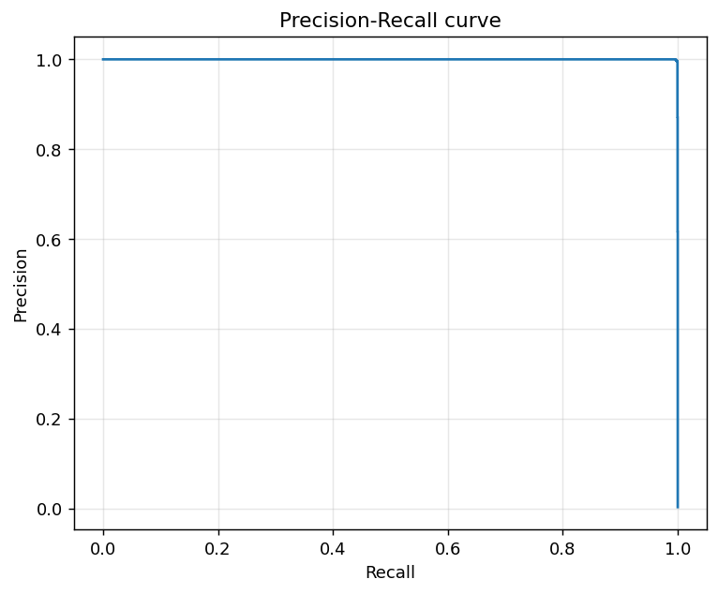
precision-recall curve
PR curve is preferred over ROC under extreme class imbalance
Area under PR ≈ 1.0 → model holds high precision across virtually all recall levels

Slide 10
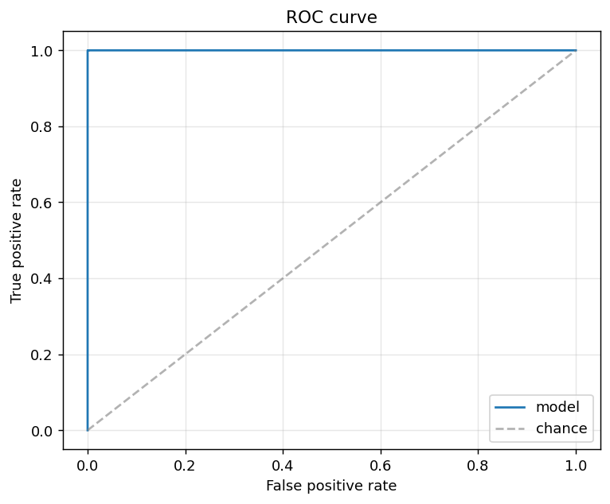
roc curve
ROC stays near the top-left corner - separability is essentially perfect on this synthetic dataset
ROC-AUC ≈ 1.0; reported for completeness but PR-AUC is the load-bearing metric here

Slide 11
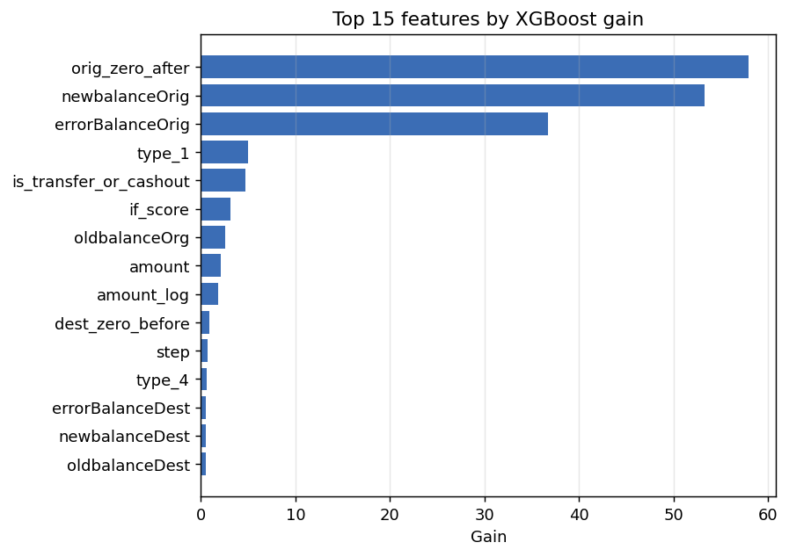
feature importance
Top 15 features by XGBoost gain
Engineered balance-error features dominate raw balances - confirms the EDA hypothesis
Isolation-Forest score (if_score) contributes meaningfully despite being unsupervised

Slide 12
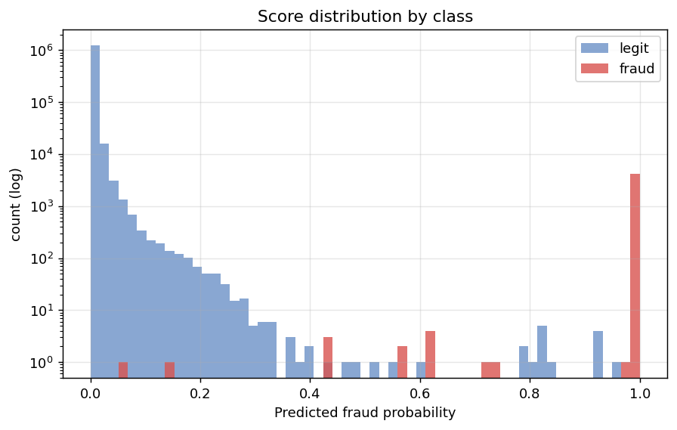
score distribution
Predicted probability histograms by true class (log y-axis)
Legit mass concentrates near 0, fraud near 1, there is clean separation
Long thin tails are where threshold choice actually matters

Slide 13
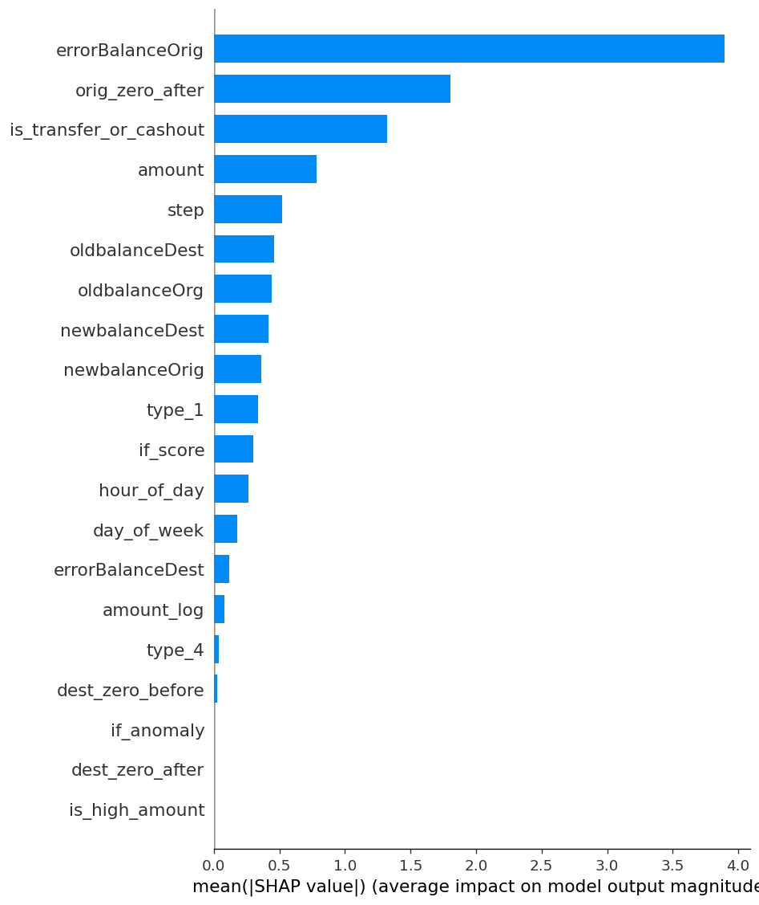
model interpretation
Top contributing features (by XGBoost gain and SHAP):
errorBalanceOrig - strongest single signal (post-transaction balance break)
errorBalanceDest - mirrors fraudulent destination behaviour
amount / amount_log - high-value transfers carry elevated risk
is_transfer_or_cashout - fraud restricted to these types in the source data
if_score (Isolation-Forest anomaly) - adds unsupervised signal at low cost
SHAP confirms the engineered balance-error features dominate over raw balances

Slide 14
stakeholders
Fraud Operations Lead - owns thresholds, alert capacity, policy escalation
ML Engineer - trains, monitors and retrains the model
Data Engineer - owns the transaction pipeline and feature freshness
Compliance / Legal Officer - reviewability, GDPR, right-to-explanation
Customer Support - handles disputes and false-positive freezes
End customers - affected by both fraud losses and false freezes

Slide 15
expected challenges during development and deployment
Technical
Extreme class imbalance (~0.13% positive) - naive metrics misleading
Concept drift - attack patterns mutate, retraining cadence required
Label scarcity in real settings -- confirmed fraud often arrives weeks late
Probability calibration - required when scale_pos_weight is used
Organizational
Trust in opaque ML scores vs. existing deterministic rules
Alert fatigue if precision is not held above the analyst-capacity threshold
Cross-team coordination between fraud ops, data and legal

Slide 16
unavailable data
Device and session signals - IP, device fingerprint, geolocation
Account history - age, KYC tier, prior chargebacks, recent disputes
Counterparty graph - repeated recipients, mule-account proximity
Customer demographicsCollection challenges:
Privacy and regulatory constraints (GDPR, data minimisation)
Integration with KYC / device-intel vendors
Late-arriving labels - confirmed fraud takes weeks to settle

Slide 17
ethical risks
False positives can freeze legitimate accounts - disproportionate harm to vulnerable users
Opacity of gradient boosting limits the customer's ability to contest a decision
Risk of bias if proxy features correlate with protected attributes (e.g. neighbourhood, device)
Data minimisation - only collect what is necessary; resist scope creep into surveillance
Mitigations: SHAP-based explanations, human review on all blocking actions, periodic fairness audits, calibrated thresholds tied to analyst capacity

