Slide 1
Renewable Energy, Challenges and Causes
Sara Rouzbehani

Slide 2
Data Cleaning
Number of data points is different for each type of energy
For some dates there is no data points available
Some of the dates are missing
There is no one-to-one correspondence between different types of data points

Slide 3
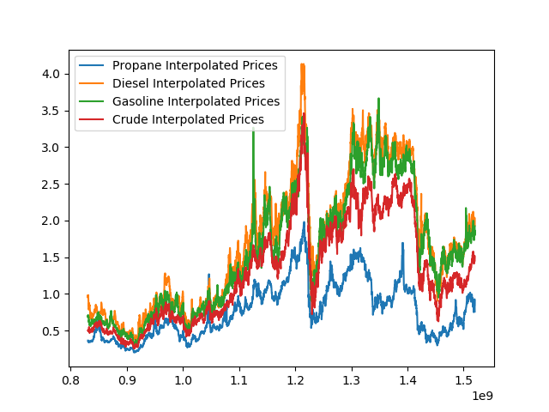
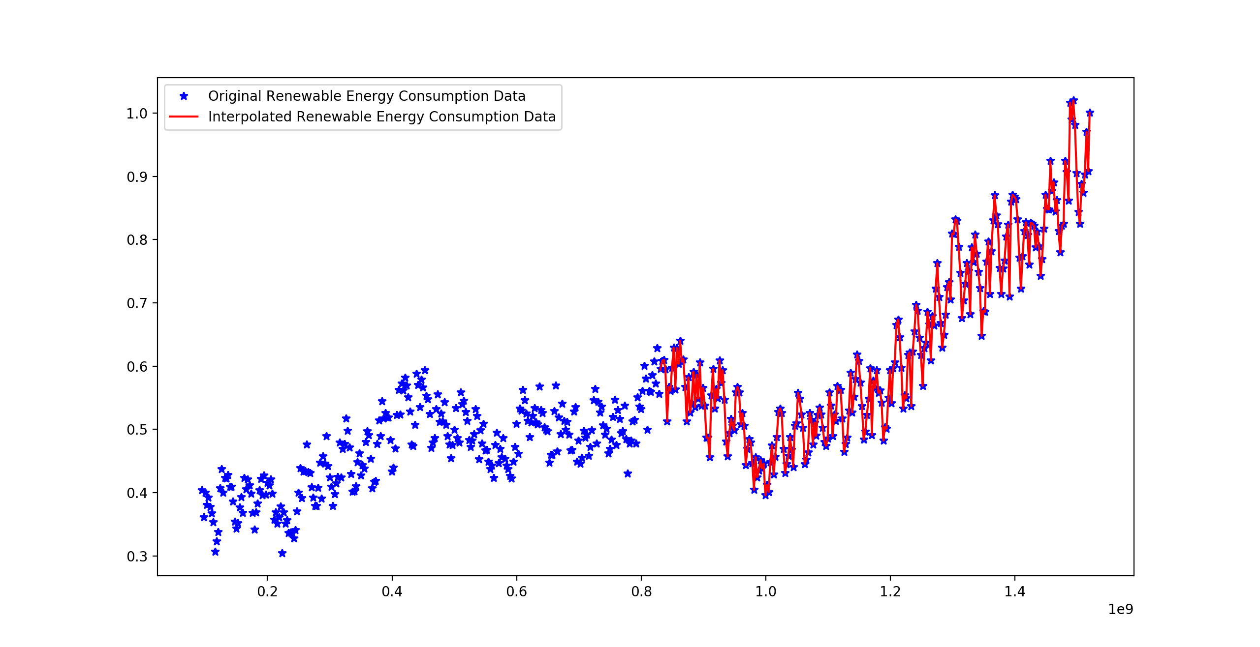
Interpolation

Slide 4
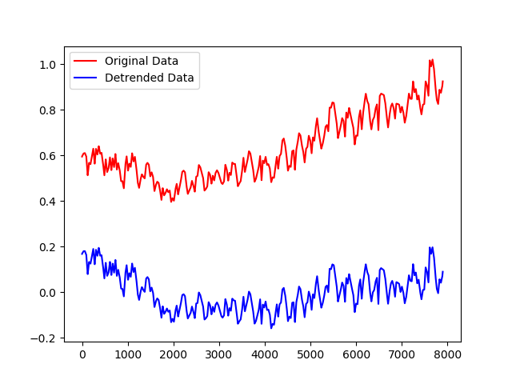
Model
De-trending the model
Residual value

Slide 5
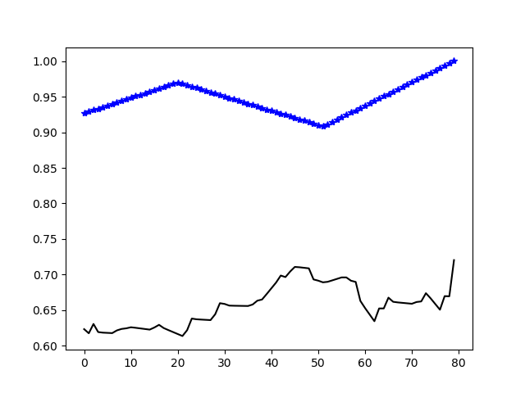
Linear Regression

Slide 6
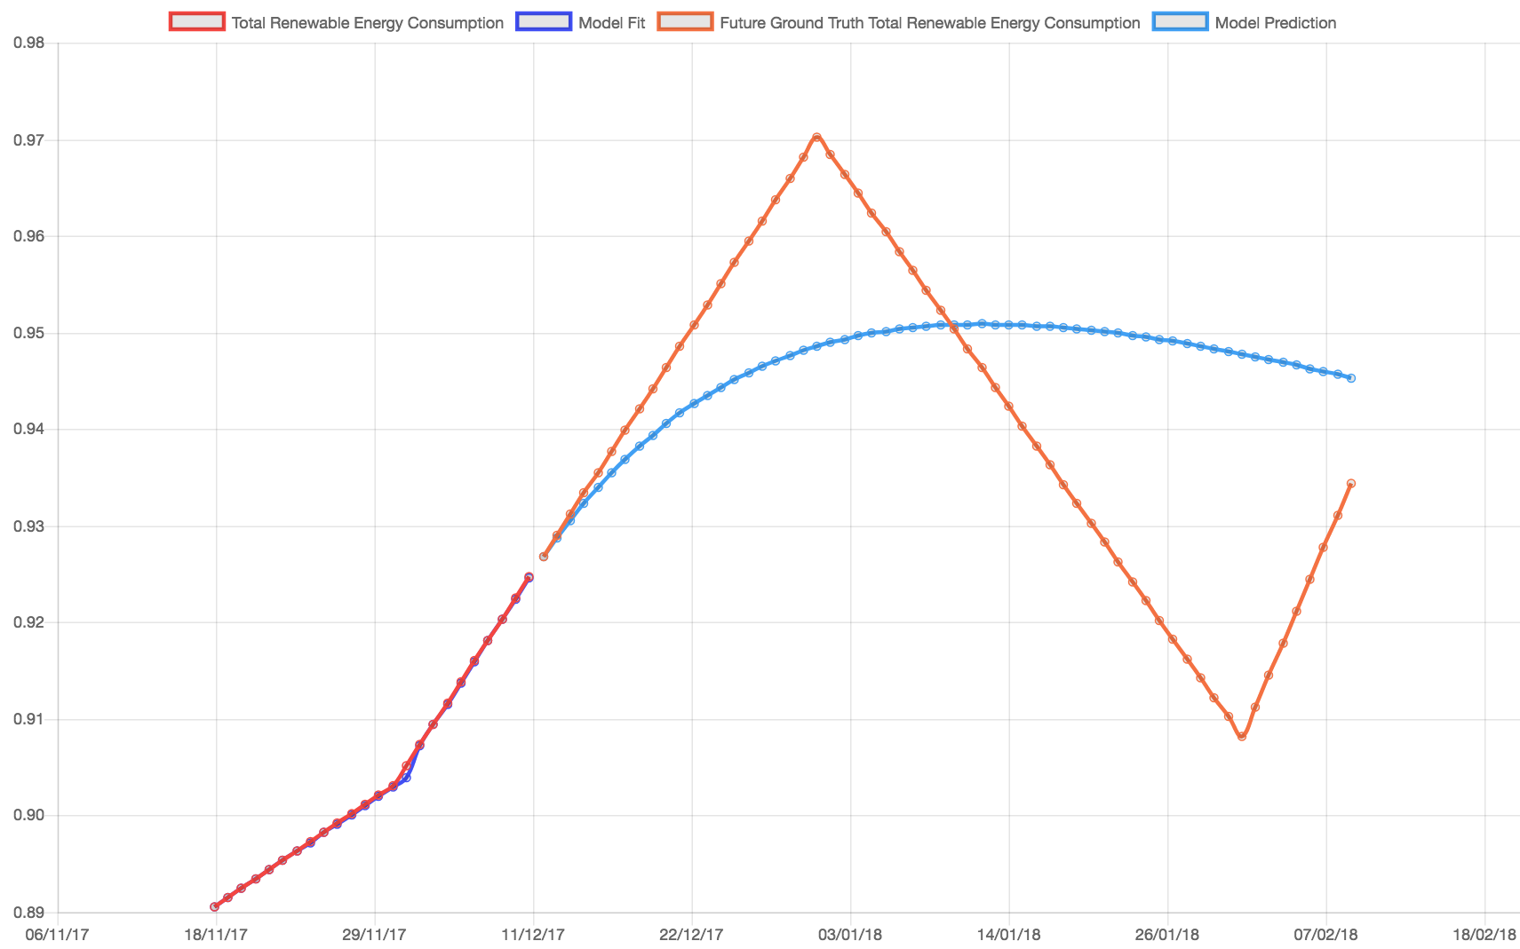
ARIMA (Autoregressive integrated moving average)
Autoregressive integrated moving average →Time series
Self-regressive model
Adding outside data
Temporal Dependence

Slide 7

Prediction
Is it a prediction?
Auto-regressive Model
What if Scenario…

Slide 8
Questions?

