Slide 1
Analysis & Prediction of Renewable Energy Consumption using Machine Learning
Sara Rouzbehani

Slide 2

Project Goals and objectives
Find the relationship between consumption of renewable energy and oil price using Machine Learning
Predict consumption of renewable energy for next 3 month
The Data Source is U.S. Energy Information Administration

Slide 3
Step 1 :Data Cleaning
1.1 Remove corrupted data points
1.2 Interpolate the data to get more points
1.3 Align the datasets
Challenges
Number of data points is different for each type of energy
For some dates there is no data points available
Some of the dates are missing
There is no one-to-one correspondence between different types of data points

Slide 4
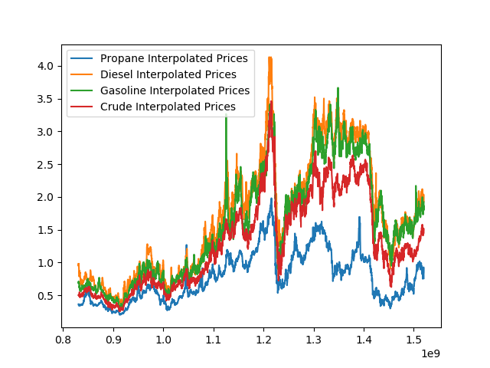
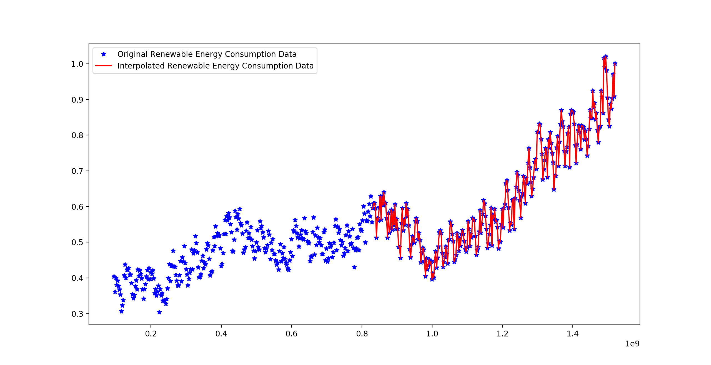
1.2 Interpolation

Slide 5
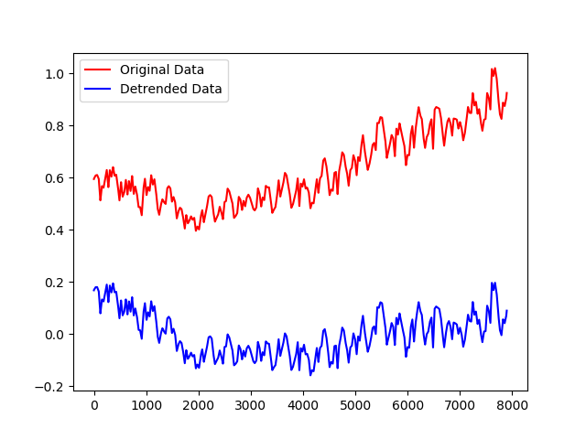
Step 2 : Creating and fitting the model
De-trending the model
Consumption of renewable energy is increasing every year
To have an accurate prediction we need to remove the increasing trend of consumption
Residual value
The remainder of the time series data after removing trend, and it contains the variance information

Slide 6
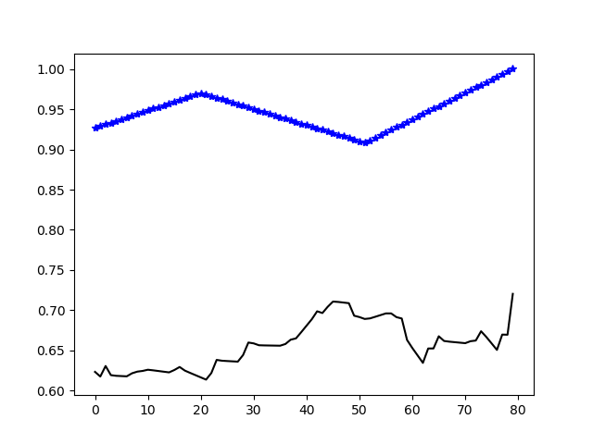
Step 3: Finding the correlation between Oil Price and Consumption of renewable energy
The correlation factor between Oil price and Consumption of renewable energy was 0.65 which means they are significantly correlated

Slide 7
Step 4 : Prediction
Auto-Regressive Integrated Moving Average (ARIMA)
Self-regressive model
Adding outside data
Temporal Dependence
(Time Series)

Slide 8
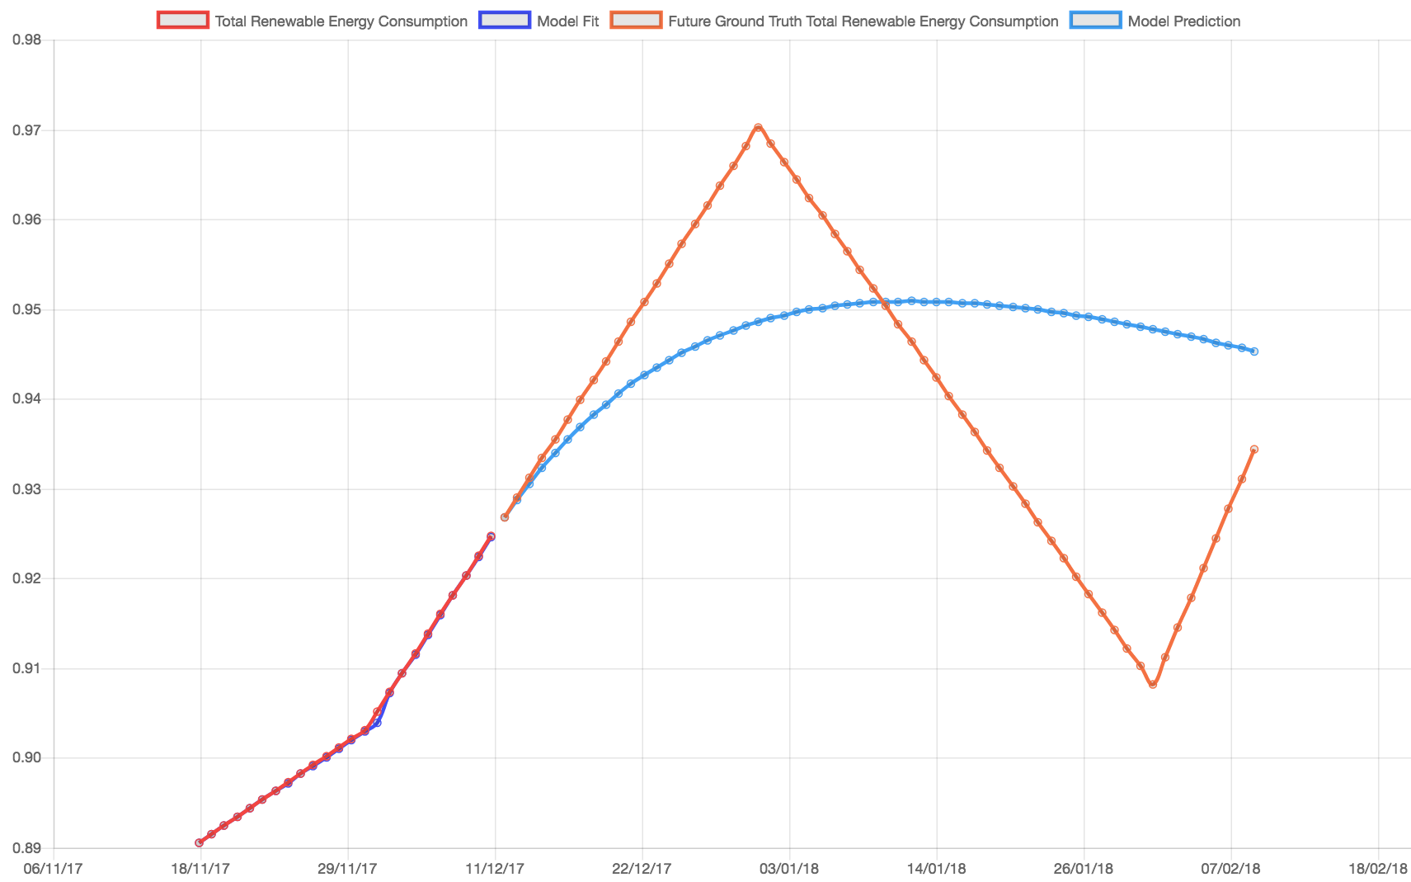
ARIMA (Auto-Regressive Integrated Moving Average)

Slide 9

Outcome
Is it a prediction
Auto-regressive Model
Use Case:
What if Scenario…
We can use this model in a what-if scenario analysis to evaluates different scenarios to predict their effects – both positive and negative – on the Consumption of Renewable energy to determine the feasibility of the schedule under unexpected and adverse situations

Slide 10
Used Tools and Software
Data Cleaning : Pandas
Correlation Analysis : Python (stat Model)
Interpolation : Python (stat Model)
Model de-trending:
Machine Learning:
Web Developing : (HTML, JavaScript, CSS)

Slide 11
Thank you

