Slide 1
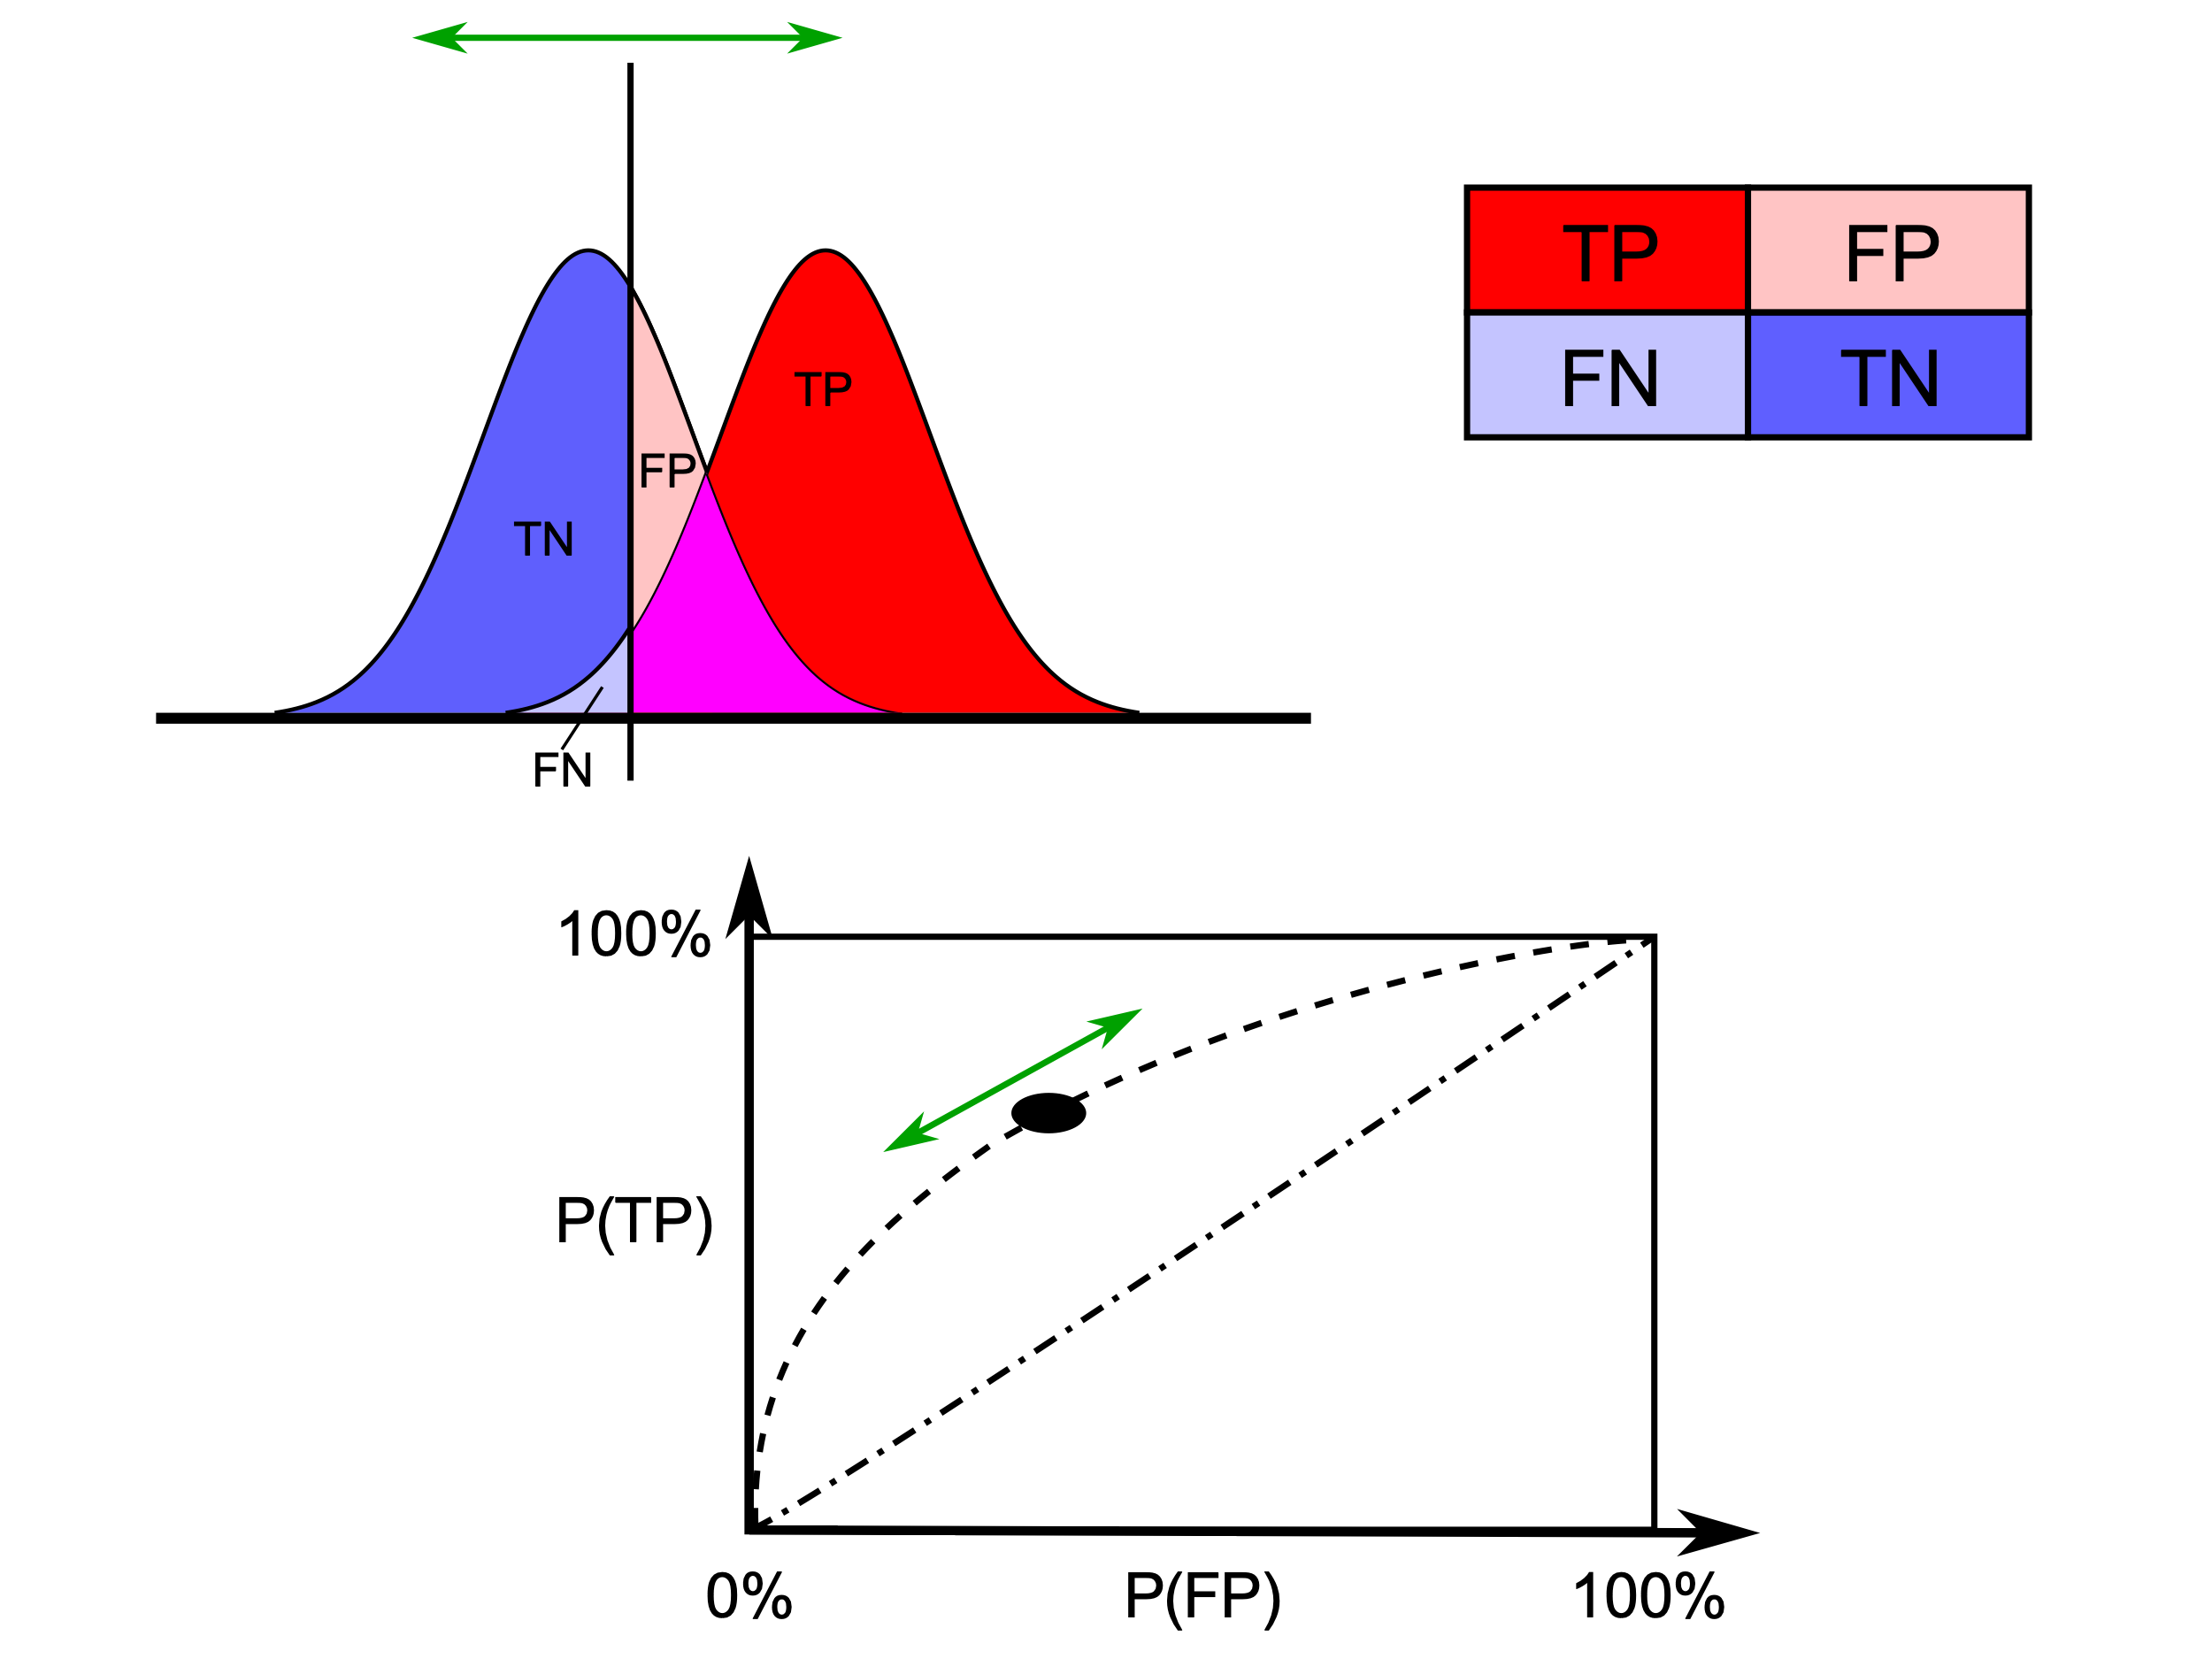
Receiver Operating Characteristic (ROC)
https://en.wikipedia.org/wiki/Receiver_operating_characteristic

Slide 2
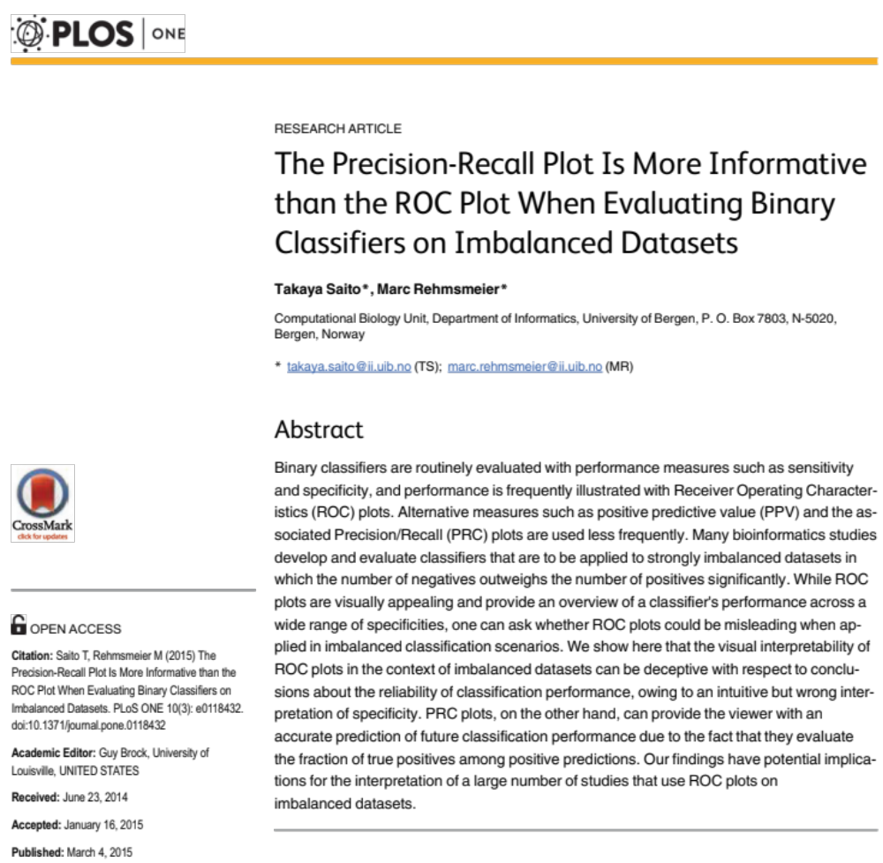
Saito T, Rehmsmeier M (2015) The Precision-Recall Plot Is More Informative than the ROC Plot When Evaluating Binary Classifiers on Imbalanced Datasets. PLOS ONE 10(3): e0118432. https://doi.org/10.1371/journal.pone.0118432
https://journals.plos.org/plosone/article?id=10.1371/journal.pone.0118432

Slide 3
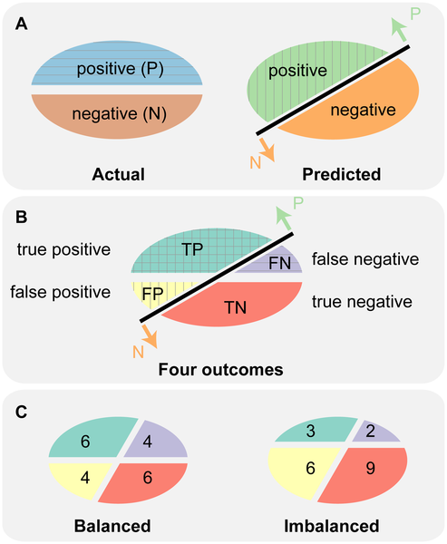
Fig 1. Actual and predicted labels generate four outcomes of the confusion matrix.

Slide 4
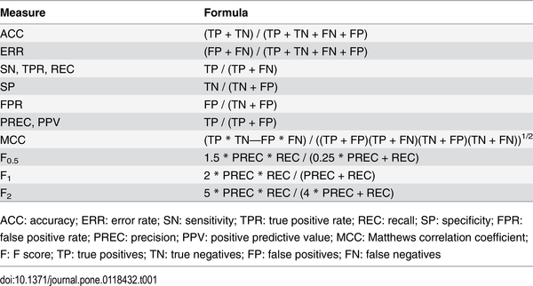
Table 1. Basic evaluation measures from the confusion matrix.
y-as ROC x-as PRC
x-as ROC
y-as PRC

Slide 5
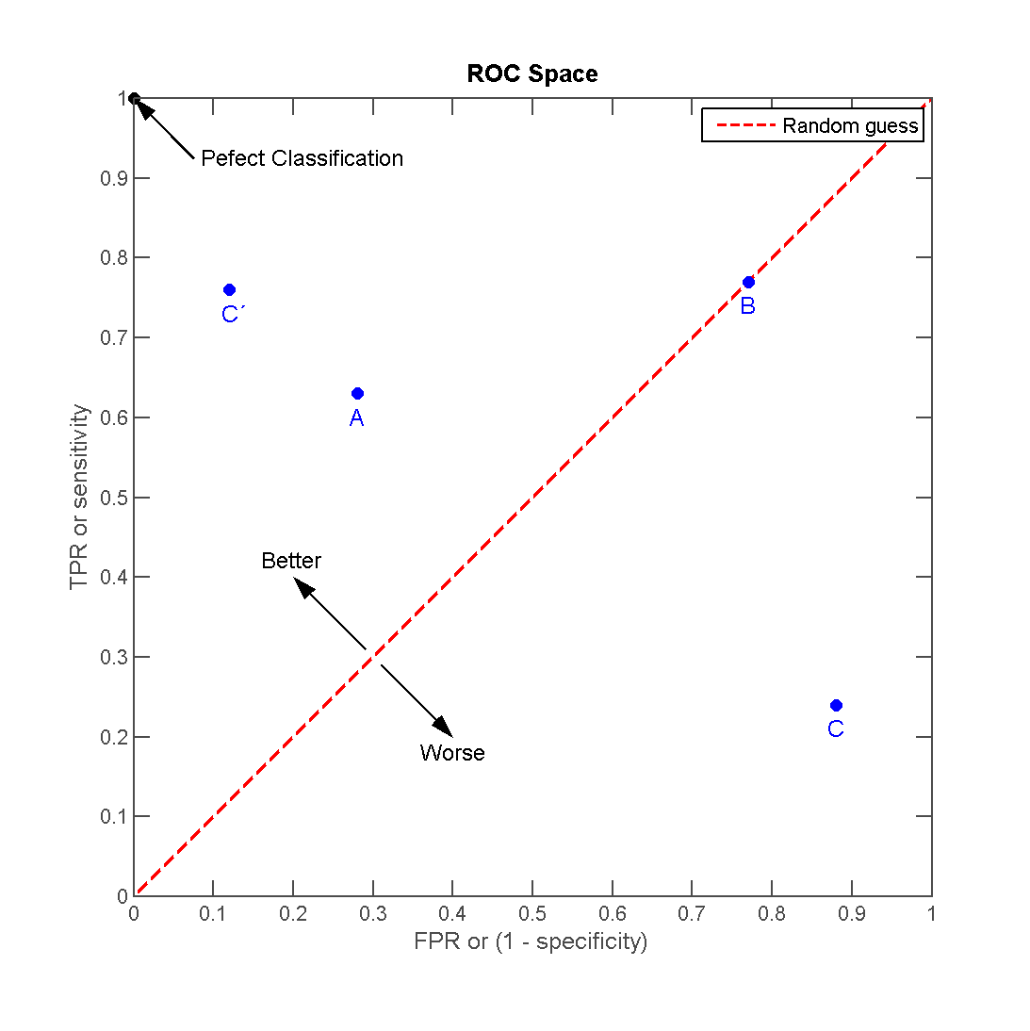
https://en.wikipedia.org/wiki/Receiver_operating_characteristic

Slide 6
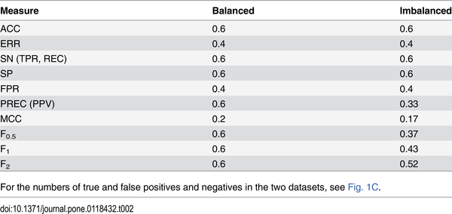
Table 2. Example of basic evaluation measures on a balanced and on an imbalanced dataset.

Slide 7
Precision recall curve: ideal classifier
https://www.datascienceblog.net/post/machine-learning/interpreting-roc-curves-auc/

Slide 8
Precision recall curve: good classifier
https://www.datascienceblog.net/post/machine-learning/interpreting-roc-curves-auc/

