Slide 1


EUROPEAN
MICROOFT
FABRIC SäL
CoitmunityConfeænce
BARCELONA
- 01 OCT 2026

Slide 2




From Notebook to Bedside: Building a Clinical Risk Prediction Pipeline in Fabric
Do not record or livestream this session
Audrius Šaras
AI & Data Engineer
KPMG Netherlands
/sarasaudrius
Manu Huygens
Cloud & Data Engineer
KPMG Netherlands
/

Slide 3
Agenda
01 | Fabric Data Science & ML | 5
02 | Prediction models in EU healthcare | 8
03 | The data and the problem | 12
04 | Training and tracking the model in Fabric | 12
05 | A model a clinician can argue with | 8
06 | Delivery: the clinician app | 5
07 | Learnings | 6

Slide 4
Fabric Data Science & Machine Learning

Slide 5

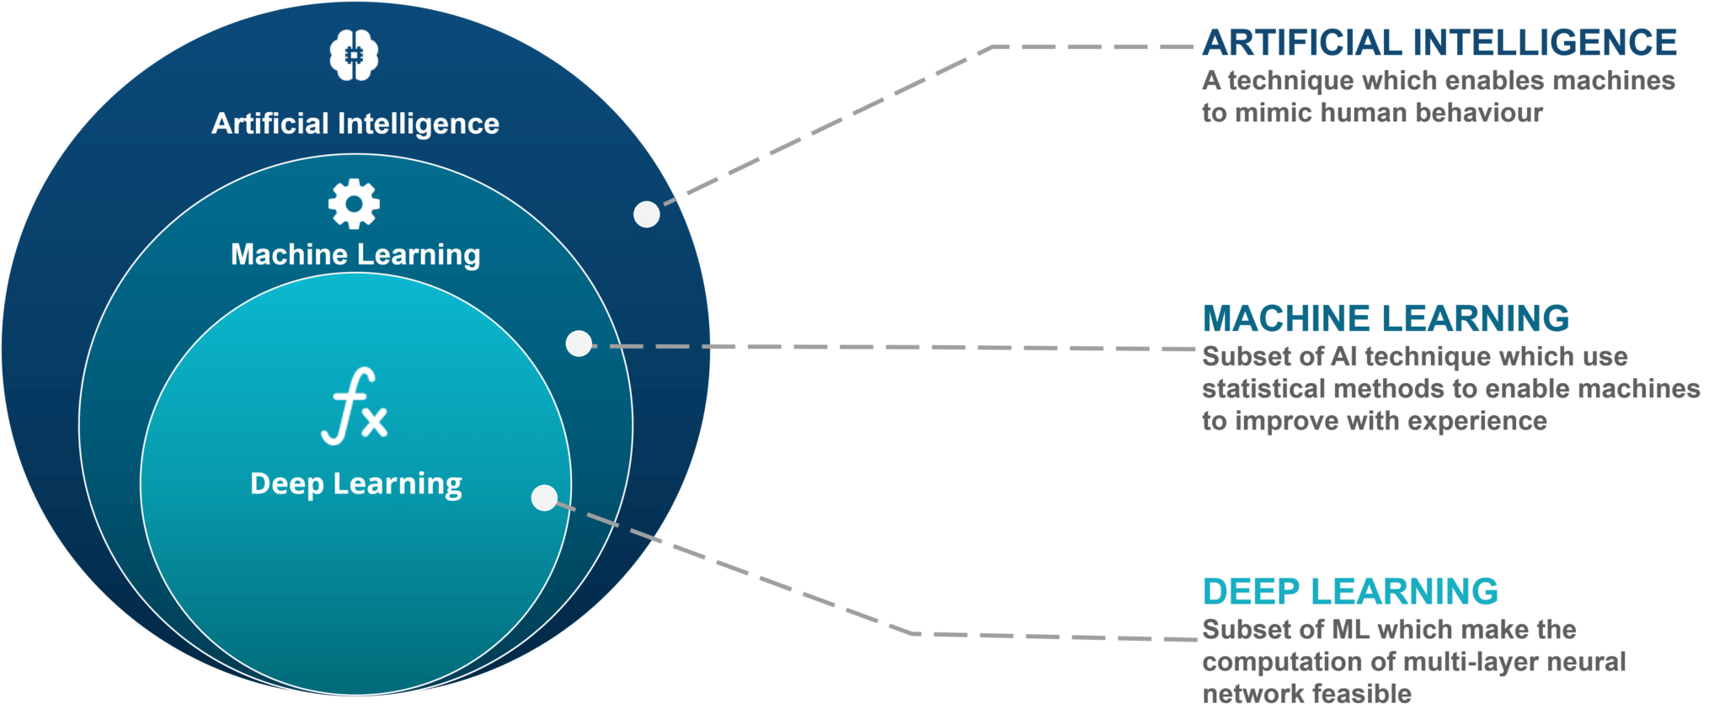
ML as a subset of AI

Slide 6
Three ways a machine learns
Machine learning is a family of methods. They differ in what the computer learns from.
Supervised learning
LEARNS FROM
Examples with the right answer attached. The computer sees the inputs and the known outcome, and learns the link between them.
TYPICAL QUESTIONS
“Will this patient have a poor outcome?” “What will this score be?”
IN HEALTHCARE
Risk scores, diagnosis support, readmission prediction.
This is what we do in this session.
Unsupervised learning
LEARNS FROM
Examples with no answer attached. The computer looks for structure on its own: groups, patterns, unusual cases.
TYPICAL QUESTIONS
“Which patients are similar to each other?” “Which records look unusual?”
IN HEALTHCARE
Patient segmentation, anomaly detection in claims or devices.
Reinforcement learning
LEARNS FROM
Trial and error. The computer takes actions, gets a reward or a penalty, and learns a strategy over time.
TYPICAL QUESTIONS
“Which sequence of actions gives the best result?”
IN HEALTHCARE
Adaptive treatment schedules, resource scheduling. Rare in clinical practice today.
Deep learning is not a fourth type: it is a way of building models (neural networks) that can be used inside any of the three.
Notes:
One minute. Three ways a machine learns, by what it learns from. Ours is supervised: we have past patients with a known outcome, so the computer learns the link between what we knew before surgery and what happened after.

Slide 7



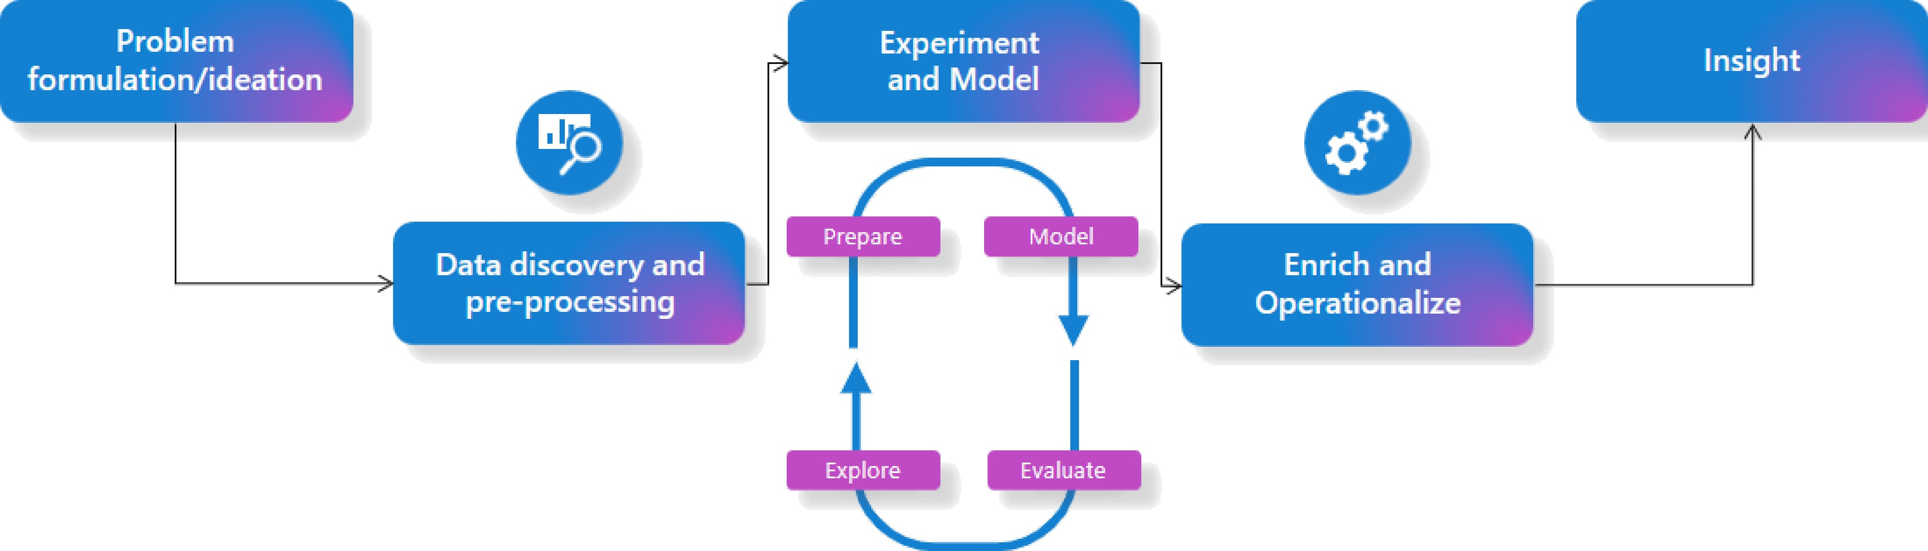

The data science process
EUROPEAN
MICROSOFT FABRIC SQL
Community Conference

Slide 8



Microsoft Fabric as a platform for Data Science
Governance & Compliance
Role-based access, lineage and versioning
keep models secure, auditable and
compliant.
End-to-End Unification
One platform for ingestion, preparation,
training, deployment and visualization.
GOV
E2E
Fabric + ML
Data Science in Microsoft Fabric
AI-powered Copilot
Accelerates data-science work and makes common tasks more
accessible.
Scalability
Distributed Spark compute handles large datasets and complex ML models.
AI
SCALE
AutoML (low-code)
Start ML tasks quickly while Fabric automates
much of the workflow.
MLflow integration
Autolog runs, metrics and parameters to compare
models and experiments without manual tracking.
Auto ML
MLflow

Slide 9
Prediction Models in Healthcare

Slide 10
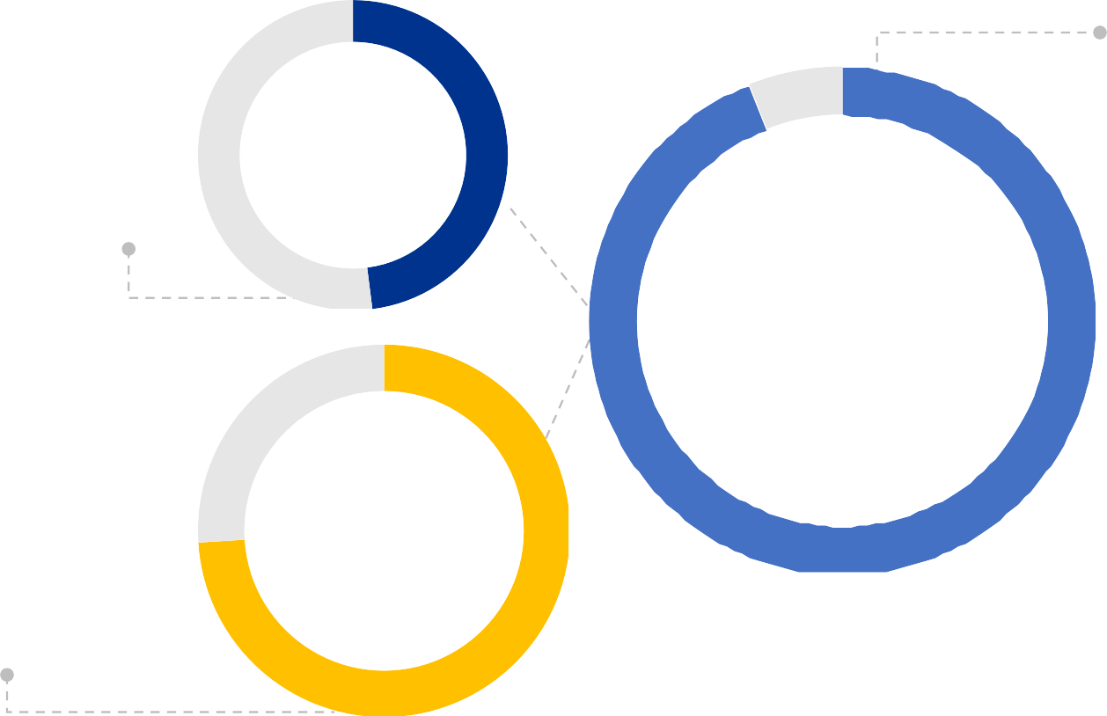
AI and ML is being embedded in EU healthcare systems
Radiology reality
48% of 572 European radiology respondents used AI; another 25% planned adoption.
48%
Radiology
Provider pipeline
94% of surveyed EU healthcare providers already use AI solutions or plan to adopt them.
94%
Providers
Diagnostics spread
Nearly 3 in 4 EU countries report AI-assisted diagnostics in clinical settings.
74%
EU countries
Measurement caveat: no harmonized EU hospital-level adoption ranking exists; these indicators use different denominators and are not directly comparable.
Sources: WHO/Europe EU readiness survey (2024–25); European Commission Digital Health Observ atory (2026); Zanardo et al., Insights into Imaging (2024).

Slide 11
However, EU rules turn healthcare ML into a governed clinical process
REQUIRED DEVELOPMENT ACTIONS
Make decisions explainable
Use an interpretable model, document intended use and limits, and provide a patient-level explanation.
Validate and retain oversight
Test calibration and performance; define human
review and record the final clinical decision.
Govern data and traceability
Enforce permissions; version data and models; retain reconstructable inputs, logs and monitoring.
Impact on care delivery
Human oversight, transparency and an auditable decision become part of the clinical workflow.
Impact on model delivery
Evidence, permissions and data lineage must remain clear from training through clinical use.
EU AI Act
High-risk clinical decision support requires risk management, transparency, human oversight and record-keeping.
GDPR Article 22
People affected by semi-automated decisions need meaningful information and safeguards.
European Health Data Space
Registry data can support secondary use—but only through governed access and permitted purposes.

Slide 12
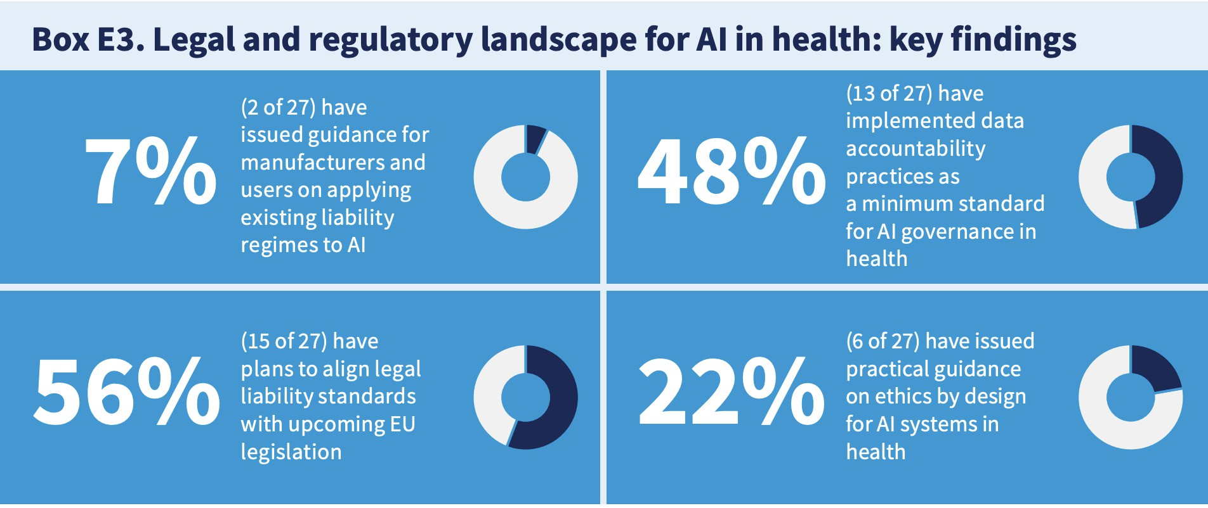
Yet not all institutions are prepared…

Slide 13
Three audiences face different obligations
Regulators & governance
Need auditable lineage, versioning, monitoring and a recorded human decision for every use.
Governance
Patients
Need a clear explanation of the score, its uncertainty and how it influenced—or can be challenged in—care.
Trusted
use
Patients
Clinicians
Need an interpretable, calibrated score in an approved workflow—while retaining final accountability.
Clinicians

Slide 14
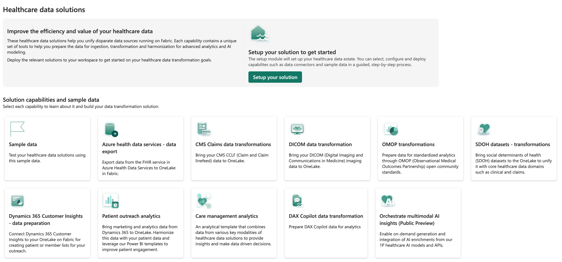
Fabric Healthcare Data Solutions

Slide 15
The case: knee replacement on NHS PROMs

Slide 16
Our data: NHS PROMs for knee replacement
Patient Reported Outcome Measures: the same questionnaire before the operation and six months after.
What it is
NHS England asks every patient having a knee replacement to fill in a questionnaire before surgery, and again six months later.
The data is published nationally, anonymised at source, and covers the reporting years 2016/17 to 2018/19 in our build.
One row is one operation (an “episode”).
Where it lives in Fabric
Lakehouse NHS_PROMs_LH, as Delta tables:
• bronze — the raw CSV files as delivered
• silver.knee_episode — renamed, typed, cleaned
• gold.knee_features — one row per episode, model-ready
Every table version is kept, so a training run can point at the exact version it used.
How big
Episodes: [count from the Fabric data]
Episodes with a known six-month outcome: [count from the Fabric data]
Columns: 79 as supplied, about 20 kept in gold.
Notes:
Explain the data plainly. Same questionnaire twice: before surgery and six months after. One row per operation. It sits in the Lakehouse as bronze, silver and gold tables. Fill the counts in from the Fabric data before the session.

Slide 17
What the patient tells us before surgery
The variables in the questionnaire, grouped. All of these are known before the decision to operate.
Group | What it is | What it looks like in the data
Oxford Knee Score (OKS) | 12 questions about knee pain and what the patient can do (walking, stairs, washing, kneeling, work…). Each answer scores 0–4. Total 0–48; lower is worse. | oks_t0_score 0–48, plus three sub-scores: pain (0–8), function (0–24), daily activities (0–16)
EQ-5D-3L | A general health questionnaire. Five areas: mobility, self-care, usual activities, pain or discomfort, anxiety or depression. Each has three levels: no problems, some problems, severe problems. | Five columns coded 1, 2 or 3
Long-term conditions | 12 yes/no questions: heart disease, high blood pressure, stroke, circulation problems, lung disease, diabetes, kidney disease, nervous system disease, liver disease, cancer, depression, arthritis. | 12 flags, and comorbidity_count (0–12)
About the patient | Age band, sex, how long the knee has hurt, previous surgery on this knee, living arrangements, disability, whether someone helped fill in the form. | Age band and sex are “not recorded” where NHS suppressed them
The hospital | Which provider operated; teaching hospital or not; NHS trust or independent sector; region. | From the provider dimension table
After surgery (not a feature) | OKS and EQ-5D six months later, satisfaction, success. Used only to build the outcome label — never as an input to the model. | oks_t1_score, oks_delta
Notes:
This is the slide people will ask about. Take the groups one at a time. The Oxford Knee Score is the key one: 12 questions, 0 to 48, lower is worse. EQ-5D is general health. Twelve long-term conditions. Then patient context and the hospital. The after-surgery answers only build the label.

Slide 18
Supervised learning, in one picture
The words the rest of the session uses: features, label, training set, test set, prediction, cut-off.
INPUTS · FEATURES
Pre-operative record
Everything from the questionnaire before surgery. About 20 columns.
MODEL · LEARNED FROM HISTORY
A function of the features
Fitted on past patients whose outcome is known. Learns which patterns went with a poor result.
OUTPUT · PREDICTION
A probability
For a new patient: the chance of a poor outcome, for example 0.63.
DECISION · CUT-OFF
Flag, or not
If the probability is above a chosen cut-off, the patient is flagged for review. The cut-off is a service choice.
›
›
›
LABEL · WHAT WE PREDICT
outcome_label = 1 if the six-month gain is 7 points or fewer, else 0. Known for past patients, unknown for the one in front of you.
TRAINING SET · TEST SET
Fit on 80% of the labelled history; measure on the 20% held out. The test set is the only honest estimate of how it will do on new patients.
WHY “SUPERVISED”
Every training row comes with its answer. The model is supervised by history, then judged on data it never saw.
Notes:
Level-set the room in one picture. Features on the left, a model fitted on past patients, a probability out, then a cut-off turns it into a decision. The cut-off is a service choice, not a model output.

Slide 19
Regression or classification?
Both are supervised learning. The difference is what comes out.
REGRESSION
Predict a number
“How many points will this patient’s Oxford Knee Score improve?”
Output: a number, for example +9 points.
Judged by how far off the number is, on average.
CLASSIFICATION · WHAT WE DO
Predict a category
“Will this patient have a poor outcome: a gain of 7 points or fewer?”
Output: a probability, then a yes/no at a chosen cut-off.
Judged by precision and recall on the class that matters — the poor outcomes.
We classify because the decision is yes/no — review this patient before surgery, or not — and the 7-point rule gives that cut a clinical meaning.
Notes:
Regression predicts a number, classification predicts a category. We chose classification because the decision is binary and the 7-point threshold has a clinical meaning. Next slide explains the 7.

Slide 20
What we predict: a poor outcome
The label is a clinical rule, decided before any model was built.
THE RULE
Poor outcome = the score improves by 7 points or fewer
The Oxford Knee Score runs 0–48. A gain of 2 points is real arithmetic but no change the patient can feel.
The smallest change a patient reliably notices — the minimal clinically important difference — is about 7 points (Beard et al.).
So the label is: outcome_label = 1 when oks_delta ≤ 7. The positive class is the bad outcome on purpose: that is the patient worth finding.
WHAT THAT MEANS IN THE DATA
Roughly one patient in five
About one in five patients gains 7 points or fewer. That is the minority class, and it drives every choice about metrics later.
Patients who never returned the six-month questionnaire have no label. They are kept apart and not used for training — they are not counted as poor outcomes.
Share of poor outcomes: [from the Fabric data]
Episodes without a six-month questionnaire: [from the Fabric data]
Notes:
The label came from patients, not from a curve. Seven points is the smallest change a patient notices. Roughly one in five patients falls at or below it. Patients with no six-month questionnaire get no label and are left out of training; the old analysis counted them as poor outcomes by mistake, and the Fabric pipeline fixed that.

Slide 21
Cleaning the data in Fabric: bronze, silver, gold
Three layers, each one a Delta table with its own version history.
Bronze · as delivered
• Raw NHS CSV files loaded as they arrived
• Nothing changed, nothing dropped
• Each load stamped with its source file and batch
Silver · cleaned
• 79 supplier columns renamed to clear names and typed
• Codes decoded: “9” means not answered — except on the 12 conditions, where 9 means “no”
• Age band and sex suppressed by NHS (“*”) become “not recorded”
• Cohort rules: keep primary knee replacements with a pre-operative score
Gold · model-ready
• One row per episode, readable values
• Derived features: comorbidity count, OKS sub-scores, merged age bands
• The outcome label, and a flag for episodes with no follow-up
• Every column documented, so the Data Agent can read it
• No imputation, no encoding, no split — those belong to the model
Notes:
Keep this short: the data was cleaned in three steps. The one detail worth a sentence is the code 9: it means not answered everywhere except the twelve condition flags, where it means no. Gold is the table everything downstream reads.

Slide 22
Missing values: two kinds, two treatments
Not every gap in the data means the same thing.
SUPPRESSED BY NHS
Age band and sex
NHS removes age band and sex when a combination of age, sex, hospital and procedure is rare — to protect the patient’s identity.
We keep these as “not recorded”. We never guess them: filling them in would undo a protection and put a guessed value into a risk score.
NOT ANSWERED BY THE PATIENT
Questionnaire items
Some patients skip a question: symptom duration, living arrangements, an EQ-5D item.
These are filled in with multiple imputation (MICE): a model estimates the missing answer from the patient’s other answers.
Fitted on the training patients only, then applied to the test patients.
Share missing per column: [from the Fabric data]
Notes:
Two kinds of gap. Suppressed by NHS: keep as not recorded, never guess. Skipped by the patient: fill in with MICE, fitted on training data only.

Slide 23
Class imbalance: why it makes prediction hard
About four patients in five do well. The patients we want to find are the minority.
Meaningful improvement · about 4 in 5
Poor outcome · about 1 in 5
Exact shares: [from the Fabric data]. Bar is illustrative.
WHAT GOES WRONG
If left unaddressed, a model favours the majority class: it predicts “good outcome” for most patients simply because that is the most common result.
That gives high overall accuracy — about 80% — and poor performance on the minority class we actually care about.
The model sees far fewer examples of a poor outcome, so the patterns behind it are harder to learn and easier to mistake for noise.
WHAT IT DOES TO THE SCORE
The probabilities come out low for almost everyone, because a poor outcome is rare. A patient at 30% is already well above the average patient.
So the cut-off cannot be the usual 50%. Where to put it becomes a decision in its own right (next slides).
Accuracy hides all of this. We do not use it.
WHAT WE DID
Class weighting: mistakes on poor-outcome patients cost the model more during training, so it cannot ignore them. No synthetic data is added.
Stratified splitting: training and test sets keep the same share of poor outcomes.
Metrics built for the minority class: precision, recall and average precision.
Oversampling (SMOTE) was also considered; it adds made-up patients and can add noise, so weighting was preferred.
Notes:
Class imbalance in plain words: one in five is a poor outcome. A model that ignores them looks accurate and helps nobody. Rare outcomes are harder to learn, and the probabilities come out low for everyone, so the usual 50 percent cut-off does not apply. We used class weighting, stratified splits, and metrics that look at the minority class.

Slide 24
Precision and recall: which mistake is worse?
Two ways to be wrong. The service has to decide which one it can live with.
 | Model says: poor outcome | Model says: good outcome
Actually poor outcome | True positive — found | False negative — missed
Actually good outcome | False positive — wrongly flagged | True negative
WHY WE PUT PRECISION FIRST
A false alarm has a high cost
If we wrongly flag a patient with a good outlook, the model might lead them to forgo an operation that would have helped. When the model says “likely to score poorly”, that has to be right.
Missing some poor outcomes is less critical for the individual: they have the surgery, score less than ideal, but usually still gain some points.
So we favour precision, but we still want to reach enough patients to make a difference — recall is not ignored, it is the price we track.
Average precision (the area under the precision–recall curve) summarises the whole trade-off in one number and is our headline metric.
THE TWO NUMBERS
Precision: of the patients we flag, how many really have a poor outcome. High precision = few false alarms.
Recall: of all patients with a poor outcome, how many we flag. High recall = few missed.
Pushing one up pushes the other down. You cannot have both from the same model.
Notes:
Two mistakes. A false positive means telling a patient with a good outlook not to operate; that is the expensive one. A false negative means a patient has surgery and gains less than hoped, but usually still gains something. So precision first, recall as the price we track.

Slide 25
From a probability to a decision: the threshold
A cut-off turns the probability into a yes or no. Moving it moves precision and recall in opposite directions.
Cut-off | Precision | Recall | Patients flagged
0.5 | 0.67 | 0.09 | 2,696
0.6 | 0.78 | 0.06 | 1,459
0.7 | 0.88 | 0.04 | 864
0.8 | 0.96 | 0.03 | 583
HOW TO READ THE TABLE
At 0.5 the model flags many patients, but a third of them would have done fine.
At 0.8 nearly every flagged patient really is at risk — but only about 3 in 100 poor outcomes are caught.
Precision rises with the cut-off in every model we tried. That is why 0.8 was used to compare models, and why the app shows the service what each cut-off costs before anyone moves it.
The cut-off is a policy choice: it depends on how many patients the service can review and on which mistake it can live with. It is not a property of the model.
EBM on the validation set, from the project report. Replace with the Fabric threshold analysis.
Raise the cut-off: fewer patients flagged, almost all of them correct, most poor outcomes missed.
Lower it: more patients flagged, more of them wrongly.
Notes:
This is the slide that makes the trade-off concrete. A higher cut-off buys precision with recall. Read one row: at 0.8 nearly every flagged patient is right, but only three in a hundred poor outcomes are found. The service chooses the row, not the data scientist.

Slide 26
Train, validate, test
The split happens first. Everything the model learns is learned from the training patients only.
STEP 1
Split
80% training, 20% test, keeping the same share of poor outcomes in both.
STEP 2
Fill in, encode, tune — on training only
Imputation and encoding are fitted on the training patients. Model settings are chosen by cross-validation inside the training set.
STEP 3
Evaluate once
The test set is used once, at the end, for the numbers we report.
›
›
CROSS-VALIDATION · HOW THE SETTINGS ARE CHOSEN
The training set is cut into 5 folds. Each candidate setting is trained on 4 folds and scored on the 5th, five times over, and the scores are averaged.
Every model has settings to choose (tree depth, learning rate, number of rounds). Cross-validation picks them without ever touching the test set.
Each of these runs is recorded in the Fabric experiment, so the winning settings can be promoted rather than retyped.
THREE CHECKS BEFORE ANY MODEL IS FITTED
• No after-surgery column can be a feature (nothing from the six-month questionnaire).
• Every feature the model expects really exists in the data.
• Age band and sex are never filled in by imputation.
Notes:
Split first. Then imputation, encoding and the choice of settings happen inside the training set, using five-fold cross-validation. The test set is touched once. Three checks run before any model is fitted.

Slide 27
Training and tracking in Fabric

Slide 28
Three models we compared
Same training data, same test data, same metrics. Only the model changes.
Model | How it works | Can a person read it? | Role | Average precision (test)
Logistic regression | One weight per variable, added up. Class-weighted so the minority class counts. | Yes — a linear model | Baseline: the floor to beat | [from the Fabric experiment]
Random forest | Hundreds of decision trees, averaged. | No — needs a second method (SHAP) to explain it | Challenger: strong but a black box | [from the Fabric experiment]
Explainable boosting machine (EBM) | One curve per variable, learned by boosting; prediction = the sum of the curves. | Yes — the curves are the model | Candidate: the one we calibrate and ship | [from the Fabric experiment]
If the EBM cannot beat the linear model, its extra complexity earns nothing. If it matches the random forest, we get the black box’s performance with a model a clinician can read. Both are checked in the experiment, not assumed.
Notes:
Three models, same split, same metrics. Logistic regression is the floor. Random forest is the strong black box. The EBM is what we want to ship if it keeps up. Fill in the average precision from the Fabric experiment.

Slide 29
ML experiments: every training run is recorded
A Fabric ML experiment is the workspace item where each run writes its parameters, metrics, tags and model file.
HOW OUR EXPERIMENT IS ORGANISED
One parent run, one child run per model
Parent: “training-session” — the split sizes, the number of features, the baseline to beat.
Children: logistic-regression, random-forest, ebm — each with its own parameters, metrics and tags.
Cross-validation runs sit underneath: one run per setting tried, so the best settings can be promoted from the experiment instead of copied by hand.
One more run: ebm-calibrated — the version that ships.
WHAT EVERY RUN CARRIES
• Parameters — the settings, so the run can be repeated
• Metrics — average precision, Brier score, calibration error, recall at 80% precision
• Tags — facts you filter on: data version, interpretability, risk class, who approved
• Artifacts — the model file, its input signature and the fitted preprocessing
WHY IT MATTERS
Six weeks later nobody remembers which run produced the model in use. The experiment does.
You can compare the three models side by side in the Fabric UI instead of in someone’s memory.
Fabric’s automatic logging is switched off on purpose: it logs accuracy-first metrics on every internal fit and buries the runs you care about. We log explicitly.
Notes:
Show the experiment item. One parent run for the session, one child per model, and the calibrated run that ships. Each run has parameters, metrics, tags and the model file. Autologging is off on purpose.

Slide 30
Tags: the facts an auditor asks for
Metrics say how good a run is. Tags say what it is, what it was trained on, and whether it may be used.
Group | Tags | The question it answers
Identity | model_family, model_role, interpretability, calibrated | What is this run? Is it a glassbox model? Is the probability calibrated?
Data | gold_table, gold_table_version, feature_set_version, target_definition, cohort | What exactly was it trained on? “gold as of version 7” can be reconstructed with Delta time travel.
Governance | intended_use, risk_class, human_oversight, approved_by, approved_on, gate_status | May we deploy it, and who signed it off? approved_by starts as “pending” and is set later by a named clinician.
Provenance | git_sha, notebook, run_by, fabric_workspace | Can we rebuild it?
Two years later: “reconstruct the exact input this model was trained on, and show me who approved it.” The tags are the answer.
Notes:
Four groups of tags. The data group turns trained on gold into trained on gold as of version 7. The governance group is where a named clinician signs off, after training, without re-running anything.

Slide 31
Calibration: a probability you can read at face value
A model can rank patients well and still be wrong about the numbers it shows.
WHAT CALIBRATED MEANS
34% should mean 34 in 100
Of a hundred patients scored 34%, about thirty-four should have a poor outcome. If it is really fifty, the number misleads the clinician.
We check this with the Brier score and the expected calibration error (ECE), not with average precision.
WHAT WE DID
Isotonic calibration on a held-out fold
The EBM is fitted, then its probabilities are corrected on data it did not train on.
Ranking barely changes; the numbers become honest. The calibrated run is the one that is registered.
Calibration error before / after: [from the Fabric experiment]
Calibration is a property of the group, not of one person. The app says so next to every number.
Notes:
Calibration makes the number actionable. Of a hundred patients scored 34 percent, about thirty-four should have a poor outcome. We correct with isotonic regression on a held-out fold and register the calibrated model.

Slide 32
The ML model item: versions and a gate
Registering promotes a run’s model file to a Fabric ML model: a versioned, permissioned item in the workspace.
THE REGISTERED MODEL
knee-poor-outcome-ebm
• Each training that passes becomes a new version
• Each version carries the run’s tags plus a signature: the exact input columns it accepts
• Exactly one version is tagged champion = true
• The app and the endpoint refer to the name and the champion tag — never to a file
Current champion version: [from the Fabric model item]
THE DEPLOYMENT GATE · THE LAST STEP OF TRAINING
Four checks, pass or fail
• Beats the no-skill baseline by at least 1.3×
• Calibration error under 5%
• Recall at 80% precision above 5%
• Interpretable model family
The result is written to gate_status. None of the checks can set approved_by: that waits for a named clinician.
Notes:
The model item is what everything downstream binds to. Versions, tags, a signature. Four automated gates write gate status. A named clinician sets approved by, later.

Slide 33
Serving the model: batch and real-time
Two ways to use one registered model. Both resolve the champion version, so they cannot disagree.
BATCH SCORING
The whole waiting list, on a schedule
A Data Pipeline runs the steps in order and re-scores every patient awaiting surgery.
It writes two gold tables: gold.patient_risk (one probability per patient) and gold.risk_explanation (the reasons). Both stamped with the model version.
Feeds: the worklist, the overview, the Data Agent.
REAL-TIME ENDPOINT · FROM THE ML MODEL ITEM
One patient, right now
Fabric can stand up a managed web endpoint from the registered version. A single patient is scored in milliseconds; a Spark session would take minutes.
Authenticated with Entra ID, versioned, inside the workspace. No model file leaves the estate.
Feeds: a what-if on a patient page, or another system.
Why it matters: a model that only lives in a notebook is not in production. The endpoint makes the registered version callable by other systems, safely.
Notes:
Batch for the list, real-time for the single patient. Both use the champion tag, so promoting a new version changes both at once.

Slide 34
What the endpoint returns
The score never travels alone.
Field | Example | Why it is there
episode_id | MFC-2026-100070 | Which patient
risk | 0.63 (calibrated) | The probability of a poor outcome
threshold, flagged | 0.50, true | The cut-off in use and the decision at that cut-off
contributions | six terms, e.g. previous surgery +0.43 | The reasons, in the model’s own units
model_version | knee-poor-outcome-ebm, champion | Which model produced the score
gold_table_version | 7 | Which version of the data the model was trained on
VERSIONED, AUTHENTICATED, IN-ESTATE
A clinician can act on the score.
An auditor can trace it back to the model version and the data version that produced it.
Neither needs a second system.
Example values are illustrative; the field list is the contract.
Notes:
Six contributions, the model version and the data version travel with every score. That is what makes the number traceable.

Slide 35
Demo: the experiment, the model and the endpoint
In the Fabric workspace.
1 · ML EXPERIMENT
Parent run and child runs
Compare the three models side by side.
2 · FILTER BY TAG
interpretability = blackbox
The deployment rule, as a query.
3 · ML MODEL ITEM
Versions and their tags
Which version is champion, and why.
4 · THE DATA VERSION
gold_table_version
Run SELECT … VERSION AS OF to show the exact training table.
5 · THE ENDPOINT
Send one patient
Read back the risk, the reasons and the versions.
If the endpoint is not deployed on the day: show the batch scoring run and the gold.patient_risk table instead.
Notes:
Demo. Experiment, filter by tag, model item, the data version query, then one call to the endpoint. Fallback: the batch scoring run.

Slide 36
A model a clinician can argue with

Slide 37
Why we chose the explainable boosting machine
Interpretability is a requirement here, not a preference: the EU AI Act asks for meaningful human oversight of high-risk clinical decision support.
THE EBM
Prediction = the sum of one curve per variable
The model learns one curve per variable: given this value, how much does the risk move? The score is the intercept plus those curves added up.
So the explanation is the model. When it says a pre-operative score of 16 added +0.42, that is what the model did, not an estimate of it.
A clinician can read the curves and disagree with them.
THE RANDOM FOREST
Needs a second model to explain the first
SHAP is good work — but it is an approximation built on top of the model. In front of a regulator you have to answer: how do you know the explanation is faithful?
For a glassbox model that question does not arise.
Performance difference EBM vs random forest: [from the Fabric experiment]
A clinician cannot disagree with a random forest. Oversight of something you cannot disagree with is not oversight.
Notes:
The EBM is additive: one curve per variable, added up. The explanation is the model itself. SHAP on a random forest is a separate model of the model. That difference is what a regulator will ask about.

Slide 38
Explaining one patient’s score
The six largest terms for one patient, in the model’s own units. They add up, with the intercept, to the score.
← LOWERS
RAISES RISK →
Previous surgery on this knee
+0.43
HOW TO READ IT
Each bar is one variable’s contribution in log-odds. Positive raises the risk, negative lowers it.
The six bars plus the smaller terms and the intercept add up to this patient’s probability.
This is the arithmetic a clinician can check and challenge — and the same numbers the app and the Data Agent show.
Illustrative values; replace with a real patient from the Fabric run.
Mobility (EQ-5D)
+0.40
Pre-operative pain
+0.30
Number of long-term conditions
-0.20
How long symptoms have lasted
+0.16
Pre-operative Oxford Knee Score
+0.12
Notes:
One patient, six bars. They add up to her score; that is arithmetic, not an analogy. Replace the values with a real patient from the Fabric run before the session.

Slide 39
Choosing the cut-off with the service
The trade-off is known. Now it has to be made in patients, by the people who run the pathway.
Cut-off | Patients flagged per 1,000 | Of which unnecessary | Poor outcomes missed
0.5 | [from the Fabric threshold analysis] | […] | […]
0.7 | […] | […] | […]
0.8 | […] | […] | […]
OUR STARTING POINT
80% precision: four of five flagged patients should really be at risk, or the review pathway loses credibility.
Counts per 1,000 patients make the cost of each cut-off visible to a clinic manager, not only to a data scientist.
TWO MORE CHECKS BEFORE THE CUT-OFF IS WRITTEN INTO A PATHWAY
• Does it hold for each subgroup — for example the over-80s? A rule that works on average and fails for one group goes in the model card as a limitation.
• Is using the model at this cut-off better than reviewing everyone, or nobody?
The chosen cut-off is recorded on the model version, so the number the app uses can always be traced to this analysis.
Notes:
The service chooses the cut-off from what it costs in patients per thousand, checks it holds for subgroups, and the choice is recorded on the model version.

Slide 40
Delivery: the clinician app

Slide 41
What it took to build the clinician app
Rayfin: a Microsoft toolkit that provisions a full application inside the Fabric workspace from one command.
WHAT RAYFIN IS
npx rayfin up
You describe the data model as TypeScript classes. One command provisions, inside the workspace:
• a SQL database in Fabric
• a GraphQL API (Data API Builder)
• Entra ID sign-in with claims
• static hosting for the React front end
No separate cloud subscription, no second identity provider, nothing to re-govern.
WHY IT IS RELEVANT HERE
Row-level security lives next to the data
The rule “a clinician sees only their own patients” is declared on the data entity and enforced by the API before a row leaves Fabric — not by a filter in the web page.
The scored tables are copied from the Lakehouse into the app’s SQL database. The app never loads a model; it reads governed tables.
The Data Agent reads the same gold tables in the Lakehouse, under the same permissions.
Notes:
Rayfin: describe the data model, run one command, and you get a database, an API, sign-in and hosting inside the workspace. The important detail is where security lives: on the data entity, enforced before a row leaves Fabric.

Slide 42
What the clinician sees, and what is recorded
Decision support, not decision making.
1 · WORKLIST
Their own patients, highest risk first
Filtered by row-level security on the data.
2 · ONE PATIENT
The probability and the reasons
The calibrated score, its band, and the six largest terms in plain words.
3 · THE DECISION
Agree or override, with a reason
Nothing is pre-selected. Stored with the score and model version the clinician saw.
4 · ASK
Questions in plain language
The Data Agent answers from the governed tables, cites them, and declines clinical advice.
The recorded decision — including every override — is the human-oversight record the EU AI Act asks for, kept as a table.
Demo: open the worklist, open the top patient, record a decision, ask the agent one question and one it must refuse.
Notes:
Four screens. Worklist, patient, decision, ask. The decision record with overrides is the oversight record. Demo it live; the offline build is the fallback.

Slide 43
Learnings

Slide 44
What we learned building it
Six things we would do again.
1. Decide the label with clinicians first
The 7-point rule is a clinical fact. Everything else follows from it.
2. Treat missing values by cause, not by column
Suppressed by NHS: keep as not recorded. Skipped by the patient: impute. Never guess a protected characteristic.
3. Split before you fit anything
Imputation and encoding fitted on all data leak the test set into training.
4. Use the metric that matches the harm
Precision–recall for a rare bad outcome. Calibrate, because the number is shown to a person.
5. Log decisions, not just results
Tags for data version, interpretability and approval; a gate that can say no; the cut-off recorded on the model version.
6. Prefer a model people can read
The EBM kept up with the random forest and can be challenged at the bedside.
Notes:
Six learnings. Read them out; each has a slide behind it earlier in the deck.

Slide 45
How this applies in a clinical setting
What has to be true before a score like this reaches a patient.
Requirement | What it means in practice | How we met it
Human oversight | A clinician makes the decision and can disagree with the model | Readable model; agree/override recorded with a reason
Explanation for the patient | The patient can be told why, in plain words | Per-patient terms with clinician-readable labels
A number that means what it says | A probability is acted on as a probability | Calibrated model; group-not-individual caveat shown
A cut-off owned by the service | Capacity and harm decide the threshold, not the data scientist | Sweep in patients per 1,000; choice recorded on the model version
Fairness across groups | The rule must not quietly fail for one group | Subgroup check of the cut-off; limitations in the model card
Traceability | Which data and which model produced this score, and who approved it | Delta versions, MLflow tags, approved_by, scores stamped with the model version
Access control | Clinicians see only their own patients | Row-level security on the data entity, enforced before rows leave Fabric
Notes:
Map the regulation to practice. Each row is something the AI Act or GDPR asks for, what it means on the ward, and where in the build we did it.

Slide 46
Why Fabric fits healthcare applications
Data, analytics and the decision stay in one governed place. No copies, no exports.
One estate
• OneLake holds the raw files, the cleaned tables and the scores
• Delta versions: any training input can be reconstructed exactly
• Lineage from the raw file to the recorded decision
• Sensitivity labels follow the data downstream
Built-in machine learning
• Notebooks with Spark for the big steps and Python for the interpretable model
• MLflow experiments and the model registry are workspace items, with permissions
• Managed endpoints from a registered model
• Data Pipelines to run scoring on a schedule
Delivery without leaving
• An application with database, API, sign-in and hosting inside the workspace (Rayfin)
• Row-level security enforced on the data
• A Data Agent that answers only from the governed tables, under the same permissions
• Healthcare data solutions for clinical data standards when you go beyond a single dataset
Accuracy gets a model into the room. Traceability, oversight and governed delivery get it to the bedside.
Notes:
The closing argument. One estate: the data never leaves. Machine learning is built in, with experiments, registry and endpoints as governed items. Delivery, including the app and the agent, stays inside the same permissions. Leave this slide up for questions.

Slide 47

Please rate
this session

