Slide 1

Employee Management System
By Saraswathi and Pragna Nerella

Slide 2

What is SQL ?
Why SQL ?
SQL (Structured Query Language) is the standard language used to communicate with databases. Think of it as the "bridge" that allows you to talk to a computer's data storage system.
.
Data Integrity
Accuracy & Speed
Handles Massive Data
Secure

Slide 3
Problem Statement
Design a centralized system to store and manage employee data efficiently.
Track personal details, job roles, qualifications, leaves, and payroll in one unified platform.
Utilize relational tables and foreign keys to ensure data accuracy and consistency.
Streamline HR operations by automating complex payroll and leave calculations.
Provide instant, data-driven insights into department performance and organizational costs.
Enhance decision-making by making technical and financial records easily accessible.

Slide 4
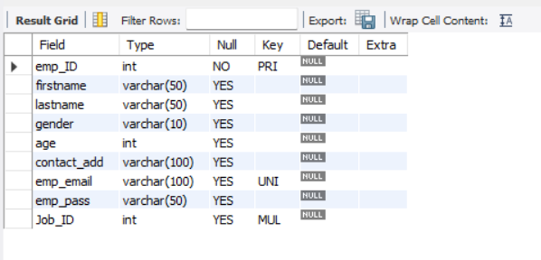
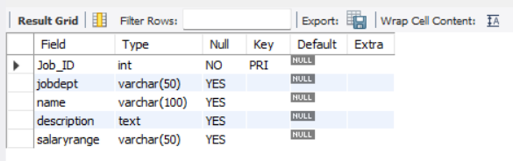
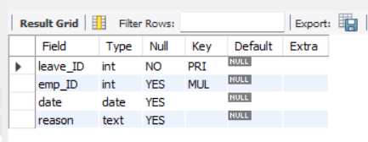
Tables
Employee
JobDepartment
Leaves

Slide 5
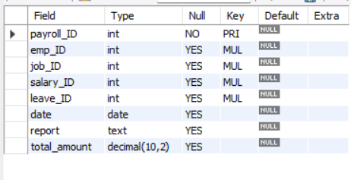
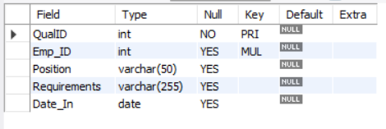
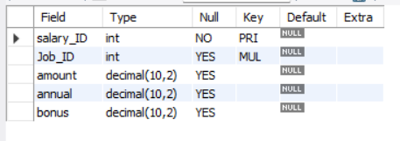
Tables
Payroll
Qualification
Salarybonus

Slide 6
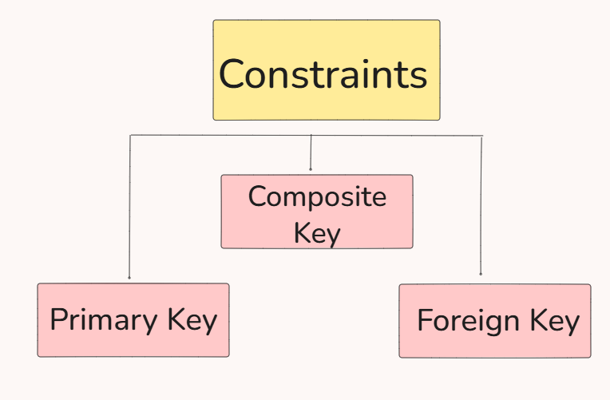
ER DIAGRAM
What is ER diagram ?
An ER Diagram (Entity-Relationship Diagram) in SQL is a design tool used before creating a database. It is a visual way to represent how data is organised in database. It shows each table is interlinked or connected with every individual

Slide 7
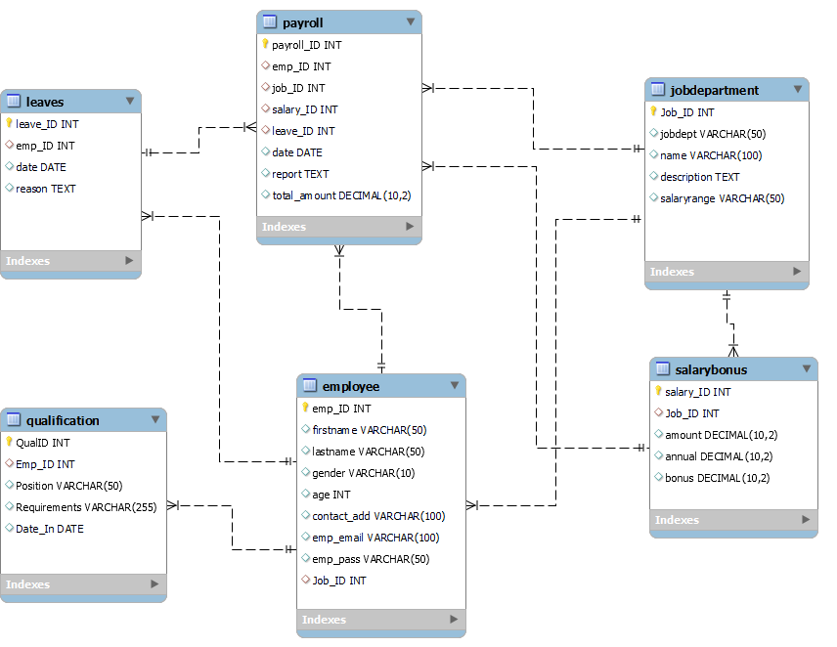
ER DIAGRAM

Slide 8

1. EMPLOYEE INSIGHTS
How many unique employees are currently in the system?
Which departments have the highest number of employees?
What is the average salary per department?
Who are the top 5 highest-paid employees?

Slide 9

How many unique employees are currently in the system?
Select distinct count(*) as Emp_Count
From Employee ;

Slide 10
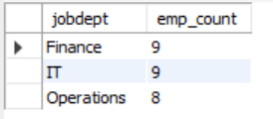
Which departments have the highest number of employees?
Select j.jobdept,
round(avg(p.total_amount),2) as avg_salary
from jobdepartment j
join payroll p
on p.job_id = j.job_id
group by jobdept
Limit 3;

Slide 11
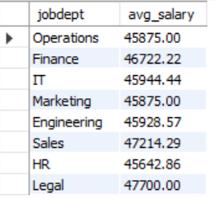
What is the average salary per department?
Select j.jobdept,
round(avg(p.total_amount),2) as avg_salary
from jobdepartment j
join payroll p
on p.job_id = j.job_id
group by jobdept;

Slide 12
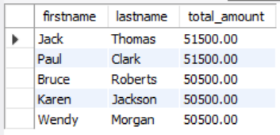
Who are the top 5 highest-paid employees?
select e.firstname,e.lastname ,p.total_amount
from employee e
join payroll p
on p.emp_id = e.emp_id
order by total_amount desc
limit 5 ;

Slide 13

2. JOB ROLE AND DEPARTMENT ANALYSIS
How many different job roles exist in each department?
Which Dept,job role has more than 50000 of salary?
Which job roles offer the highest salary?
Which departments have the highest total salary allocation?

Slide 14
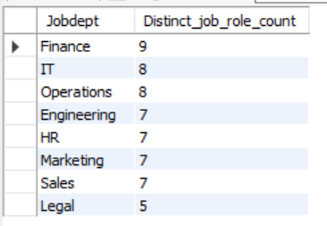
How many different job roles exist in each department?
select Jobdept ,
count(distinct name) as Distinct_job_role_count
from jobdepartment
group by jobdept
order by Distinct_job_role_count desc ;

Slide 15
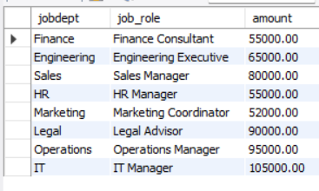
Which Dept,job role has more than 50000 of salary?
select jobdept,name as job_role ,amount
from jobdepartment j
join salarybonus s
on s.job_id = j.job_id
where amount > 50000
group by jobdept;

Slide 16
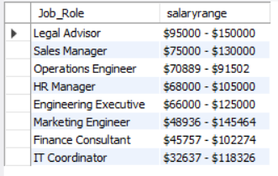
Which job roles offer the highest salary?
SELECT
name as Job_Role,salaryrange
FROM jobdepartment
GROUP BY jobdept
order by salaryrange desc;

Slide 17
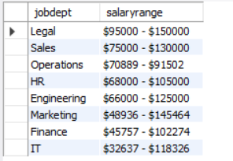
Which departments have the highest total salary allocation?
SELECT
jobdept,salaryrange
FROM jobdepartment
GROUP BY jobdept
order by salaryrange desc;

Slide 18

3. QUALIFICATION AND SKILLS ANALYSIS
How many employees have at least one qualification listed?
Which positions require the most qualifications?
Which employees have the highest number of qualifications?

Slide 19

How many employees have at least one qualification listed?
SELECT
COUNT(DISTINCT Emp_ID) AS Total_Employees_With_Qualifications
FROM Qualification;

Slide 20
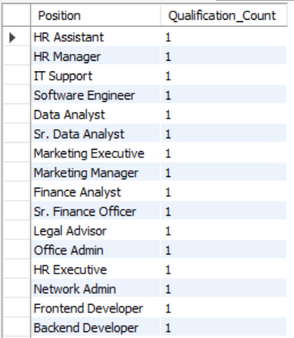
Which positions require the most qualifications?
SELECT Position,
COUNT(*) AS Qualification_Count
FROM Qualification
GROUP BY Position
ORDER BY Qualification_Count DESC;

Slide 21
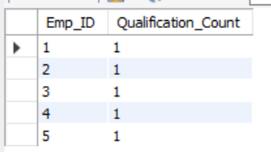
Which employees have the highest number of qualifications?
SELECT Emp_ID,
COUNT(*) AS Qualification_Count
FROM Qualification
GROUP BY Emp_ID
ORDER BY Qualification_Count DESC
LIMIT 5;

Slide 22

4. LEAVE AND ABSENCE PATTERNS
Identify years with the highest leave frequency to spot seasonal trends.
Calculate average leave days per department to assess workload distribution.
Track employees with the most frequent absences for HR review.
Measure the total volume of leave days taken across the entire company.

Slide 23
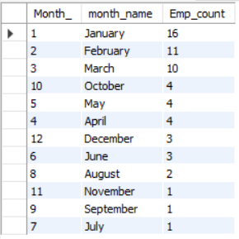
Which year had the most employees taking leaves?
select month(date) as Month_ ,
monthname(date) as month_name,
count(leave_id) as Emp_count
from leaves
group by month(date)
order by Emp_count desc;

Slide 24
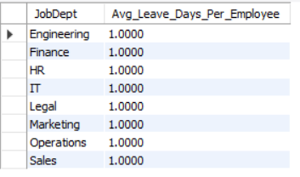
What is the average number of leave days taken by its employees per department?
SELECT j.JobDept,
COUNT(l.leave_id) / COUNT(DISTINCT e.emp_id)
AS Avg_Leave_Days_Per_Employee
FROM jobdepartment j
JOIN employee e ON j.Job_ID = e.job_id
LEFT JOIN leaves l
ON e.emp_id = l.emp_id
GROUP BY j.JobDept;

Slide 25
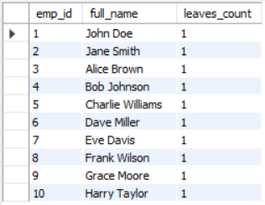
Which employees have taken the most leaves?
select e.emp_id ,
concat_ws(' ',firstname,lastname) as full_name ,
count(leave_id) as leaves_count
from employee e
join leaves l
on e.emp_id = l.emp_id
group by emp_id
order by count(leave_ID) desc ;

Slide 26

What is the total number of leave days taken company-wide?
Select count(distinct leave_id) as total_leaves_count
From Leaves ;

Slide 27

5. PAYROLL AND COMPENSATION ANALYSIS
What is the total monthly payroll processed?
What is the average bonus given per department?
Which department receives the highest total bonuses?

Slide 28

What is the total monthly payroll processed?
select monthname(date) as month_name ,
sum(total_amount) as total_amount
from payroll ;

Slide 29
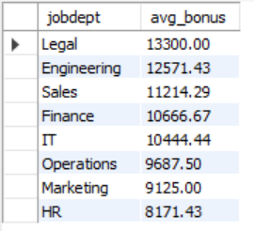
What is the average bonus given per department?
select j.jobdept ,
round(avg(bonus),2) as avg_bonus
from salarybonus s
join jobdepartment j
on j.job_id = s.job_id
group by j.jobdept
order by avg_bonus desc;

Slide 30
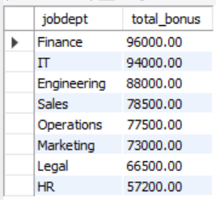
Which department receives the highest total bonuses?
select j.jobdept ,
round(sum(bonus),2) as total_bonus
from salarybonus s
join jobdepartment j
on j.job_id = s.job_id
group by j.jobdept
order by total_bonus desc;

Slide 31
Conclusion
Finance Department has the highest number of employees .
The high headcount in Finance is partly due to the fact that it contains 9 different job roles.
Jack Thomas and Paul Clark are the top two highest-paid employees in the organization.
The Legal Department (Legal Advisor is the job role) overall has a high salary allocation.
Most job roles require at least one qualification.
The total monthly payroll processed was 2,778,000 (2.77M).
The Finance Department has the highest total bonuses overall.
January is the month with the most employees taking leaves. July is the month with the fewest employees taking leaves.
On average, employees across departments take 1–2 days of leave.

Slide 32
Challenges
Managed salary ranges in place of fixed amounts to enable accurate compensation benchmarking.
Shifted to monthly analysis due to the dataset being restricted to the year 2024.
Resolved table complexities and implemented multi-table joins to ensure data accuracy.
Maintained data integrity by establishing and verifying correct foreign key relationships.
Addressed data inconsistencies to produce reliable payroll and leave reports.

Slide 33

Thank You

