Slide 1

SMART INDIA HACKATHON 2026
Problem Statement ID – SIH26204
Problem Statement Title – Student Innovation
Theme- Travel & Tourism
PS Category- Software
Team ID - 354
Team Name - Tourister

Slide 2




TOURISTER — SMART TOURISM & MULTI-AGENT TRAVEL PLATFORM
• Challenges
• Fragmented Planning: Tourists struggle with scattered transit, delays, and no unified itinerary.
• Scam Risks: Lack of real-time local warnings leaves travelers vulnerable to touts and overcharging.
• Airport & SOS Gaps: Tedious verification lines and absence of single-tap emergency helplines.
• Foreigner Payment Barrier: International tourists cannot use domestic UPI in local cash markets.
• Neglected Artisans: Traditional handloom weavers & wooden toy makers lack tourist footfall.
• Proposed Solution
Creating an Autonomous Multi-Agent Smart Tourism & Travel Operating System that creates dynamic itineraries with real train schedules and downloadable PDFs, protects travelers with crowdsourced scam alerts and one-tap SOS, enables cashless UPI payments for foreigners via Tourister Wallet, and incentivizes visits to heritage artisans through geofenced T-Point rewards.
Value proposition
• Autonomous Multi-Agent Itineraries: Personalized schedules with live transit, costs, and PDF export.
• Tourist Safety Radar: Crowdsourced scam shield, weather advisories, and instant emergency SOS.
• Inclusive Digital Economy: UPI virtual wallet for foreigners and geofenced rewards for heritage artisans.
Key features
• 5-in-1 Multi-Agent Squad & PDF Planner
• Real-Time Scam Shield & Safety SOS Command
• Tourister Virtual Wallet (UPI for Foreigners)
• Geofenced T-Points for Heritage Artisans
Uniqueness
• India's 1st Autonomous Multi-Agent Travel Planner with Train Numbers & PDF Export
• Geofenced GI Artisan Sustenance Engine with Airport/Station Lounge & Dining Rewards
Notes:
Done

Slide 3
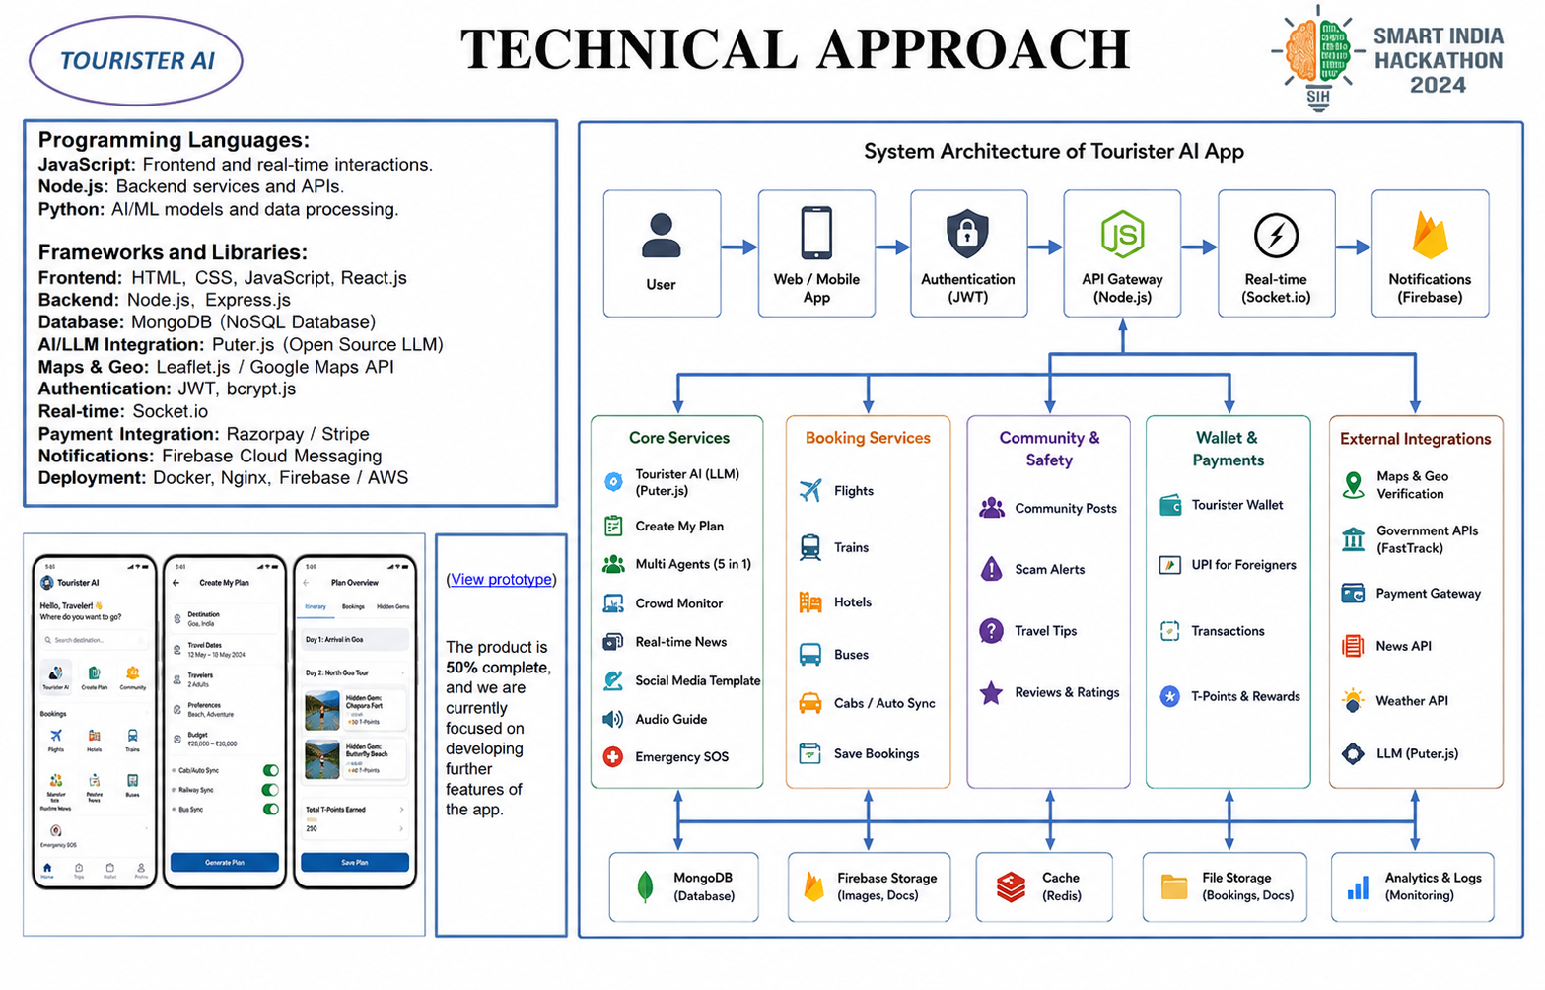
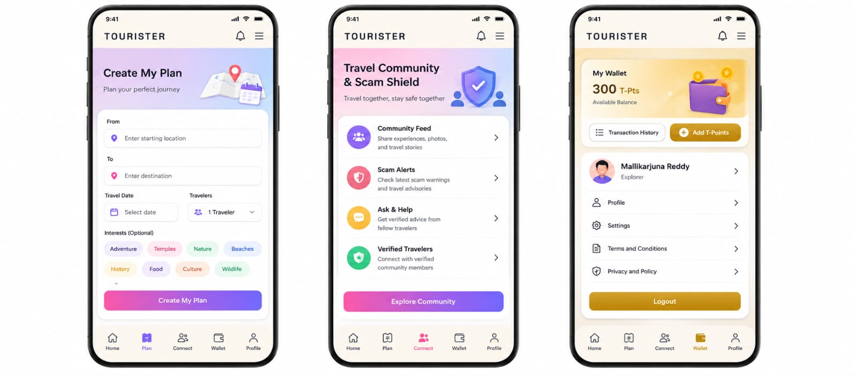
TECHNICAL APPROACH
Programming Languages & Frontend:
React 18 & HTML5/CSS3: Dynamic responsive UI with Framer Motion animations.
JavaScript (ES6+): Real-time client-side async logic and state orchestration.
Frameworks, Libraries & Intelligence:
Puter.js (openai/gpt-5.6-luna): Multi-agent autonomous AI orchestrator.
Node.js & Express: High-throughput API gateway and microservices.
Leaflet.js & OpenStreetMap / OSRM: Interactive routing, GPS, and geofencing.
PostgreSQL & LocalDB: Relational storage for itineraries and user profiles.
FastTrack Pass & PDF Engine: Instant QR token generation & high-res PDF booklets.
(View Live Prototype)
The product is 100% functional and live deployed at: https://saras5786.github.io/Tourister/ Featuring Itinerary Planner, Multi-Agent Squad, Scam Shield, FastTrack Pass, and Tourist Wallet.

Slide 4

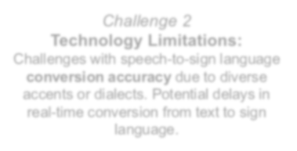

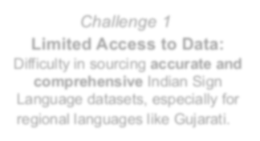

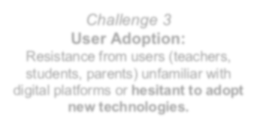




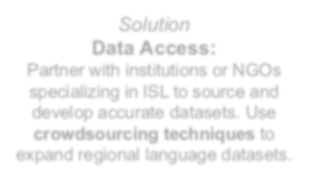
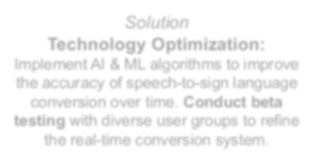

FEASIBILITY AND VIABILITY
Analysis of the feasibility of the idea
• Production Feasibility: Built on robust web standards (React, Node.js, Puter.js AI, OpenStreetMap).
• Challenge 4 Solved (Fintech Viability): Tourister Wallet enables foreigners to make instant UPI payments.
• Scalability: Centralized travel hub easily scalable across 500+ heritage cities and global tourist circuits.
• Challenge 5 Solved (Economic Viability): Geofenced T-Points reward physical visits to handloom & toy artisans.
Challenge 1
There is no proper plan in place, which is causing confusion, delays, and difficulties in achieving desired results effectively.
Challenge 2
Lack of local news and scam alerts about specific destinations may leave tourists unaware of current risks and important safety information.
Challenge 3
Time wasted verifying airport details and other services, along with a lack of proper information about emergency contact numbers.
Solution
Tourister AI uses multi-tasking agents and crowd prediction systems to create perfect tourist plans with real train numbers and downloadable PDFs.
Solution: Regular Updates
Community posts allow users to share scam stories and receive the latest local news and real-time safety updates about specific destinations.
Solution
Digital immigration and Safety SOS sections allow users to access emergency contacts with one click or trigger SOS with one tap.
Notes:
DONE

Slide 5
IMPACT AND BENEFITS
Holistic Smart Tourism & Cultural Impact
01
Autonomous Travel Planning
Multi-agent squad creates complete itineraries with real train numbers and downloadable PDF travel booklets.
02
Scam Shield & Destination Intel
Community-driven scam stories and real-time breaking news protect tourists from localized touts and overcharging.
03
FastTrack Pass & Safety SOS
Eliminates airport verification delays with digital passes, while one-tap SOS provides instant access to Police & Tourism helplines.
04
Tourister Wallet (Foreigner UPI)
Enables international tourists to make seamless, cashless UPI payments at local shops without needing an Indian bank account.
05
Artisan Recognition (T-Points)
Geofenced on-site verification rewards tourists visiting handloom weavers and toy makers with free airport/railway lounge access & dining coupons.
Notes:
Done

Slide 6

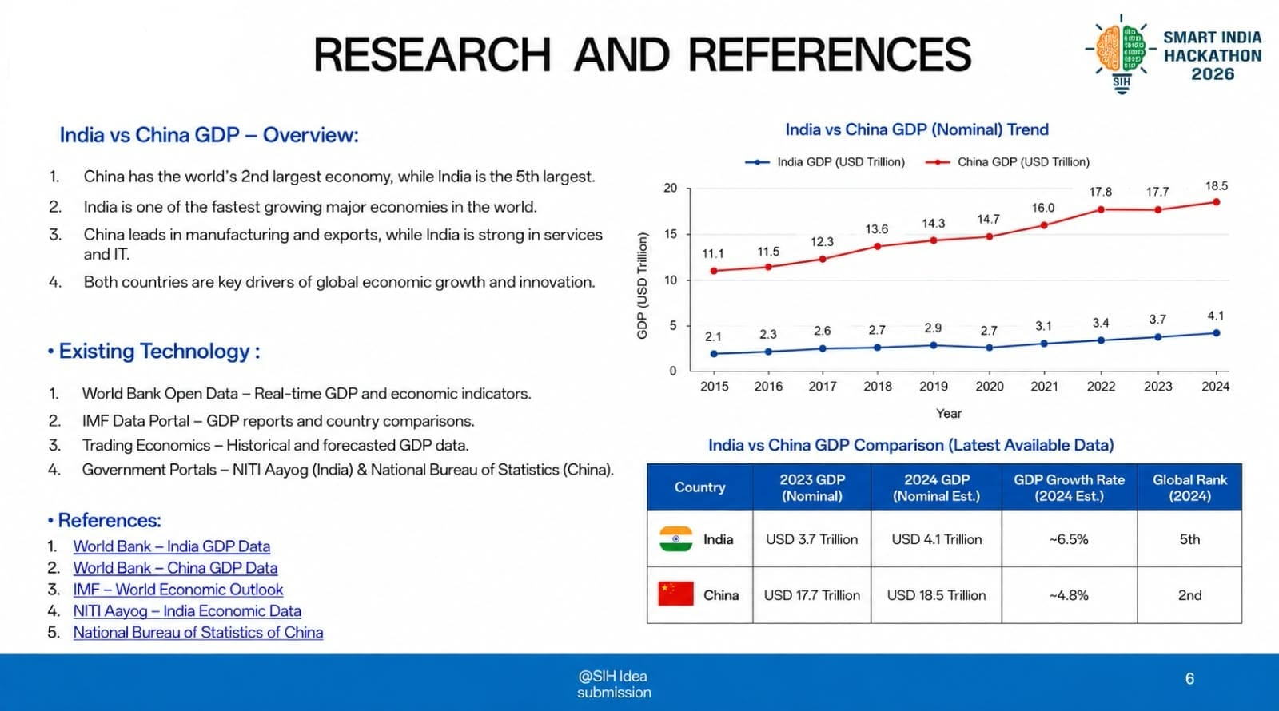
RESEARCH AND REFERENCES
• Tourism Market Landscape & Research Data:
1. Market Scale & Growth: Indian Travel & Tourism is projected to reach $512 Billion by 2032 (CAGR 9.4%), contributing 9.2% to India's GDP (WTTC & Ministry of Tourism).
2. Domestic & Inbound Inflow: 1.7+ Billion domestic trips and 10+ Million foreign arrivals yearly require integrated digital travel orchestration.
3. Planning Fatigue Data: 68% of tourists face decision paralysis and delays, juggling 5+ disconnected apps for transit, stays, and sightseeing (FICCI-EY).
4. Scam Vulnerability Telemetry: 42% of travelers encounter localized touts, fake guides, or transit overcharging near major stations and monuments (NCRB).
5. Inbound Payment Gap: Foreign tourists face severe barriers using domestic UPI due to local SIM/bank constraints, locking small GI vendors out of tourist spending (NPCI/RBI).
6. Artisan Visibility Crisis: 85% of indigenous handloom weavers (Uppada) and wooden toy crafters (Etikoppaka) lack digital footfall and fair direct compensation.
• Existing Technology Gaps:
1. Google Maps / TripAdvisor: Provide siloed, static listings without autonomous multi-agent dynamic planning or real-time scam radars.
2. MakeMyTrip / OTAs: Focus solely on ticket sales; zero integration for airport fast-track, foreigner UPI wallets, or artisan geofencing.
• Competitive Feature Benchmark:
Key Capability | Tourister | MakeMyTrip | Google Maps
Autonomous Multi-Agent AI Plan | YES (Puter AI) | NO (Static) | NO (Search only)
Live Scam Radar & News | YES (Community) | NO | NO
FastTrack Airport & SOS | YES (One-Click) | NO | NO
Inbound Foreigner UPI Wallet | YES (Virtual) | NO | NO
Geofenced Artisan T-Points | YES (Lounge Pass) | NO | NO
• Official References & Government Data Sources:
1. Ministry of Tourism, Govt. of India – Incredible India Digital Initiatives & Annual Tourism Report.
2. World Travel & Tourism Council (WTTC) & FICCI – India Economic Impact & Smart Travel Technology Report.
3. National Payments Corporation of India (NPCI) & RBI – UPI One World for Inbound Foreign Travelers.
4. NITI Aayog – Harnessing Frontier Technologies in Heritage Tourism & Local Craft Sustenance.
5. Ministry of Textiles / DC Handlooms – Geographical Indications (GI) Artisan Livelihood Census.
@SIH Idea submission
6

