Slide 1










A Missing Piece in the Puzzle: Considering the Role of Task Complexity in Human-AI Decision Making
Human-AI Decision Making
various domains

Slide 2


A Missing Piece in the Puzzle: Considering the Role of Task Complexity in Human-AI Decision Making
Human-AI Decision Making
complementary performance?
human factors
AI features
decision tasks

Slide 3











A Missing Piece in the Puzzle
Considering the Role of Task Complexity in Human-AI Decision Making
@SaraSalimzadeh
s.salimzadeh@tudelft.nl
Sara Salimzadeh
Gaole He
Ujwal Gadiraju

Slide 4

A Missing Piece in the Puzzle: Considering the Role of Task Complexity in Human-AI Decision Making
Decision Tasks & Task Features
across domains
The choice of decision tasks also affects the performance of human-AI teams.
There is no standard and coherent way to compare decision tasks.
generalizability
There is a need for a comprehensive understanding of how different task attributes impact the performance of human-AI teams.
transferability

Slide 5


A Missing Piece in the Puzzle: Considering the Role of Task Complexity in Human-AI Decision Making
Task Complexity
information load
task features
information diversity
task complexity
information change
task complexity
human performance
human behaviour
reliance & trust on AI
error detection

Slide 6

A Missing Piece in the Puzzle: Considering the Role of Task Complexity in Human-AI Decision Making
Research Questions
RQ1: How has recent research in human-AI decision making considered the influence of task complexity?
RQ2: How can task complexity facilitate a comparative lens for empirical work on human-AI decision making?

Slide 7
A Missing Piece in the Puzzle: Considering the Role of Task Complexity in Human-AI Decision Making
Scoping our Literature Review
Definition
Search
Select
Analyze
key phrases
human-AI decision making
AI-assisted decision making
decision-support systems
human-AI collaboration
human-AI team
Human-in-the-loop
empirical studies
human-AI
decision making
empirical studies
CHI, CSCW, IUI, UMAP, FAccT, TOCHI, HCOMP, UIST
full paper
Annotation based on full text
task complexity task risk
task type
required knowledge
manual screen
N = 127 articles

Slide 8
A Missing Piece in the Puzzle: Considering the Role of Task Complexity in Human-AI Decision Making
RQ1 - Task Complexity in Literature
Limited numbers of studies have considered task complexity in designing their decision tasks.
There is no standard framework to quantify the complexity of decision tasks.
We operationalize the measurement of task complexity by proposing a framework.

Slide 9
A Missing Piece in the Puzzle: Considering the Role of Task Complexity in Human-AI Decision Making
Operationalizing Task Complexity - Example
Will this person reoffend in 2 years?
Gender | Male
Age | 45
Charge Name | Domestic Violence
Race | White
Gender | Male
Age | 45
Charge Name | Domestic Violence
Race | White
Gender | Male
Age | 45
Charge Name | Domestic Violence
Race | White
Yes
No
AI predicts Yes
Yes
No
(1) Initial Decision
(2) Review Model Prediction
(3) Final Decision
Coordinative Complexity = # of Steps : 3
Dynamic Complexity = Any dynamic changes: 0
Component Complexity = # of Features: 4

Slide 10
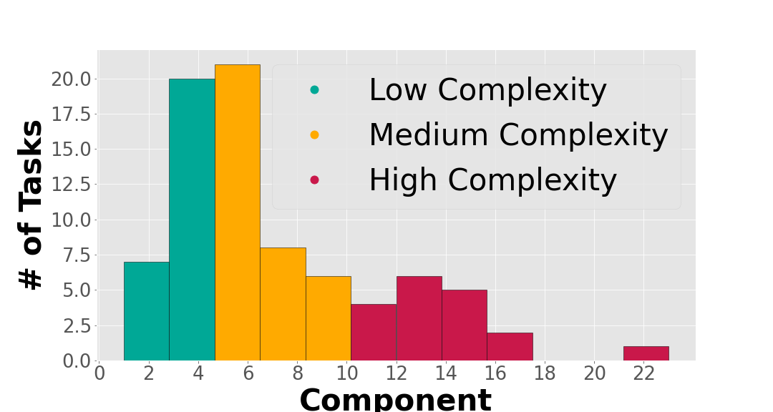
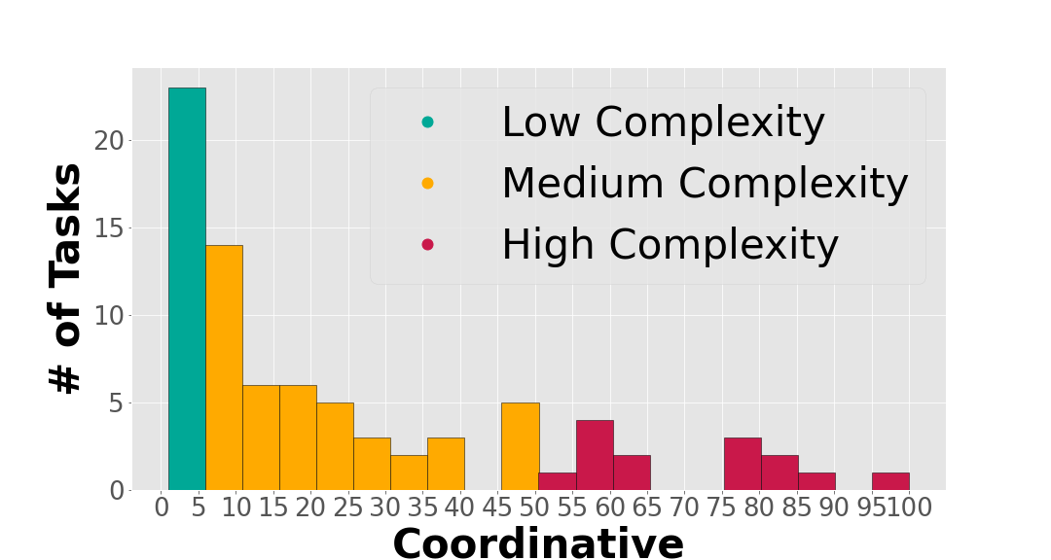
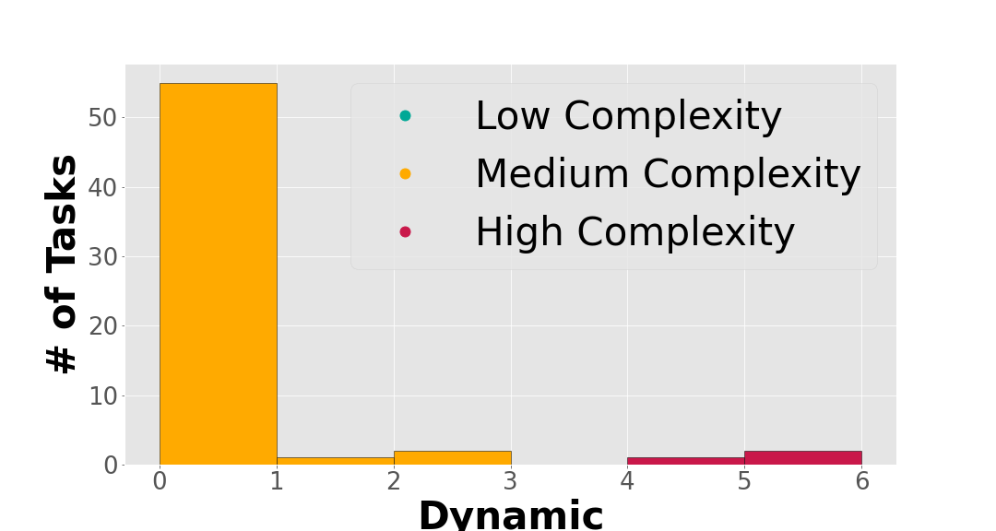
A Missing Piece in the Puzzle: Considering the Role of Task Complexity in Human-AI Decision Making
RQ2 - Distribution of Task Complexity in Decision Tasks
Most studies have low or medium complexity.
Different Tasks Same Complexity * Low-Complex tasks are comparable in terms of stake, domain expertise, and task types.
* The more complex the task, the more it resembles real-world use cases.
Same Tasks Different Complexity * Component complexity could be controlled by enhancing explanations, visualizations, and user preferences when making recommendations.

Slide 11

A Missing Piece in the Puzzle: Considering the Role of Task Complexity in Human-AI Decision Making
Why Task Complexity Has been Overlooked
complex tasks
simple tasks
promote the need to rely on AI
limited cost
use explanations to fill the knowledge gap
limited access to experts
ensure better decisions
help crowdworkers understand
representing real-world
explore human-AI interaction over time

Slide 12
A Missing Piece in the Puzzle: Considering the Role of Task Complexity in Human-AI Decision Making
Common Limitations in Empirical Human Studies
arbitrary selection of task design parameters
05
artificially created tasks
01
04
complicated explanations
imposed limitation by external factors
02
03
required knowledge like AI literacy and statistics even for simple tasks

Slide 13


A Missing Piece in the Puzzle: Considering the Role of Task Complexity in Human-AI Decision Making
Main Takeaways
Task complexity has been overlooked in study design.
Task complexity provides an axis for comparing decision tasks in HCI studies, particularly tasks with lower level of complexity.
It is important to measure and report the different types of expertise or domain knowledge that the participants might have (numeracy, AI literacy, familiarity with statistics or information visualization).
@SaraSalimzadeh
s.salimzadeh@tudelft.nl
sara.salimzadeh.com
code and data Available:
https://github.com/sarasal/task_complexity-HCI.git

Slide 14
A Missing Piece in the Puzzle: Considering the Role of Task Complexity in Human-AI Decision Making
Future Work
Future studies should consider explicitly controlling the level of task complexity across the experimental conditions.
We aim to expand our operationalization of task complexity to account for other task features.
@SaraSalimzadeh
We aim to build a tool that can automatically measure the complexity of tasks and inform researchers in their design of empirical human-AI studies.
s.salimzadeh@tudelft.nl
sara.salimzadeh.com
code and data Available:
https://github.com/sarasal/task_complexity-HCI.git

