Slide 1
SIR Model Review
By Evan Behmer Porter, MPH
BehmerPorter.2@osu.edu / EvanJPorter99@gmail.com

Slide 2
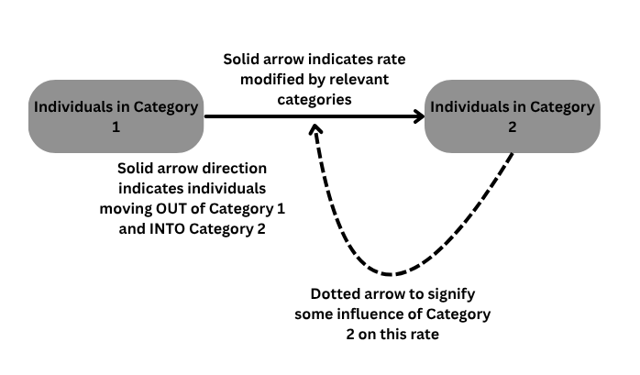
Compartmental Models: Generalized
Diagrams created with Canva (www.canva.com)

Slide 3
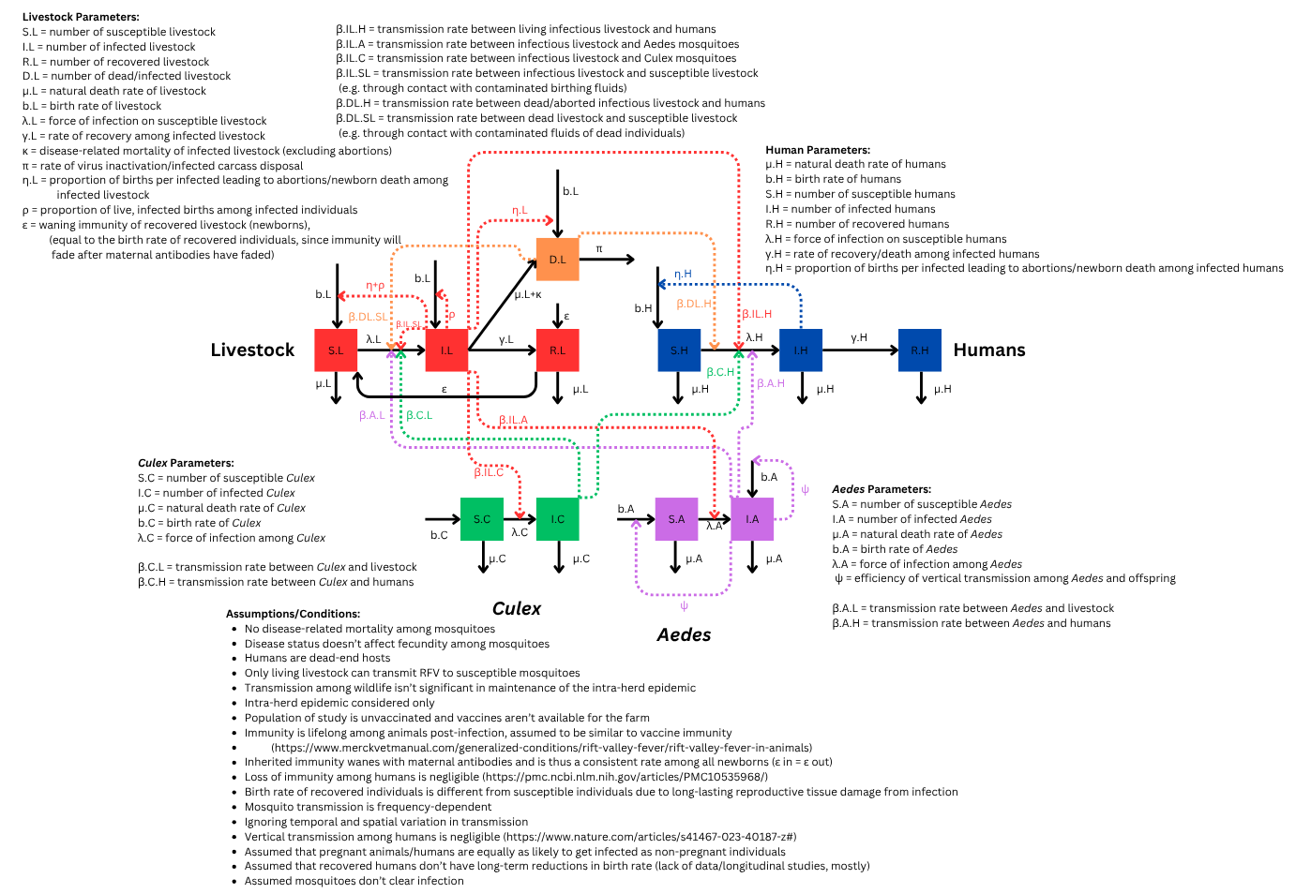
Complex Example: Rift Valley Fever

Slide 4
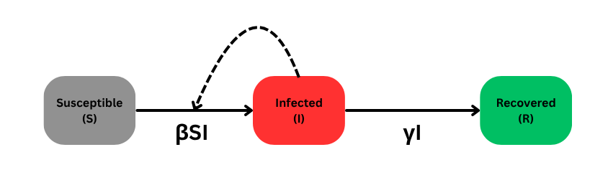
SIR: Basic
Equations:
S_{t+1} = S_{t} - βS_{t}I_{t}
I_{t+1} = I_{t} + βS_{t}I_{t} - γI_{t}
R_{t+1} = R_{t} + γI_{t}
Where:
S = # of Susceptibles
I = # of Infected
R = # of Recovered
β = Infection Rate (rate of contact * P(infection | contact))
γ = Recovery Rate

Slide 5
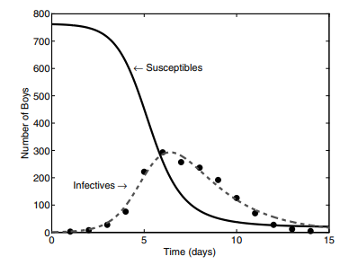
Graphical Example
Keeling, M. J., & Rohani, P. (2011). Modeling Infectious Diseases in Humans and Animals. Princeton University Press. https://doi.org/10.1515/9781400841035

Slide 6
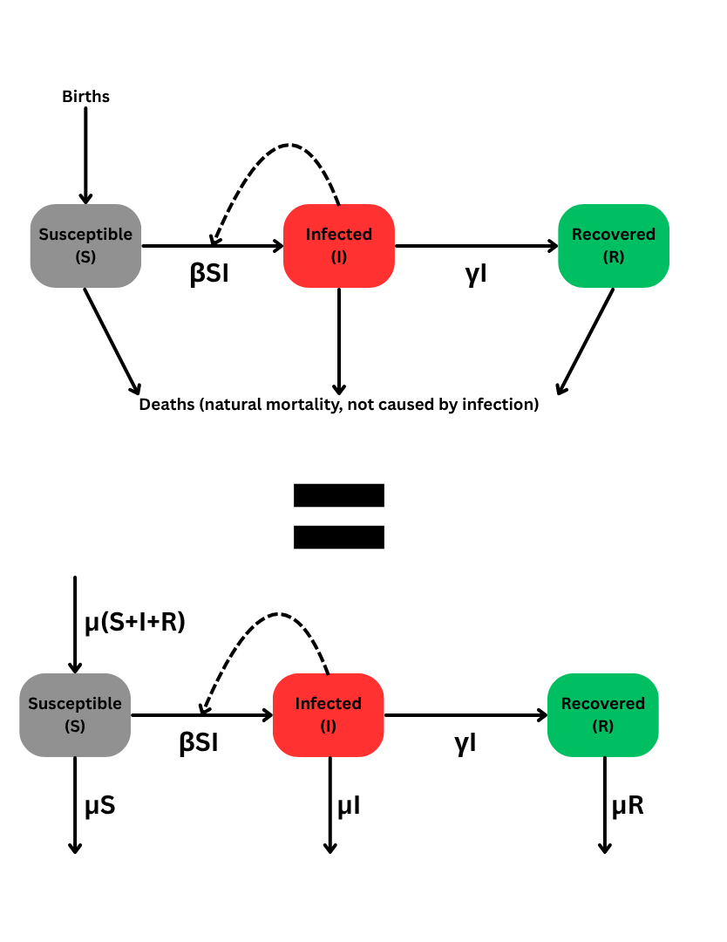
SIR with Demography
Equations remain SAME except add birth/death rate
Equations:
S_{t+1} = S_{t} - βS_{t}I_{t} + (S_{t} + I_{t} + R_{t})μ - μS_{t}
I_{t+1} = I_{t} + βS_{t}I_{t} - γI_{t} - μI_{t}
R_{t+1} = R_{t} + γI_{t} - μR_{t}
Where:
S = # of Susceptibles
I = # of Infected
R = # of Recovered
β = Infection Rate (rate of contact * P(infection | contact))
γ = Recovery Rate
μ = natural birth rate = natural death rate
Note: S+I+R = N, aka, population size
Notes:
All it is, is the proportion of the population that turns over due to natural rates of births and deaths

Slide 7
Note: Density vs. Frequency-Dependent
Remember that:
β = Infection Rate (rate of contact * P(infection | contact))
In density-dependent systems (e.g. flu):
# contacts is dependent on population size (N)
βS_{t}I_{t} represents this…
β modified by product S * I, which increase with greater N
e.g. one individual infects all individuals within an average of 6 feet of them while infected with the flu
In frequency-dependent systems (e.g. HIV)
# contacts is NOT dependent on population size (N)
βS_{t}I_{t}/N represents this...
Dividing by N compensates for rate of contact remaining constant at higher N
e.g. one individual bites average of 3 other animals while infected with rabies
Notes:
Difference between sneezing into a crowd and biting one person

Slide 8
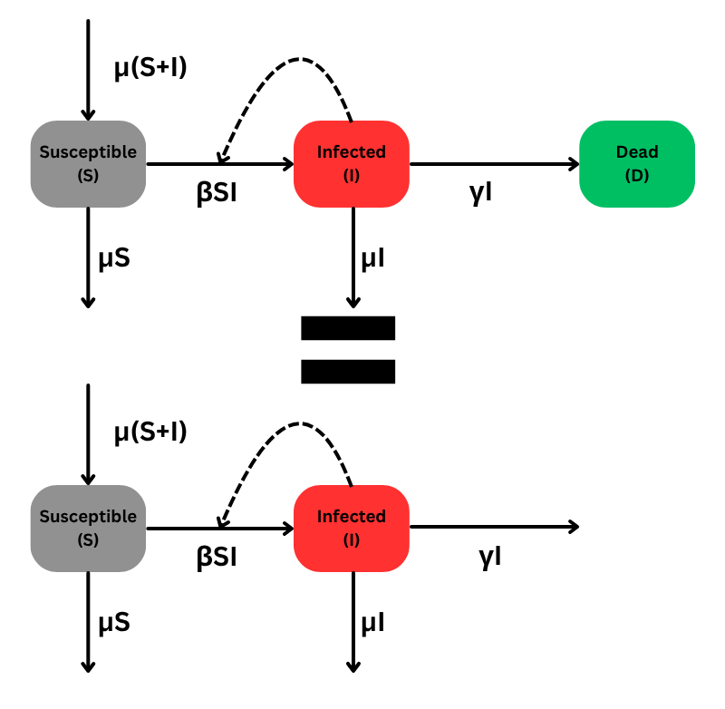
SI/SID: Fatal Infections
Essentially same as SIR, but R replaced by D or omitted
Equations:
S_{t+1} = S_{t} - βS_{t}I_{t} + (S_{t} + I_{t} )μ - μS_{t}
I_{t+1} = I_{t} + βS_{t}I_{t} - γI_{t} - μI_{t}
D_{t+1} = D_{t} + γI_{t} (or omit)
Where:
S = # of Susceptibles
I = # of Infected
D = # of Dead due to infection
β = Infection Rate (rate of contact * P(infection | contact))
γ = death rate due to infection
μ = natural birth rate = natural death rate

Slide 9
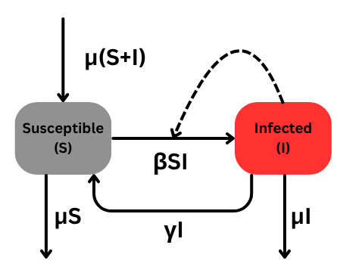
SIS: No Recovery
Infected individuals become susceptible again (no acquired immunity)
Equations:
S_{t+1} = S_{t} - βS_{t}I_{t} + (S_{t} + I_{t} )μ – μS_{t} + γI_{t}
I_{t+1} = I_{t} + βS_{t}I_{t} - γI_{t} - μI_{t}
Where:
S = # of Susceptibles
I = # of Infected
β = Infection Rate (rate of contact * P(infection | contact))
γ = Recovery Rate (but NO immunity)
μ = natural birth rate = natural death rate

Slide 10
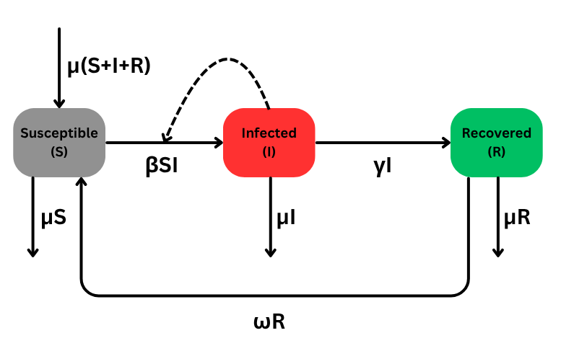
SIRS: Waning Immunity
Equations remain SAME except added waning immunity rate
Equations:
S_{t+1} = S_{t} - βS_{t}I_{t} + (S_{t} + I_{t} + R_{t})μ - μS_{t}
I_{t+1} = I_{t} + βS_{t}I_{t} - γI_{t} - μI_{t}
R_{t+1} = R_{t} + γI_{t} - μR_{t} - ωR_{t}
Where:
S = # of Susceptibles
I = # of Infected
R = # of Recovered
β = Infection Rate (rate of contact * P(infection | contact))
γ = Recovery Rate
μ = natural birth rate = natural death rate
ω = rate of waning immunity

Slide 11
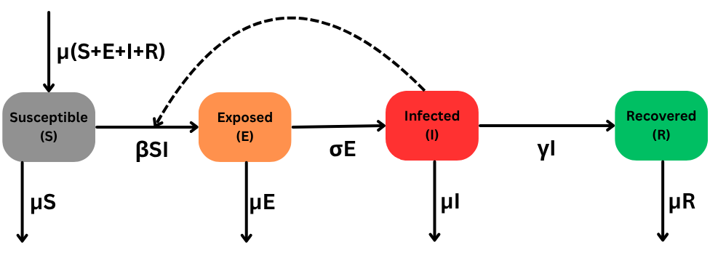
SEIR: Latent Infection
Shedding of pathogen is latent; doesn’t begin immediately
Equations:
S_{t+1} = S_{t} - βS_{t}I_{t} + (S_{t} + E_{t} + I_{t} + R_{t})μ – μS_{t}
E_{t+1} = E_{t} + βS_{t}I_{t} - σE_{t} - μE_{t}
I_{t+1} = I_{t} - γI_{t} - μI_{t} + σE_{t}
R_{t+1} = R_{t} + γI_{t} - μR_{t}
Where:
S = # of Susceptibles
I = # of Infected
R = # of Recovered
β = Infection Rate (rate of contact * P(infection | contact))
γ = Recovery Rate
σ = rate of shedding/symptom onset
μ = natural birth rate = natural death rate

Slide 12
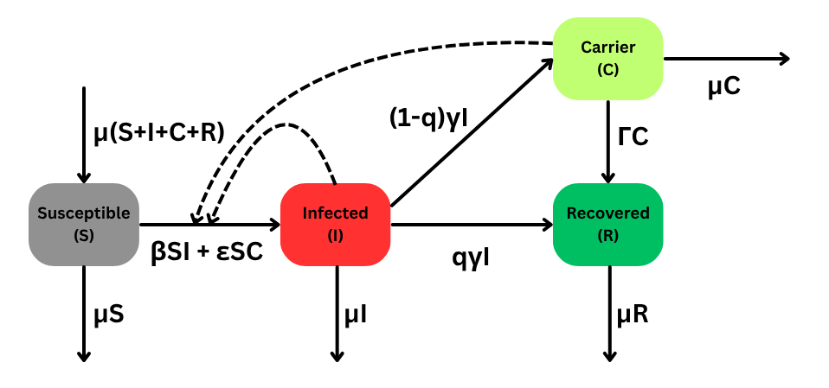
SIRC: Carrier State
Added carrier state; hybrid of I and R states
Equations:
S_{t+1} = S_{t} - βS_{t}I_{t} - εS_{t}C_{t} - (S_{t} + I_{t} + C_{t} + R_{t})μ - μS_{t}
I_{t+1} = I_{t} + βS_{t}I_{t} - γI_{t} - μI_{t} + εS_{t}C_{t}
C_{t+1} = C_{t} + (1 - q)γI_{t} - ΓC - μC_{t}
R_{t+1} = R_{t} + qγI_{t} - μR_{t}
Where:
S = # of Susceptibles
I = # of Infected
R = # of Recovered
C = # of Carriers
β = Infection Rate (rate of contact * P(infection | contact))
γ = Recovery Rate
ε = Infection rate of carriers on susceptibles
q = probability of recovering without becoming carrier
1 – q = probability of becoming a carrier
Γ = rate of carrier recovery
μ = natural birth rate = natural death rate

Slide 13
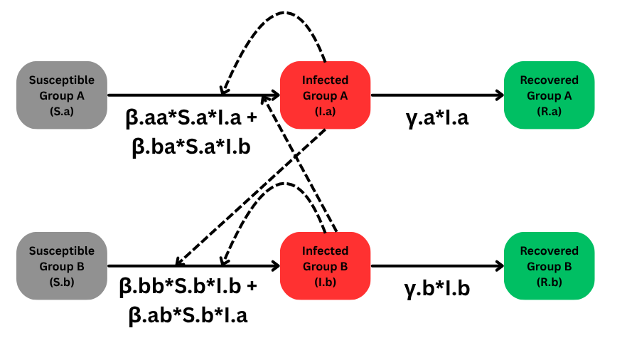
SIR: Multiple Species (~Age Classes, too)
Only difference is two SIR models, with infected contacting those from either population (ignoring demographics for now)
May also have systems where Group A moves to Group B at some rate (e.g. age classes), or one group serves as a dead-end host and thus doesn’t transmit back to the other group (e.g. some zoonoses)
Equations:
S.a_{t+1} = S.a_{t} – β.aa*S.a_{t}I.a_{t} – β.ba*S.a_{t}I.b_{t}
I.a_{t+1} = I.a_{t} + β.aa*S.a_{t}I.a_{t} + β.ba*S.a_{t}I.b_{t} - γ.a*I.a_{t}
R.a_{t+1} = R.a_{t} + γ.a*I.a_{t}
S.b_{t+1} = S.b_{t} – β.bb*S.b_{t}I.b_{t} – β.ab*S.b_{t}I.a_{t}
I.b_{t+1} = I.b_{t} + β.bb*S.b_{t}I.b_{t} + β.ab*S.b_{t}I.a_{t} - γ.b*I.b_{t}
R.b_{t+1} = R.b_{t} + γ.b*I.b_{t}
Where:
S.a = # of Susceptibles in Group A
S.b = # of Susceptibles in Group B
I.a = # of Infected in Group A
I.b = # of Infected in Group B
R.a = # of Recovered in Group A
R.b = # of Recovered in Group B
β.aa = Infection Rate of Group A on itself
β.bb = Infection Rate of Group B on itself
β.ab = Infection Rate of Group A on Group B
β.ba = Infection Rate of Group B on Group B
γ.a = Recovery Rate of Group A
γ.b = Recovery Rate of Group B

