Slide 1
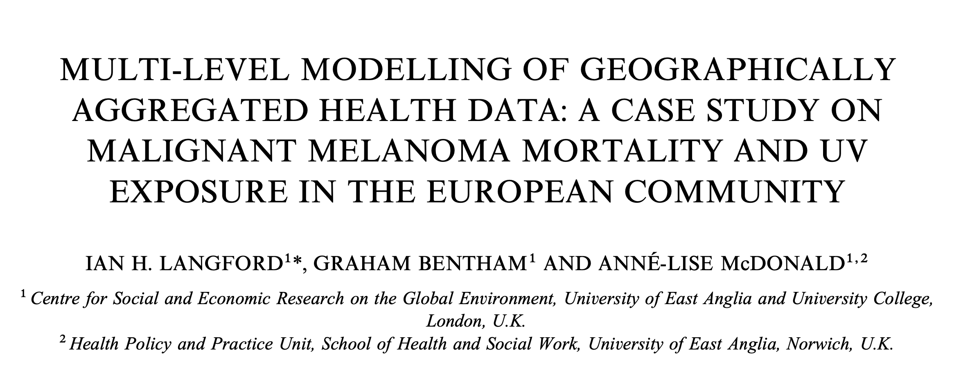
Sara Serafino’s project
for Bayesian Statistics

Slide 2
Goals of the project
Analyse the data using a Bayesian approach
Build a model for the number of male deaths, taking into account the hierarchical data structure
Check the model and comment the results
Compare the results with those of Langford et al. (1998):
what can be said about the effect of the UVB dose on the malignant melanoma mortality?
Notes:
Non binomial perché il paper ha detto che per maschi non occorreva, per femmine sì

Slide 3
Data
354 observations on 6 variables:
Nation: Belgium, West Germany (WG), Denmark, France, United Kingdom (UK), Italy, Ireland, Luxembourg, Netherlands
Region: Region ID - a factor from 1 to 79, skipping 26
County: County ID - a factor from 1 to 354
Deaths: Number of male deaths due to malignant melanoma during 1971–1980 (for some nations it is from 1975-1976 onwards)
Expected: Number of expected deaths
UVB: Centered measure of the UVB dose reaching the earth’s surface in each county.

Slide 4
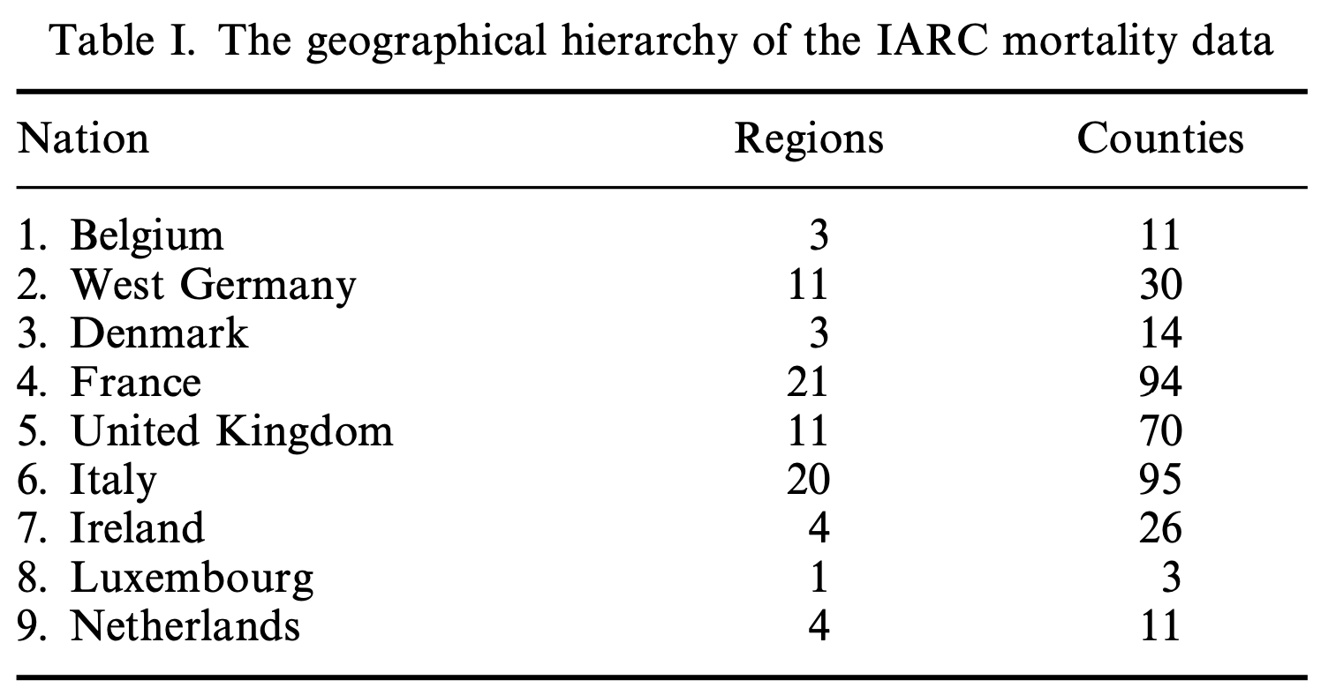
Data
Geographical hierarchy: counties within regions within nations
multi-level model hierarchy

Slide 5
Explorative analysis
If they were too different, there could be some unconsidered factors influencing the observed deaths.

Slide 6
Explorative analysis
Negative correlation with complete pooling
On the contrary, accounting for hierarchy at nation level…
Notes:
But tracing a regression line for each nation we see that a simple negative association between UVB and mortality is misleading because after accounting for hierarchy, the association disappears.

Slide 7
Explorative analysis
Nation | deaths | people/km^{2 *}
Belgium | 449 | 384
WG | 2949 | 234
Denmark | 681 | 139
France | 1495 | 101
UK | 2179 | 281
Italy | 1462 | 195
Ireland | 67 | 65
Luxembourg | 23 | 255
Netherlands | 546 | 520
* From most recent data, just for the big picture
Notes:
Also, for having the big picture I summarized the total of deaths for every nation and reported the population density. Since I just wanted to have an idea, the data for the density is simply the most recent one, and for example I used the Germany one for the West Germany.
What is immediately evidenced is that, even though Ireland is less populated in density than Luxembourg, it has more deaths; and that, despite being more dense in population, Belgium and the Netherlands have proportionally less deaths than other nations.

Slide 8
Explorative analysis
UK, Ireland, Netherlands, Luxembourg:
🌥️ Low exposure to UVB
📈 Positive relationship
Belgium, WG, Denmark:
🌥️ Low exposure to UVB
📉 Negative relationship
Italy:
☀️ High(est) exposure to UVB
📉 Negative relationship
France:
🌤️ Mid exposure to UVB
📉 (slightly) Negative relationship

Slide 9
Explorative analysis
UK, Ireland, Netherlands, Luxembourg:
🌥️ Low exposure to UVB
📈 Positive relationship
Belgium, WG, Denmark:
🌥️ Low exposure to UVB
📉 Negative relationship
Italy:
☀️ High(est) exposure to UVB
📉 Negative relationship
France:
🌤️ Mid exposure to UVB
📉 (slightly) Negative relationship
Northern Europeans more at risk of intermittent high exposures.
Less sun exposure at home & more recreational travel to warmer climates?
Other factors influencing the behaviour:
Use of sunscreen
Effective UVB exposure
History of deceased
Origin different from nation
Differences within nations – especially Italy and France – depending on north-south and genetic factors
Notes:
Effective UVB exposure and history of deceased: for example if someone does a work inside or outside, it is different; someone may not go to the beach…
Origin may be different from the nation, so for example an italian who grew up in Italy with more UVB exposure and maybe «better» genetic, could have later been in WG modifying the statistics and viceversa

Slide 10
Explorative analysis
Boxes extend from 25% to 75% of data.
Whiskers extend from minimum to maximum within 1.5 times its box.
Outliers are regions with deaths exceptionally higher than the average.
West Germany has higher number of deaths and variation
Ireland and Luxembourg have lower mortality rates with less variation
Notes:
Boxplots of deaths by nation from which we can analyse the variability of deaths across counties.

Slide 11
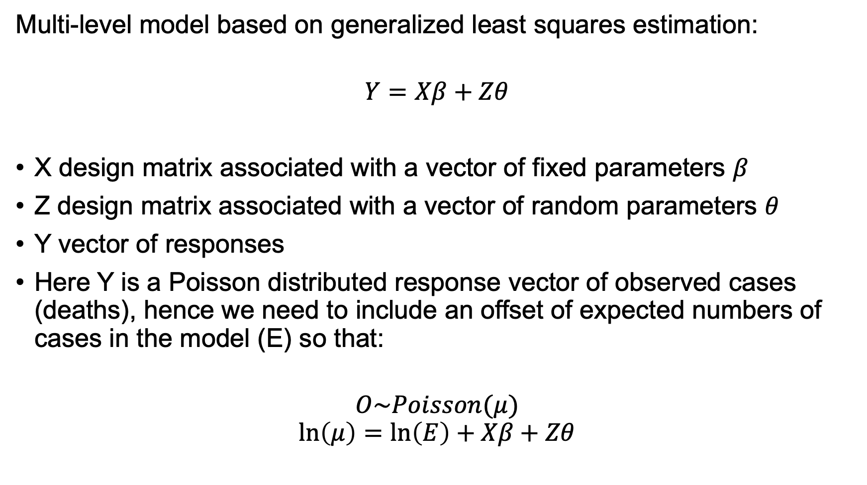
Methods
Multi-level model based on generalized least squares estimation:
$$Y=Xβ+Zθ$$
X design matrix associated with a vector of fixed parameters $β$
Z design matrix associated with a vector of random parameters $θ$
Y vector of responses
Here Y is a Poisson distributed response vector of observed cases (deaths), hence we need to include an offset of expected numbers of cases in the model (E) so that:
$$O\sim Poisson(μ)$$
$$\ln\left(μ\right)=\ln\left(E\right)+Xβ+Zθ$$
Notes:
Poisson distribution to model the level 1 variance, with a logarithmic link function, and assume random parameters at higher levels (in this case region and nation) as being multivariate normal.
The counties have very heterogeneous populations, hence deaths in each county are being modelled as Poisson conditional on the distribution of rates between counties. These rates may be assumed to follow a gamma distribution, and hence the mixture of these two distributions can be expressed as a negative binomial distribution of counts.

Slide 12
Frequentist approach
Generalized linear mixed model with Poisson regression, an intercept for each region and an offset term to take into account the expected deaths:
M1 <- glmer(deaths ~ uvb + (1 | region) +
+ (1 | nation),
Mmmec,
poisson,
offset = log(expected))

Slide 13
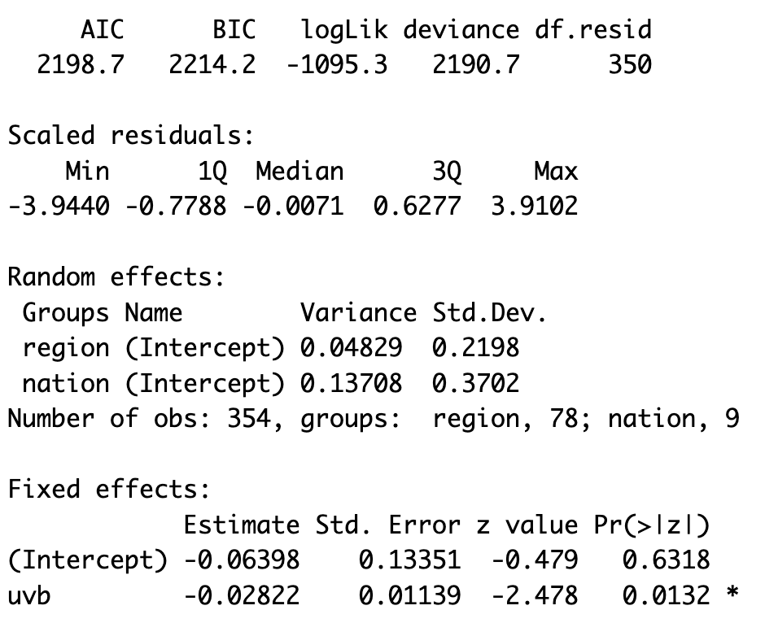
Frequentist approach
Overall nice model quality, but needs comparison with others
Variation between regions not explained by UVB exposure
📉 Negative relationship
Notes:
As seen from the plot before the boxplot, there is a slightly negative relationship between UVB exposure and deaths.
A better model has AIC, BIC and deviance lower, log-likelihood higher so less negative, a higher number of degrees of freedom indicates that the model does not overfit the data.

Slide 14
Bayesian approach (stan_glmer)
Like before, but the Bayes approach relies on Hamiltonian Monte Carlo sampling from the posterior distribution:
M1.rstanarm <- stan_glmer (deaths ~ uvb +
+ (1 | region) + (1 | nation),
Mmmec,
poisson,
offset = log(expected))

Slide 15
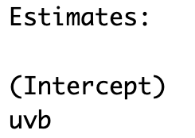
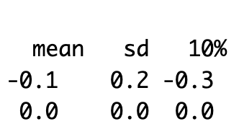
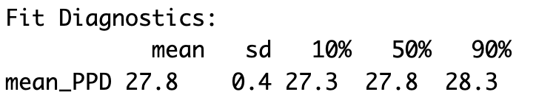
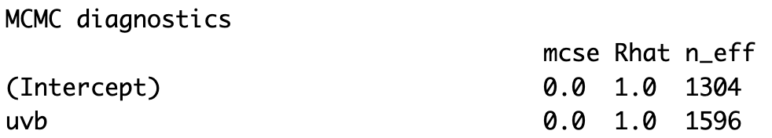
Bayesian approach (stan_glmer)
UVB does not have a meaningful effect (contrary to M1)
Seems a good fit…
Converges

Slide 16
Bayesian approach (stan_glmer)
Credibility intervals:
Solid blue line: 50% credible interval
Tinner light blue line: 95% credible interval
Captures well the uncertainty of estimated parameters

Slide 17
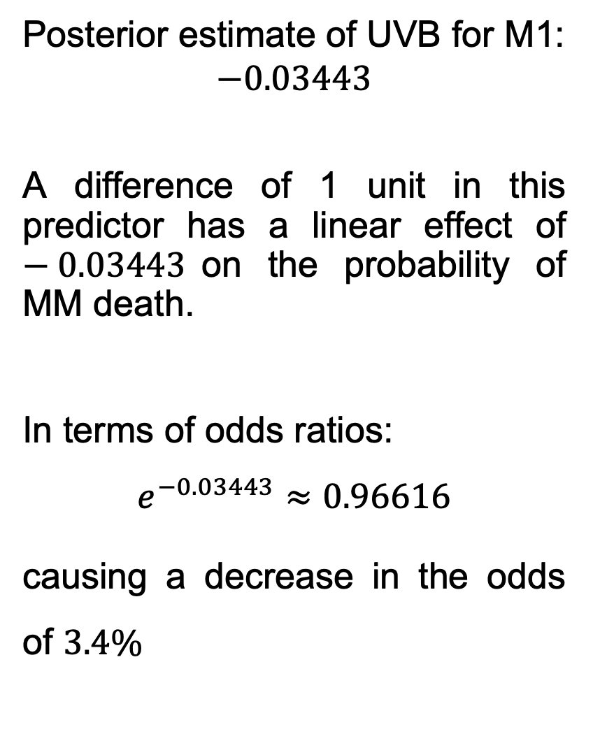
Bayesian approach (stan_glmer)
Posterior estimate of UVB for M1:
$$−0.03443$$
A difference of 1 unit in this predictor has a linear effect of $−0.03443$on the probability of MM death.
In terms of odds ratios:
$$e^{−0.03443}≈0.96616$$
causing a decrease in the odds of $3.4\%$
Notes:
Plot the posterior marginal densities along with 50% intervals for the ‘fixed-effects’ uvb
We see that the posterior estimate of uvb is almost the same as the one for model M1

Slide 18

Bayesian approach (stan_glmer)
Random effects for the regions:
Posterior means of the region intercepts $±$ standard error of random effect
Notes:
Positive values indicate that, w.r.t. the mean, the posterior mean of that region intercept is higher w.r.t. the global mean -> more deaths than expected.
Red lines indicate the standard deviation of intercepts (uncertainty) -> the longer, the less info or data for that region

Slide 19
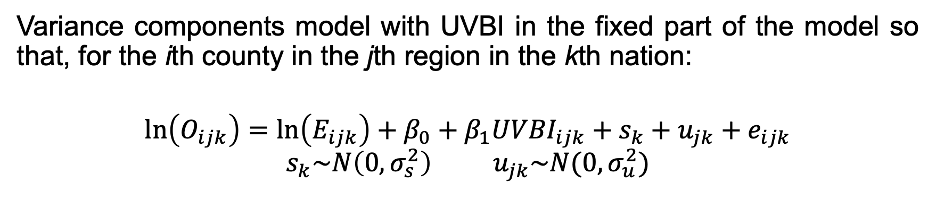

Bayesian approach (model A)
Variance components model with UVBI in the fixed part of the model so that, for the ith county in the jth region in the kth nation:
$$\ln\left(O_{ijk}\right)=\ln\left(E_{ijk}\right)+β_{0}+β_{1}{UVBI}_{ijk}+s_{k}+u_{jk}+e_{ijk}$$
$$s_{k}\sim N\left(0,σ_{s}^{2}\right){ u}_{jk}\sim N(0,σ_{u}^{2})$$
$β_{0}$ intercept term
$β_{1}$ mean (fixed) effect of UVBI
$s_{k}, u_{jk}, e_{ijk}$ random terms associated with the intercept at levels 3, 2, 1 respectively

Slide 20
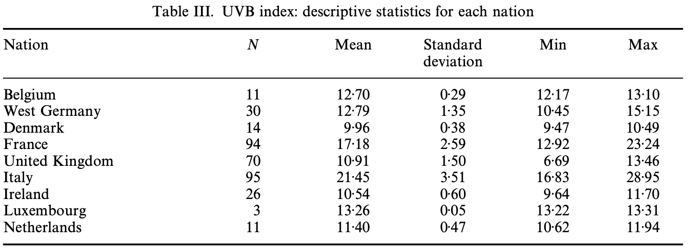
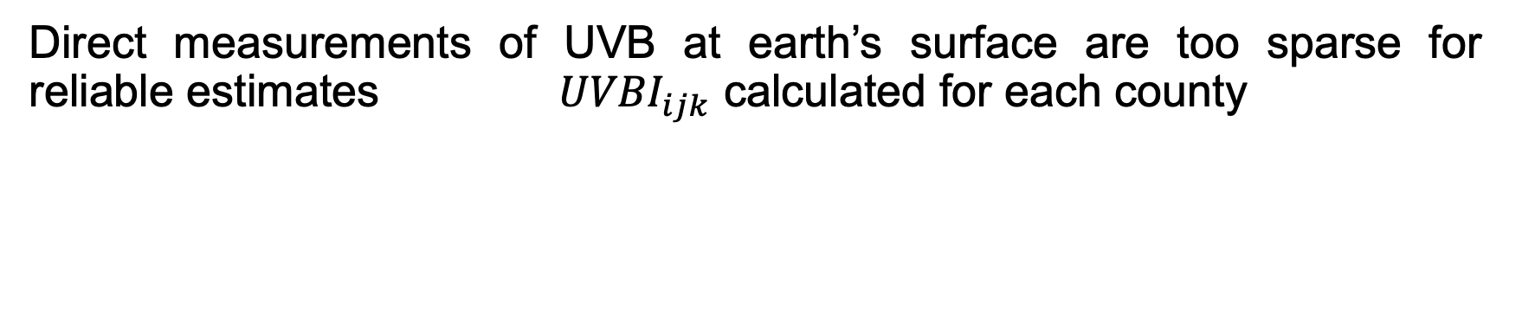
Bayesian approach (model A)
Direct measurements of UVB at earth’s surface are too sparse for reliable estimates ${UVBI}_{ijk}$ calculated for each county
Use a truncated norm to generate random deviates for each county starting from nation statistics
Notes:
Direct measurements … so an index previously employed in epidemiological studies has been calculated for each county

Slide 21
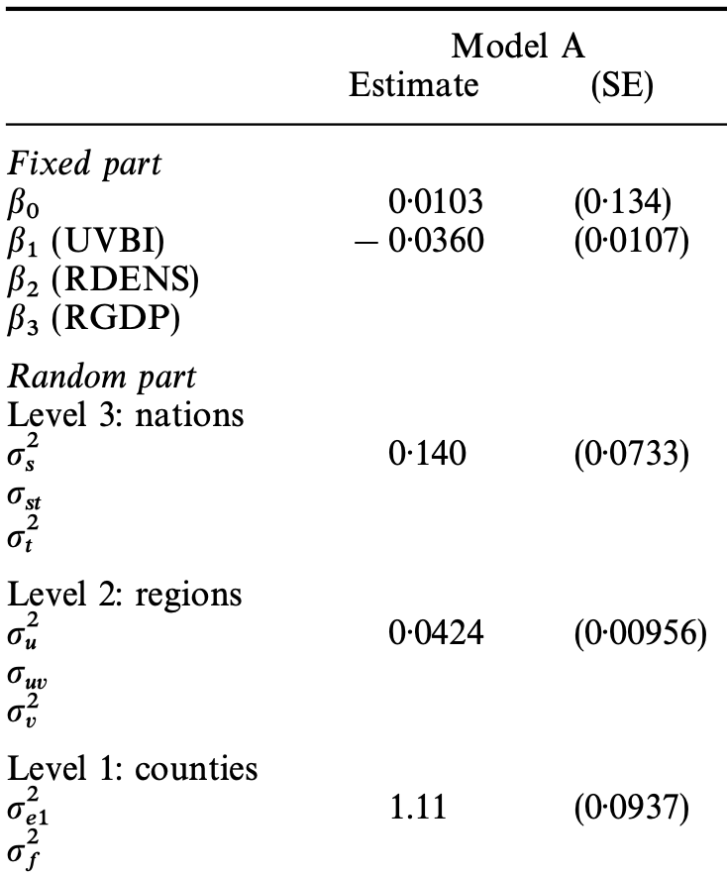

Bayesian approach (model A)
$$β_{0}, β_{1}, σ_{s}, σ_{u}, σ_{e} \sim N(0,1)$$
Notes:
Started with a normal prior for every parameter. Since prior is given by what we know and I know the results of the paper, I tried changing into the results of Table IV of the paper but the results didn’t change significantly.
I plotted the traceplots of the parameters from which you see that sigma_e ‘s chains do not mix very well

Slide 22
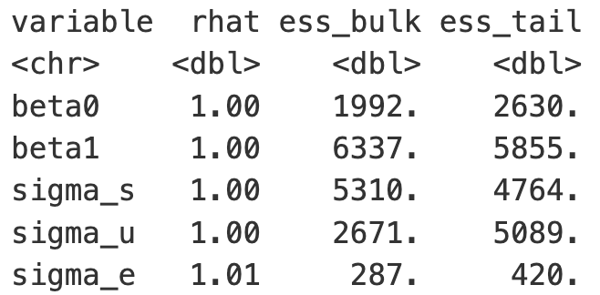

Bayesian approach (model A)
$$β_{0}, β_{1}, σ_{s}, σ_{u}, σ_{e} \sim N(0,1)$$
With 8000 iterations instead of 4000, the warning about bulk and tail ESS too low disappears and ${\hat{R}}_{σ_{e}}=1.00$
Notes:
In fact we get some warnings. For example the one about bulk and tail Effective Sample Size, that disappears using more iterations; but since the posterior predictive check plots did not got substantially better, I left 4000 iterations.
ESS of a quantity of interest captures how many independent draws contain the same amount of information as the dependent sample obtained by the MCMC algorithm
Bulk_ESS=effective sample size for rank normalized values using split chains
Tail_ESS=minimum of the effective sample sizes for 5% and 95% quantiles

Slide 23
stan_glmer VS model A: densities

Slide 24
stan_glmer VS model A: ECDF

Slide 25
stan_glmer VS model A: proportion zero

Slide 26
stan_glmer VS model A: mean

Slide 27
stan_glmer VS model A: standard deviation

Slide 28
stan_glmer VS model A: median

Slide 29
stan_glmer VS model A: max

Slide 30
stan_glmer VS model A: standardized residuals
Notes:
Dal residual : It looks as though we have more positive residuals than negative ⇒maybe the model tends to underestimate the number of deaths

Slide 31
stan_glmer VS model A: predictive intervals

Slide 32
stan_glmer VS model A

