Slide 1

Sara Serafino’s project for «Bayesian Statistics»

Slide 2
Goals of the project

Slide 3
Data and methods
354 observations on 6 variables:
Nation: Belgium, W.Germany, Denmark, France, UK, Italy, Ireland, Luxembourg, Netherlands
Region: Region ID - a factor from 1 to 78
County: County ID - a factor from 1 to 354
Deaths: Number of male deaths due to malignant melanoma during 1971-1980 (but for some nations it is from 1975-1976 onwards)
Expected: Number of expected deaths
UVB: Centered measure of the UVB dose reaching the earth’s surface in each county.

Slide 4
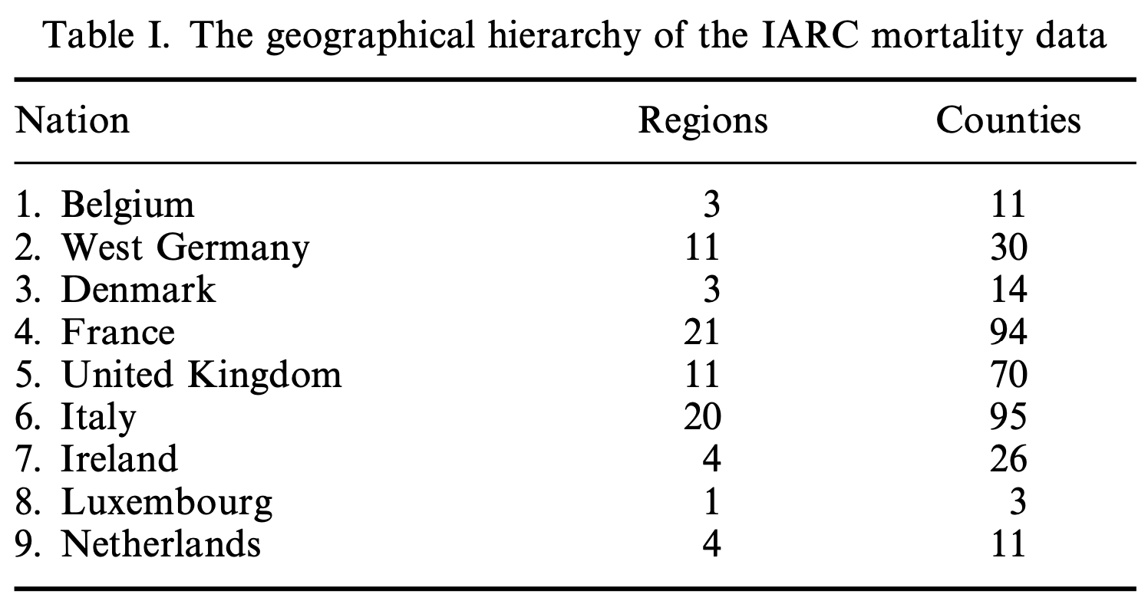
Data and methods

Slide 5
Data and methods
Geographical hierarchy: counties within regions within nations
multi-level model hierarchy

Slide 6
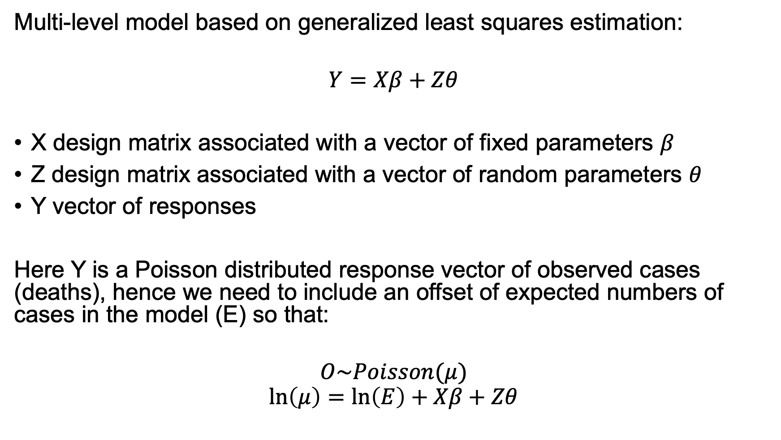
Data and methods
Multi-level model based on generalized least squares estimation:
$$Y=Xβ+Zθ$$
X design matrix associated with a vector of fixed parameters $β$
Z design matrix associated with a vector of random parameters $θ$
Y vector of responses
Here Y is a Poisson distributed response vector of observed cases (deaths), hence we need to include an offset of expected numbers of cases in the model (E) so that:
$$O\sim Poisson(μ)$$
$$\ln\left(μ\right)=\ln\left(E\right)+Xβ+Zθ$$

Slide 7
Explorative analysis
If they were very different, there could be some unconsidered factors influencing the observed deaths.
They could be better:
History of deceased?
Sunscreen?
Holiday abroad?
Native of the nation?
Notes:
Plotted distribution of deaths and expected separately and then I gathered them in the single histogram with transparency that you see here.
It would have been great to know more information about the deceased people: how they lived, if they used sunscreen, if they went on holidays in sunnier places, if they are native of that region or they moved and so on

Slide 8
Explorative analysis
Notes:
Then I plotted some scatter plots of deaths VS UVB exposure with a single regression line from which we already observe a negative correlation

Slide 9
Explorative analysis
Notes:
Then I did the same but with a regression line for each nation. I also divided for each nation, which can result less chaotic for someone

Slide 10
Explorative analysis
UK, Ireland, Netherlands:
🌥️ Low exposure to UVB
📈 Positive relationship
West Germany, Denmark:
🌥️ Low exposure to UVB
📉 Negative relationship
Italy:
☀️ High(est) exposure to UVB
📉 Negative relationship
Notes:
The difference between these first two groups could be due to knowledge of risk or other factors influencing the behaviour.
France shows a poor relationship and let’s not speak about Luxembourg.
Italy has the highest UVBI and a negative relationship.

Slide 11
Explorative analysis
Box extends from 25% to 75% of data
Whiskers extend from minimum to maximum within 1.5 times the box
Other points are outliers
West Germany has higher number of deaths on mean
…..
Notes:
Then I did some boxplots of deaths by nation from which we can analyse the variability of deaths.
For example the box of West Germany is bigger than the others, meaning that it has a higher number of deaths on mean

Slide 12
Frequentist approach
Generalized linear mixed model with Poisson regression, an intercept for each region and an offset term to take into account the expected deaths:
M1 <- glmer(deaths ~ uvb + (1 | region) +
+ (1 | nation),
Mmmec,
poisson,
offset = log(expected))

Slide 13
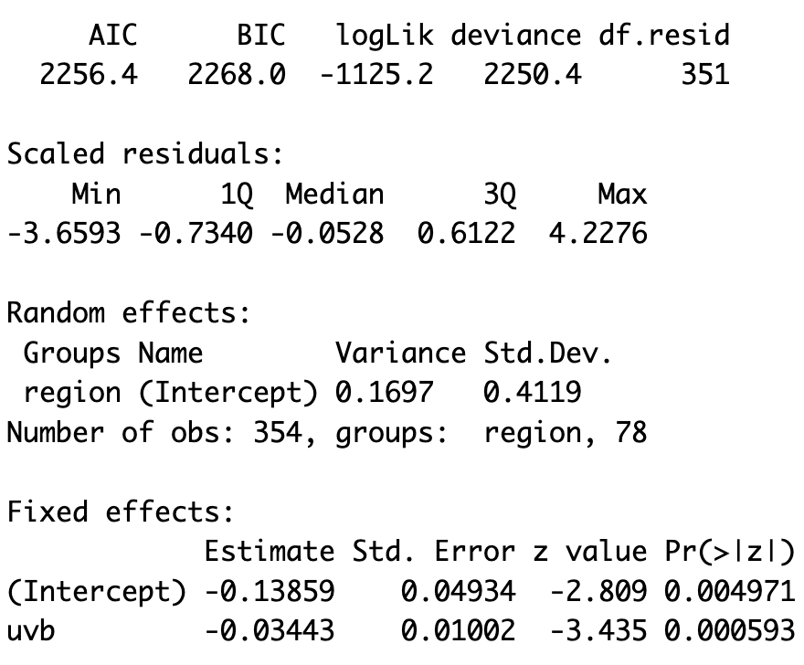
Frequentist approach
Overall nice model quality, but needs comparison with others
Variation between regions not explained by UVB exposure
📉 Negative relationship
Notes:
As seen from the plot before the boxplot, there is a slightly negative relationship between UVB exposure and deaths.
A better model has AIC, BIC and deviance lower, log-likelihood higher so less negative, a higher number of degrees of freedon indicates that the model does not overfit the data.

Slide 14
Bayesian approach (stan_glmer)
Like before, but the Bayes approach relies on Hamiltonian Monte Carlo sampling from the posterior distribution:
M1.rstanarm <- stan_glmer (deaths ~ uvb +
+ (1 | region) + (1 | nation),
Mmmec,
poisson,
offset = log(expected))

Slide 15
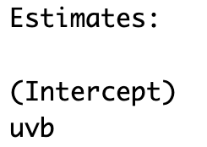
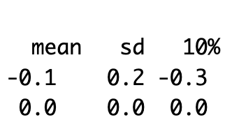
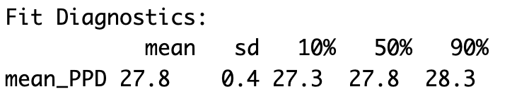
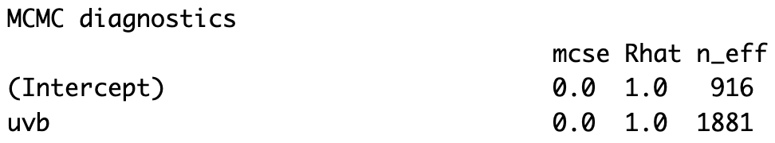
Bayesian approach (stan_glmer)
UVB does not have a meaningful effect (contrary to M1)
Seems a good fit…
Converges

Slide 16
Bayesian approach (stan_glmer)
 | AIC | BIC | Log-Likelihood
Frequentist (M1) | 2256.4 | 2268.0 | -1125.2
Bayesian (M1.rstanarm) | 2313.8 | 2658.2 | /
Bayesian approach of M1.rstanarm could be better…

Slide 17
Bayesian approach (stan_glmer)
Credibility intervals:
Solid blue line: 50% credible interval
Tinner light blue line: 95% credible interval
Captures well the uncertainty of estimated parameters

Slide 18
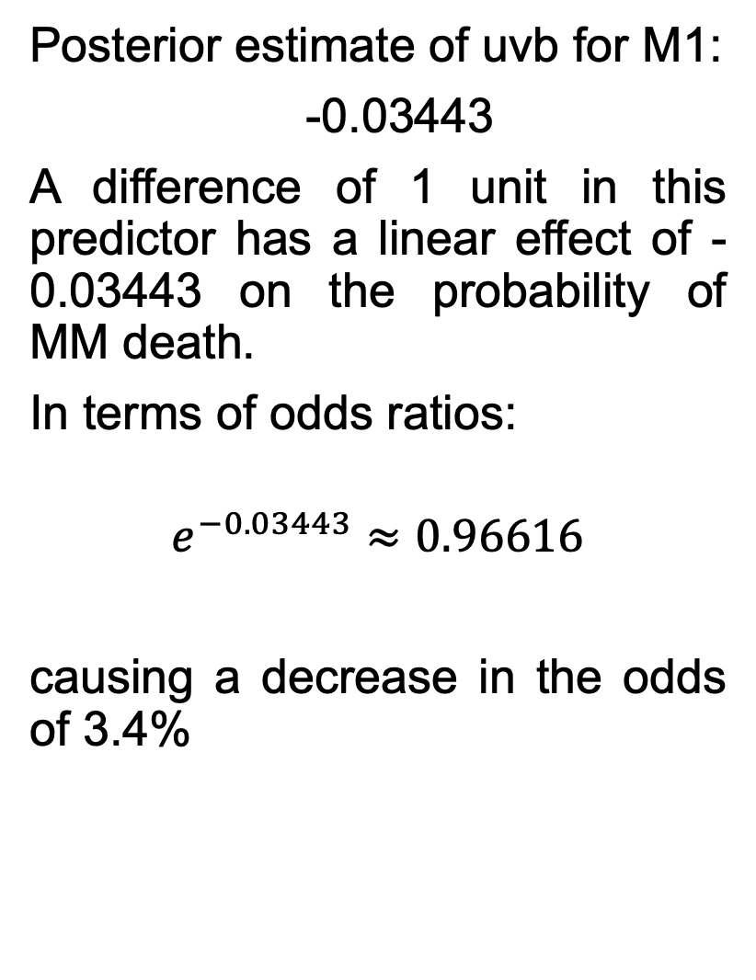
Bayesian approach (stan_glmer)
Posterior estimate of uvb for M1:
-0.03443
A difference of 1 unit in this predictor has a linear effect of -0.03443 on the probability of MM death.
In terms of odds ratios:
$$e^{−0.03443}≈0.96616$$
causing a decrease in the odds of 3.4%
Notes:
Plot the posterior marginal densities along with 50% intervals for the ‘fixed-effects’ uvb
We see that the posterior estimate of uvb is almost the same as the one for model M1
SISTEMA E CONTROLLA

Slide 19

Bayesian approach (stan_glmer)
Random effects for the regions:
Posterior means of the region intercepts $±$ standard error of random effect
Notes:
Positive values indicate that, w.r.t. the mean, the posterior mean of that region intercept is higher.
Red lines indicate the standard deviation of intercepts

Slide 20
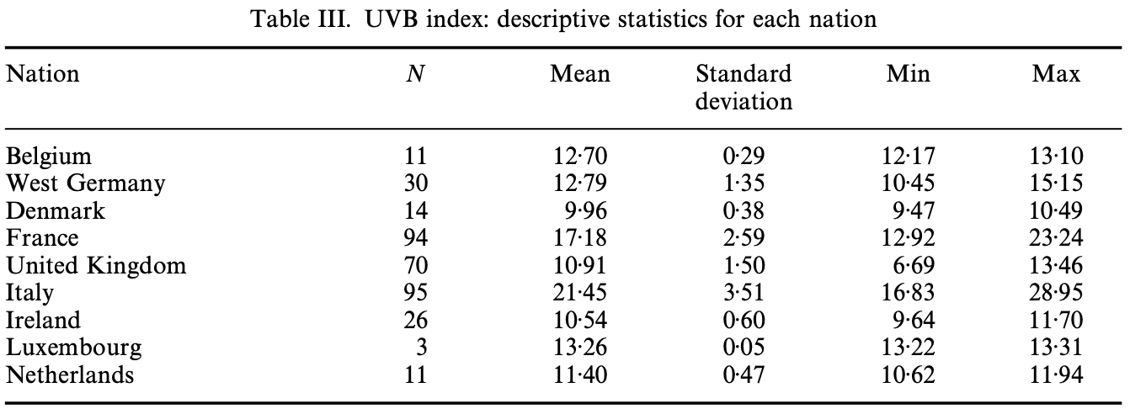
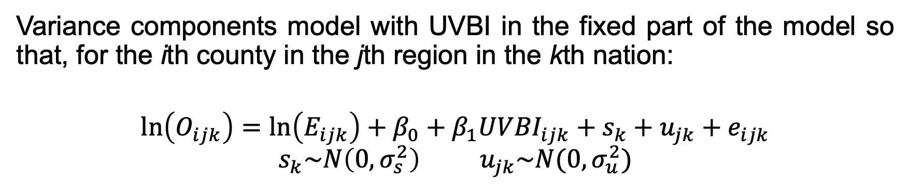
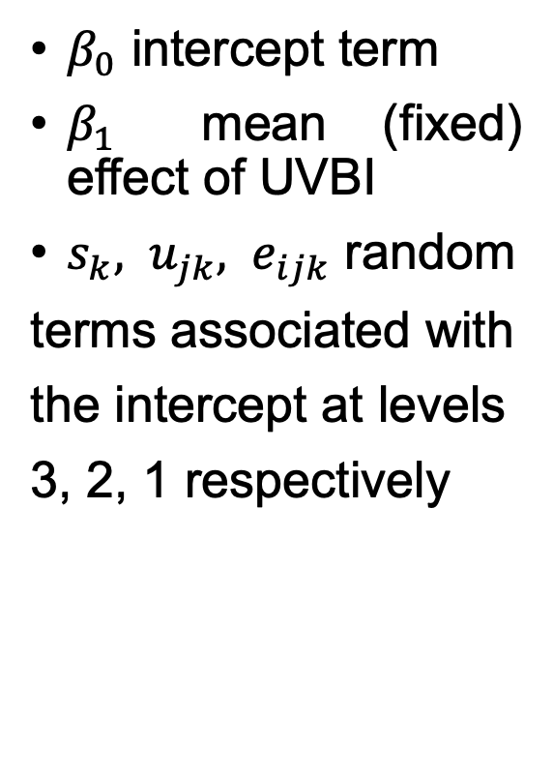
Bayesian approach (model A)
Variance components model with UVBI in the fixed part of the model so that, for the ith county in the jth region in the kth nation:
$$\ln\left(O_{ijk}\right)=\ln\left(E_{ijk}\right)+β_{0}+β_{1}{UVBI}_{ijk}+s_{k}+u_{jk}+e_{ijk}$$
$$s_{k}\sim N\left(0,σ_{s}^{2}\right){ u}_{jk}\sim N(0,σ_{u}^{2})$$
$β_{0}$ intercept term
$β_{1}$ mean (fixed) effect of UVBI
$s_{k}, u_{jk}, e_{ijk}$ random
terms associated with
the intercept at levels
3, 2, 1 respectively
Notes:
… I constructed UVBI with the values of this table and add it to the Mmmec dataframe.Then for each county I generated a UVBI value using a truncated norm that allowed me to take into consideration the minimum and maximum values.

Slide 21
Bayesian approach (model A)
Parla del modello stan e delle prior che hai dato in base a cosa le hai date, che cambiamenti hai fatto etc

Slide 22
Bayesian approach (model A)
aic_A <- - 2 * elpd_loo_A + 2 * p
> print(aic_A)
[1] 2994.942
> bic_A <- - 2 * elpd_loo_A + log(n) * p
> print(bic_A)
[1] 4720.648
Èe peggiorato

Slide 23
Bayesian approach (model A)
Model A of the paper is a variance components model with UVBI in the fixed part of the model so that, for the ith county in the jth region in the kth nation:

Slide 24
Bayesian approach (model A)
Model A of the paper is a variance components model with UVBI in the fixed part of the model so that, for the ith county in the jth region in the kth nation:

