Slide 1
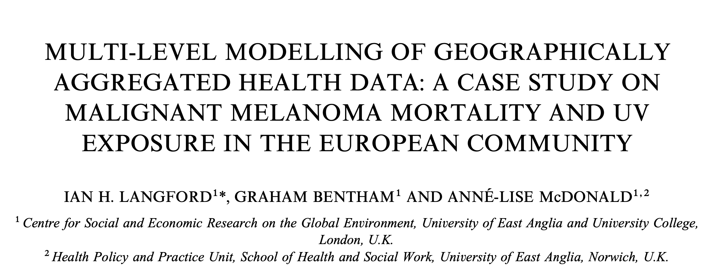
Sara Serafino’s project for «Bayesian Statistics»

Slide 2
Goals of the project
Domande poste dai prof
1. Analyse the data using a Bayesian approach. Build a model for the number of male deaths, taking into account the hierarchical data structure.
2. Check the model and comment the results.
3. [optional] Compare your results with those of Langford at al. (1998): what can you say about the effect of the UVB dose on the MM mortality?
Notes:
Non binomial perché il paper ha detto che per maschi non occorreva, per femmine sì

Slide 3
Data
354 observations on 6 variables:
Nation: Belgium, W.Germany, Denmark, France, UK, Italy, Ireland, Luxembourg, Netherlands
Region: Region ID - a factor from 1 to 78
County: County ID - a factor from 1 to 354
Deaths: Number of male deaths due to malignant melanoma during 1971-1980 (but for some nations it is from 1975-1976 onwards)
Expected: Number of expected deaths
UVB: Centered measure of the UVB dose reaching the earth’s surface in each county.

Slide 4
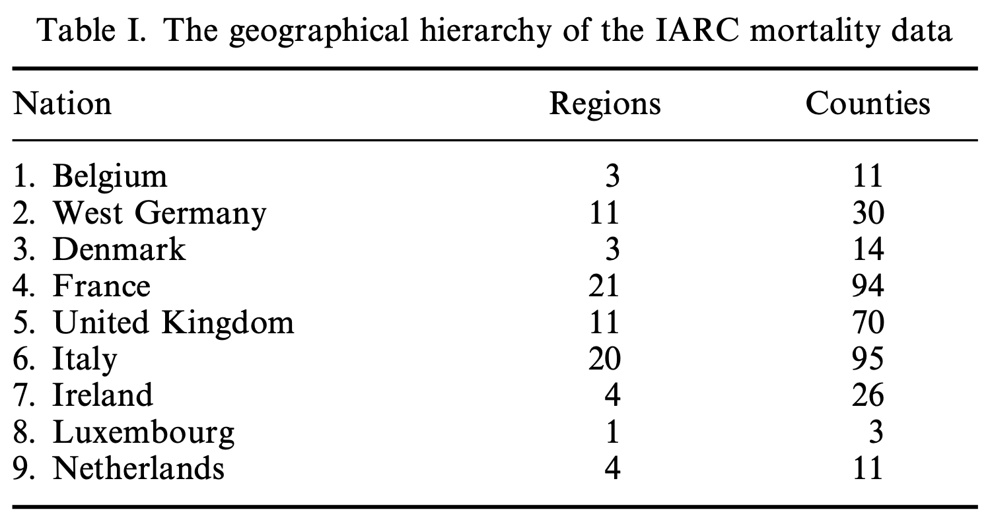
Data

Slide 5
Data
Geographical hierarchy: counties within regions within nations
multi-level model hierarchy

Slide 6
Explorative analysis
If they were too different, there could be some unconsidered factors influencing the observed deaths.
Notes:
I separately plotted the distribution of deaths and expected deaths per county and then I gathered them in this single histogram with transparency

Slide 7
Explorative analysis
Negative correlation with complete pooling

Slide 8
Explorative analysis
Nation | deaths | people/km^{2 *}
Belgium | 449 | 384
WG | 2949 | 234
Denmark | 681 | 139
France | 1495 | 101
UK | 2179 | 281
Italy | 1462 | 195
Ireland | 67 | 65
Luxembourg | 23 | 255
Netherlands | 546 | 520
* From most recent data, just for the big picture
Notes:
But tracing a regression line for each nation we see that a simple negative association between UVB and mortality is misleading because after accounting for hierarchy, the association disappears.
Also, for having the big picture I summarized the total of deaths for every nation and reported the population density. Since I just wanted to have an idea, the data for the density is simply the most recent one, and for example I used the Germany one for the West Germany.
What is immediately evidenced is that, even though Ireland is less populated in density than Luxembourg, it has more deaths; and that, despite being more dense in population, Belgium and the Netherlands have proportionally less deaths than other nations.

Slide 9
Explorative analysis
UK, Ireland, Netherlands, Luxembourg:
🌥️ Low exposure to UVB
📈 Positive relationship
Belgium, WG, Denmark:
🌥️ Low exposure to UVB
📉 Negative relationship
Italy:
☀️ High(est) exposure to UVB
📉 Negative relationship
France:
🌤️ Mid exposure to UVB
📉 (slightly) Negative relationship

Slide 10
Explorative analysis
UK, Ireland, Netherlands, Luxembourg:
🌥️ Low exposure to UVB
📈 Positive relationship
Belgium, WG, Denmark:
🌥️ Low exposure to UVB
📉 Negative relationship
Italy:
☀️ High(est) exposure to UVB
📉 Negative relationship
France:
🌤️ Mid exposure to UVB
📉 (slightly) Negative relationship
Northern Europeans more at risk of intermittent high exposures
Less sun exposure at home & more recreational travel to warmer climates?
Other factors influencing the behaviour:
Use of sunscreen
Effective UVB exposure
History of deceased
Origin different from nation
Differences within nations – especially Italy and France – depending on north-south and genetic factors
Notes:
Effective UVB exposure and history of deceased: for example if someone does a work inside or outside, it is different; someone may not go to the beach…
Origin may be different from the nation, so for example an italian who grew up in Italy with more UVB exposure and maybe «better» genetic, could have later been in WG modifying the statistics and viceversa

Slide 11
Explorative analysis
West Germany has higher number of deaths on mean
…..
Notes:
Boxplots of deaths by nation from which we can analyse the variability of deaths across counties.
Box extends from 25% to 75% of data
Whiskers extend from minimum to maximum within 1.5 times the box
Other points are outliers

Slide 12
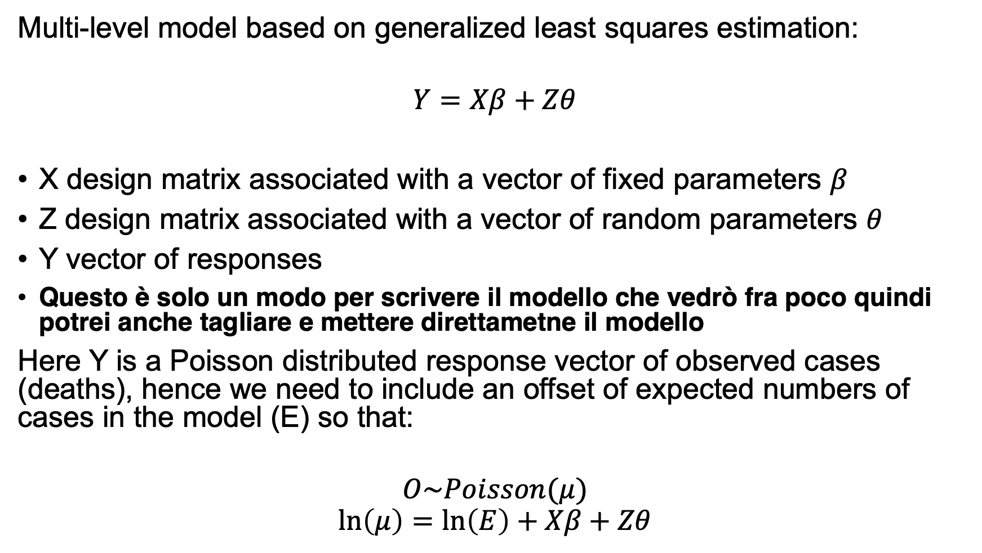
Methods
Multi-level model based on generalized least squares estimation:
$$Y=Xβ+Zθ$$
X design matrix associated with a vector of fixed parameters $β$
Z design matrix associated with a vector of random parameters $θ$
Y vector of responses
Questo è solo un modo per scrivere il modello che vedrò fra poco quindi potrei anche tagliare e mettere direttametne il modello
Here Y is a Poisson distributed response vector of observed cases (deaths), hence we need to include an offset of expected numbers of cases in the model (E) so that:
$$O\sim Poisson(μ)$$
$$\ln\left(μ\right)=\ln\left(E\right)+Xβ+Zθ$$
Notes:
Poisson distribution to model the level 1 variance, with a logarithmic link function, and assume random parameters at higher levels (in this case region and nation) as being multivariate normal.
The counties have very heterogeneous populations, hence deaths in each county are being modelled as Poisson conditional on the distribution of rates between counties. These rates may be assumed to follow a gamma distribution, and hence the mixture of these two distributions can be expressed as a negative binomial distribution of counts.

Slide 13
Frequentist approach
Generalized linear mixed model with Poisson regression, an intercept for each region and an offset term to take into account the expected deaths:
M1 <- glmer(deaths ~ uvb + (1 | region) +
+ (1 | nation),
Mmmec,
poisson,
offset = log(expected))

Slide 14
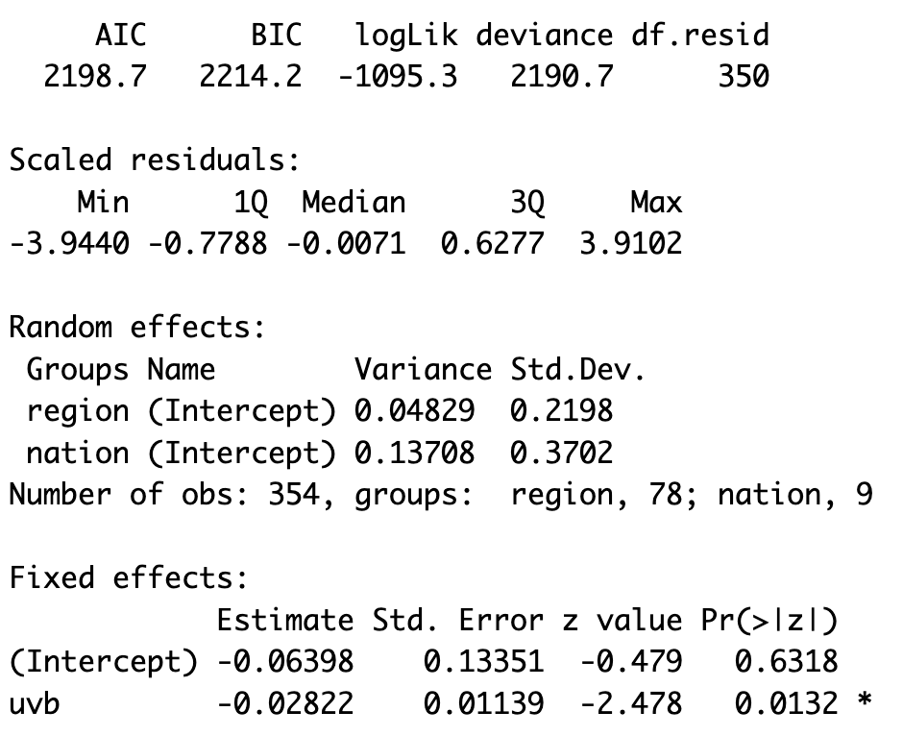
Frequentist approach
Overall nice model quality, but needs comparison with others
Variation between regions not explained by UVB exposure
📉 Negative relationship
Notes:
As seen from the plot before the boxplot, there is a slightly negative relationship between UVB exposure and deaths.
A better model has AIC, BIC and deviance lower, log-likelihood higher so less negative, a higher number of degrees of freedom indicates that the model does not overfit the data.

Slide 15
Bayesian approach (stan_glmer)
Like before, but the Bayes approach relies on Hamiltonian Monte Carlo sampling from the posterior distribution:
M1.rstanarm <- stan_glmer (deaths ~ uvb +
+ (1 | region) + (1 | nation),
Mmmec,
poisson,
offset = log(expected))

Slide 16
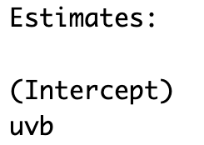
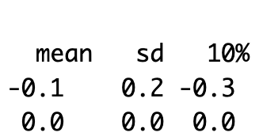
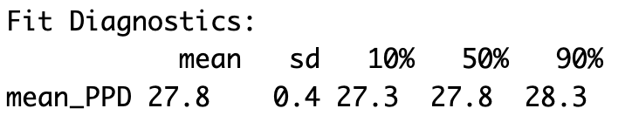
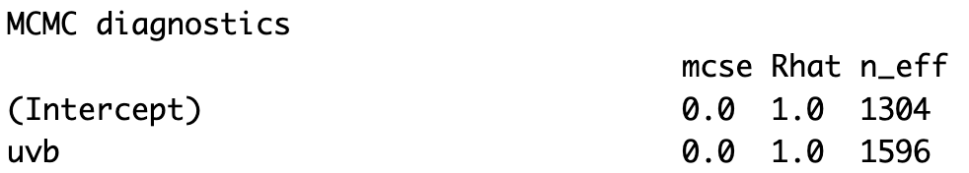
Bayesian approach (stan_glmer)
UVB does not have a meaningful effect (contrary to M1)
Seems a good fit…
Converges

Slide 17
Bayesian approach (stan_glmer)
 | AIC | BIC | Log-Likelihood
Frequentist (M1) | 2198.7 | 2214.2 | -1095.3
Bayesian (M1.rstanarm) | 2313.4 | 2657.8 | /
Bayesian approach of M1.rstanarm could be better…

Slide 18
Bayesian approach (stan_glmer)
Credibility intervals:
Solid blue line: 50% credible interval
Tinner light blue line: 95% credible interval
Captures well the uncertainty of estimated parameters

Slide 19
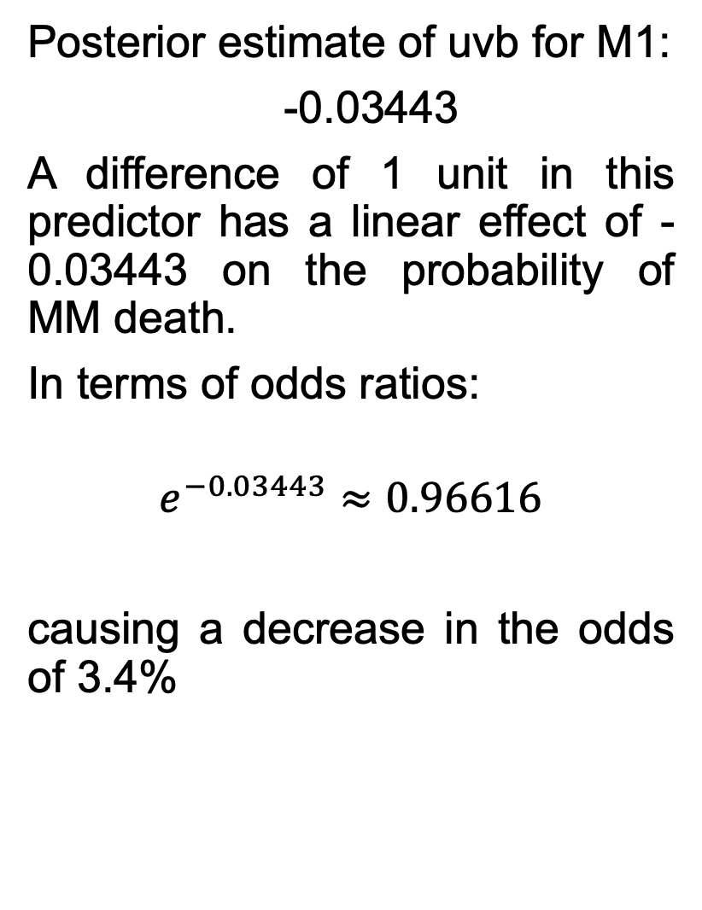
Bayesian approach (stan_glmer)
Posterior estimate of uvb for M1:
-0.03443
A difference of 1 unit in this predictor has a linear effect of -0.03443 on the probability of MM death.
In terms of odds ratios:
$$e^{−0.03443}≈0.96616$$
causing a decrease in the odds of 3.4%
Notes:
Plot the posterior marginal densities along with 50% intervals for the ‘fixed-effects’ uvb
We see that the posterior estimate of uvb is almost the same as the one for model M1

Slide 20

Bayesian approach (stan_glmer)
Random effects for the regions:
Posterior means of the region intercepts $±$ standard error of random effect
Notes:
Positive values indicate that, w.r.t. the mean, the posterior mean of that region intercept is higher w.r.t. the global mean -> more deaths than expected.
Red lines indicate the standard deviation of intercepts (uncertainty) -> the longer, the less info or data for that region

Slide 21
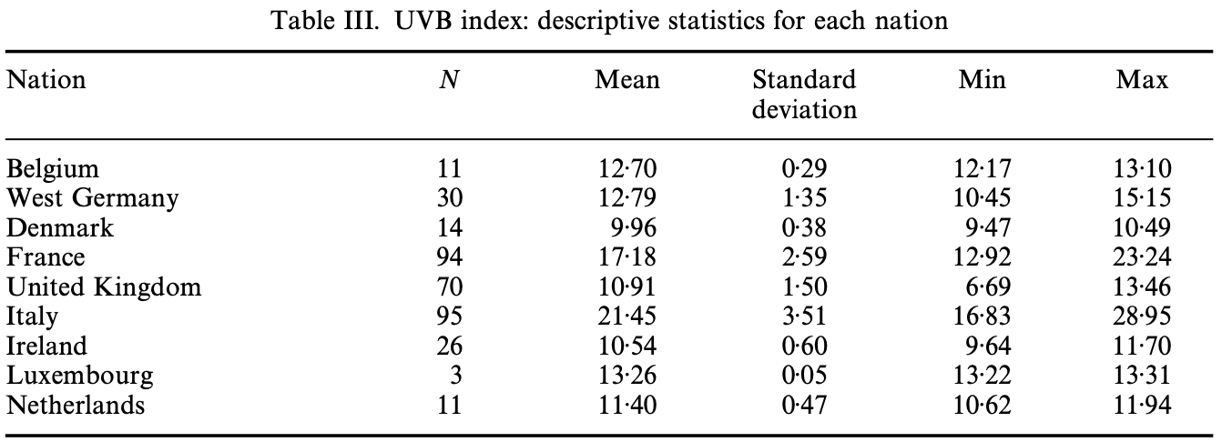
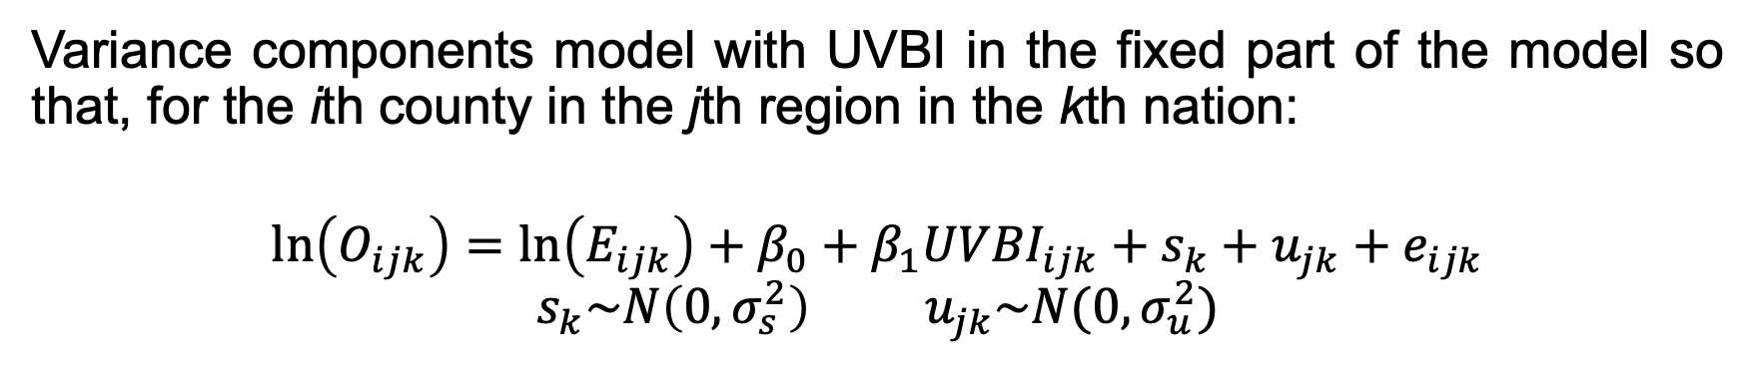
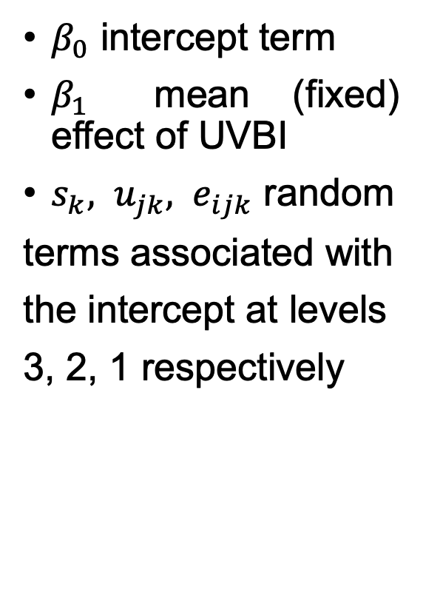
Bayesian approach (model A)
Variance components model with UVBI in the fixed part of the model so that, for the ith county in the jth region in the kth nation:
$$\ln\left(O_{ijk}\right)=\ln\left(E_{ijk}\right)+β_{0}+β_{1}{UVBI}_{ijk}+s_{k}+u_{jk}+e_{ijk}$$
$$s_{k}\sim N\left(0,σ_{s}^{2}\right){ u}_{jk}\sim N(0,σ_{u}^{2})$$
$β_{0}$ intercept term
$β_{1}$ mean (fixed) effect of UVBI
$s_{k}, u_{jk}, e_{ijk}$ random
terms associated with
the intercept at levels
3, 2, 1 respectively
Notes:
… I constructed UVBI with the values of this table and add it to the Mmmec dataframe. Then for each county I generated a UVBI value using a truncated norm that allowed me to take into consideration the minimum and maximum values.

Slide 22
Bayesian approach (model A)
Parla del modello stan e delle prior che hai dato in base a cosa le hai date, che cambiamenti hai fatto etc
Notes:
In comparing nested models, the key questions of model comparison are typically: (1) is the improvement in fit large enough to justify the additional diﬃculty in fitting, and (2) is the prior distribution on the additional parameters reasonable?

Slide 23
Bayesian approach (model A)
Estimate SE
elpd_loo -1053.1 20.7
p_loo 112.5 8.8
looic 2106.1 41.4
P_loo < p = 5+nation+regions+obs=446 GOOD

Slide 24
Bayesian approach (model A)
Model A of the paper is a variance components model with UVBI in the fixed part of the model so that, for the ith county in the jth region in the kth nation:
Notes:
Dal residual : It looks as though we have more positive residuals than negative ⇒maybe the model tends to underestimate the number of deaths

Slide 25
Bayesian approach (model A)
Model A of the paper is a variance components model with UVBI in the fixed part of the model so that, for the ith county in the jth region in the kth nation:

