Slide 1
Giorgia Leoncilli, Sara Serafino
Exam: Mathematical Optimization
Analysis and results reproduction of:
Dynamic Wireless Charging Lanes location model in urban networks considering route choices
Cong Quoc Tran, Mehdi Keyvan-Ekbatani, Dong Ngoduy, David Watling
Transportation Research Part C
2022

Slide 2
To determine the optimal location for dynamic Wireless Charging Lanes
To support the system planner in deploying the WCL, the paper takes into consideration traffic dynamics and congestion under multiple vehicle classes (EV and ICV).
The problem combines a mixed-integer linear program with dynamic routing behaviour into the charging location problem.
The objective is to maximise network performance while providing insights into traffic propagation patterns over the network.

Slide 3
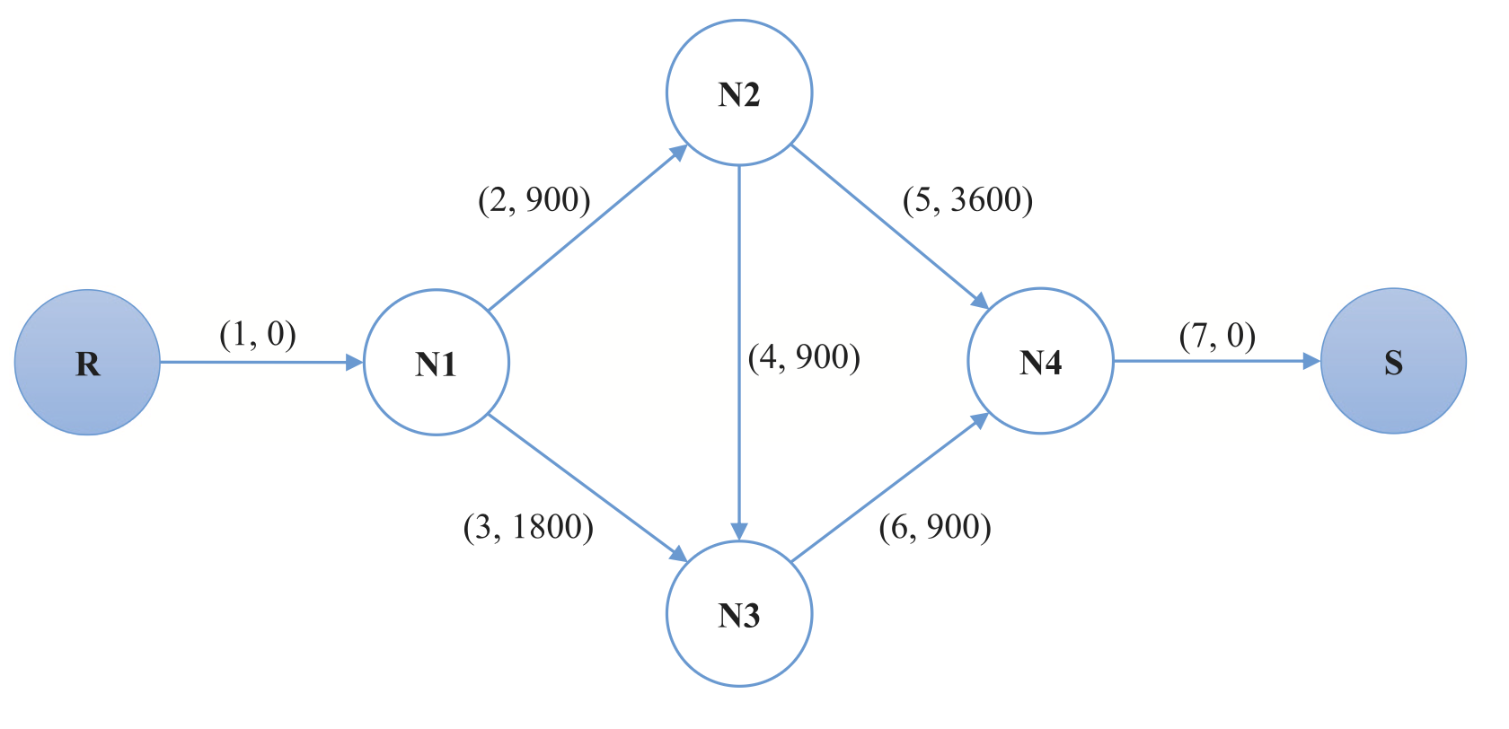
Network design problem → limited to single Origin-Destination networks
Upper level: minimise the system cost with specific demands
Lower level: Traffic Assignment Problem

Slide 4
Traffic Assignment Problem
Determine which routes will be used and how much traffic can be expected on each route.
Requirements:
Estimated n.vehicles
Available routes and travel times on each route
Decision criteria for route choice (route choice behaviours and path feasibility constraints)
Route choice decisions are a function of travel times
Traffic flow is a product of route choice decisions
Travel times are determined by traffic flow

Slide 5
Traffic Assignment Problem with Dynamic System Optimal
User Equilibrium:
Users choose the route that minimizes their own travel time.
System Optimal:
Users cooperatively achieve the minimum system-wide travel time.
✅ REALISTIC SCENARIO
❌ EFFICIENT IN THE
BI-LEVEL FRAMEWORK
❌ REALISTIC SCENARIO
✅ EFFICIENT IN THE
BI-LEVEL FRAMEWORK

Slide 6
Traffic Assignment Problem with Dynamic System Optimal
User Equilibrium:
Users choose the route that minimizes their own travel time.
System Optimal:
Users cooperatively achieve the minimum system-wide travel time.
✅ REALISTIC SCENARIO
❌ EFFICIENT IN THE
BI-LEVEL FRAMEWORK
❌ REALISTIC SCENARIO
✅ EFFICIENT IN THE
BI-LEVEL FRAMEWORK
Problem reformulated as single-level

Slide 7
Assumptions
All EVs have homogeneous battery size.
The energy consumption rate of an EV is assumed proportional only to the travelled distance and homogeneous for all EVs.
The energy recharge rate is underestimated proportionally to travel time at free-flow speed.
Network must be cleared at time horizon.

Slide 8
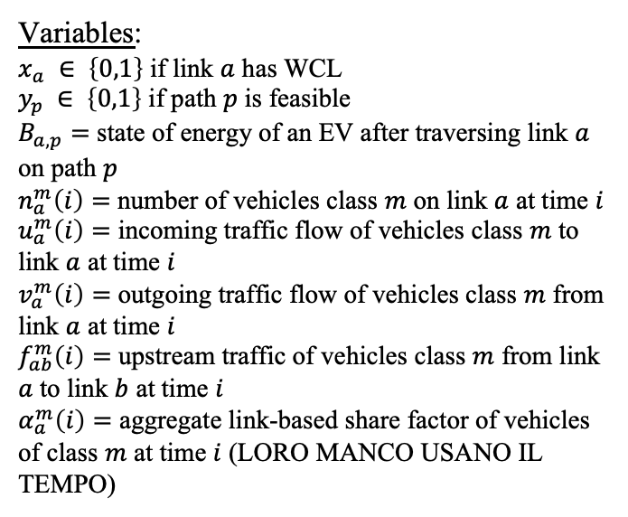
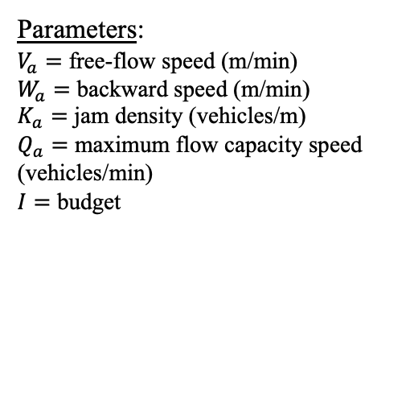
General formulation
Variables:
$x_{a} ∈ \left\{0,1\right\}$ if link $a$ has WCL
$y_{p} ∈ \left\{0,1\right\}$ if path $p$ is feasible
$B_{a,p}=$ state of energy of an EV after traversing link $a$ on path $p$
$n_{a}^{m}\left(i\right)=$ number of vehicles class $m$ on link $a$ at time $i$
$u_{a}^{m}\left(i\right)=$ incoming traffic flow of vehicles class $m$ to link $a$ at time $i$
$v_{a}^{m}\left(i\right)=$ outgoing traffic flow of vehicles class $m$ from link $a$ at time $i$
$f_{ab}^{m}\left(i\right)=$ upstream traffic of vehicles class $m$ from link $a$ to link $b$ at time $i$
$α_{a}^{m}\left(i\right)=$ aggregate link-based share factor of vehicles of class $m$ at time $i$ (LORO MANCO USANO IL TEMPO)
Parameters:
$V_{a}=$ free-flow speed (m/min)
$W_{a}=$ backward speed (m/min)
$K_{a}=$ jam density (vehicles/m)
$Q_{a}=$ maximum flow capacity speed (vehicles/min)
$I=$ budget

Slide 9
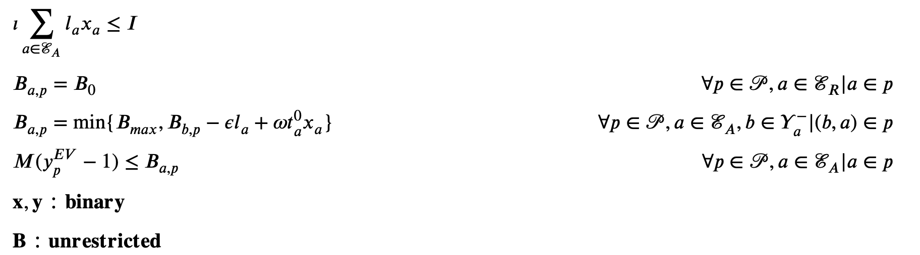

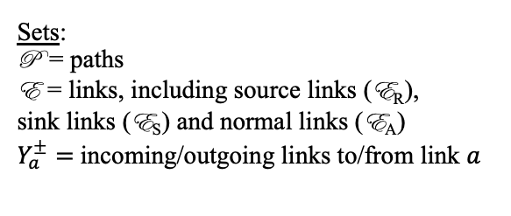


Constraints
Recharge:
$ω=$energy received
$t_{a}^{0}=\frac{l_{a}}{V_{a}}$ travel time at velocity $V_{a}$
Consumption:
$ε=$ consumption rate
$l_{a}=$ length of link $a$
budget
initial state of energy
path feasibility
Sets:
P = paths
E = links, including source links (E_{R}),
sink links (E_{S}) and normal links (E_{A})
$Y_{a}^{±}=$incoming/outgoing links to/from link $a$

Slide 10
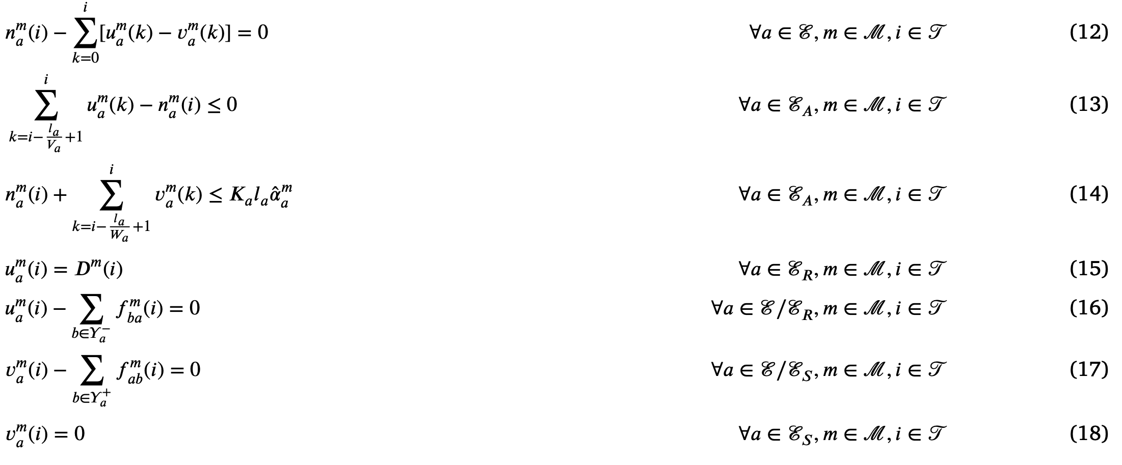

Constraints
vehicles conservation
incoming flow ≤ vehicles on $a$
capacity per class
demand for incoming vehicles at origin
}
flow conservation
network cleared at destination

Slide 11

Constraints
vehicles conservation
incoming flow ≤ vehicles on $a$
Extra constraints:
SCRIVILE QUANDO LE AVRAI
capacity per class
demand for incoming vehicles at origin
}
flow conservation
network cleared at destination

Slide 12
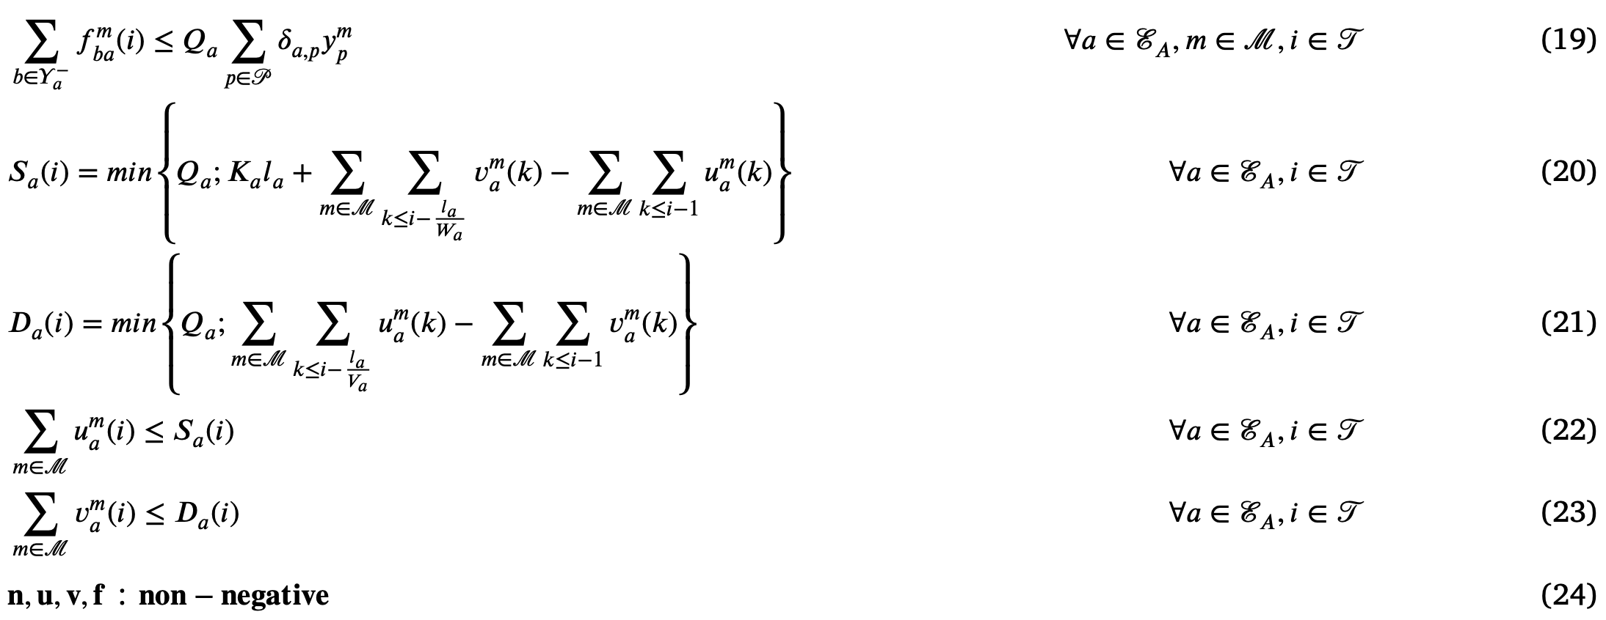
Constraints
different route choices
supply
demand
}
true capacity

Slide 13
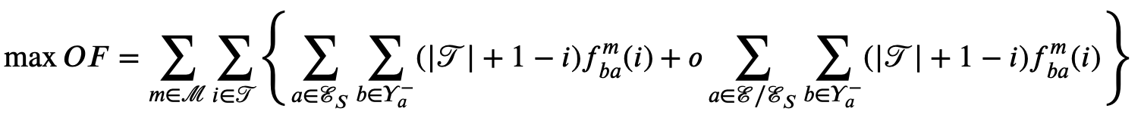
Objective function
Set of discrete time steps
Penalty cost to incentivise travellers to move along instead of waiting
Maximising total traffic outflow is mathematically equivalent to minimising total travel times.

Slide 14
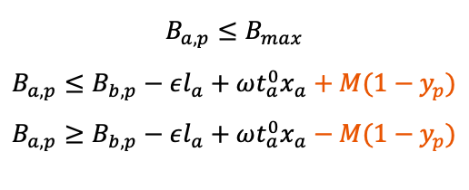
Minimising constraints
$$B_{a,p}≤B_{max}$$
$$B_{a,p}≤B_{b,p}−εl_{a}+ωt_{a}^{0}x_{a}+M(1−y_{p})$$
$$B_{a,p}≥B_{b,p}−εl_{a}+ωt_{a}^{0}x_{a}−M(1−y_{p})$$

Slide 15
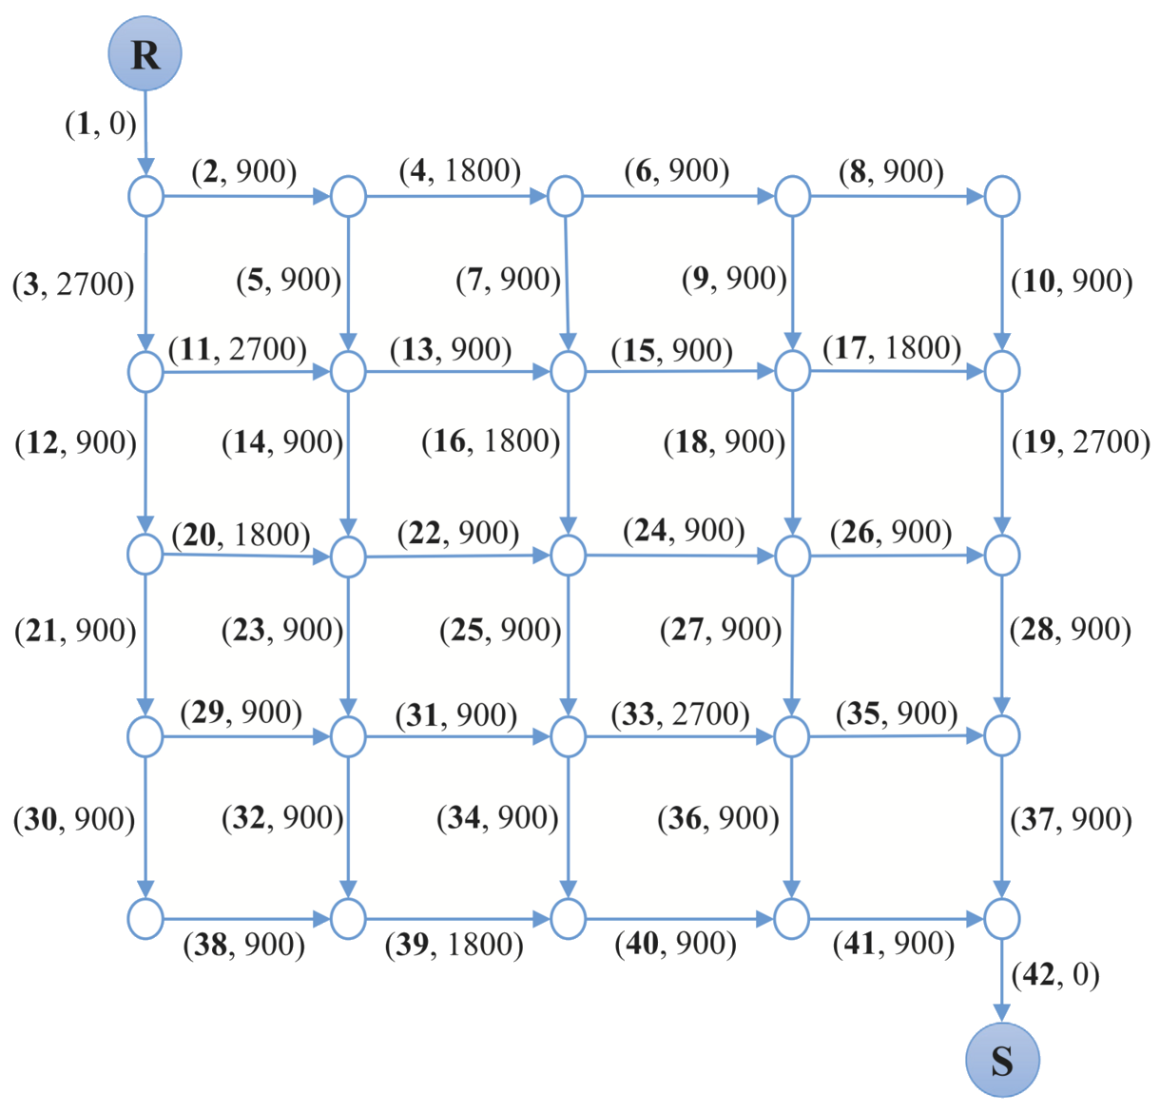
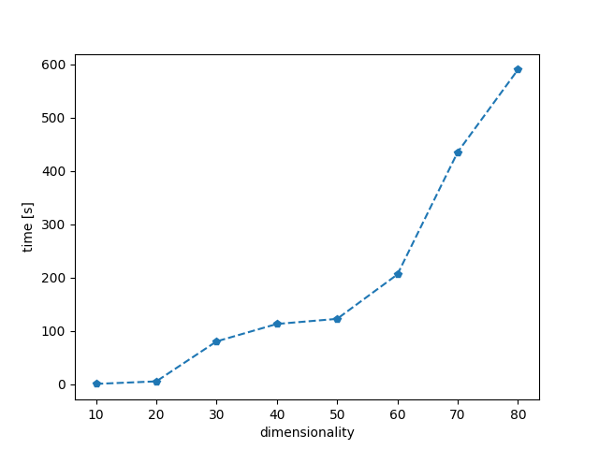
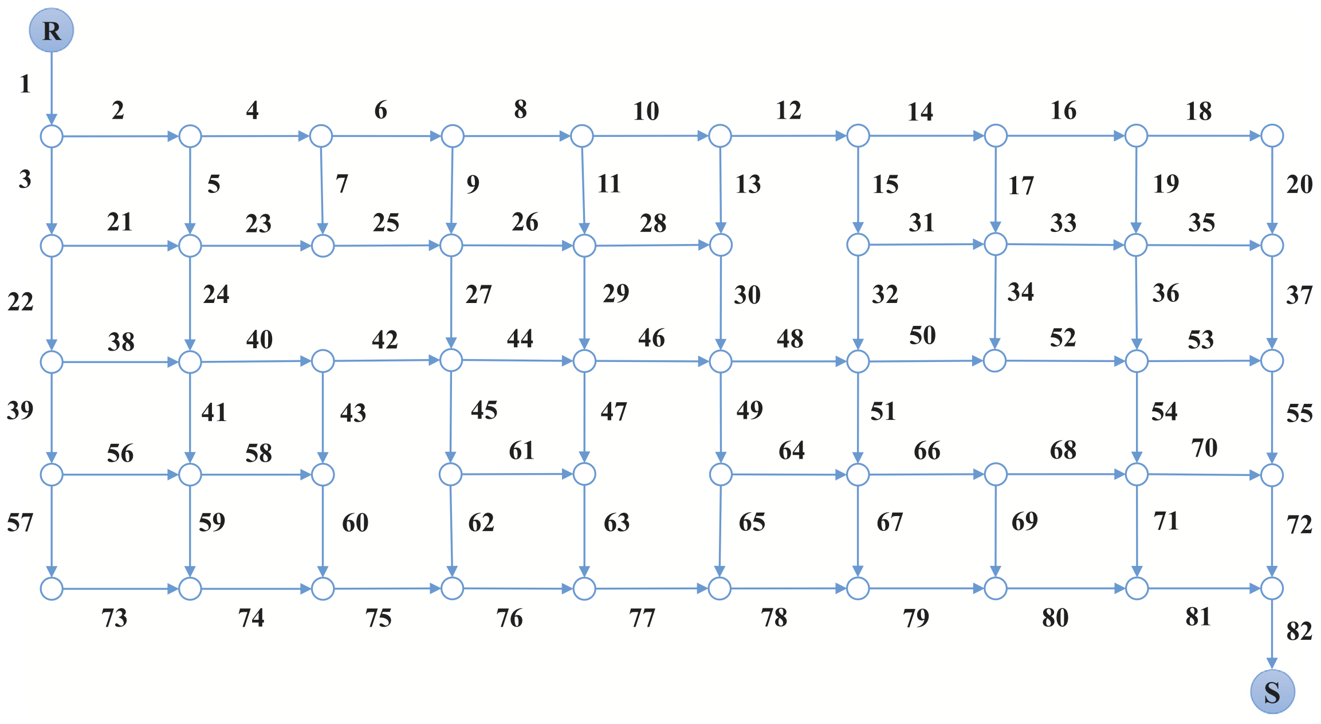
Gurobi optimization: increasing dimensionality
Boosting the dimensionality of the problem, the time of execution highly increases.
Dimensionality increases

Slide 16
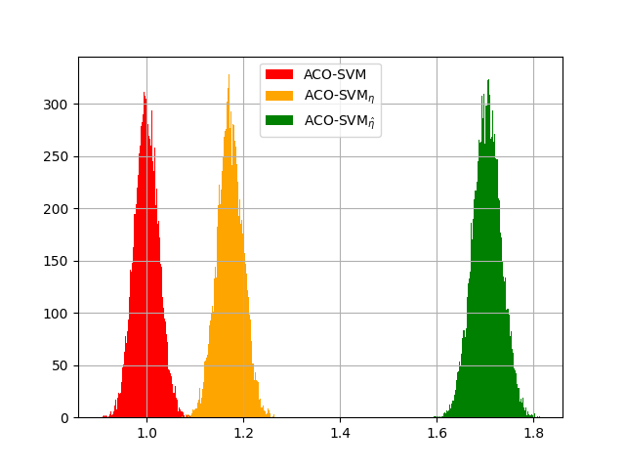
Analysis of results: ACO-SVM
This graphic is obtained using the initial probabilistic models to sample 10,000 solutions for each test problem instance, and plotting the distribution of averaged normalized objective values.
The objective values of the sample solutions are normalized by the mean objective value generated by the classic ACO algorithm. The normalized objective values are then averaged across 100 test problem instances.
AS and MMAS distinguish is in this case irrelevant because we refer only to the initial probability model.

Slide 17
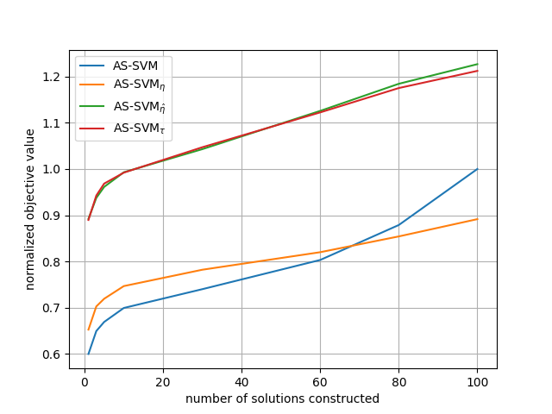
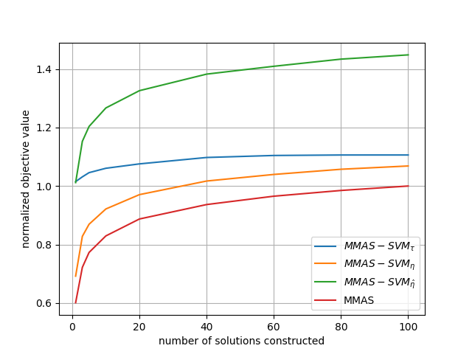
Analysis of results: ACO-SVM
40% improving with the second ML-MMAS algorithm
The objective values generated by each ML-algorithm varying the number of solutions generated are normalized by the best objective value found by classic AS (or MMAS), and are averaged across 100 problem instances and 15 independent runs.
The curves of normalized objective value v.s. number of solutions constructed is shown for both AS and MMAS methods
20% improving

Slide 18
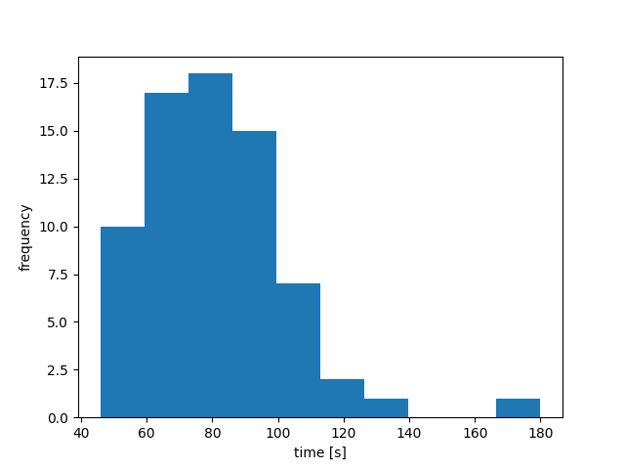
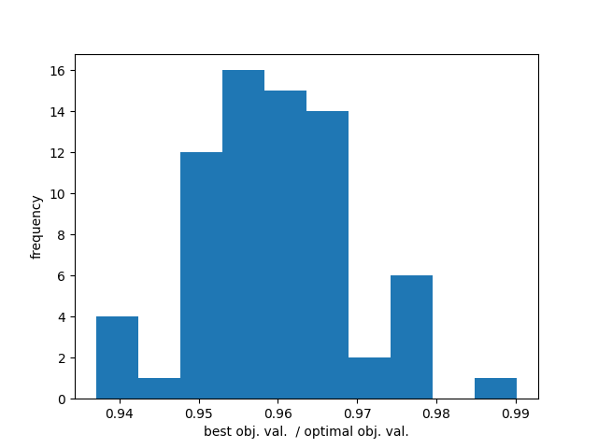
Analysis of results: ACO-SVM
Testing the MMAS-SVM method on 71 problems of dimensionality equal to 100.
The time-taken analysis could be extremely improved adding elements of parallel programming to the implementation.

Slide 19
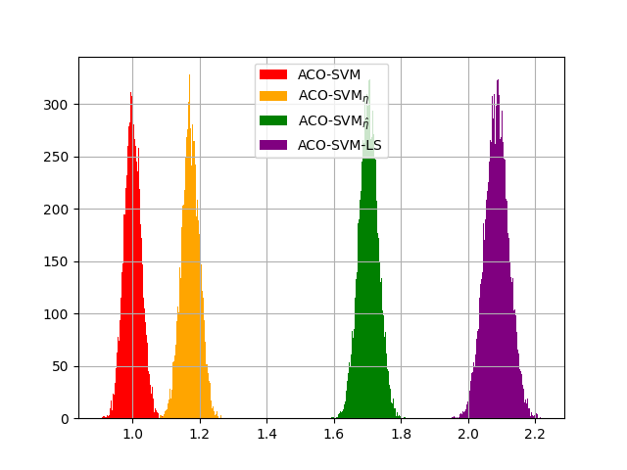
Analysis of results: ACO-SVM-LS
Same histograms obtained by computing 10,000 solutions for each test problem instance, and plotting the distribution of averaged normalized objective values.

Slide 20
Thank you for the attention

Slide 21
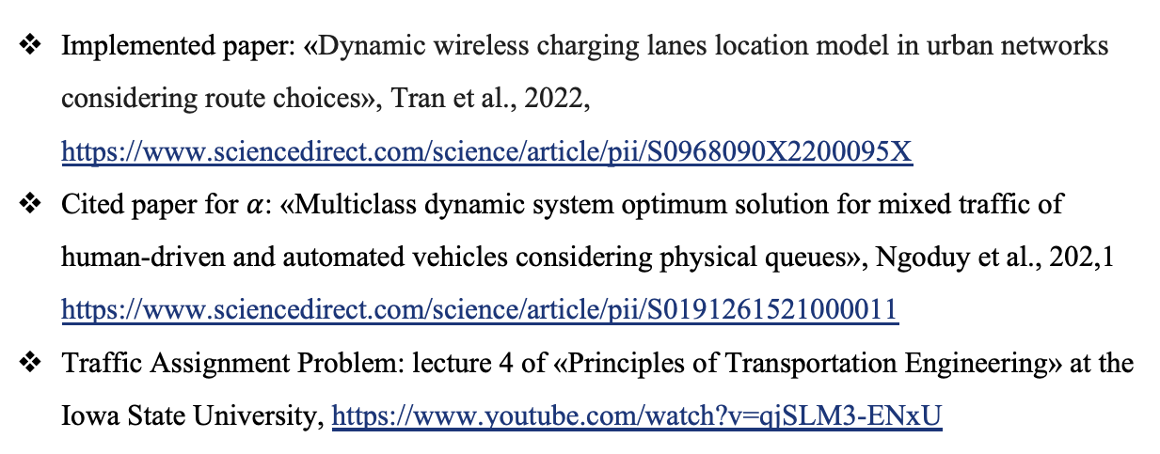
Sitography
Implemented paper: «Dynamic wireless charging lanes location model in urban networks considering route choices», Tran et al., 2022, https://www.sciencedirect.com/science/article/pii/S0968090X2200095X
Cited paper for $α$: «Multiclass dynamic system optimum solution for mixed traffic of human-driven and automated vehicles considering physical queues», Ngoduy et al., 202,1 https://www.sciencedirect.com/science/article/pii/S0191261521000011
Traffic Assignment Problem: lecture 4 of «Principles of Transportation Engineering» at the Iowa State University, https://www.youtube.com/watch?v=qjSLM3-ENxU

