Slide 1
Giorgia Leoncilli, Sara Serafino
Exam: Mathematical Optimization
Analysis and results reproduction of:
Dynamic Wireless Charging Lanes location model in urban networks considering route choices
Cong Quoc Tran, Mehdi Keyvan-Ekbatani, Dong Ngoduy, David Watling
Transportation Research Part C
2022

Slide 2
To determine the optimal location for dynamic Wireless Charging Lanes
To support the system planner in deploying the WCL, the paper takes into consideration traffic dynamics and congestion under multiple vehicle classes (EV and ICV).
The problem combines a mixed-integer linear program with dynamic routing behaviour into the charging location problem.
The objective is to maximise network performance while providing insights into traffic propagation patterns over the network.

Slide 3
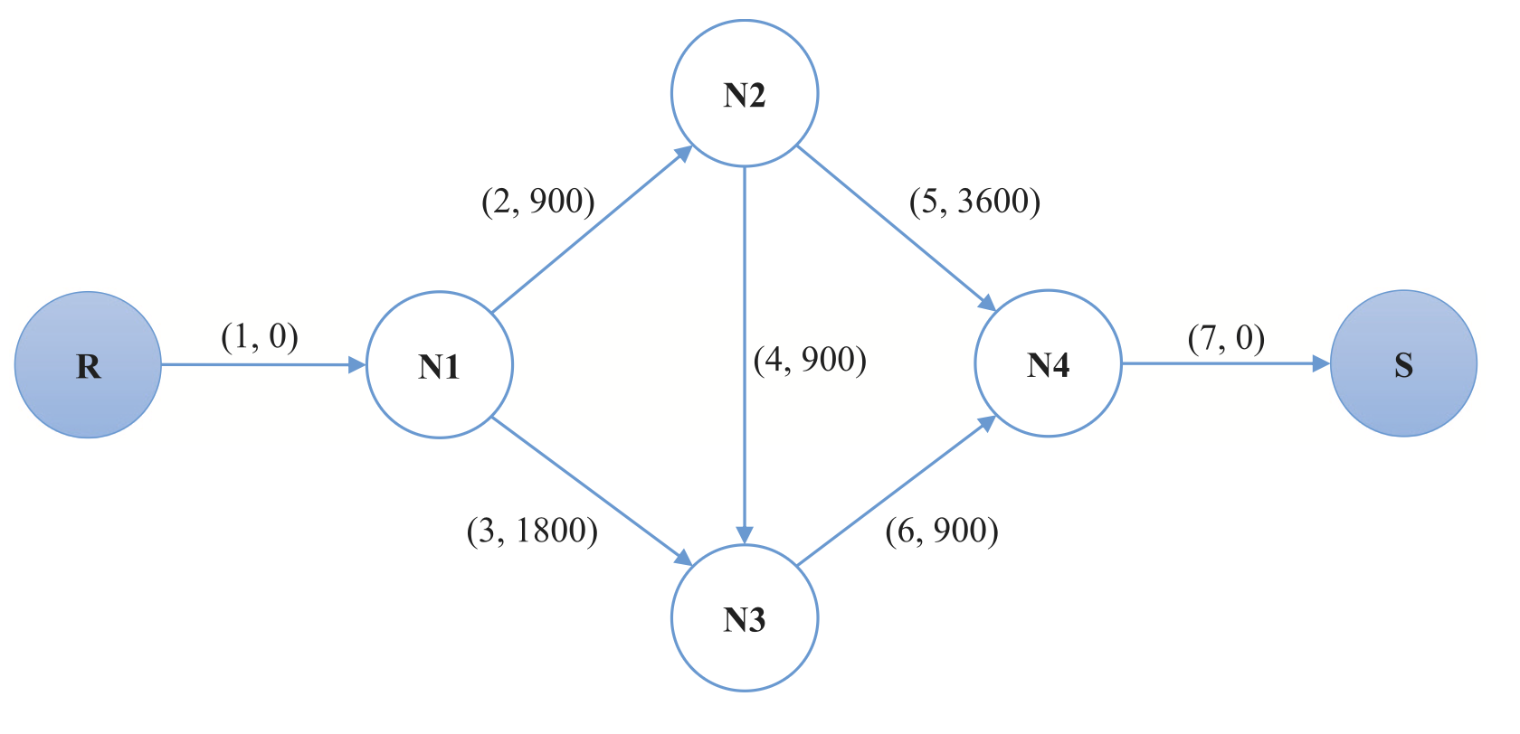
Network design problem → limited to single Origin-Destination networks
Upper level: minimise the system cost with specific demands
Lower level: Traffic Assignment Problem

Slide 4
Traffic Assignment Problem
Determine which routes will be used and how much traffic can be expected on each route.
Requirements:
Estimated n.vehicles
Available routes and travel times on each route
Decision criteria for route choice (route choice behaviours and path feasibility constraints)
Route choice decisions are a function of travel times
Traffic flow is a product of route choice decisions
Travel times are determined by traffic flow

Slide 5
Traffic Assignment Problem with Dynamic System Optimal
User Equilibrium:
Users choose the route that minimizes their own travel time.
System Optimal:
Users cooperatively achieve the minimum system-wide travel time.
✅ REALISTIC SCENARIO
❌ EFFICIENT IN THE
BI-LEVEL FRAMEWORK
❌ REALISTIC SCENARIO
✅ EFFICIENT IN THE
BI-LEVEL FRAMEWORK

Slide 6
Traffic Assignment Problem with Dynamic System Optimal
User Equilibrium:
Users choose the route that minimizes their own travel time.
System Optimal:
Users cooperatively achieve the minimum system-wide travel time.
✅ REALISTIC SCENARIO
❌ EFFICIENT IN THE
BI-LEVEL FRAMEWORK
❌ REALISTIC SCENARIO
✅ EFFICIENT IN THE
BI-LEVEL FRAMEWORK
Problem reformulated as single-level

Slide 7



Assumptions
All EVs have homogeneous battery size.
The energy consumption rate of an EV is assumed proportional only to the travelled distance and homogeneous for all EVs.
The energy recharge rate is underestimated proportionally to travel time at free-flow speed.
Network must be cleared at time horizon.

Slide 8
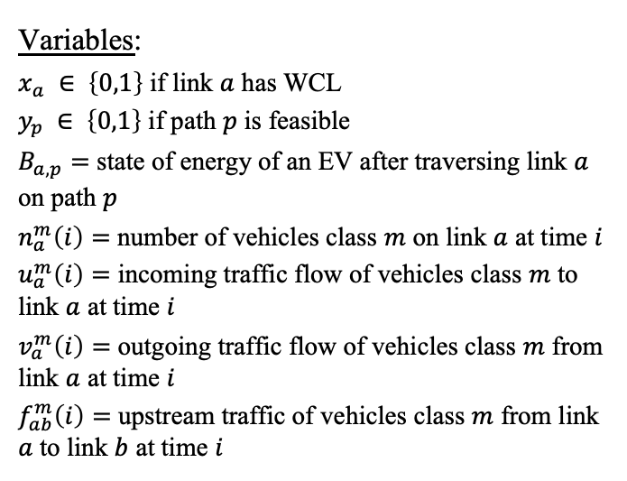
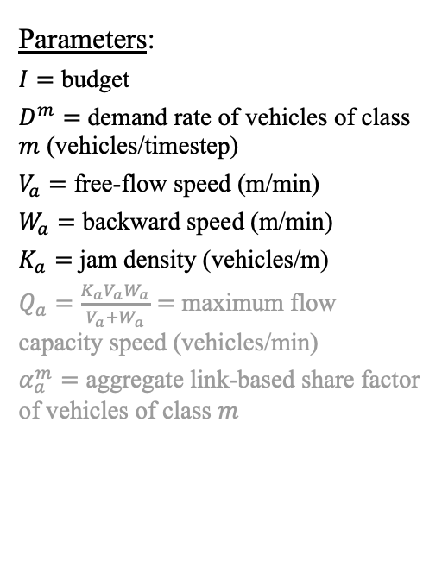
General formulation
Variables:
$x_{a} ∈ \left\{0,1\right\}$ if link $a$ has WCL
$y_{p} ∈ \left\{0,1\right\}$ if path $p$ is feasible
$B_{a,p}=$ state of energy of an EV after traversing link $a$ on path $p$
$n_{a}^{m}\left(i\right)=$ number of vehicles class $m$ on link $a$ at time $i$
$u_{a}^{m}\left(i\right)=$ incoming traffic flow of vehicles class $m$ to link $a$ at time $i$
$v_{a}^{m}\left(i\right)=$ outgoing traffic flow of vehicles class $m$ from link $a$ at time $i$
$f_{ab}^{m}\left(i\right)=$ upstream traffic of vehicles class $m$ from link $a$ to link $b$ at time $i$
Parameters:
$I=$ budget
$D^{m}=$ demand rate of vehicles of class $m$ (vehicles/timestep)
$V_{a}=$ free-flow speed (m/min)
$W_{a}=$ backward speed (m/min)
$K_{a}=$ jam density (vehicles/m)
$Q_{a}=\frac{K_{a}V_{a}W_{a}}{V_{a}+W_{a}}=$ maximum flow capacity speed (vehicles/min)
$α_{a}^{m}=$ aggregate link-based share factor of vehicles of class $m$

Slide 9
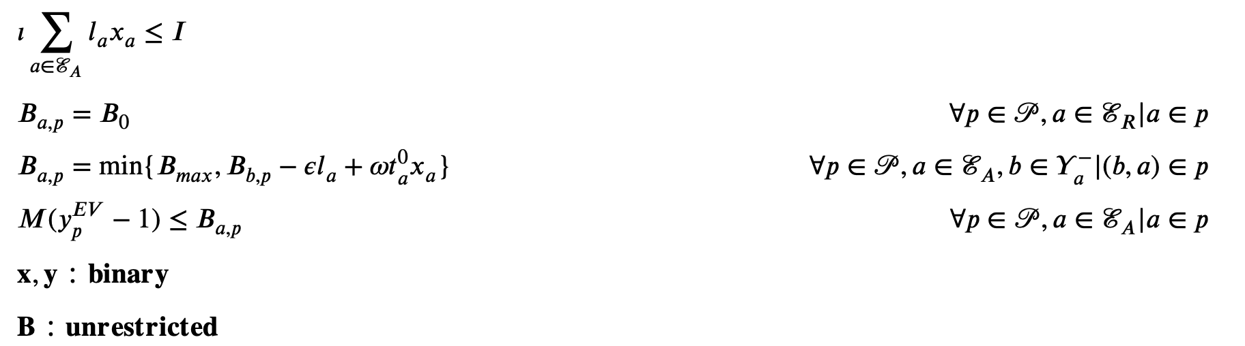

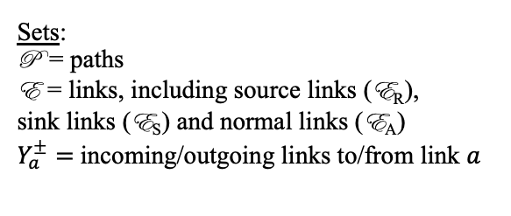


Constraints
Recharge:
$ω=$energy received
$t_{a}^{0}=\frac{l_{a}}{V_{a}}$ travel time at velocity $V_{a}$
Consumption:
$ε=$ consumption rate
$l_{a}=$ length of link $a$
budget
initial state of energy
path feasibility
Sets:
P = paths
E = links, including source links (E_{R}),
sink links (E_{S}) and normal links (E_{A})
$Y_{a}^{±}=$incoming/outgoing links to/from link $a$

Slide 10
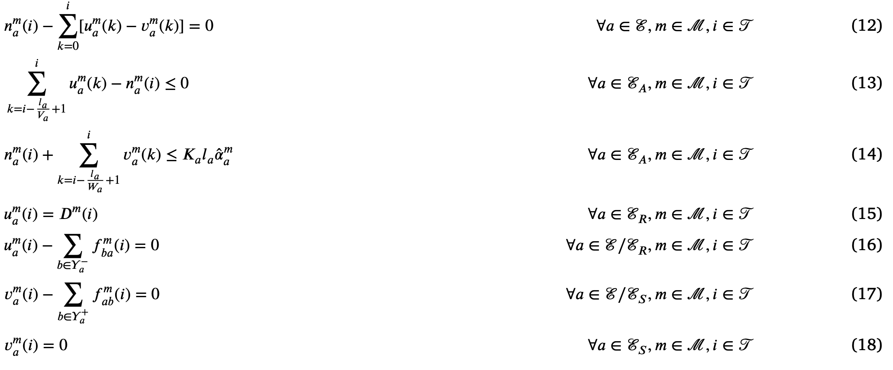

Constraints
vehicles conservation
incoming flow ≤ vehicles on $a$
capacity per class
demand for incoming vehicles at origin
}
flow conservation
network cleared at destination

Slide 11

Constraints
vehicles conservation
incoming flow ≤ vehicles on $a$
It can be used to give priority to one vehicle class over the other
capacity per class
demand for incoming vehicles at origin
}
flow conservation
network cleared at destination

Slide 12
Constraints
vehicles conservation
incoming flow ≤ vehicles on $a$
It can be used to give priority to one vehicle class over the other
capacity per class
demand for incoming vehicles at origin
}
Not coherent with assumption of network cleared at time horizon
flow conservation
network cleared at destination

Slide 13
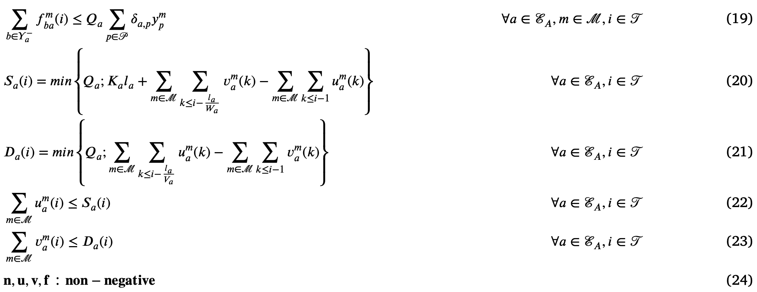

Constraints
different route choices
supply
demand
}
true capacity
$Q_{a}$ (veh/min) → $Q_{a}τ$ (veh/timestep)

Slide 14
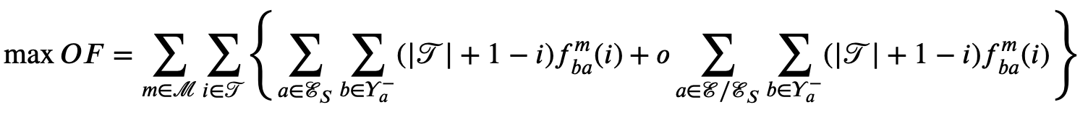
Objective function
Set of discrete time steps
Penalty cost to incentivise travellers to move along instead of waiting
Maximising total traffic outflow is mathematically equivalent to minimising total travel times.

Slide 15
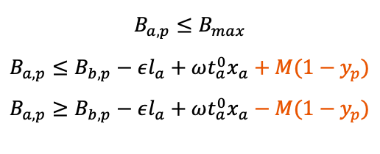
Minimising constraints
$$B_{a,p}≤B_{max}$$
$$B_{a,p}≤B_{b,p}−εl_{a}+ωt_{a}^{0}x_{a}+M(1−y_{p})$$
$$B_{a,p}≥B_{b,p}−εl_{a}+ωt_{a}^{0}x_{a}−M(1−y_{p})$$

Slide 16
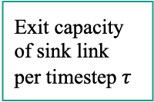

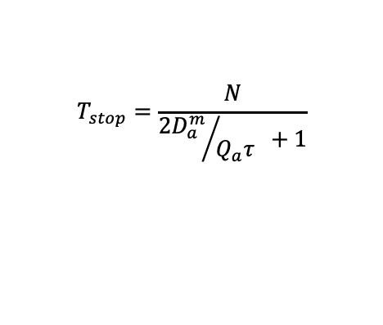


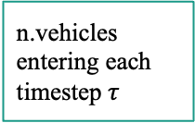
Modified demand rate at origin
Clearance time in worst case scenario:
$$T_{stop}=\frac{N}{{2D_{a}^{m}}/{Q_{a}τ} +1}$$
Last time step to clear network
$$i≤ T_{stop}$$
n.vehicles entering each timestep $τ$
$$0$$
$$i> T_{stop}$$
Exit capacity of sink link per timestep $τ$

Slide 17

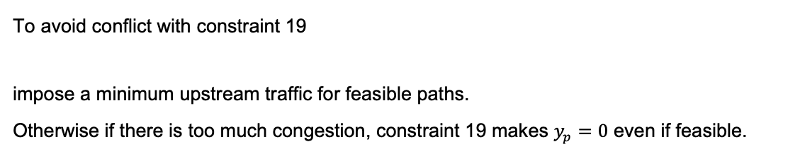
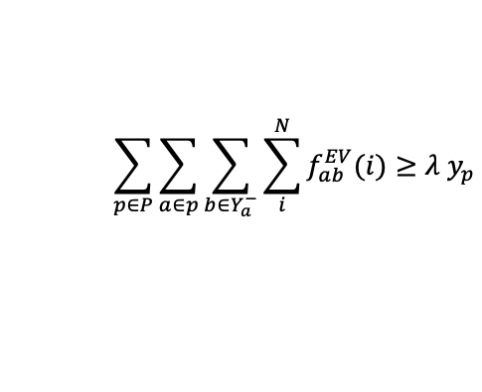
Extra constraint
( )
To avoid conflict with constraint 19
impose a minimum upstream traffic for feasible paths.
Otherwise if there is too much congestion, constraint 19 makes $y_{p}=0$ even if feasible.
$$\sum_{p∈P}{\sum_{a∈p}{\sum_{b∈Y_{a}^{−}}{\sum_{i}^{N}{f_{ab}^{EV}(i)}}}}≥λ{ y}_{p}$$
Arbitrary small

Slide 18
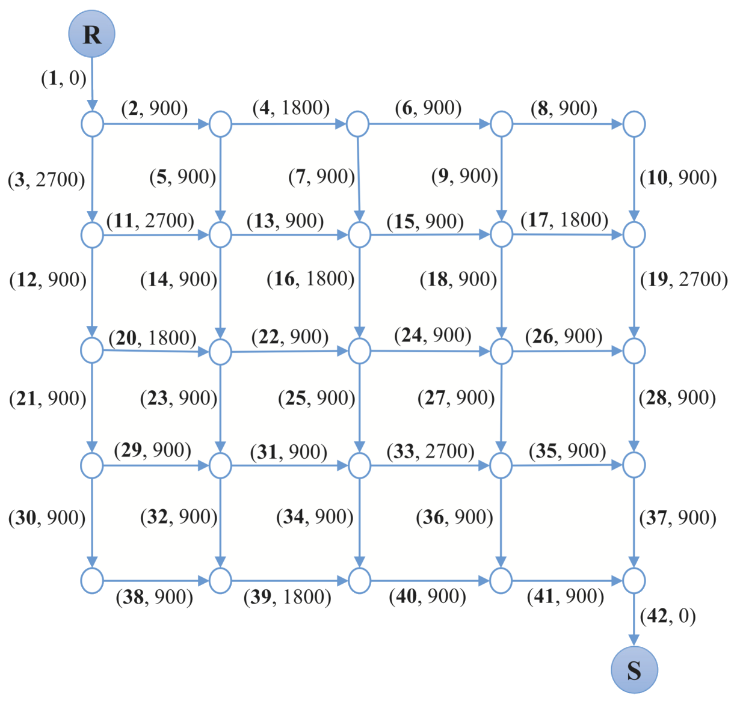
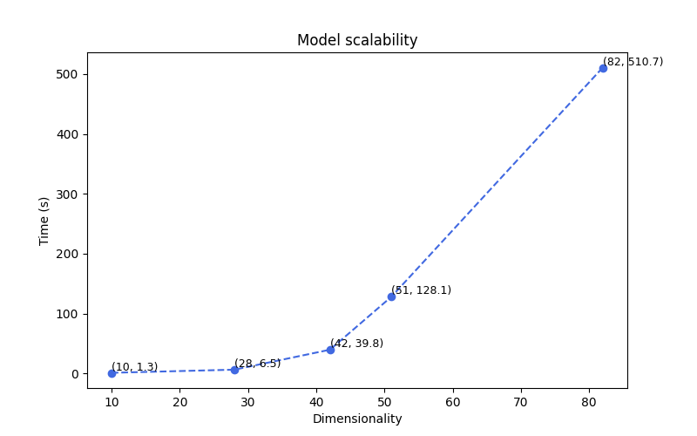
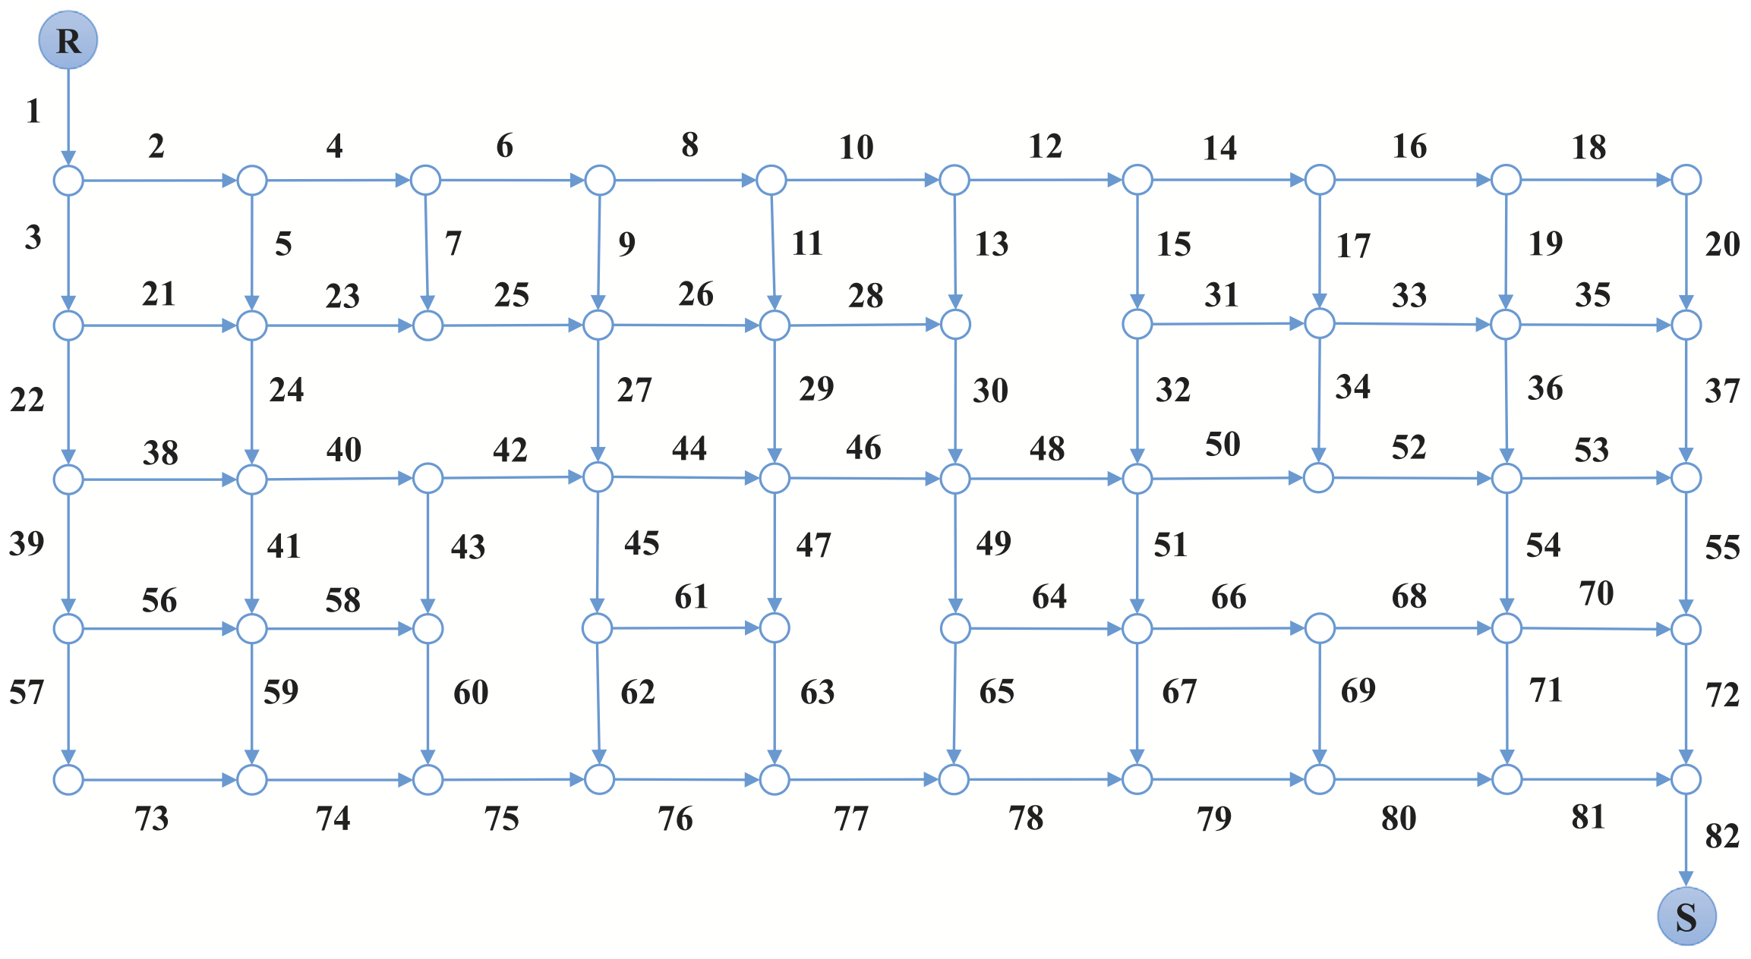
Gurobi optimization: increasing dimensionality
Boosting the dimensionality of the problem, the time of execution highly increases.
Dimensionality increases

Slide 19
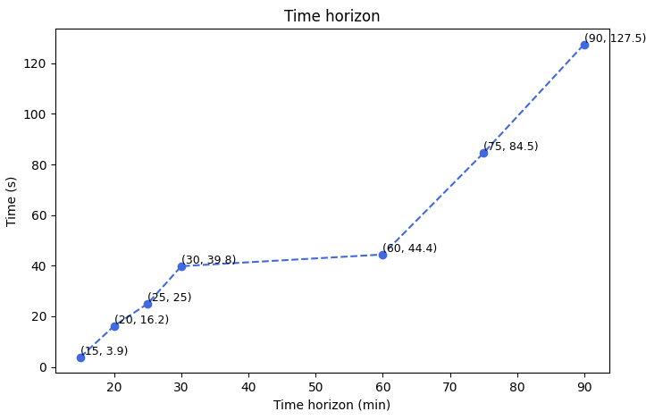
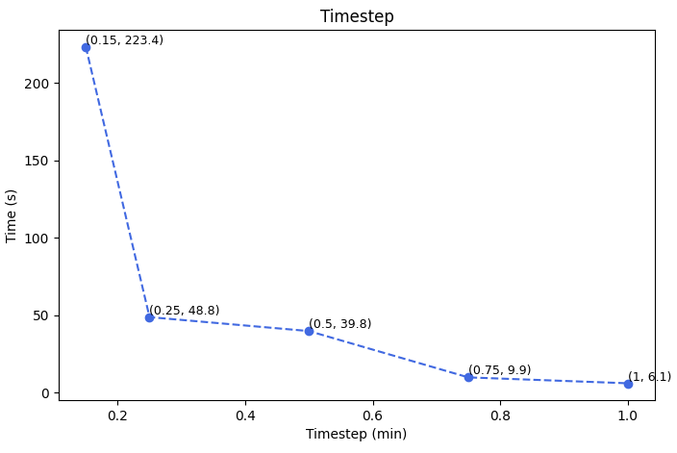
Parameters value’s effect on execution time
Increasing time horizon increases execution time
With increasing timestep, less vehicles enter the network, lowering the execution time

Slide 20
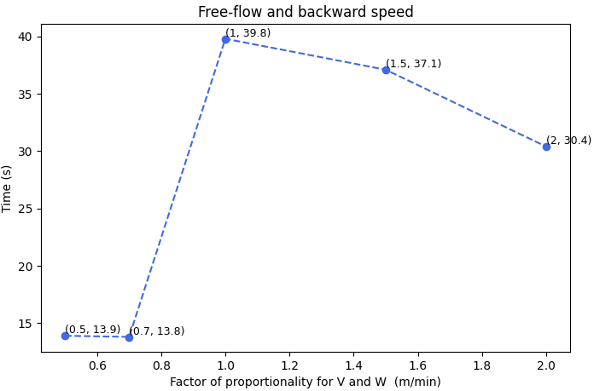
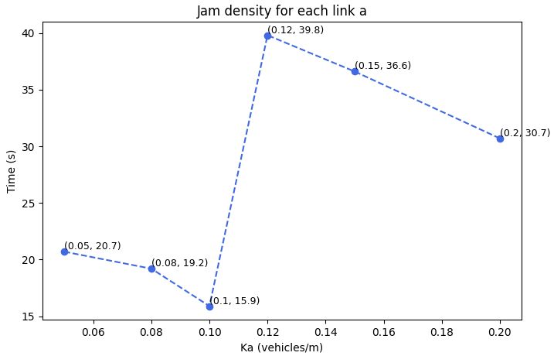
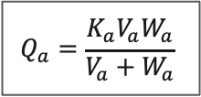
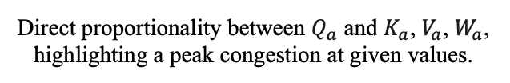
Parameters value’s effect on execution time
Direct proportionality between $Q_{a}$ and $K_{a}$, $V_{a}$, $W_{a}$, highlighting a peak congestion at given values.
$$Q_{a}=\frac{K_{a}V_{a}W_{a}}{V_{a}+W_{a}}$$

Slide 21
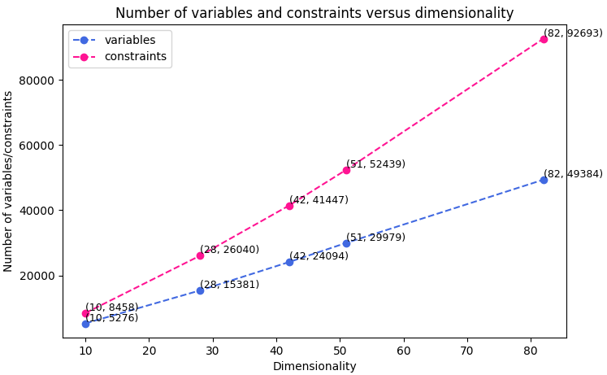
Parameters value’s effect on execution time
Direct proportionality as expected

Slide 22
Thank you for the attention

Slide 23
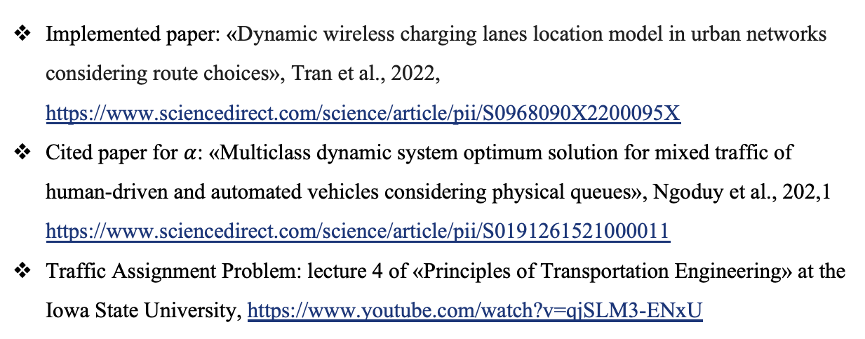
Sitography
Implemented paper: «Dynamic wireless charging lanes location model in urban networks considering route choices», Tran et al., 2022, https://www.sciencedirect.com/science/article/pii/S0968090X2200095X
Cited paper for $α$: «Multiclass dynamic system optimum solution for mixed traffic of human-driven and automated vehicles considering physical queues», Ngoduy et al., 202,1 https://www.sciencedirect.com/science/article/pii/S0191261521000011
Traffic Assignment Problem: lecture 4 of «Principles of Transportation Engineering» at the Iowa State University, https://www.youtube.com/watch?v=qjSLM3-ENxU

