Slide 1
Smart Contract
Group 6
Member:
Yousef Zare
Sara Solatani
Erfan Najafi Sobhan Safdarian Mohammad Esmaeil MohammadZade

Slide 2
Table of Contents
01
02
Insurance
Supply Chain
03
04
Real Estate
Comparison
05
Implementation

Slide 3
Insurance
IT Fundamentals Course
Group 6

Slide 4
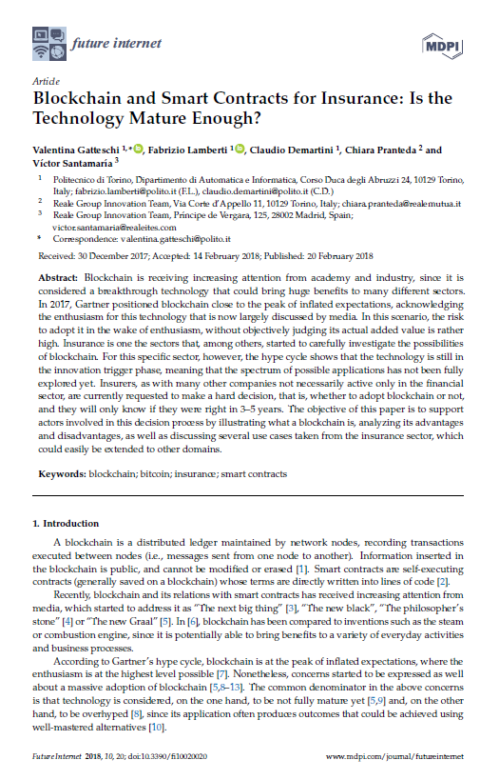
Reference:
Gatteschi, Valentina, et al. "Blockchain and smart contracts for insurance: Is the technology mature enough?." Future internet 10.2 (2018): 20.

Slide 5
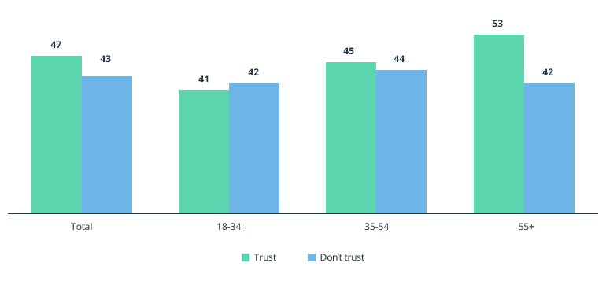
Purpose of using the smart contract
The main challenge of the insurance industry is mistrust
Only 29% of customers trust insurers

Slide 6
Types of blockchains
Private blockchain
Decentralization
No central authority is available
Public blockchain
Consortium blockchain
Lower validation and shorter validation times
Reduce the risk of attacks
Increase privacy

Slide 7
Consortium
The most appropriate architecture for insurance is a consortium
Blockchain
Only a limited number of users are allowed to approve transactions
Blockchain tracks the sender of each transaction
Restore the status of the blockchain by controlling a small number of nodes
Driving violation that has been reported to the wrong person

Slide 8
Architecture
Public blockchain
Companies that goal to provide payment services for use
Higher transaction costs
Black Insurance
Platform based on two separate but connected blockchains
The public part of the system is connected with a blockchain of the Privacy Consortium
Combines these two models to use the best of both worlds

Slide 9
Smart contract applications
Speed up processing as well as reduce costs
More complex uses
Include oracles to collect real-world information
Oracle is the agent that obtains and validates external data and provides it to smart contracts
Reimburse automatically
Part of the insurance is also associated with IoT
Intelligent systems that use sensors in homes

Slide 10
Smart contract applications
Everyone can check the smart contract
Comparing situations becomes easier
Reduce additional costs by using an encryption mechanism
Customers are identified by a unique address
There is no need to provide identification for the first or later contracts
reduces the time and cost of data collection
Combined with the IoT process for automatic registration
GPS data can be used for automatic collection

Slide 11
Example Smart contract applications
In case of death, the smart contract can automatically transfer the testator money through its own request which is encrypted in the blockchain
Put restrictions on reaching legal age
Oracle can be used to check death records
Automatically calculate premium by reading all information related to a person for fraud prevention
Different part must work together to store each person's information
By reviewing and comparing data from previous claims

Slide 12
Advantages of using Smart Contract
Less fraud through transparency
Task automation
Save time on verifying claims
Protect policy documents
Risk assessment

Slide 13
Constraints of using Smart Contract
Completely convert to programming code
It can be difficult to convert code to tasks that are easily done on paper
Good faith , Reasonableness
Disadvantage related to scalability is energy consumption and performance
Reduce the number of transactions per second compared to the traditional method
Space is also an issue, because data is duplicated at each network node
Possible bugs in code

Slide 14
Constraints of using Smart Contract
Uncertainty of legal regulations
Limited contract scope

Slide 15
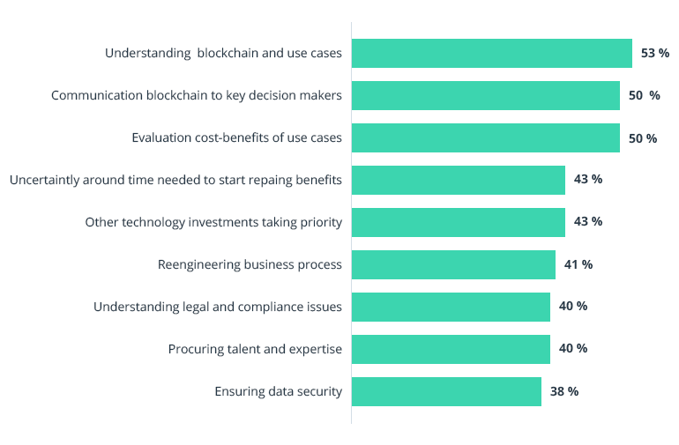
concerns that limit the popularization of smart contracts

Slide 16
Supply Chain
IT Fundamentals Course
Group 6

Slide 17
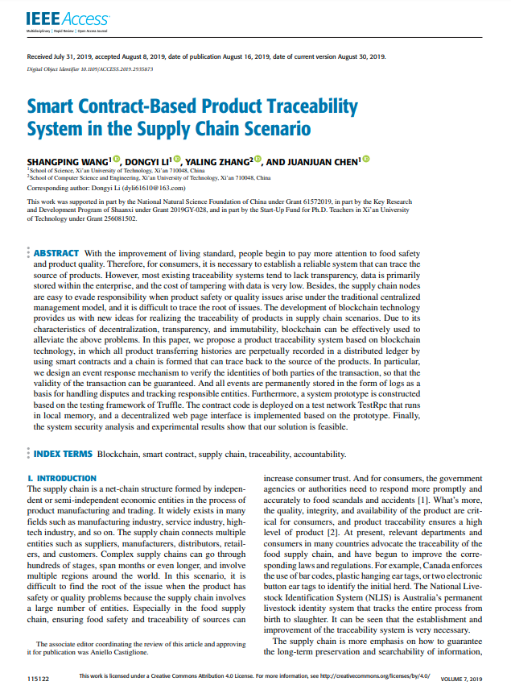
Reference:
Wang, Shangping, et al. "Smart contract-based product traceability system in the supply chain scenario." IEEE Access 7 (2019): 115122-115133.

Slide 18
Introduction
The supply chain is a net-chain structure formed by independent or semi-independent economic entities in the process of product manufacturing and trading
National Livestock Identification System
It is difficult to find the root of the issue when the product has safety or quality problems
Especially in the food supply chain, ensuring food safety and traceability of sources can increase consumer trust

Slide 19
Traditional Supply Chain
The data is mostly recorded by each enterprise in a centralized ledger that is stored locally
It may be falsified privately
Inconsistency between nodes data due to the fact that data has likely been tampered

Slide 20
Challenges Solved by the System
Product traceability process is easily interrupted and accountability is hard to achieve
Decentralized product traceability system based on blockchain technology
The nodes in the network are mutually untrustworthy
An event response mechanism for KYC

Slide 21
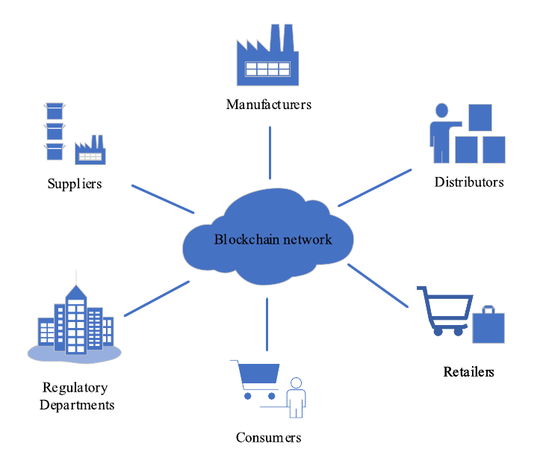
System Model
System security requirements:
Data Accessibility
Data Immutability
System Autonomy
Resistance to Man-in-the-middle Attacks

Slide 22
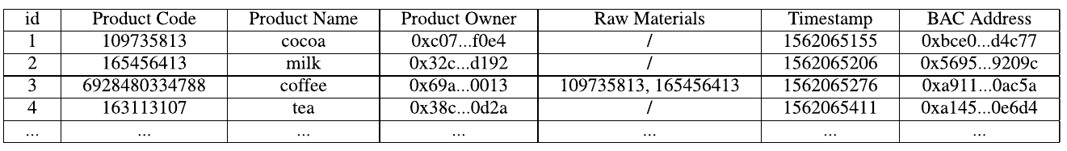
Smart Contract Design
Product Registration Contract (PRC)
Provides a product registration function register()
Product code, product name, product owner, and raw materials or parts
BAC contract address

Slide 23
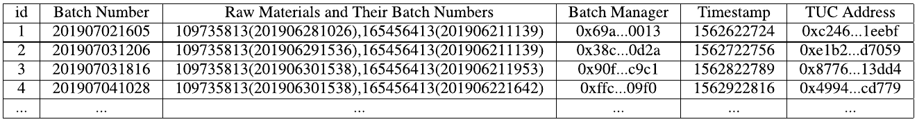
Smart Contract Design
Batch Addition Contract (BAC)
Provides the function addBatch() to add the production batch information of the product
Batch number, the batch manager, the timestamp, and the batch number of raw materials used to produce this batch of products
TUC contract information

Slide 24
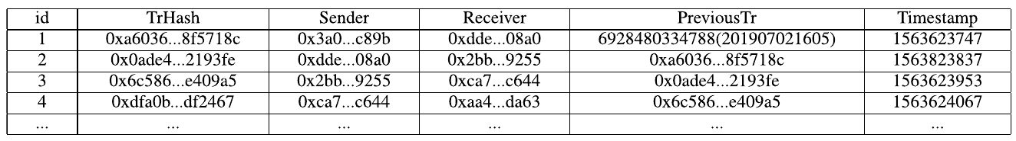
Smart Contract Design
Transaction Update Contract (TUC)
When adding the production batch information and provides the function updateTr() to update the transaction history for this batch of products

Slide 25
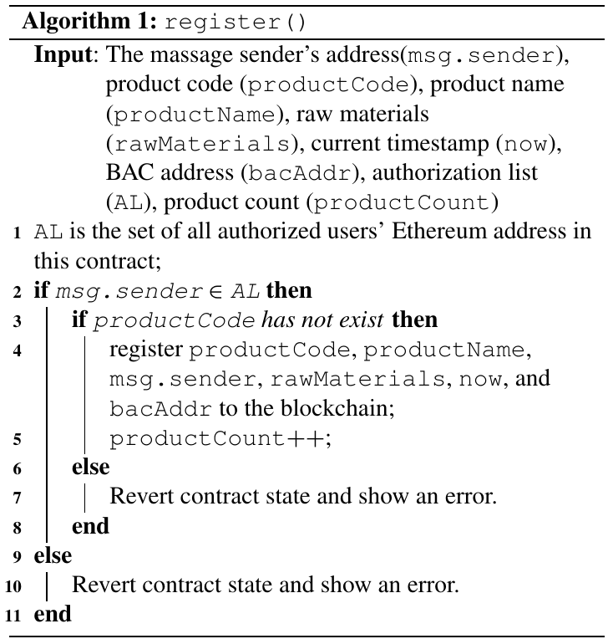
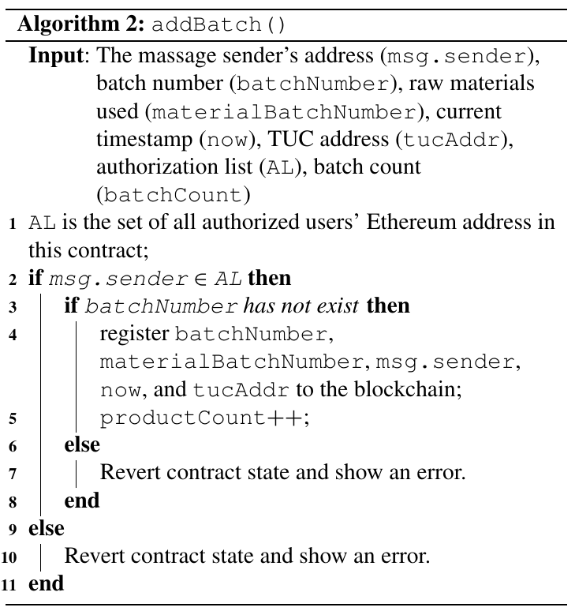
Algorithms

Slide 26
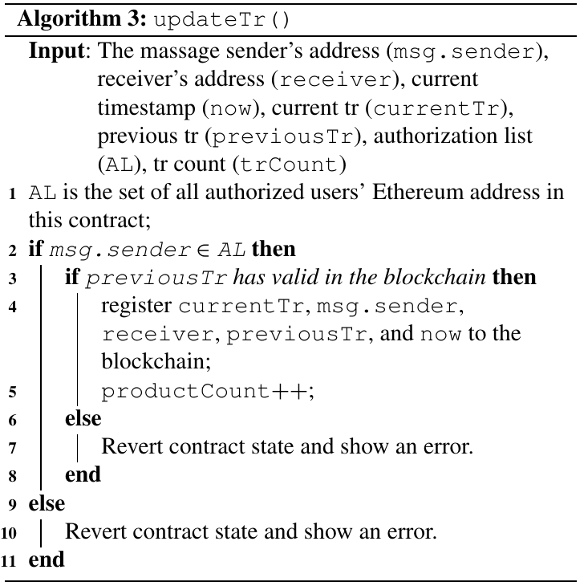
Algorithms

Slide 27
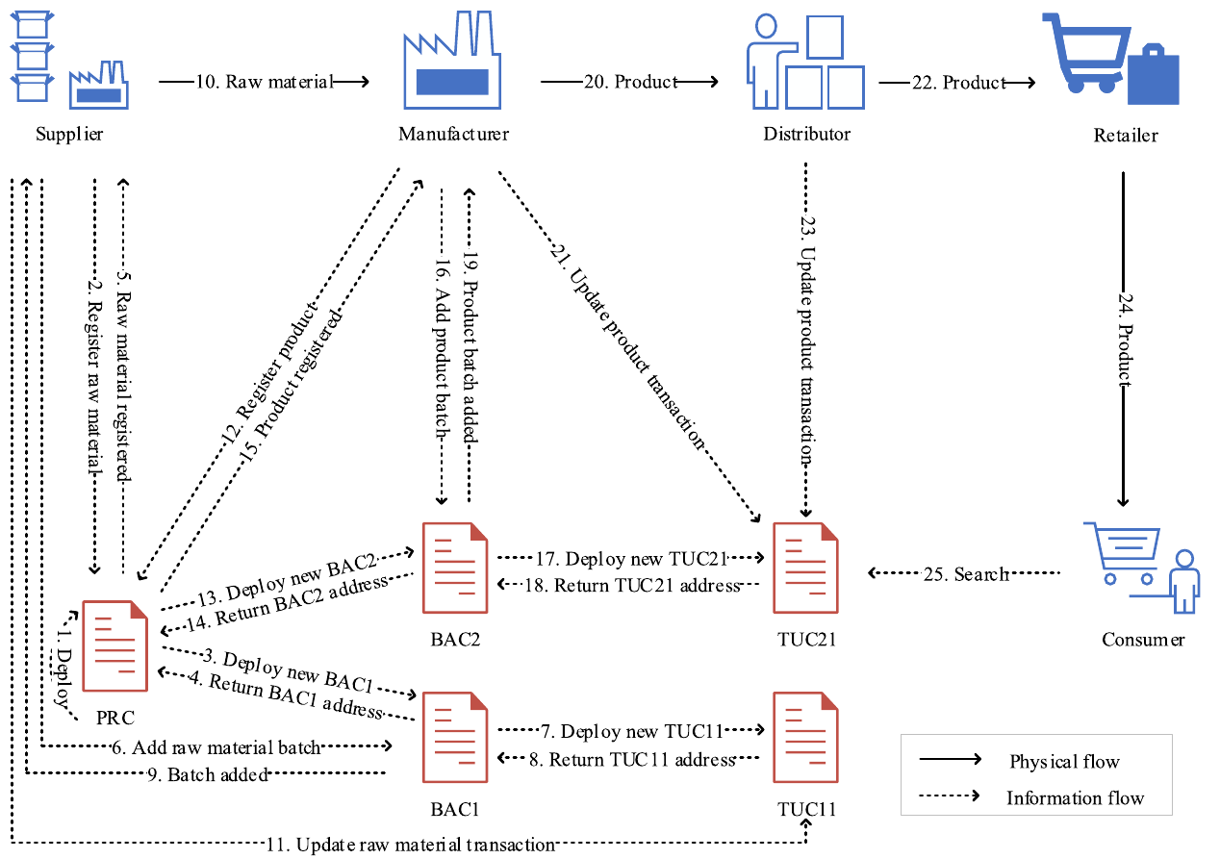
The process of product registration, transferring, and tracking

Slide 28
Real Estate
IT Fundamentals Course
Group 6

Slide 29
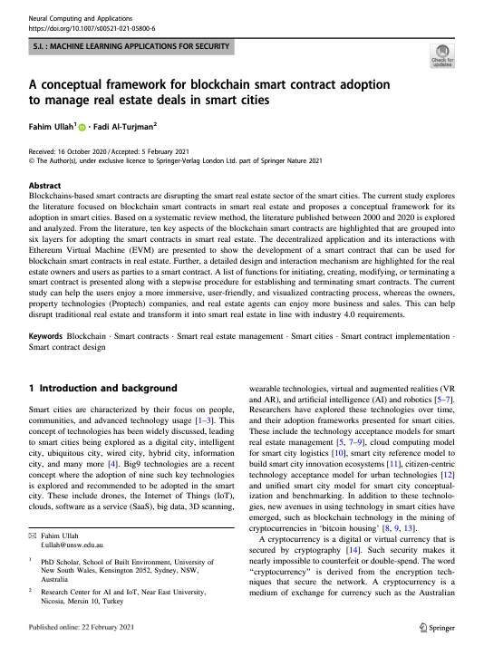
Reference:
Ullah, Fahim, and Fadi Al-Turjman. "A conceptual framework for blockchain smart contract adoption to manage real estate deals in smart cities." Neural Computing and Applications (2021): 1-22.

Slide 30
Introduction
related to technology, which is characterized by three key aspects
Stability
Innovation
Focus on the user
Smart real estate management that involves the use of blockchain technology

Slide 31
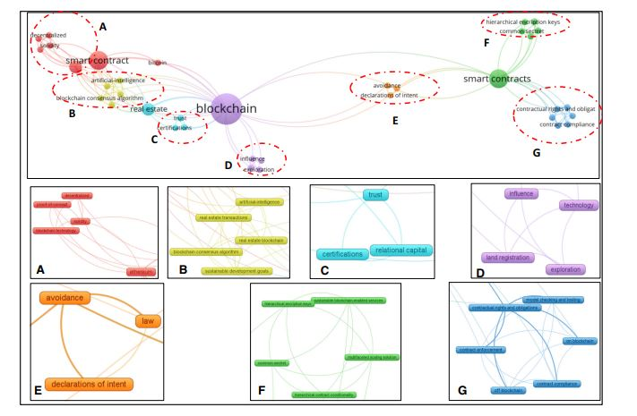
Relation between blockchain and smart contract
Keyword | Category
Solidity, Ethereum, Decentralization and Blockchain | Computer
real state transaction, use of artificial intelligence | Transactional
Trust, certifications | communicational
Impact of technology, blockchain land registration | Technology
Law, avoidance | Legal
hierarchical encryption, common secret | Network
Compliance and execution of the contract | Agree and adapt

Slide 32
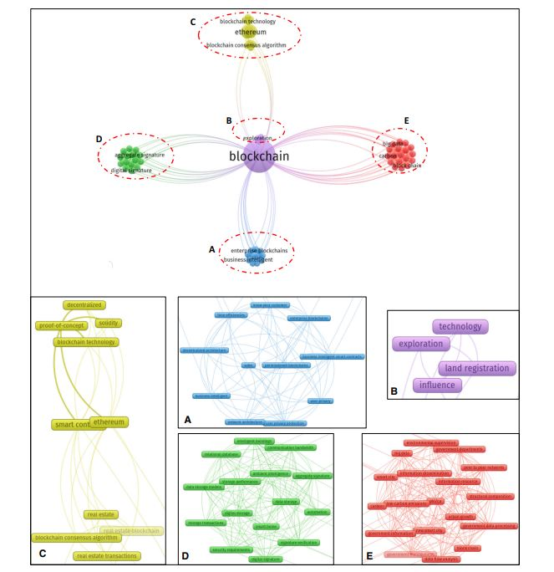
Classification of blockchain
Keyword | Category
user data business intelligence | Organizational
Impact of technology, blockchain land registration | Technology
Solidity, Ethereum, Decentralization and Blockchain | Computer
Data storage ,signature verification | Memory
Information management, information infrastructure | Informational

Slide 33
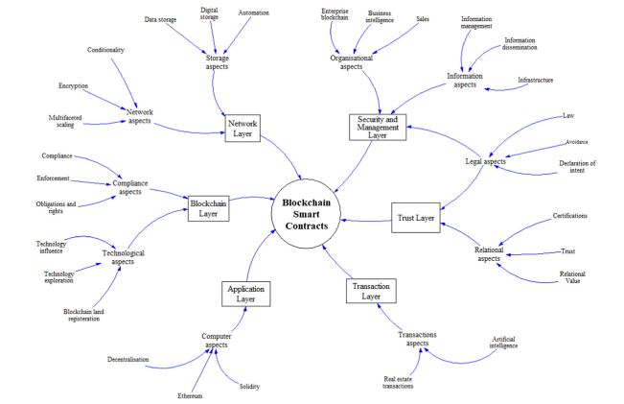
Blockchain in smart real estate
It is made of 6 layers
Combine 10 categories in these layers

Slide 34
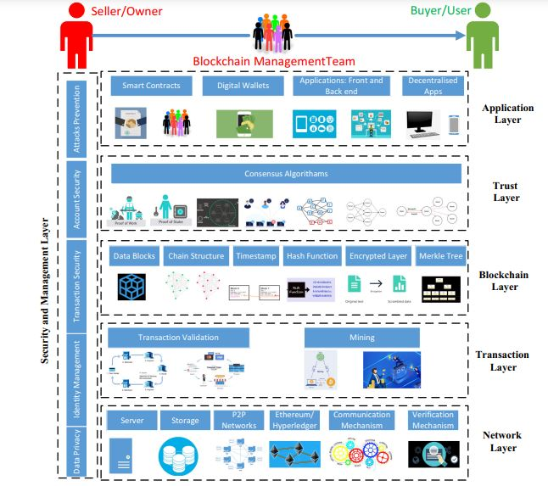
Classification of blockchain
goals | layer
communication and verification mechanisms | Network
validation and processing and currency extraction | Transaction
hash function, chain structure, encrypted layer | blockchain
Consensus development mechanism and authenticate transactions in the network | Trust and confidence
Front-end and back-end applications | Application
Securing and managing smart contracts | Security and management

Slide 35
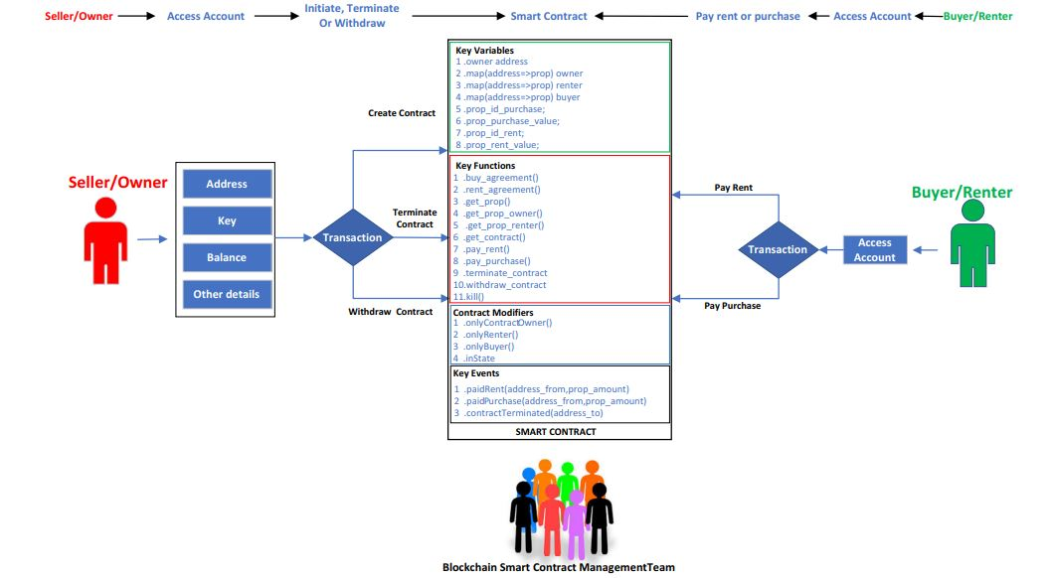
smart real estate management
The owner can create, terminate or cancel the contract
The user can access his account and authorize transactions
In smart contract function the parties are exchanged and the smart contract is set.

Slide 36
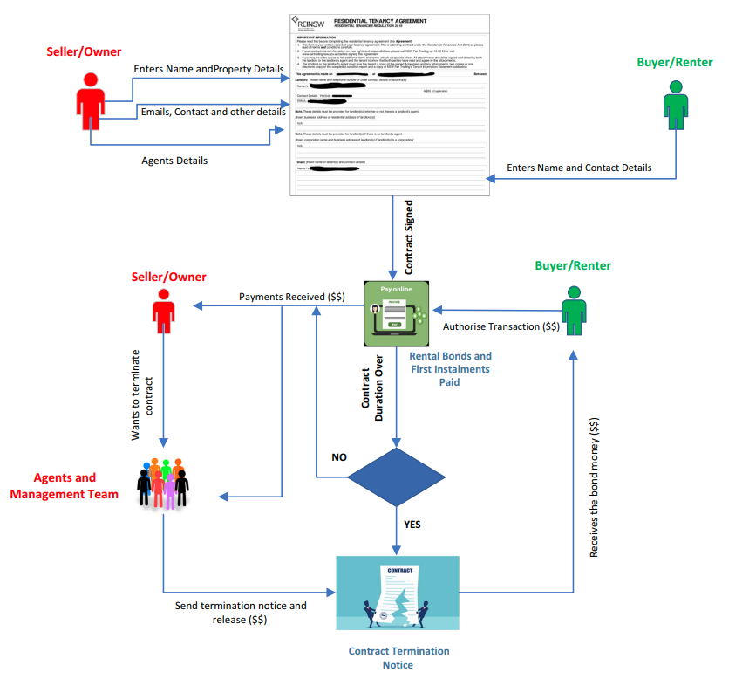
implement and terms of smart contract termination
Access with Web page
The owner registers the details of the real estate in the smart contract
The user registers the details of the desired contract
Deposit and withdraw money automatically

Slide 37
Comparison
IT Fundamentals Course
Group 6

Slide 38
Comparison between three applications
Establish trust between the parties of the contract
Decentralized
Create transparency
Less fraud
Unchangeable
Do not completely remove third parties

Slide 39
Implementation
IT Fundamentals Course
Group 6

