Slide 1
A probabilistic generative grammar for semantic parsing
Abulhair Saparov
Vijay Saraswat
Tom Mitchell

Slide 2
Background
In semantic parsing, we convert natural text into a logical form that represents its meaning.
We have developed good semantic parsers for specific domains, such as geography, airline ticketing, …
Most approaches rely on domain-specific supervision, such a lexicon, an ontology of types, …
To move toward open-domain parsing, we can trade off language generality for more domain-independent supervision.
We don’t claim to build an open-domain semantic parser, but we hope our model will help lead to one.

Slide 3
Background
We propose a generative model of natural language utterances.
The logical form is drawn from a “semantic prior.”
Our model of grammar generates a derivation tree top-down, given the logical form.
The leaves of this derivation tree form the output utterance.
Background knowledge can be incorporated easily via the semantic prior.
We can provide domain-independent (and domain-specific) supervision by restricting the set of rules in the grammar.
The joint distribution factorizes, which enables efficient and exact inference.

Slide 4
Contributions
A generative model of natural language.
An MCMC algorithm to efficiently train the model on pairs of sentences and logical forms.
A dynamic programming algorithm to efficiently parse a new sentence, given the trained model.
All code available at: github.com/asaparov/parser

Slide 5
Semantic grammar
To enable context-free grammars (CFGs) to understand semantics, we modify the production rules.
S → N VP
VP → V N
N → “Chopin”
N → “Michael Phelps”
N → “tennis”
N → “piano”
V → “plays”
V → “swims”
Example of simple context-free grammar.

Slide 6
Semantic grammar
To enable context-free grammars (CFGs) to understand semantics, we modify the production rules.
S → N : select_arg1 VP : delete_arg1
VP → V : identity N : select_arg2
N → “Chopin”
N → “Michael Phelps”
N → “tennis”
N → “piano”
V → “plays”
V → “swims”
For every rule, associate every right-hand nonterminal symbol with a semantic transformation function.
This is a function that takes a semantic statement as input, and outputs another (usually simpler) semantic statement.

Slide 7
How do we generate a sentence?
Example: generate a sentence for the logical form
athlete_plays_sport(concept:phelps,concept:tennis)
S
First step: Draw a semantic statement from a prior, such as a knowledge base.
concept:phelps
N
VP
Recursively: expand the nonterminal node by selecting a production rule.
athlete_plays_sport(,concept:tennis)
V
N
athlete_plays_sport(,concept:tennis)
concept:tennis
Recursively: apply the transformation functions on the right-hand side to the semantic statement.
“Michael Phelps”
“plays”
“tennis”
S → N : select_arg1 VP : delete_arg1
VP → V : identity N : select_arg2
N → “Chopin”
N → “Michael Phelps”
N → “tennis”
N → “piano”
V → “plays”
V → “swims”

Slide 8
Training
Let
x = {x₁,…,x_{n}} be n logical forms with
y = {y₁,…,y_{n}} sentences.
We want to learn the latent derivation trees t = {t₁,…,t_{n}} and any other latent variables in the grammar θ.
To do so, we use MCMC. Repeat:
For i = 1,…,n, sample t_{i} | θ,x_{i},y_{i}.
Sample θ | t.

Slide 9

Training
The distribution of t_{i} | θ,x_{i},y_{i} fully factorizes:
$$p\left(t_{i} | θ,x_{i}, y_{i}\right)∝𝟙\left\{\text{yield}\left(t_{i}\right)=y_{i}\right\}\prod_{n∈t_{i}}{p\left(r^{n} | θ,x_{i}^{n}\right)}\text{.}$$
Due to the complete factorization, we can apply the inside-outside algorithm, a classical dynamic programming method, to sample from this distribution.

Slide 10
Training
But this Markov chain can be slow to mix, so we integrate out θ and derive a collapsed Gibbs sampler.
Repeat: For i = 1,…,n, sample t_{i} | t_{-i},x_{i},y_{i}.
But the distribution t_{i} | t_{-i},x_{i},y_{i} does not necessarily factorize.
Instead, we draw samples from the earlier fully factorized distribution, and use a Metropolis-Hastings step to accept or reject the samples.
In practice, samples are almost always accepted.

Slide 11

Parsing
During parsing, we want to compute
$$\max_{x_{∗},t_{∗}}{p\left(x_{∗},t_{∗} | θ, y_{∗}\right)}∝𝟙\left\{\text{yield}\left(t_{∗}\right)=y_{∗}\right\}\prod_{n∈t_{∗}}{p\left(r^{n} | θ,x_{∗}^{n}\right)}\text{.}$$
for a new sentence $y_{∗}$.
We again use dynamic programming to perform this combinatorial optimization.
Algorithm is an agenda-driven chart parser, and has structure similar to the inside step in sampling.
We show that our algorithm is monotonic: the probability of the state at each iteration does not increase → guarantees optimality.

Slide 12
Results
To demonstrate that state-of-the-art semantic parsers can be built with our model, we evaluate on GeoQuery and Jobs.
For fairer comparison, we also include results with domain-specific supervision:
Lexicon mapping lexemes such as state/city names to entities.
Type-checking: assign zero prior probability to logical forms that are not type-correct.
Even without domain-specific supervision, our parser performs competitively.
All code available at: github.com/asaparov/parser

Slide 13
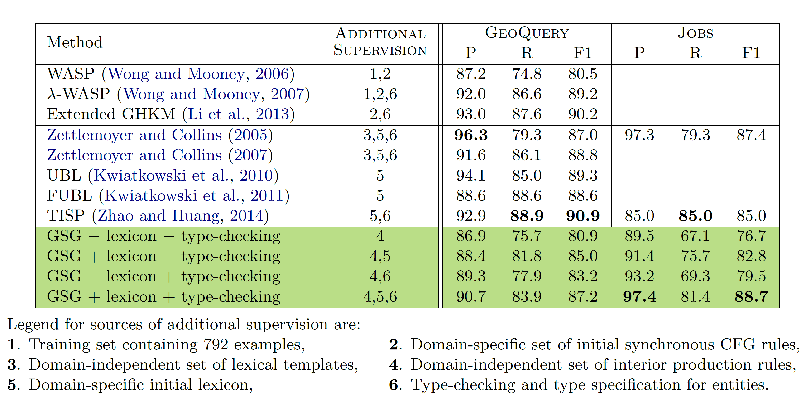
Results

Slide 14

Future work
Consider semi-supervised/unsupervised settings, where sentences are paired with denotations, rather than full logical forms.
Our model is generative, so we can use it for generation.
Either sample from $y_{∗}|θ, x_{∗}$ or compute $\max_{y_{∗},t_{∗}}{p\left(y_{∗},t_{∗} | θ, x_{∗}\right)}$.
Interactive learning?
We can place richer priors on the logical form:
ontology learning,
relation extraction,
modeling context.

Slide 15
Questions? github.com/asaparov/parser

