Slide 1

How To Play Board Games
(Android App)
Developed by,
Saraswathi Datar

Slide 2
Overview
Project Idea: Develop a mobile application for learning rules of various board games with visual and textual elements to help different learning styles.
Github Link: https://github.com/saraswathidatar/HowToPlayBoardGames
Intended Users: Children and board game enthusiasts
License: MIT License
Contact info: saras3@pdx.edu

Slide 3
About App:
Starting with a game like Chess includes:
Game layout:
How to set up the board
List the Pieces and when clicked on individual piece specifies rules related to it
Also includes text to speech to read out the rules

Slide 4
Design decisions
Learnt android basics such as activity, intent, managing activity lifecycle
Activity lifecycle- onCreate(), onStart(), onResume(), onPause(), onStop(), and onDestroy()
Mainactivity.java- First screen that appears when user launches app
Manifest file- declares activities and their attributes
Java files
Layout xml files
Text to speech interface- Implement the TextToSpeech.OnInitListener to be notified of the completion of the initialization.

Slide 5
Screenshots

Slide 6
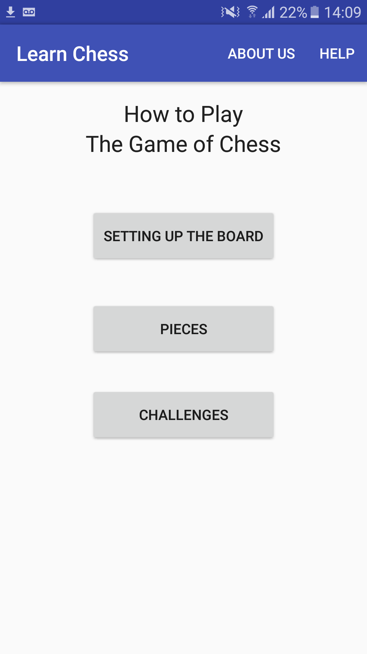
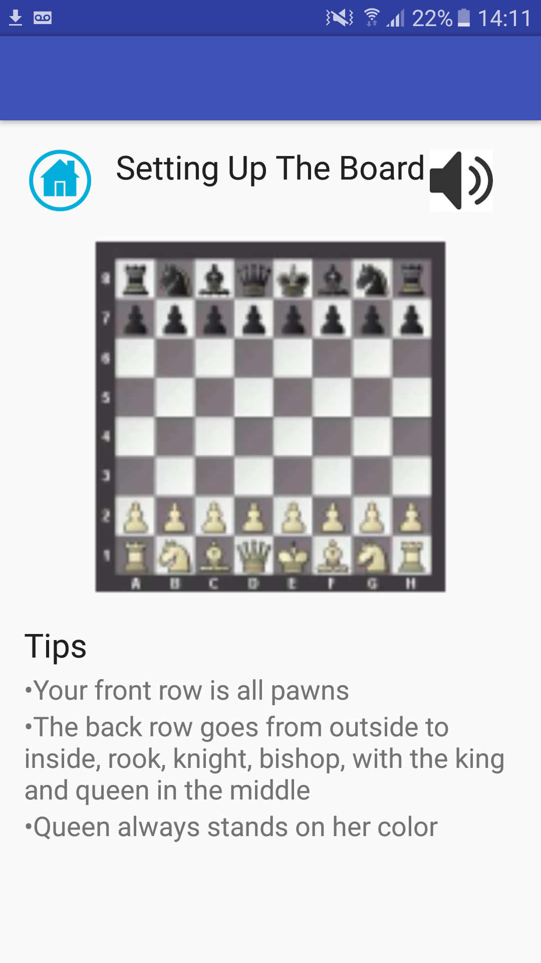
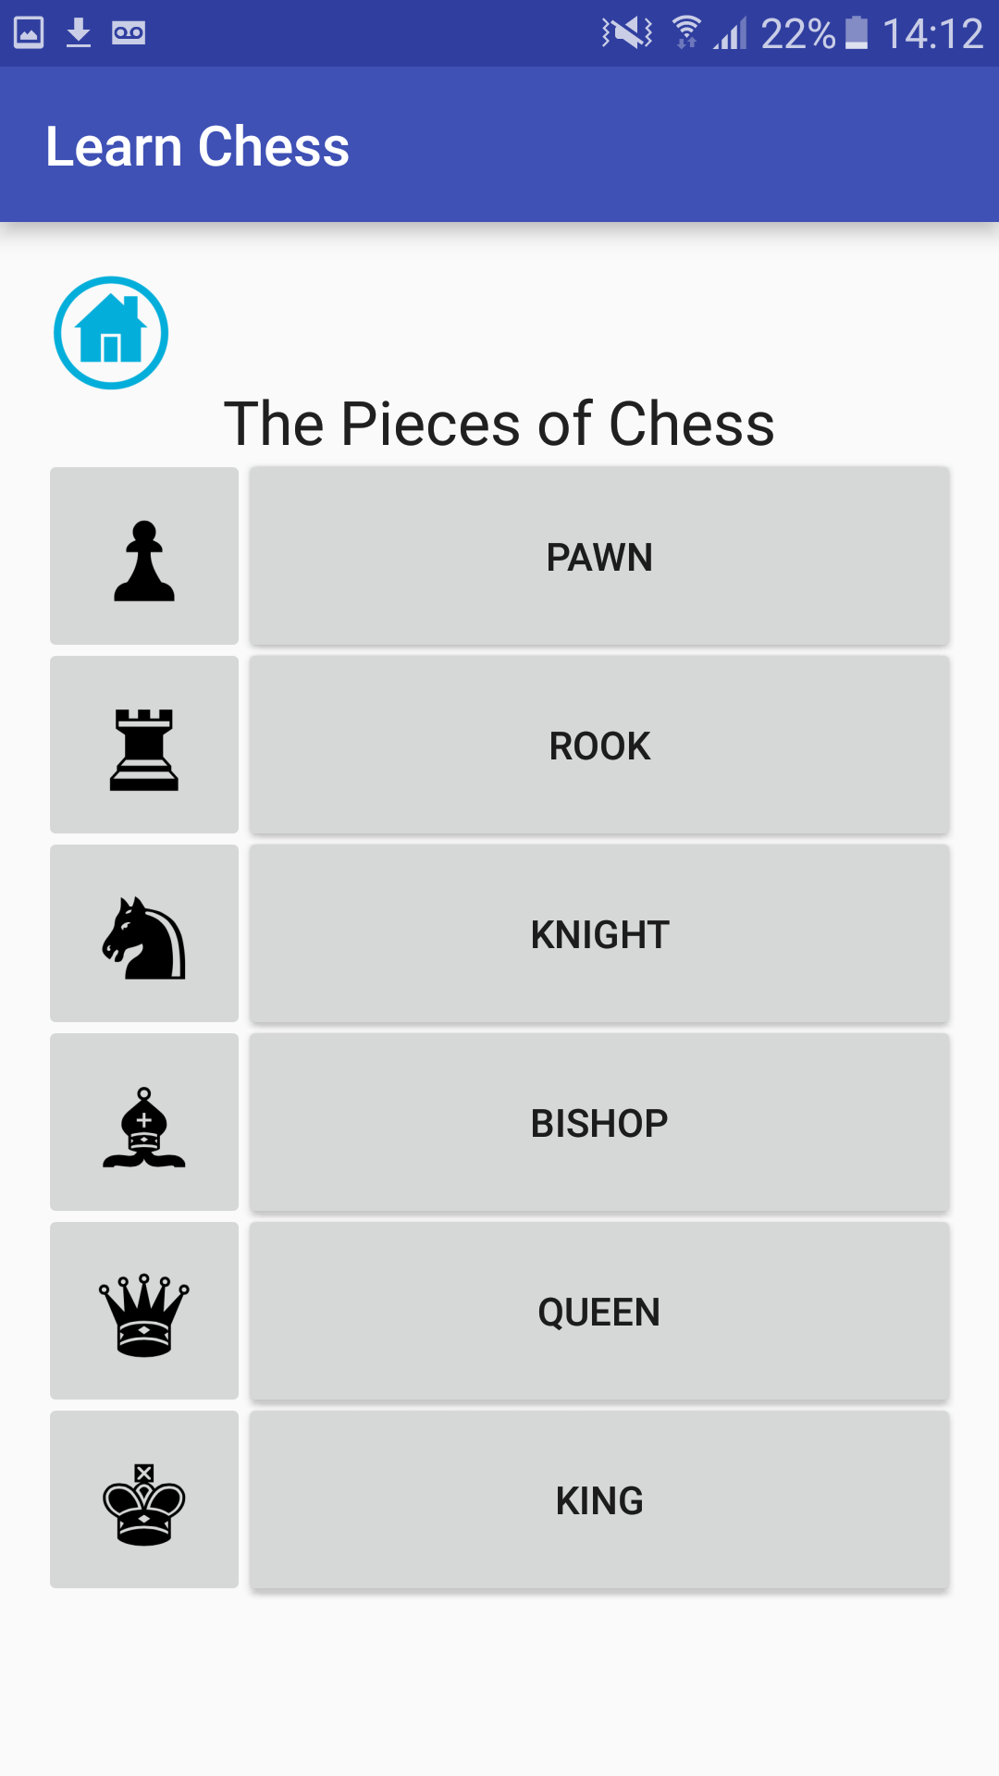

Slide 7
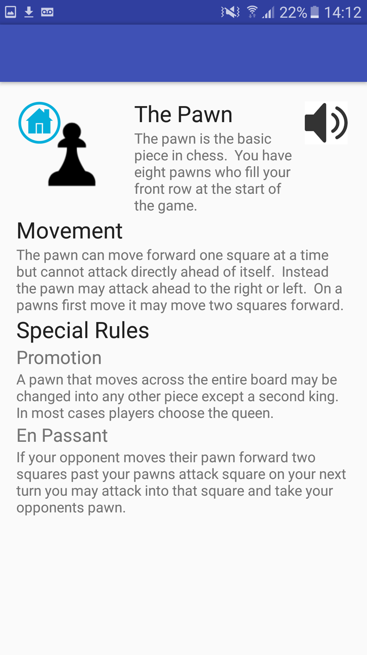
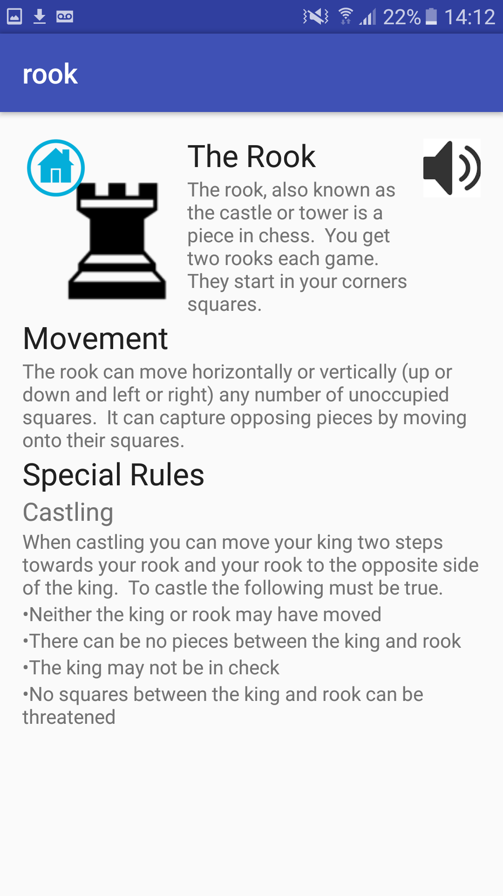
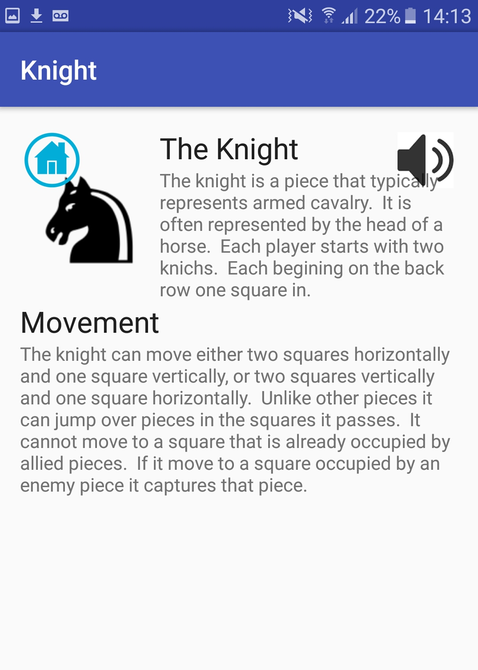

Slide 8
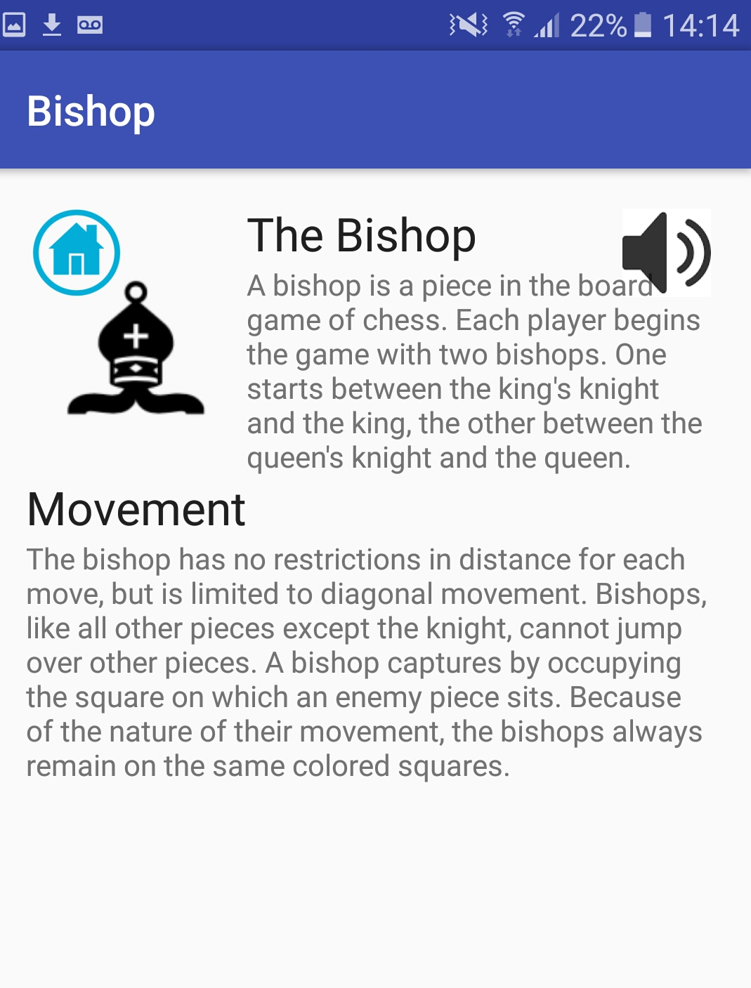
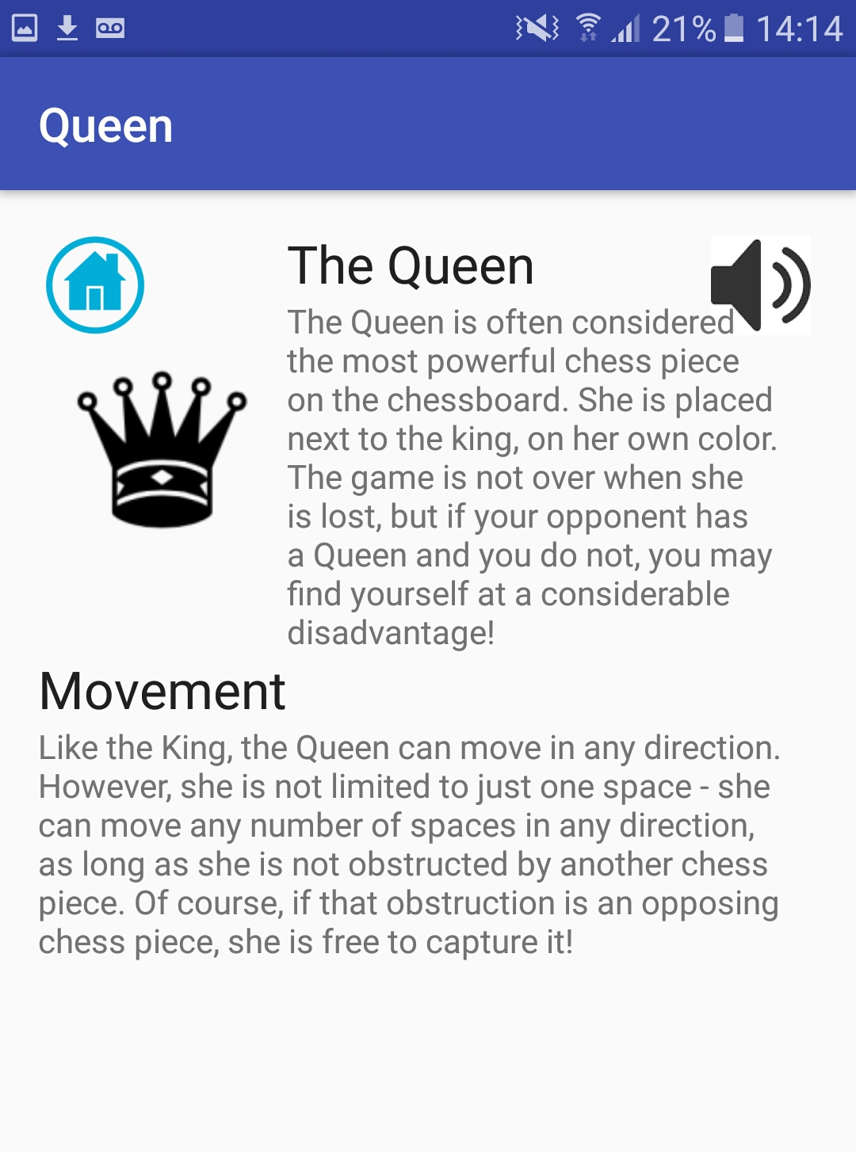
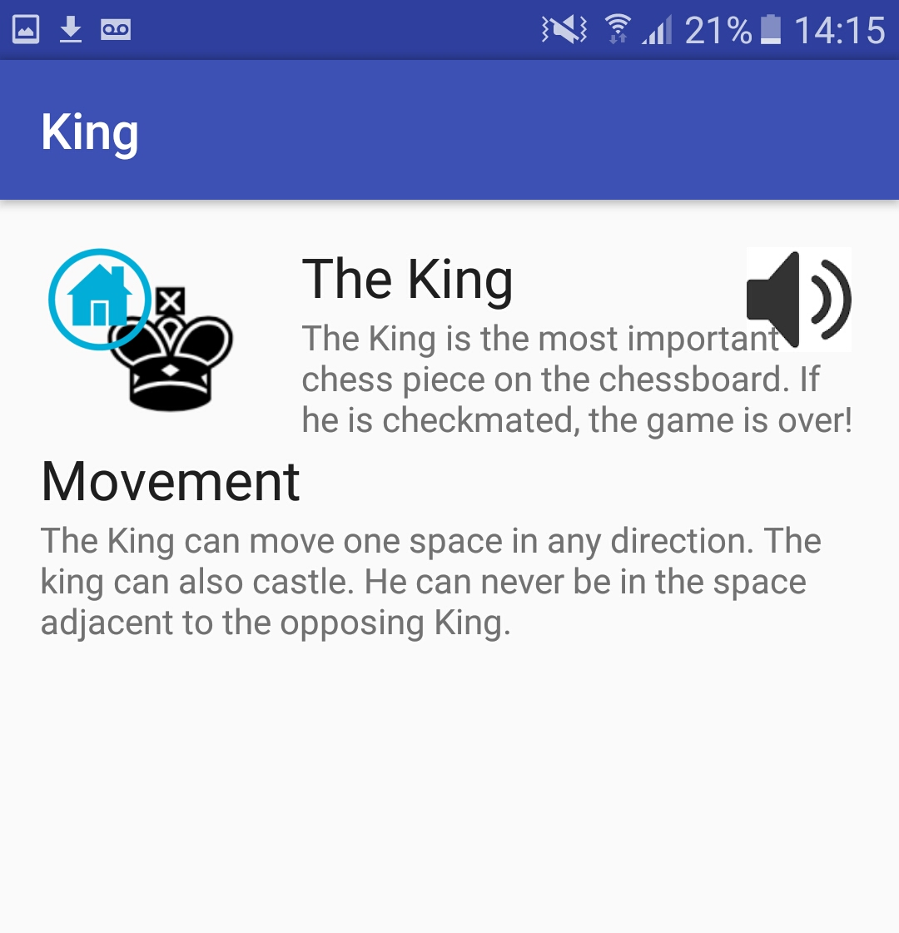

Slide 9
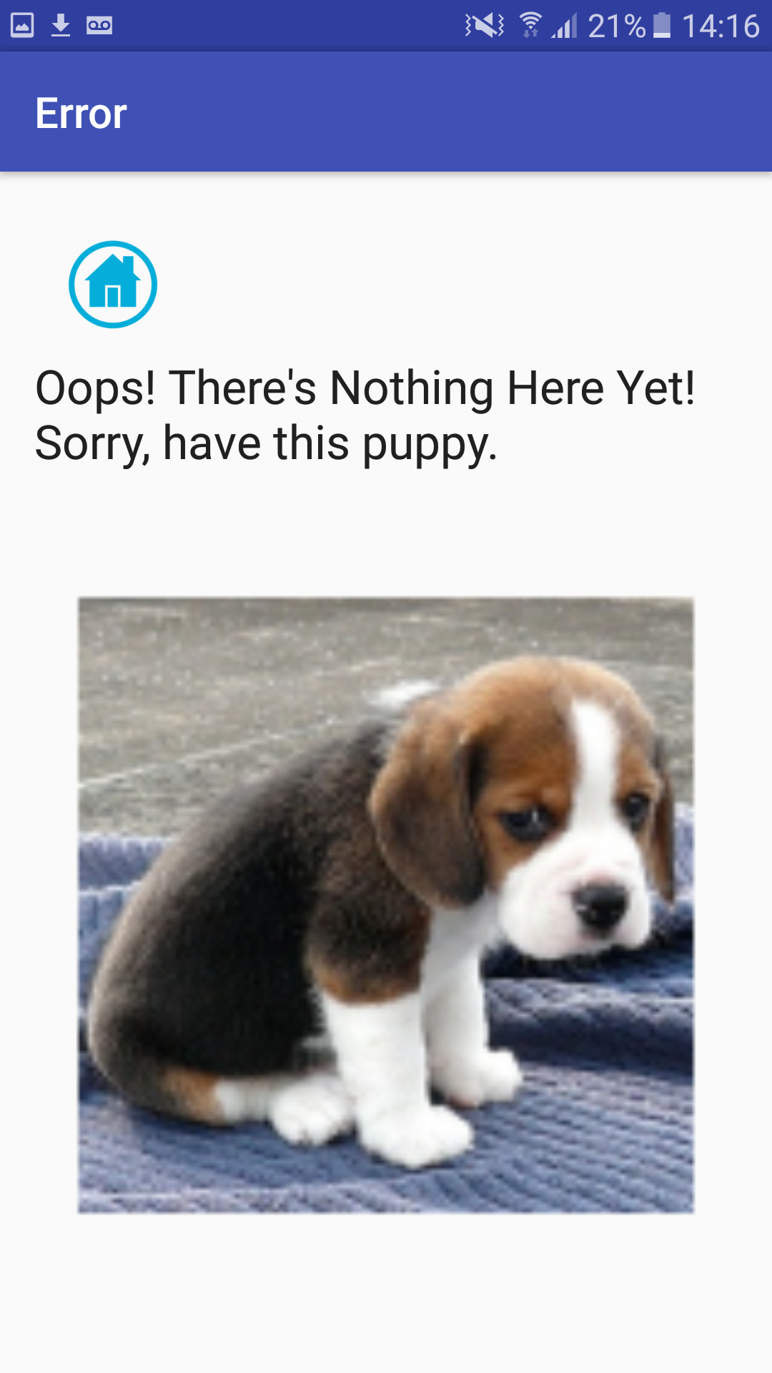
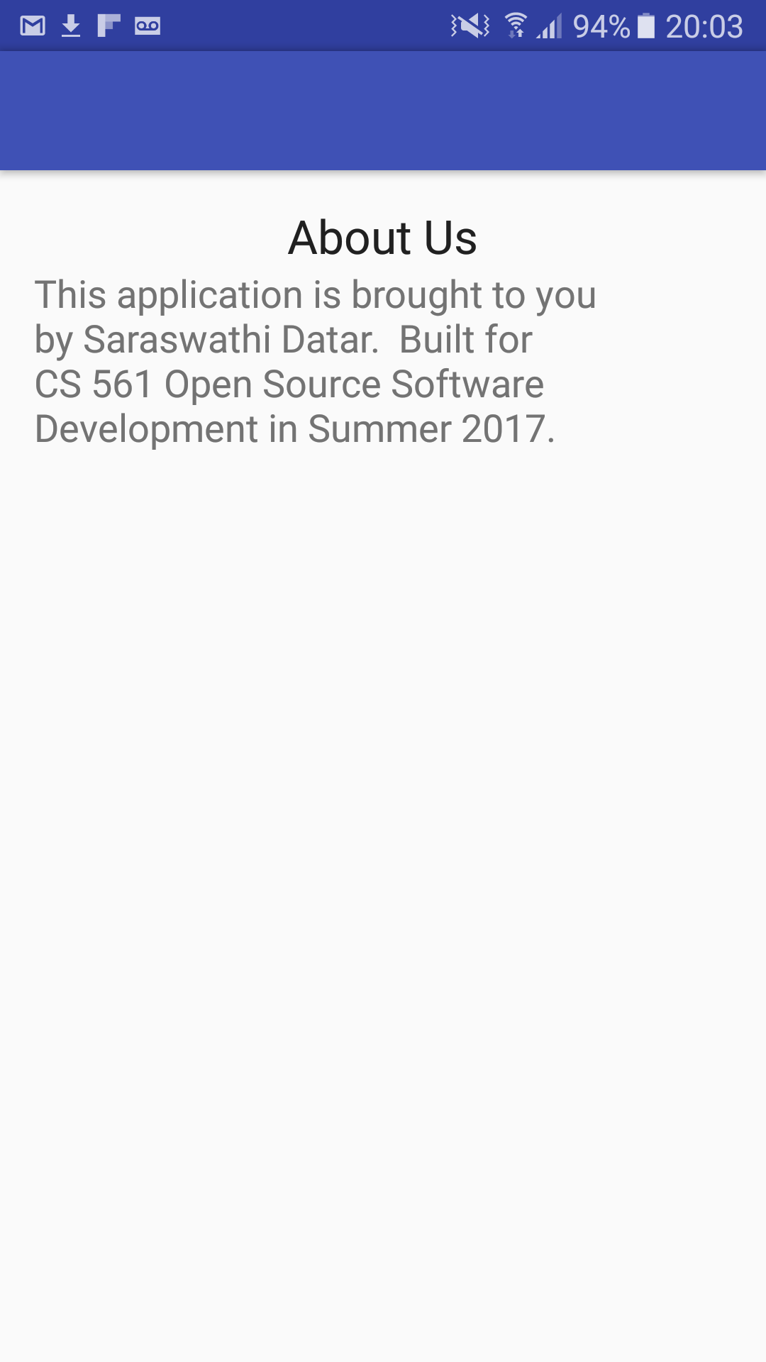
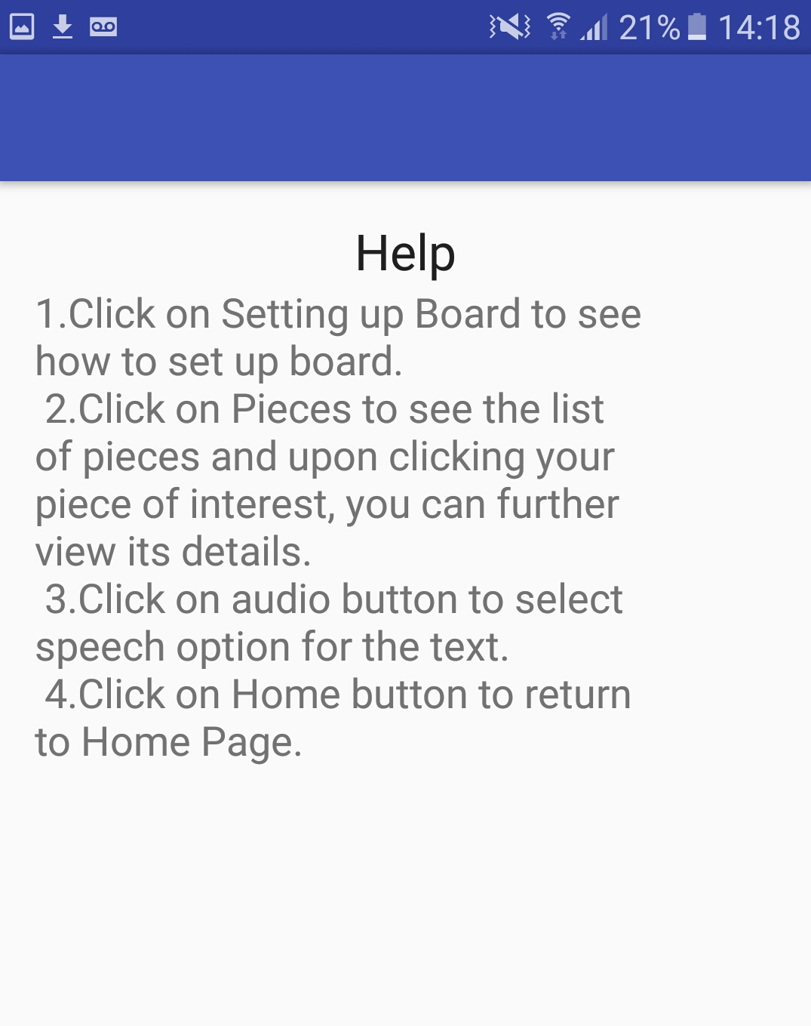

Slide 10
Lessons Learned
Having too many activities in the activity stack is not a good idea.
Handling orientation changes is an important step in making your app interactive
Need to build a dynamic UI with fragments to support wide range of screen sizes
Embedding Youtube player

Slide 11
Future enhancements
Scale the app to include other board games
Include a list of challenges for users to play with
Add some gifs and animated pictures for pieces
Include an email facility

Slide 12
References
1. Text to speech- https://developer.android.com/reference/android/speech/tts/TextToSpeech.html
2. Reusing layouts- https://developer.android.com/training/improving-layouts/reusing-layouts.html
3. Activity lifecycle- https://developer.android.com/guide/components/activities/activity-lifecycle.html
4. Orientation changes- https://developer.android.com/guide/topics/resources/runtime-changes.html
-code.hootsuite.com/orientation-changes-on-android/
5. Building dynamic UI using fragments- https://developer.android.com/training/basics/fragments/fragment-ui.html
6. Adding youtube player to android- https://www.youtube.com/watch?v=3LiubyYpEUk
-http://stacktips.com/tutorials/android/youtubeplayerview-example-in-android-using-youtube-api
7. Github with android- https://www.londonappdeveloper.com/how-to-use-git-hub-with-android-studio/

