Slide 1
Customer Shopping Behavior Analysis
Spending patterns, segments and subscription behavior across 3,900 purchases
Python · PostgreSQL · Power BI
Notes:
Introduce the project: an end-to-end analysis using Python for cleaning, PostgreSQL for business queries and Power BI for the dashboard.

Slide 2
Project overview
Transactional data from 3,900 purchases across product categories, analyzed to guide strategic business decisions.
3,900
18
rows (purchases)
columns
Customer demographics
Purchase details
Shopping behavior
4
37
product categories
missing ratings, imputed
Notes:
Goal: uncover insights into spending patterns, customer segments, product preferences and subscription behavior to guide strategic decisions.

Slide 3
Data preparation in Python
1
Load & explore
2
Impute missing data
3
Standardize columns
Imported with pandas; checked structure with info() and describe()
37 Review Rating gaps filled with each category's median
Renamed all columns to snake_case
4
Engineer features
5
Check consistency
6
Load to PostgreSQL
Created age_group and purchase_frequency_days
Dropped promo_code_used as redundant with discount_applied
Cleaned DataFrame loaded for SQL analysis
Notes:
Pipeline from raw data to a clean PostgreSQL table.

Slide 4
Revenue by gender
68%
of revenue comes from male customers, who also make up 68% of the customer base
The gap reflects customer count, not higher spend per person.
Notes:
Male customers generate roughly 2.1x female revenue. Male customers are 2,652 of 3,900 (68%), so the gap tracks customer count.

Slide 5
Subscribers vs. non-subscribers
Subscribers
Non-subscribers
1,053
2,847
Customers
Customers
$59.49
$59.87
Avg. spend
Avg. spend
$62,645
$170,436
Total revenue
Total revenue
Average spend is nearly identical, so the upside is converting more of the 73% who don't subscribe.
Notes:
Only 27% subscribe. Average spend is almost identical, so subscription does not currently lift basket size.

Slide 6
Revenue by age group
$62.1K
from Young Adults, the top-earning group
Only about $6K separates the highest and lowest groups.
Notes:
Revenue is spread fairly evenly; young adults lead at roughly 27% of total.

Slide 7
Product ratings and discount dependence
Ratings are tightly clustered; five products sell on discount in nearly half of purchases.
Notes:
Top-rated products score 3.78 to 3.86. Hats, sneakers and coats have about half of purchases discounted.

Slide 8
Most purchased items by category
Accessories
Clothing
Footwear
Outerwear
Jewelry
Blouse
Sandals
Jacket
171 orders
171 orders
160 orders
163 orders
Sunglasses
Pants
Shoes
Coat
161 orders
171 orders
150 orders
161 orders
Belt
Shirt
Sneakers
161 orders
169 orders
145 orders
Notes:
Top products by order count within each category. Outerwear's third item was not shown in the source report.

Slide 9
Customer segments and repeat buyers
Repeat buyers (>5 purchases)
958
2,518
subscribed
not subscribed
Frequent buying alone doesn't lead to subscribing: loyal shoppers are an untapped subscription audience.
Notes:
80% of customers fall in the Loyal segment. Among repeat buyers (>5 purchases) about 28% subscribe, similar to the overall 27%.

Slide 10
Shipping type and high-spending discount users
839
customers used a discount yet spent above the average purchase amount
Express: +$2.02 per order vs. Standard
Notes:
Express shoppers spend about $2 more per order. 839 customers used a discount and still spent above the average purchase amount.

Slide 11
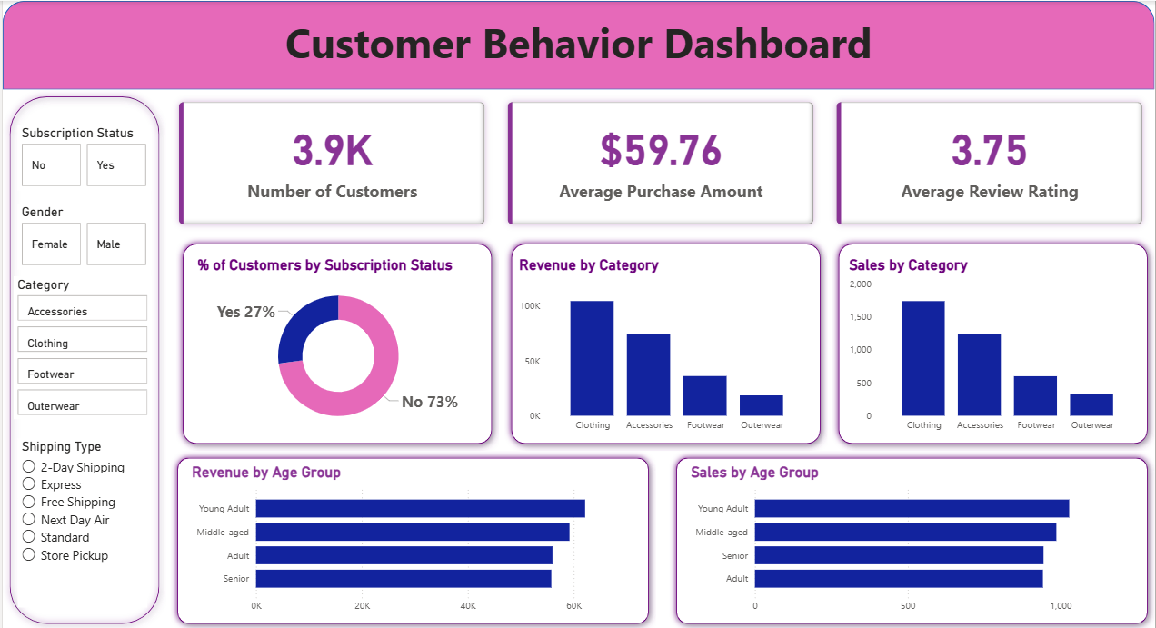
Interactive Power BI dashboard
3.9K
customers
$59.76
average purchase
3.75
average review rating
Filter by subscription, gender, category and shipping type.
Notes:
Filters for subscription status, gender, category and shipping type; KPIs and breakdowns by category and age group.

Slide 12
Business recommendations
1
Boost subscriptions
Promote exclusive benefits for subscribers
2
Customer loyalty programs
Reward repeat buyers to move them into the Loyal segment
3
Review discount policy
Balance sales boosts with margin control
4
Product positioning
Highlight top-rated and best-selling products in campaigns
5
Targeted marketing
Focus on high-revenue age groups and express-shipping users
Notes:
Each recommendation ties back to findings: only 27% subscribe, 80% of customers are Loyal, about half of purchases of several products are discounted, and express shipping and young adults show the highest spend.

