Slide 1
Machine Learning
Team Karstark by Manish Saraswat

Slide 2
What is the problem ?
Given features, we need to predict which investment id by different advisors will be redeemed in 2017.
Gaining foresight at this will help Invesco take necessary measures to improve the performance of advisors and instruments.

Slide 3
My Best Scores
Random Guess - 70.62
Machine Learning Model - 68.5656 (Voting Ensemble 3 XGBoost)
Single XGB Model - 67.2745
Was machine learning really required ?

Slide 4
How did I do it ?

Slide 5
Random Guess Approach
Using past performance as an indicator of future performance
Made predictions using mean of target variable by Advisor Id
Common Investment IDs not present in test / train
Prediction threshold was kept at >=0.3 (manual tuning)
Score - 70.62

Slide 6
Machine Learning Approach
How did I start ?

Slide 7
Like Everyone...
Struggled for hours to load data ( in R, data.table rocks! )
Balanced data set
Treated transaction.csv as train file
Merged all the files based on available group by features (UAID, UIID, Month)
Convert activity_type column into a list to avoid invalid joins
Got a data frame with 3.5M rows

Slide 8
Keep what’s really needed!
Removed columns with NULL values ( 80 % & Above)
Removed near zero variance columns ( such as index return features)
Encoded character variables as integers
Removed Data before 2016 ( memory issues! )
Training Model Frame -: (July - Nov, Aug-Nov, Sep-Nov)
Testing Frame -: December 2016

Slide 9
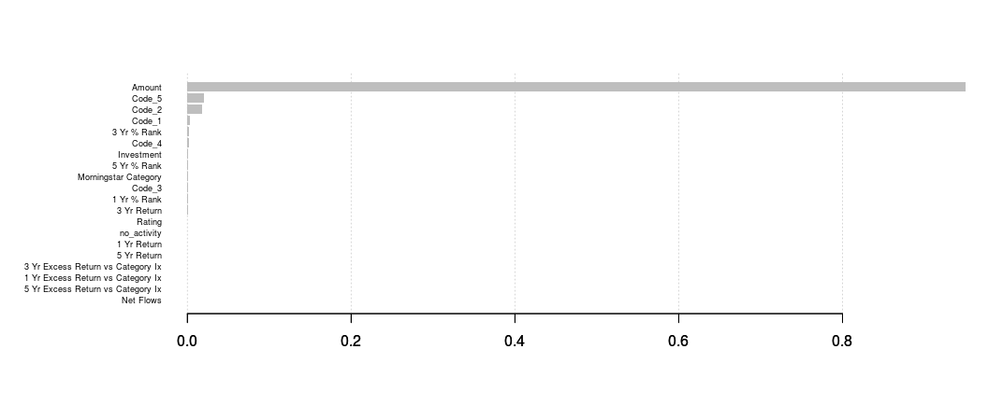
Created New Features (1)
From activity file, created activity_count
XGboost feature importance plots gave ideas!

Slide 10
Created New Features (2)
X_train[,mean_amt_bothid := round(mean(Amount)),.(Unique_Advisor_Id,Unique_Investment_Id)]
X_train[,sum_codes_2 := Code_3 + Code_4 + Code_5]
X_train[,sum_codes := Code_1 + Code_2 + Code_3 + Code_4 + Code_5]
X_train[,sum_code_by_2 := sum(sum_codes),.(Unique_Advisor_Id,Month)]
X_train[,sum_codes := NULL]
+ many more…(but all in failed :(

Slide 11
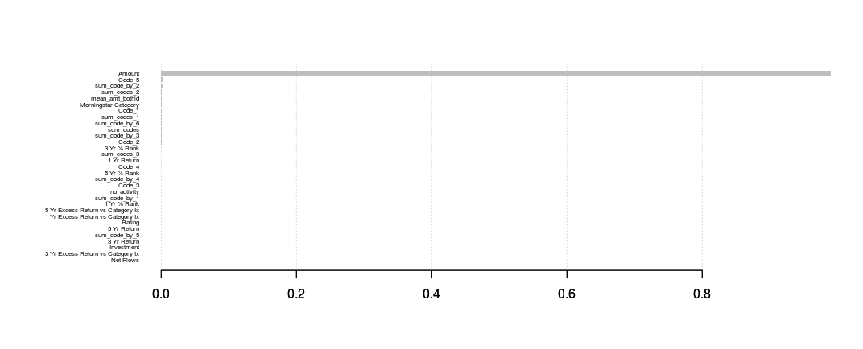

Slide 12
Finally...
Things tried ...
Voting Ensemble of 3 Xgboost Models with accuracies.
Logistic Regression
Light GBM

Slide 13
Thank you!

