Slide 1

Professional Certificate in Coding
Office Hour: Puneet Saraswat
November 2nd 2021

Slide 2
Agenda
01 | React Now! React States: Depths React Hooks
02 | Let’s Code Exercise
03 | Q/A

Slide 3
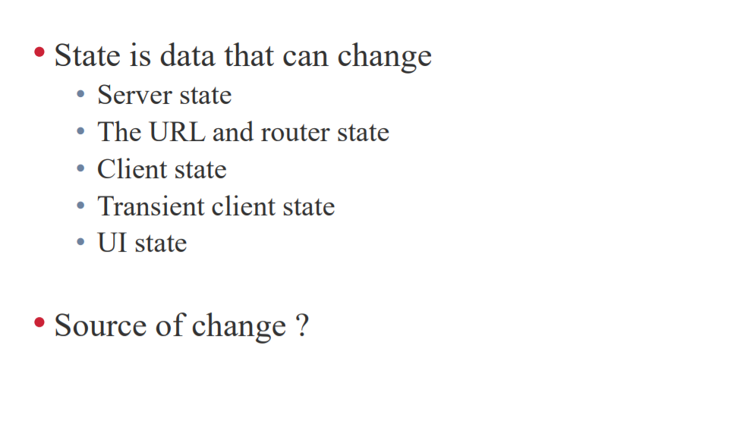

Slide 4
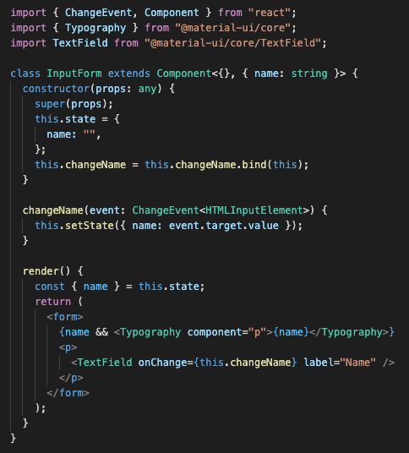
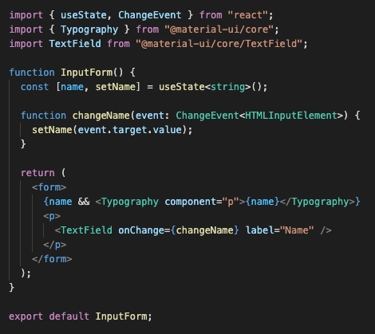
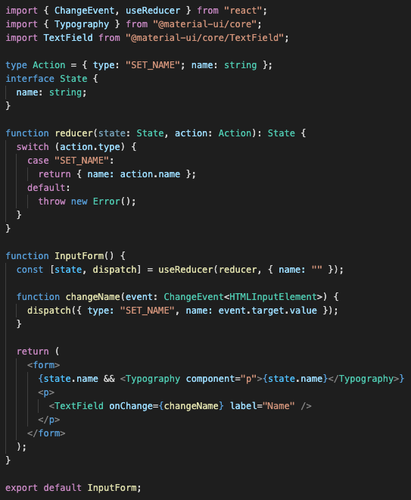
React State
Class component state
Functional component state
useState
Great for simple local state
useReducer
Good for more complex local state

Slide 5
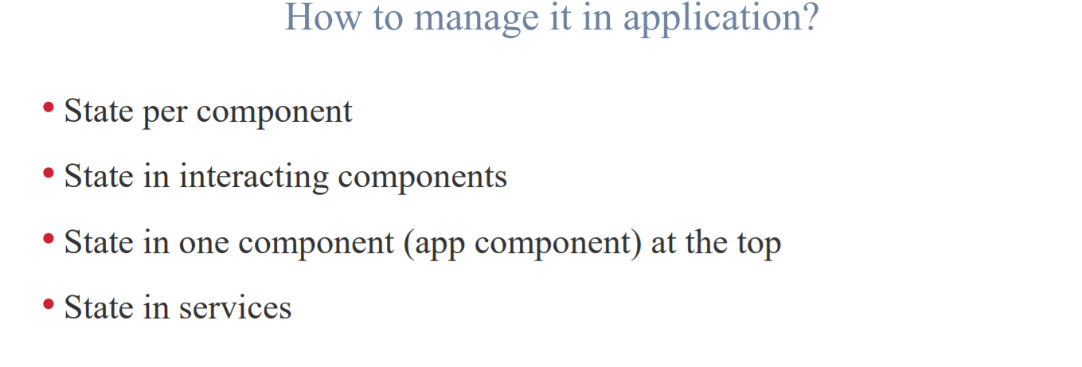

Slide 6
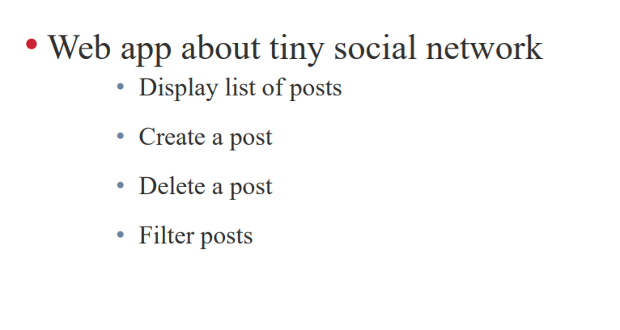

Slide 7
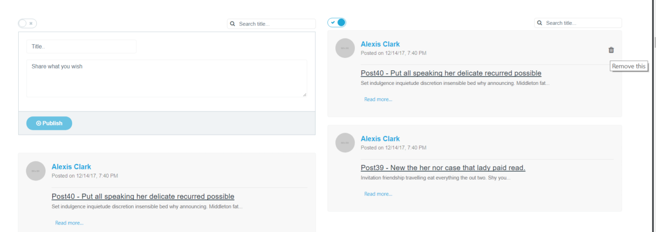

Slide 8
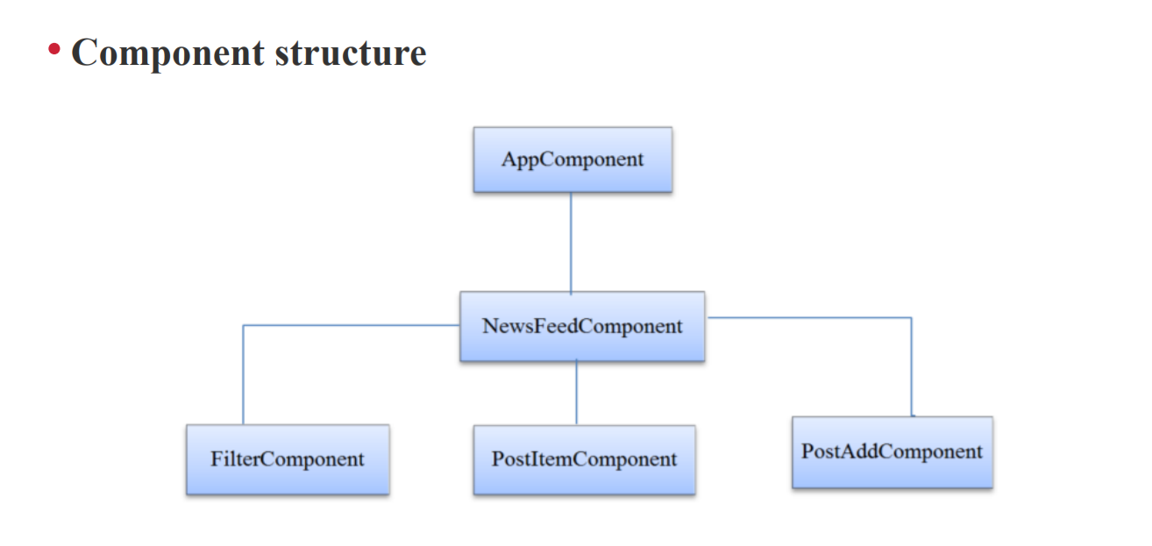

Slide 9
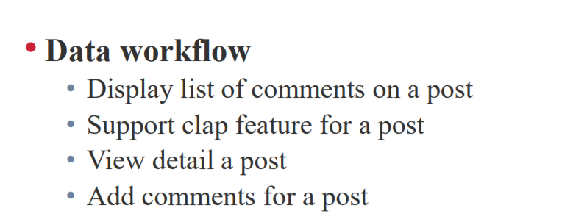

Slide 10
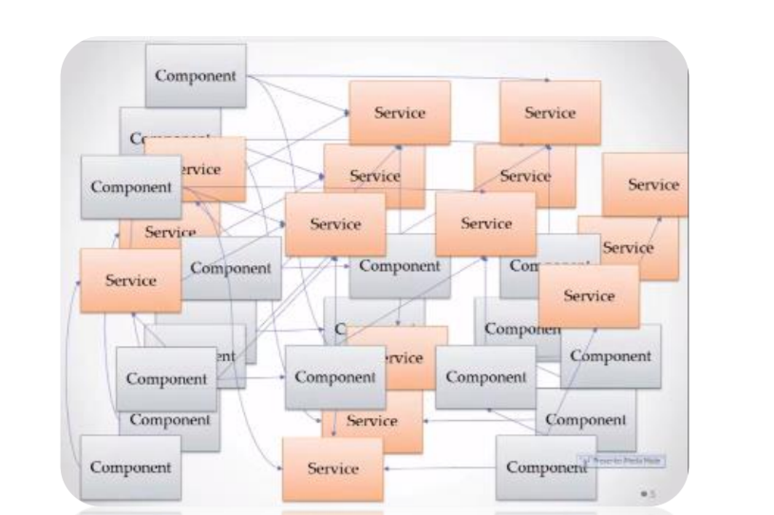

Slide 11
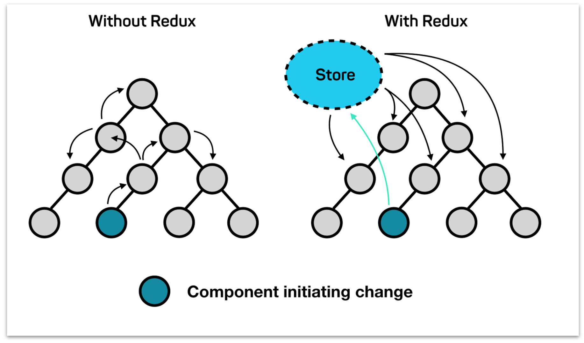

Slide 12


Slide 13
First released in October of 2018, the React hook APIs provide an alternative to writing class-based components, and offer an alternative approach to state management and lifecycle methods. Hooks bring to functional components the things we once were only able to do with classes, like being able to work with React local state, effects and context through useState, useEffect and useContext.

Slide 14
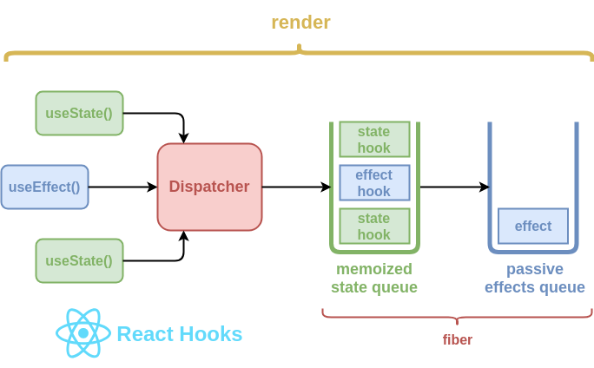

Slide 15
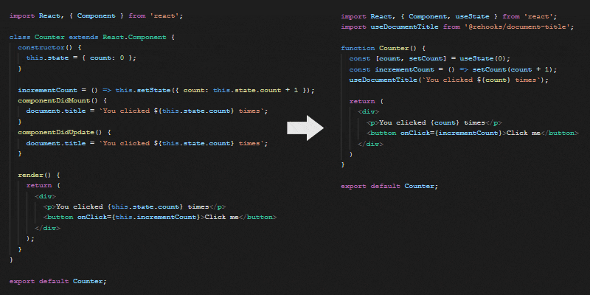
HOOKS! They are Amazing
https://stackblitz.com/edit/react-state-hook-04?file=Counter.js
https://stackblitz.com/edit/react-custom-hook-npm?file=Counter.js
https://reactjs.org/docs/hooks-state.html
https://www.telerik.com/kendo-react-ui/react-hooks-guide/

Slide 16
02
Let’s Code

Slide 17
03
Q/A

