Slide 1
BLUESTOCK FINTECH
Mutual Fund Analytics Platform
Bluestone_MF_Dashboard_Analysis Report
Data Analyst Intern, Bluestock Fintech (MJ28)
Mutual Fund / Fintech Domain • 7-Day Individual Capstone • June 2026
Notes:
Open by introducing the project as a 7-day individual capstone covering the full data pipeline — from raw AMFI data to a working dashboard.

Slide 2
Problem & Objective
The Problem
The Objective
₹81 lakh crore AUM, 1,908 schemes, 26.12 crore folios — yet investors lack a unified, risk-adjusted way to compare funds.
NAV, AUM, SIP, and holdings data live in fragmented formats (TXT, PDF, HTML) across AMFI's site.
Most retail investors don't know if their fund is beating its benchmark.
Monthly reports are static PDFs — no live, self-service drill-down.
Build an ETL pipeline that consolidates 10 AMFI/mfapi.in datasets into one SQLite database.
Compute risk-adjusted performance metrics: Sharpe, Sortino, Alpha, Beta, Max Drawdown.
Benchmark schemes against Nifty 50 / Nifty 100 / BSE SmallCap.
Deliver an interactive 4-page Power BI dashboard for fund selection.
Notes:
Frame this as solving 5 concrete business problems from the brief: data fragmentation, performance comparison gap, no benchmark tracking, investor behaviour blind spots, and slow reporting.

Slide 3
Dataset Overview
40
10
87K+
4.5 Yrs
Real Fund
Schemes
Datasets
Provided
Transaction
Rows
NAV
History
01 fund_master.csv | 40 schemes | 02 nav_history.csv | ~46,000 rows
03 aum_by_fund_house.csv | ~90 rows | 04 monthly_sip_inflows.csv | 48 rows
05 category_inflows.csv | ~144 rows | 06 industry_folio_count.csv | 21 rows
07 scheme_performance.csv | 40 rows | 08 investor_transactions.csv | ~32,000 rows
09 portfolio_holdings.csv | ~320 rows | 10 benchmark_indices.csv | ~8,000 rows
Notes:
Walk through the 4 stat callouts first, then point out the dataset table covers fund metadata, NAV history, AUM, SIP flows, investor transactions, holdings, and benchmark indices.

Slide 4





Architecture & ETL Pipeline
1
2
3
4
5
EXTRACT
TRANSFORM
LOAD
ANALYSE
VISUALISE
AMFI NAV/TXT, mfapi.in REST API,
NSE/BSE Bhavcopy, 10 CSVs
Pandas cleaning, forward-fill,
CAGR/returns, code validation
SQLite 5-table star schema
(dim_fund, dim_date, fact_nav...)
Sharpe, Sortino, Alpha, Beta,
VaR, cohort analysis
4-page Power BI dashboard
with slicers & KPI cards
Orchestrated end-to-end by run_pipeline.py — ingestion → cleaning → DB load → metrics → risk analytics
Notes:
Walk left to right through the five-layer architecture, mirroring real fintech pipelines used at Zerodha/Groww/Paytm Money per the project brief.

Slide 5
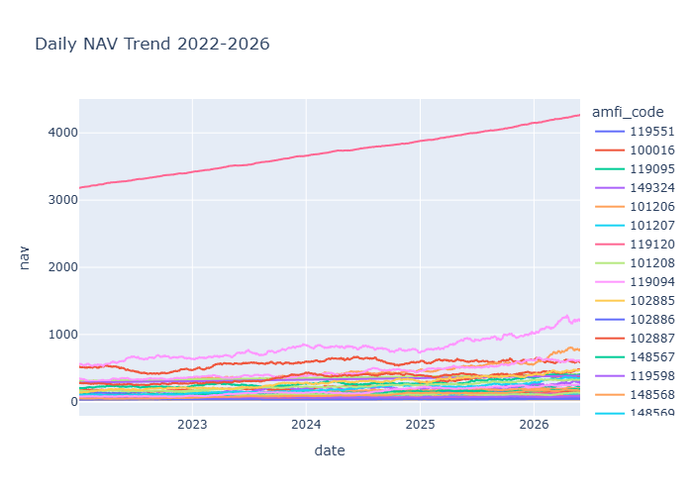
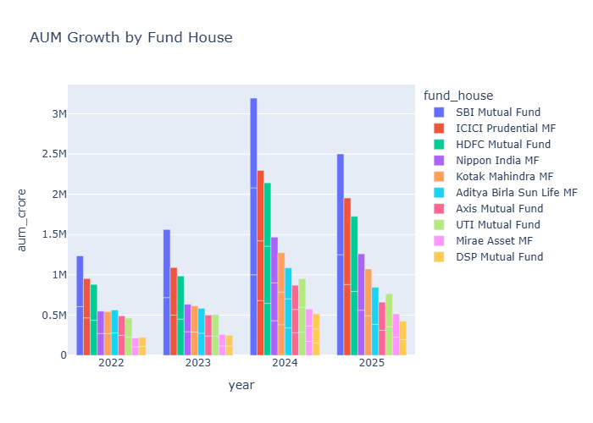
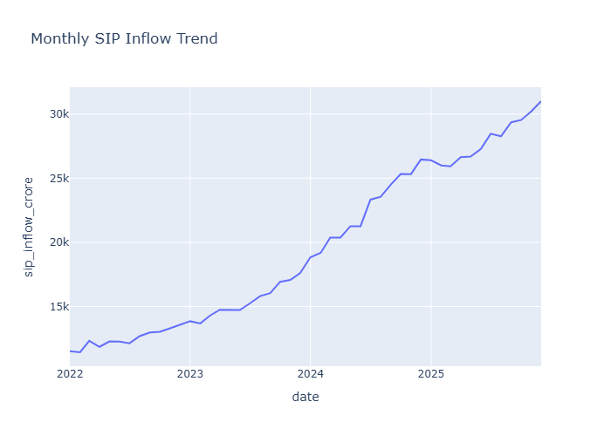
EDA Highlights — Industry Trends
NAV Trend (2022–2026)
AUM Growth by Fund House
Monthly SIP Inflow Trend
SBI MF holds clear AUM leadership (₹12.50L Cr, Dec 2025), with the gap widening every year.
SIP inflows grew from ~₹11,500 Cr (2022) to the real all-time high of ₹31,002 Cr (Dec 2025).
Equity NAVs show clear corrections (2024) vs the steady, low-volatility climb of liquid funds.
Notes:
Highlight: SBI's AUM dominance, SIP all-time high in Dec 2025, and the contrast between volatile equity NAVs and steady liquid fund NAVs.

Slide 6
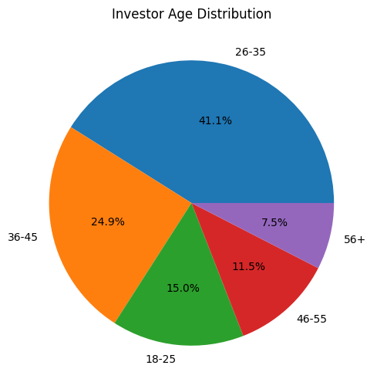
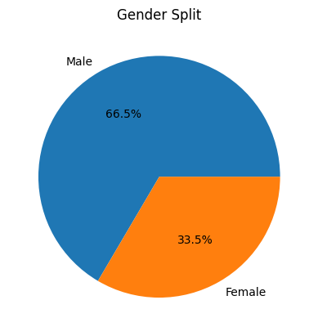
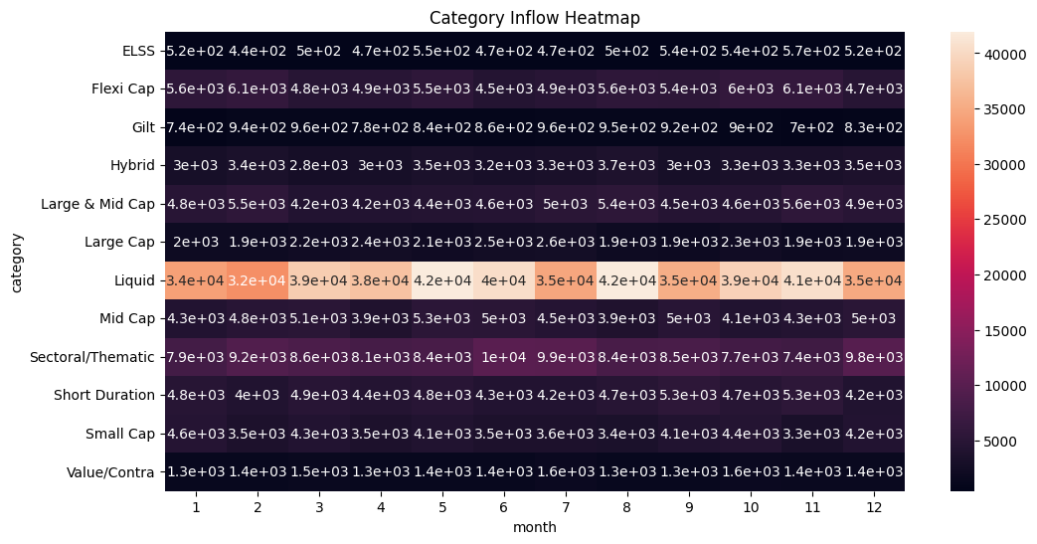
EDA Highlights — Investor & Category Patterns
Investor Age Distribution
Investor Gender Split
Category-wise Inflow Heatmap (FY24–25)
26–35 year-olds are the largest investor cohort (41.1%); 26–45 together form two-thirds of all investors.
Gender gap: 66.5% male vs 33.5% female — a clear opportunity for targeted engagement.
Liquid funds dominate net category inflows (₹32K–42K Cr/month), far above any equity category.
Notes:
Call out the gender gap explicitly as an actionable insight for AMCs, and the liquid-fund dominance in net inflows.

Slide 7
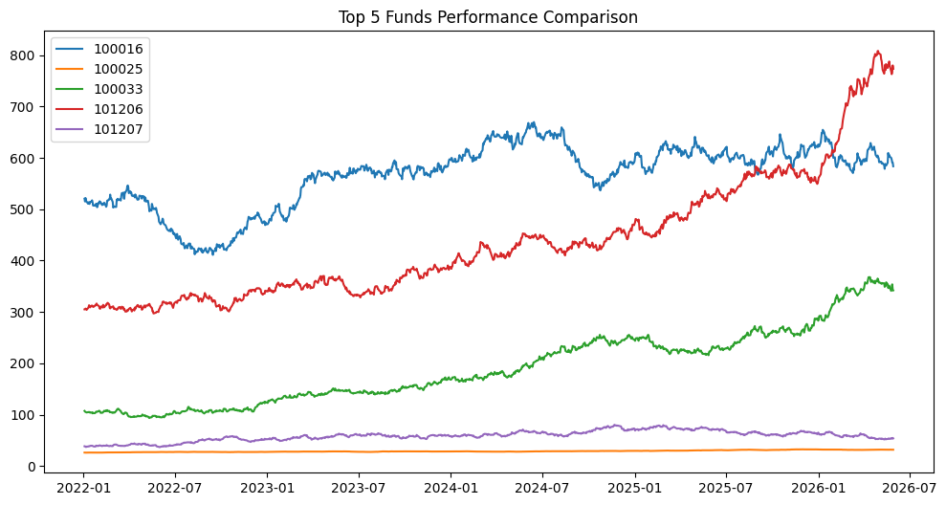
Performance Metrics
Fund Scorecard — Top 5 by Composite Score
Metrics Computed
Scheme | Category | 3yr Ret% | Sharpe | Score
Axis Bluechip Fund | Large Cap | 18.04 | 1.62 | 84.0
Parag Parikh Flexi Cap | Flexi Cap | 13.40 | 1.73 | 76.0
HDFC Top 100 Fund | Large Cap | 18.18 | 1.76 | 72.0
Quant Small Cap Fund | Small Cap | 23.28 | 1.51 | 64.0
SBI Bluechip Fund | Large Cap | 13.23 | 1.41 | 57.5
CAGR — 1yr / 3yr / 5yr
Sharpe Ratio (Rf = 6.5%)
Sortino Ratio (downside risk)
Alpha & Beta vs Nifty 100
Maximum Drawdown
Score = 30%×(3yr Return) + 25%×(Sharpe) + 20%×(Alpha) + 15%×(Exp. Ratio, inv) + 10%×(Max DD, inv)
Benchmark vs Top Funds
Notes:
Walk through the top-5 scorecard, then the metric list, then the benchmark chart — point out Axis Bluechip leads the composite score despite HDFC having the highest raw Sharpe.

Slide 8
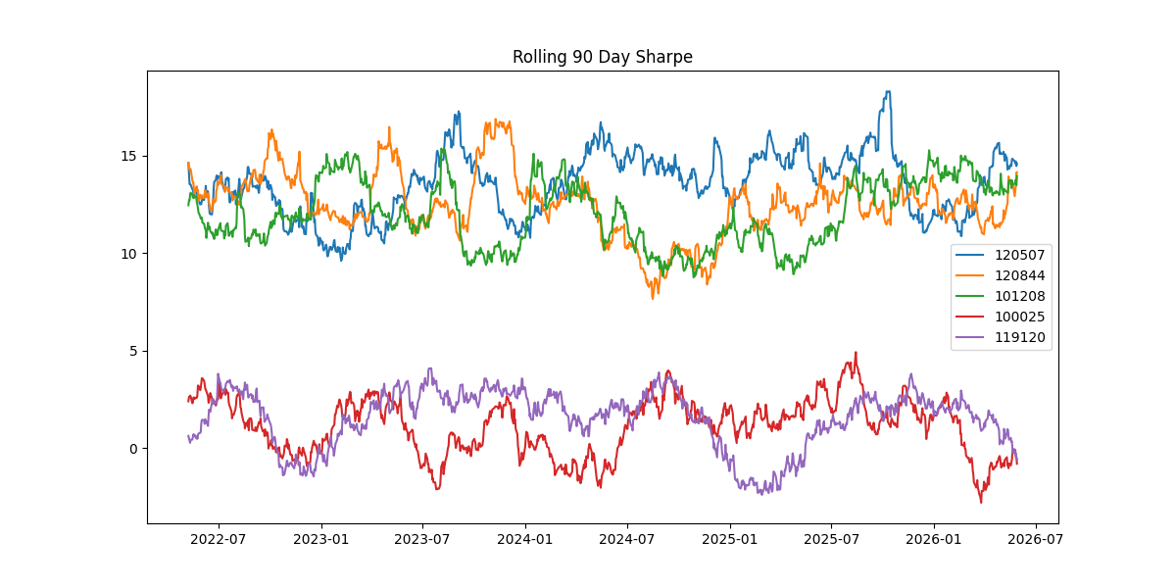
Risk Analytics
Rolling 90-Day Sharpe Ratio
VaR (95%) & CVaR
5th percentile of daily return distribution; CVaR = mean of returns below that threshold. Liquid funds show near-zero VaR vs equity schemes.
Sector Concentration (HHI)
HHI = Σ(weight_i²). Banking (19.2%) + IT (13.4%) = 32.6% of equity holdings — moderate concentration risk.
Two distinct Sharpe bands emerge: codes 120507/120844/101208 sustain 10–18 rolling Sharpe, while 100025/119120 cluster much lower (-2 to 5), with dips into negative territory in late 2022 and late 2025.
Notes:
Explain the rolling Sharpe chart shows two performance tiers among the five tracked funds — this is one of the most actionable risk findings.

Slide 9
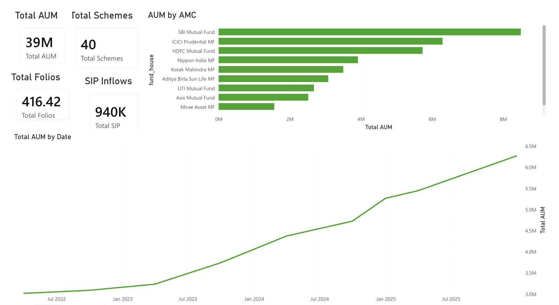
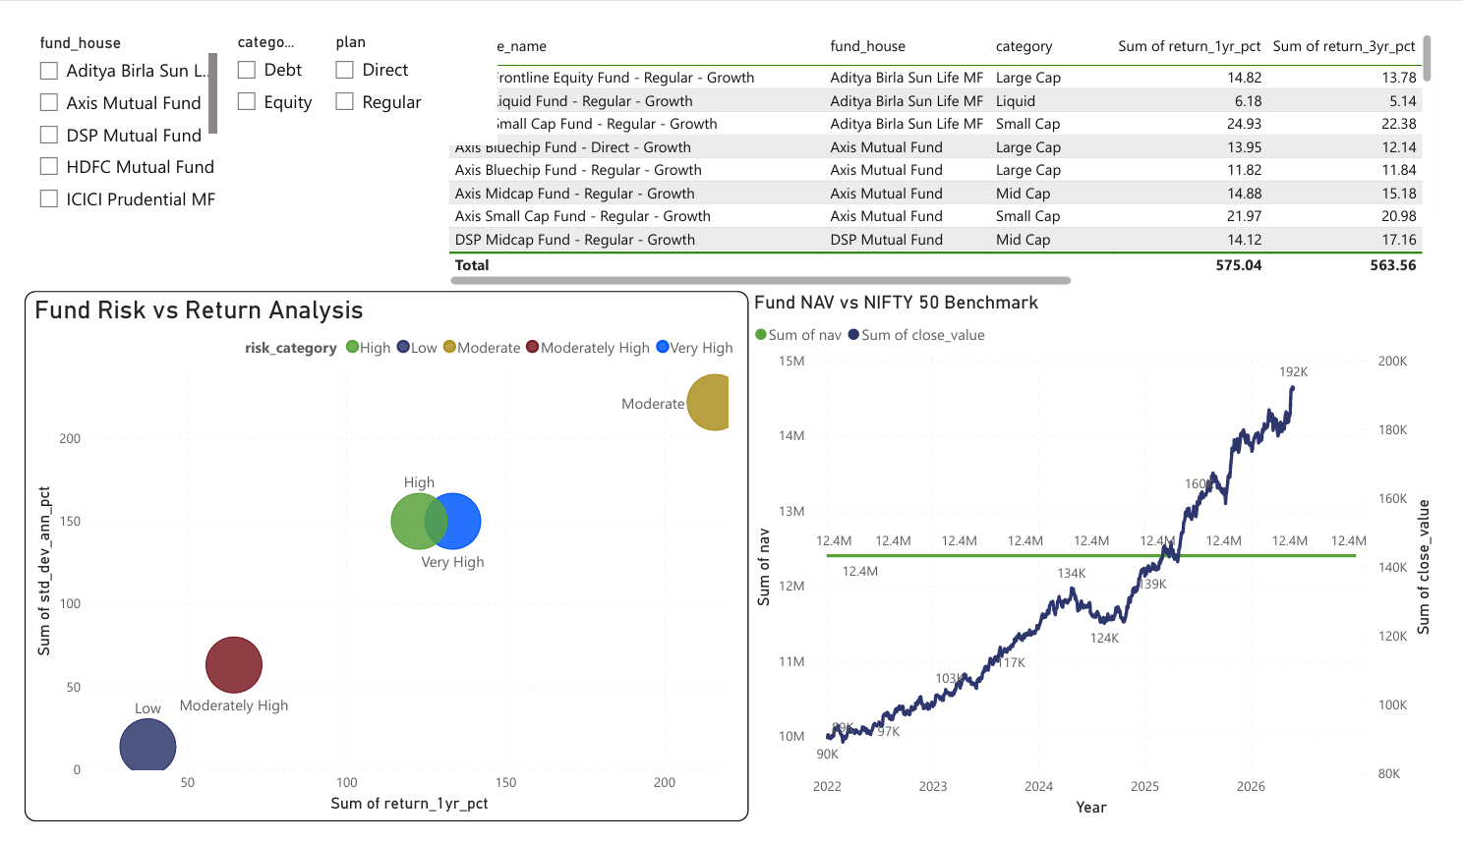
Dashboard — Pages 1 & 2
(screenshot to be inserted)
(screenshot to be inserted)
Dashboard Page 1 — Industry Overview
Dashboard Page 2 — Fund Performance
Notes:
Insert the actual Power BI screenshots for Page 1 (Industry Overview: KPI cards, AUM trend, fund-house bar chart) and Page 2 (Fund Performance: scatter, scorecard table, NAV vs benchmark) here.

Slide 10
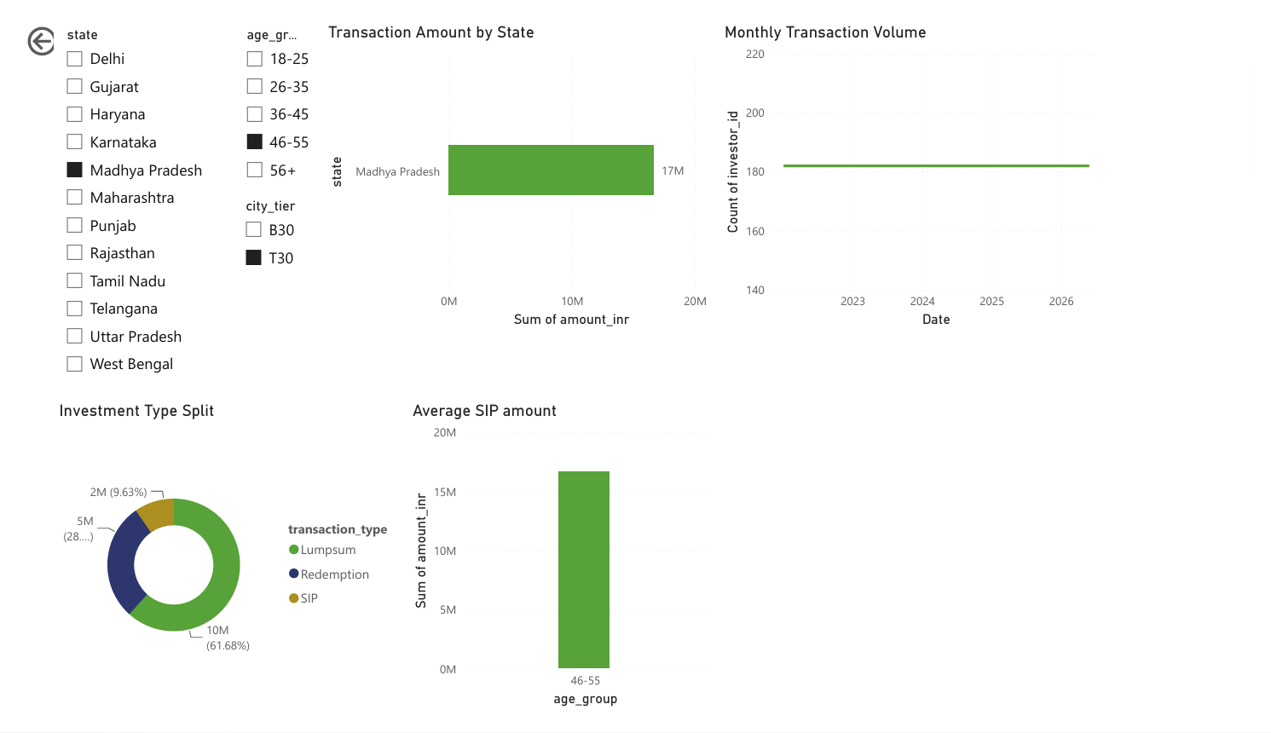
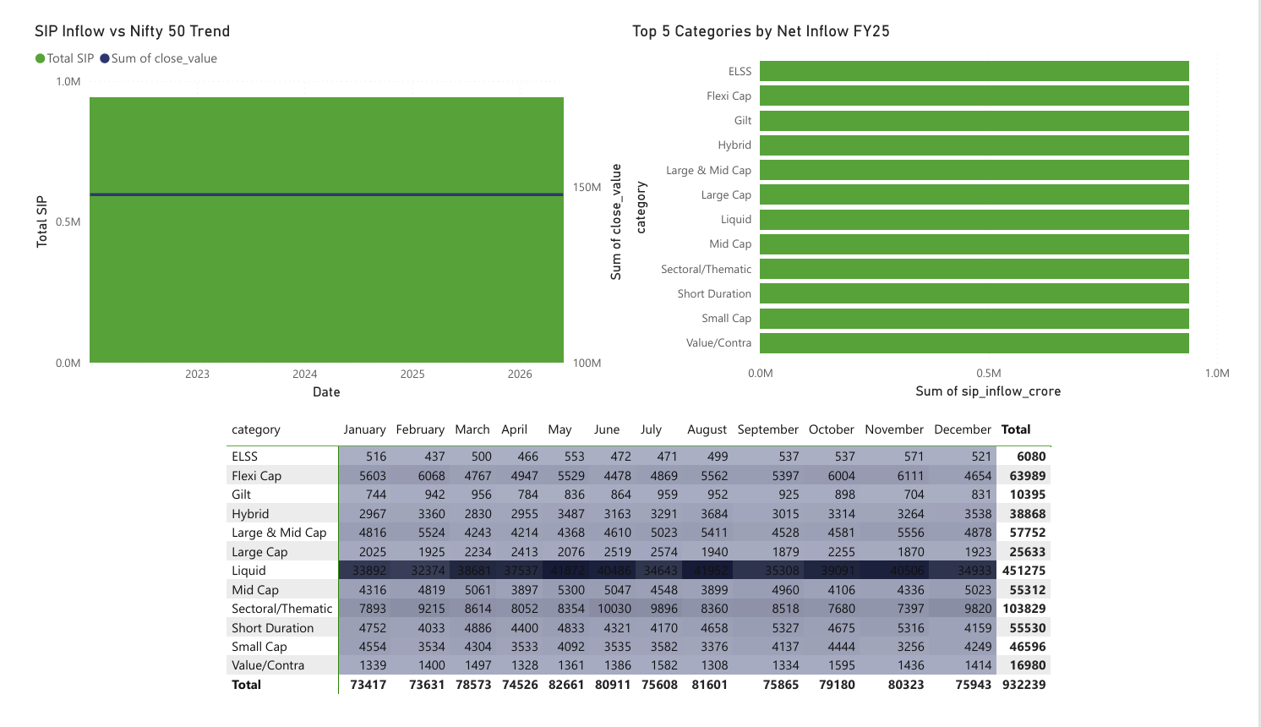
Dashboard — Pages 3 & 4
(screenshot to be inserted)
(screenshot to be inserted)
Dashboard Page 3 — Investor Analytics
Dashboard Page 4 — SIP & Market Trends
Notes:
Insert the actual Power BI screenshots for Page 3 (Investor Analytics: state map/bar, SIP/Lumpsum/Redemption donut, age-group bars) and Page 4 (SIP & Market Trends: dual-axis chart, category heatmap) here.

Slide 11





Key Findings
SBI MF leads AUM
SIP inflows hit record high
26–35 cohort dominates
₹12.50L Cr in Dec 2025, with the lead widening every year since 2022.
Grew from ~₹11,500 Cr to ₹31,002 Cr (Dec 2025) — a real AMFI milestone.
41.1% of investors; gender gap of 66.5% male vs 33.5% female.
Two risk-adjusted tiers
Moderate sector concentration
Liquid funds dominate inflows
Rolling Sharpe splits tracked funds into a high band (10–18) and low band (-2 to 5).
Banking + IT = 32.6% of equity holdings weight across portfolios.
₹32K–42K Cr/month — far outpacing every equity category combined.
Notes:
Run through all six findings briefly — these are the headline takeaways for the report's audience.

Slide 12

Thank You
Bluestock Fintech — Mutual Fund Analytics Capstone
GitHub: github.com/saraswatsakshi12/bluestock-mf-capstone • Tag v1.0
Notes:
Close by pointing to the GitHub repo (tag v1.0) as the canonical source for all code, notebooks, the database, and the dashboard file. Invite questions.

