Slide 1
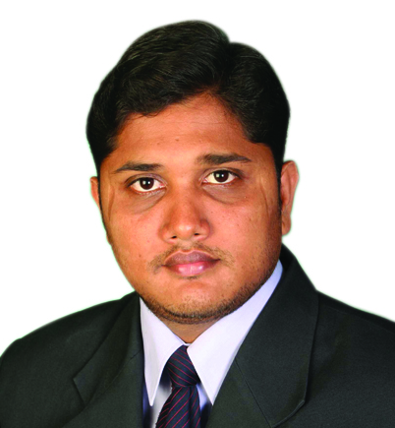




Dr. Sarat Babu Imandi
Associate Professor
Department of Biotechnology
GITAM Institiute of Technology
GITAM (Deemed to be University), Visakhapatnam – 530 045, Andhra Pradesh, INDIA
09347328704
saratbabu.imandi@gitam.edu
https://www.scopus.com/authid/detail.uri?authorId=16028604600
https://www.ncbi.nlm.nih.gov/pubmed/?term=Imandi+SB

