Slide 1
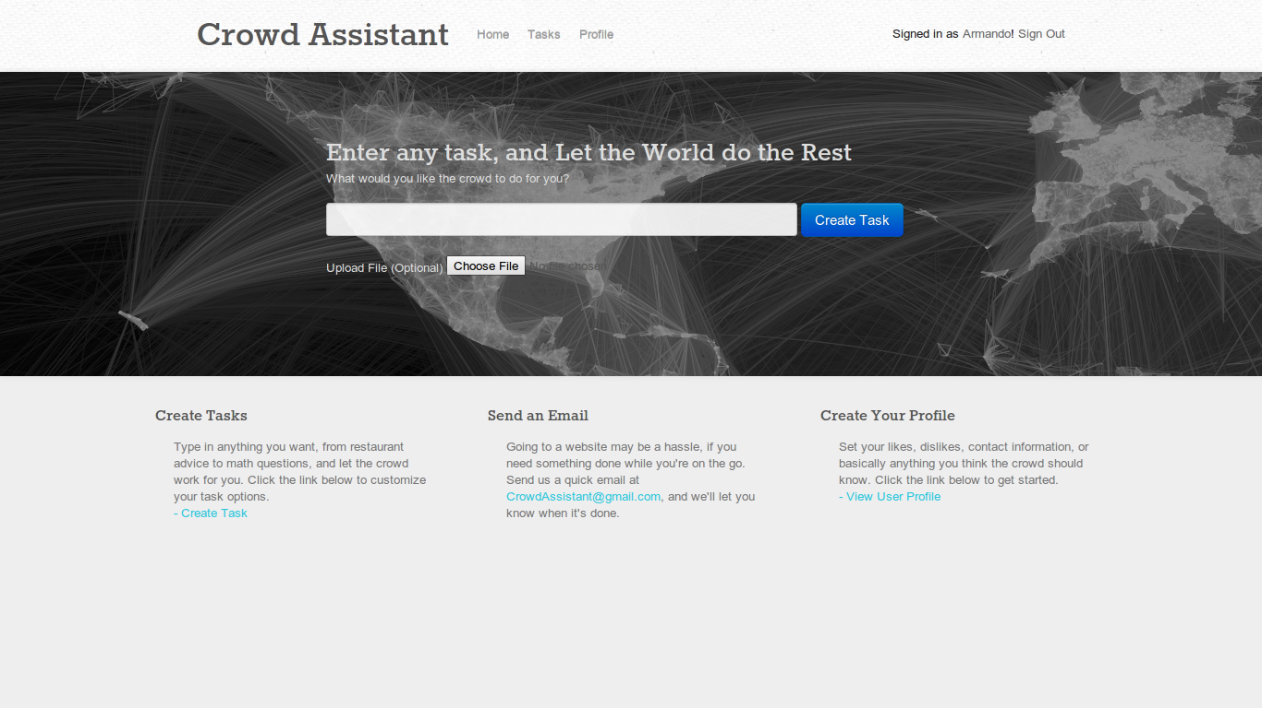
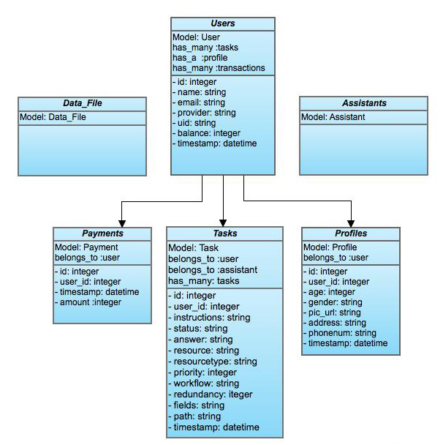
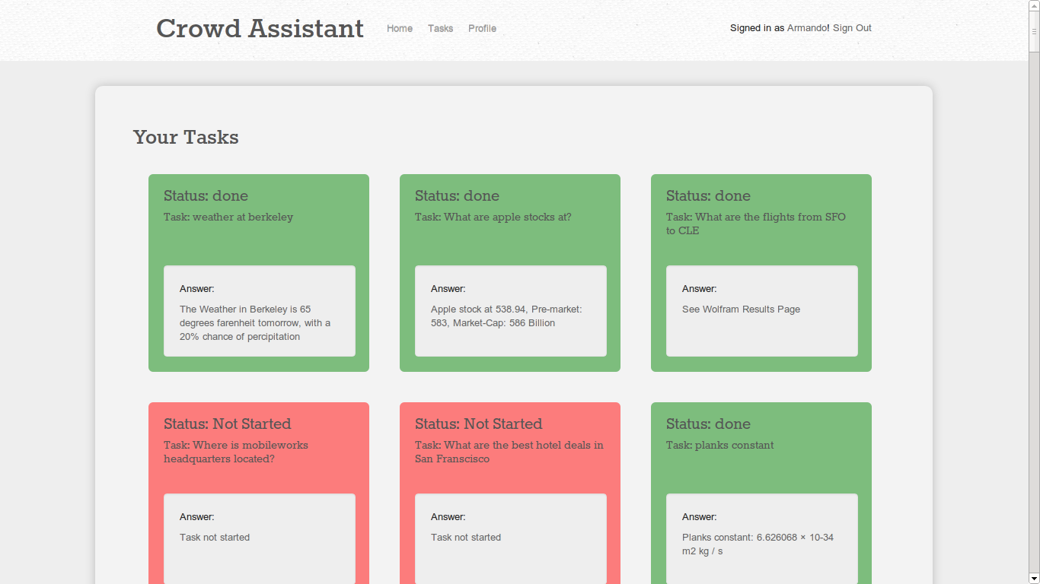
Current Problems
Crowd-Powered Assistant: What Can Crowd Do For You?
Key Features
User needs to have tasks done, but doesn’t have time to do it himself
Hiring a personal assistant/secretary is expensive – CrowdAssistant only takes a few cents for a query
From a purely financial perspective, human secretaries are not working at 100% capacity for all of the paid hours
Having a separate secretary is unnecessary when only a few tasks are needed
Normal secretaries have to sleep at night
When many tasks need to be done, having multiple humans reporting in person gets disorganized and confusing
Current online solutions do not offer robust, reliable results
Automated processes using AI suffer under problems requiring domain-specific knowledge
Current State-Of-The-Art AI does not easily solve problems without explicit enumeration of problem constraints
AI usually will need more contextual information
Search engines can only solve a subset of data-retrieval problems (i.e... Once again need extensive context to function properly)
Users can submit tasks by typing them into the text field on the front page and submitting, after Facebook authentication
Users can submit tasks via email
Users can add resources for the worker instance to reference
If the user wants to upload a file to refer to, there is a field to upload a file for the worker to reference
The user can specify parameters such as Distribution/workflow in the Advanced Tasks option
Worker can access the users profile (and Facebook information if provided) as additional resources for customized task completions
Database Schematic
Competitors
Platforms that perform simple tasks:
Mechanical Turk
MicroTask
crowdCloud
Platforms that let users perform structured tasks
CrowdFlower
ScalableWorkforce
CrowdGuru
Serv.io
HoudiniAPI
Peer-to-peer Task Delegation Platforms
OpTask
AskSunday
StudentOfFortune
User Flow
Summary
User submits task to CrowdAssistant
CrowdAssistant routes task appropriately to WolframAlpha or MobileWorks via their APIs
External services complete the task and return information to CrowdAssistant
User receives notification and answer upon completion of task
All of our features have been successfully implemented and the additional features go well above the core requirements
The application is thoroughly tested and has a 3:1 test to code ratio
The application is modularly designed and we architected the system to optimize for ease of testing and rapid iterations
Why We Win
Ease of Use:
Get results right away
Email in tasks, get emails back
Intuitive, clean interface
Social Integration
Payments are small and easy
Smart Query Handling
Check if Wolfram API can handle tasks
High Quality Ensured Through Redundancy
Send redundant tasks through MobileWorks QA system
Get reliability scores and confirmations of correctness
Target Audience
Applications
Future Steps
Enterprise (Think normal secretaries)
Researchers/Academia
Surveyors
Data Miners
How-To short queries
Software Developers/Hackers
Travelers
Service Industry Professionals
College Students
Data Scientists
Anybody
Surveys
Looking up how to do small programming tasks
Data Mining
Geography- Based Recommendations
Writing Papers
Converting Pseudo-Code to statistically correct implementations
OCR
Media Collection
Medicine
Add text messaging interface
Mobile Application
Gamification of the System
Heavy Social Integration
Utilize more external API’s, with NLP Router
Integrate IFTTT.com
Optimize for Real-Time Interactions
Expose a REST API
Make Massively Scalable and Increase Virality

