Slide 1
MY EXPERIENCE

Slide 2
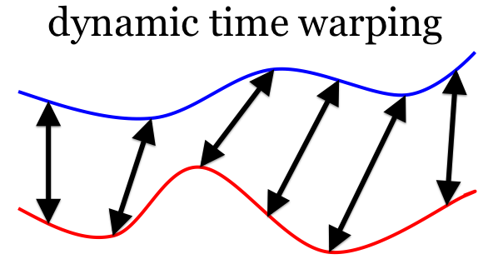
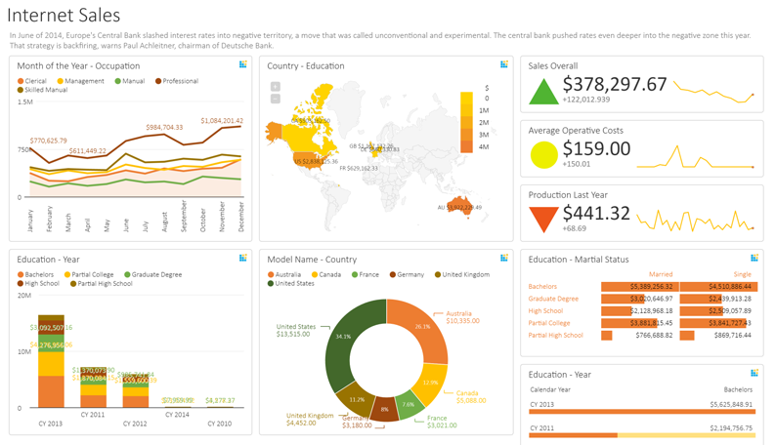
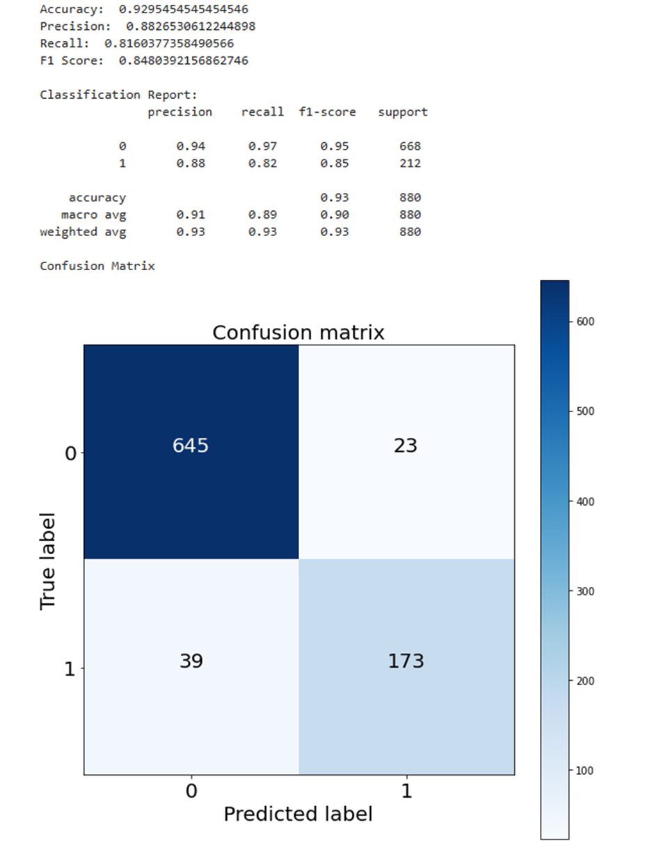
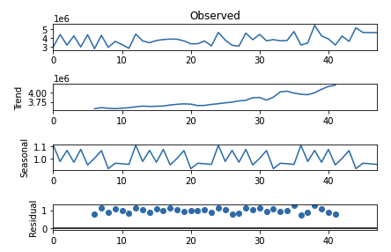
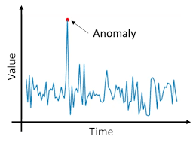
DataDisca
Supermarket Sales
Packaging Material Plant
Industrial Pipelines
Computer Vision
1. Basic Forecasting
2. Data Viz and Analysis
1. Predictive Analysis
2. Model Training and Evaluation
1. Pipeline Fluid Flow Analysis
1. Image Classification
2. Object Detection
3. Path Tracing
- Preprocessing and Analysing Trend, Seasonality and Noise
- Tools Used: ARIMA FB Prophet (multivariate forecasting)
- Tons of Data
Material
Machine Metrics
QA Metrics
Timestamp Data
Batch Details
Location Data
Weather data - Data Cleansing and Preprocessing
Rolling window stats
- Clustering
Proximity Based (Euclidean)
Cosine Similarity Dynamic Time Warping
(Out of phase trends)
3 Clusters Identified
- Time Series Analysis and Anomaly Detection
- ResNet, VGG
- YOLO, PyTorch
- Created dashboards and interactive charts
- Market Basket Analysis
- Recommender Systems
- LDA, SVM, RF, NB

Slide 3
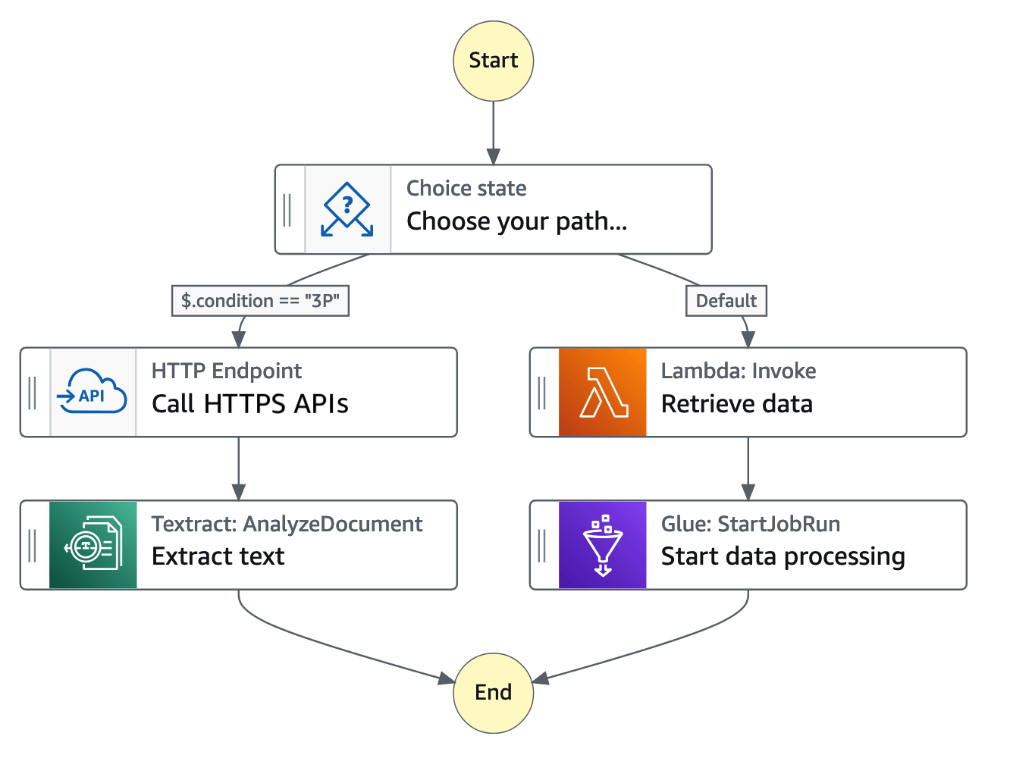
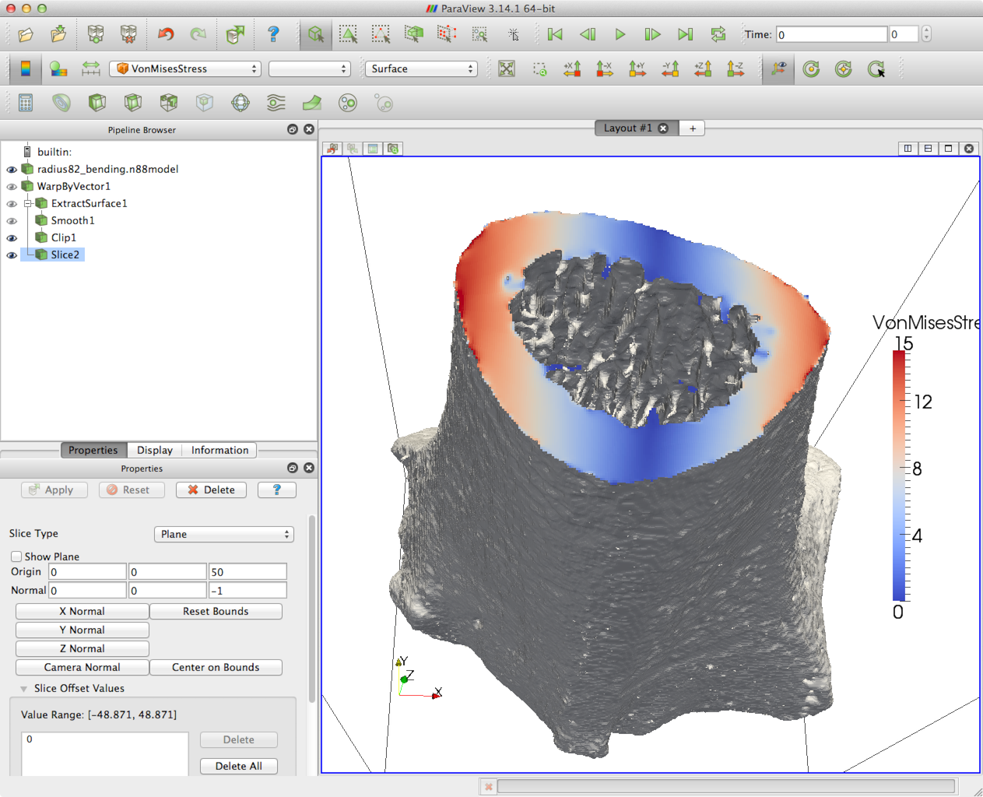
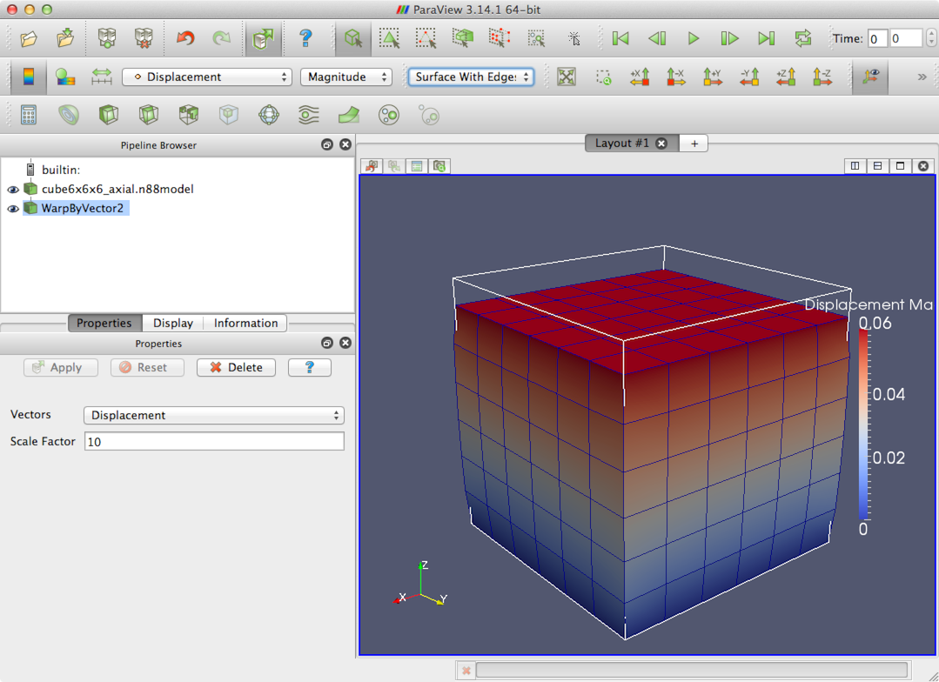
Curvebeam AI
Data Management Platform
SaaS Infrastructure
DevOps and ML
Computer Vis PoC Research
1. DMP
2. Data Preprocessing
3. Data Storage
1. CI/CD
2. Logging and Testing
1. ML Orchestration
1. FEM
2. DICOM Manipulation
- Building the microservice Architecture for data ingestion and storage
- Tools: AWS Lambda, API Gateway
- CDK
- Automated deployment using Cloudformation and CodePipeline
- Building internal tools for DICOM handling
- Deploying New Services
- AWS Step Functions
- Kubernetes
- ML Pipeline updates and improvements
- Research feasibility of analysing stresses in load bearing CT scans
- Manipulating DICOM data
- Converting pixel data to voxel data
- Experimenting with Tetrahedral, Hexahedral and other representations
- Tools: VTK, Gmsh, Paraview, ImageJ
- Preprocessing DICOM images
- Indexing metadata to OpenSearch
- Tools: Numpy, SciPy, SKLearn
- Cloudwatch and Datadog
- Test Driven Development
- Unit, Integration and Full Pipeline testing
- S3, DynamoDB, OpenSearch
- ECR

Slide 4
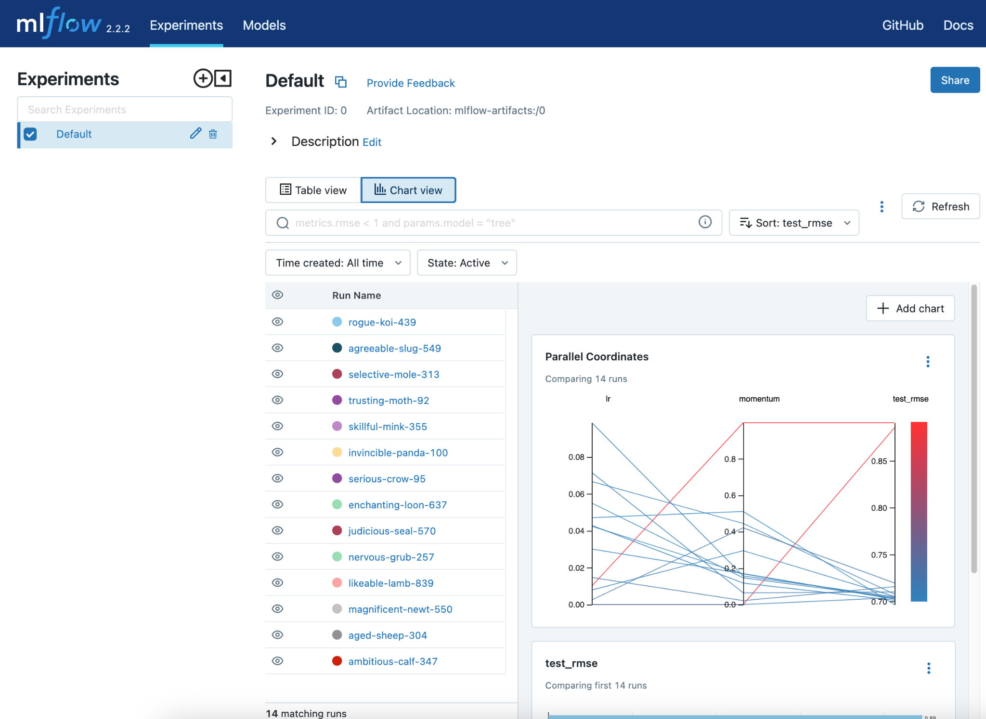
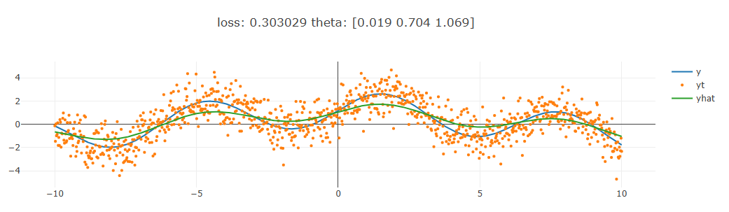
My Projects
MLOps
Machine Learning
Deep Learning
Statistics and Programming
1. Model Selection
2. Model Deployment
1. Feature Engineering
2. Model Training
1. DL Frameworks
2. LLMs
1. Data Wrangling
2. Tools and Methods
3. Entropy
- MLFlow, Hyperopt
- Keras Feature Spaces
- Feature Crossing
- Imbalanced Data
Credit Card Fraud Data
Banking Data
Diabetes Data
- Anomaly Detection AutoEncoders
Statistical Analysis
- PyTorch, Keras, Cuda
- Experimentation with parametric models
- Pandas, Numpy
- Spark
- SQL
- Data manipulation
- Algorithms and Data Structures
- Built microservices for Curvebeam
- Looking to continue that for my daily tasks
- Model Artifact Saving
- Serialization
Pickle, hdf5, gguf, ggml
- Classification and Regression models
- Ensemble models (Libraries and coded)
- XGBoost
- Recommender Systems
Music Recommender
- Mixture Modeling
- BookGPT Online Inference
- Testing Lightweight Local Models: Llama 2, Gemma 2,
Phi 2

Slide 5
END

